Slide 1
NPRR872 Modifying the SASM Shadow Price Cap
ERCOT
WMWG
January 25th, 2018

Slide 2
Introduction
NPRR872 proposes changes to SASM to implement shadow price caps (demand or penalty curves) with relatively permissive penalty curves
ERCOT is not comfortable that the penalty curves as originally submitted would procure sufficient AS capacity
  ERCOT is already very efficient in procurement of Regulation—in Real-Time the entire procured capacity is routinely deployed
  The risk associated with going short on RRS depends on actual and projected Real-Time conditions, especially PRC
To ensure sufficient AS is procured, ERCOT considered the steeper penalty curves shown on the following slides

Slide 3
Pricing Outcomes with Insufficient Offers
If there are insufficient offers to fulfill the SASM requirement, the current SASM algorithm effectively sets the MCPC at the highest cleared offer rather than using a demand curve
  SASM was implemented using the same algorithm as DAM
NPRR872 changes this to instead set the MCPC using a penalty curve
Pricing outcomes will be different under the two methods and use of a penalty curve may increase the MCPC in some cases, relative to the current implementation

Slide 4
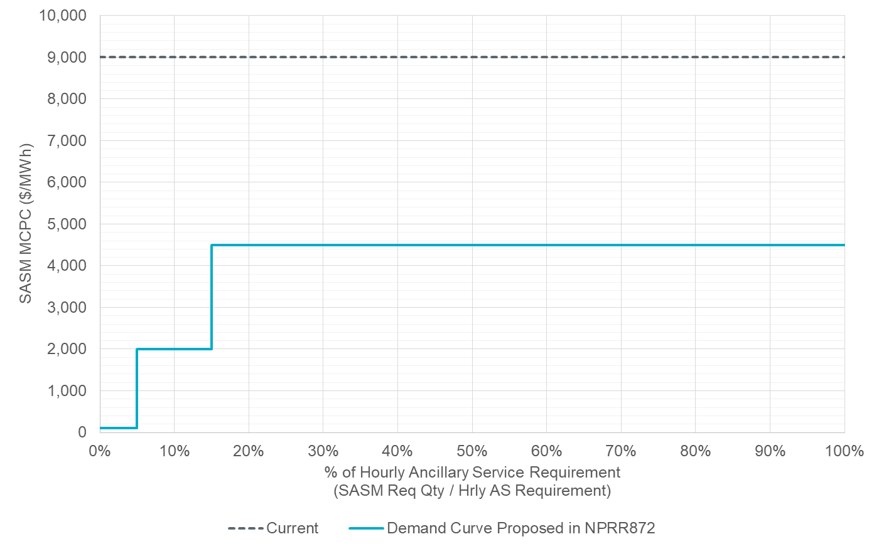
Possible Penalty Curve for Non-Spin
AS Product | Historical SASM Count (SASM-Hours) | With Sufficient Offers but SASM MCPC > Penalty Curve |  |  | With Post-SASM Insufficiency
 |  | ≤ 5% | > 5% & ≤ 15% | > 15% | ≤ 5% | > 5% & ≤ 15% | > 15%
Non-Spin | 452 | 24 | 0 | 0 | 30 | 12 | 5
VOLL/2
min(VOLL/2, max($2,000/MWh, 5*DAM))
min(VOLL/2, max($100/MWh, 5*DAM))
DAM MCPC typically ~$5/MWh

Slide 5
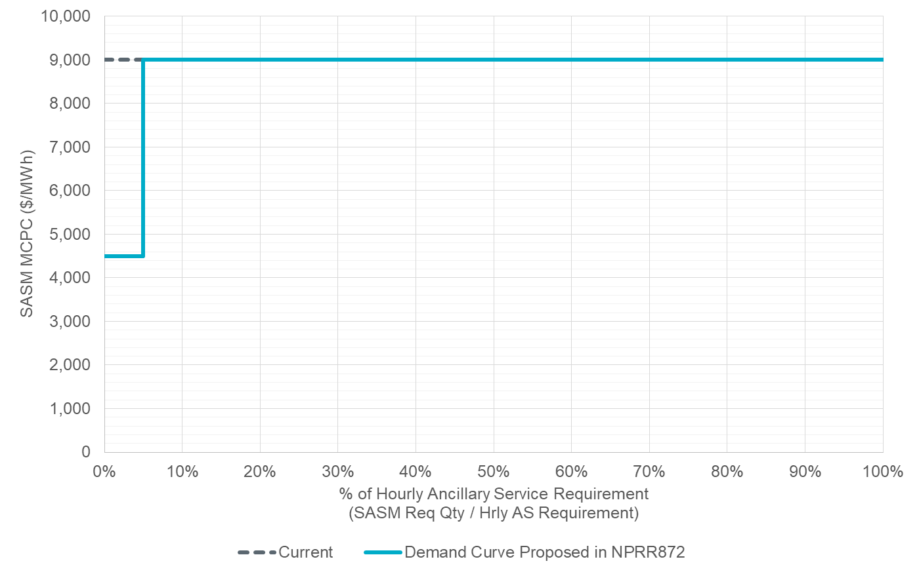
Possible Penalty Curve for Regulation & RRS
VOLL = $9,000/MWh
VOLL/2
AS Product | Historical SASM Count (SASM-Hours) | With Sufficient Offers but SASM MCPC > Penalty Curve |  | With Post-SASM Insufficiency
 |  | ≤ 5% | > 5% | ≤ 5% | > 5%
Regulation-Up | 631 | 1 | 0 | 96 | 58
Regulation-Down | 590 | 0 | 0 | 15 | 39
RRS | 1635 | 0 | 0 | 262 | 31

Slide 6
Observations from Historical Data
With these penalty curves, a few historical Non-Spin and Regulation-Up SASMs would have cleared fewer MW and had the MCPC set (reduced) by the penalty curve
All AS products have had many more historical SASMs with insufficient offers to cover the AS shortage and the MCPC would have been set by the penalty curve while still clearing the same quantity of MW
With the current level of illiquidity in SASM, unless the demand curves were made so permissive as to jeopardize reliability, historical data suggests that pricing on demand curves would apply very steep financial penalties when there are insufficient offers
SASMs purpose is to cover insufficient AS to the maximum extent possible and not to penalize AS providers more than necessary

Slide 7
Other Important Issues
NPRR872 does not remove a QSE’s obligation to transfer the AS responsibility to another Resource within its portfolio if it is able to do so

Slide 8
Questions?
Thank you!

