Slide 1
Supply Analysis Working Group Meeting
Proposed NPRR Language for DC Tie Capacity Forecasts
Pete Warnken
Manager, Resource Adequacy
January 18, 2019

Slide 2
Current DC Tie Capacity Forecast Approach
Contained in Protocol Section 3.2.6.2.2

Slide 3
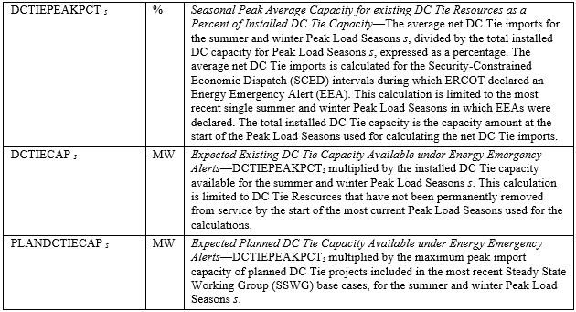
New DC Tie Capacity Forecast Approach
Define three variables used for the capacity forecasts
Addresses both existing DC Ties and planned DC Tie projects that qualify to be included in the ERCOT transmission planning models

