Slide 1
Load Forecast Review – 2019 RTP
January 2019 RPG

Slide 2
Agenda
Load review per PG 3.1.7
Next Steps

Slide 3
Load forecast (MW)
SSWG Load– Based on 18 SSWG cases dated 10/10/2018 less self-served load
Year | Coast | East | Far West | North | North Central | South Central | Southern | West | NCP Total
2020 | 24,008 | 2,873 | 5,653 | 1,630 | 25,165 | 13,268 | 6,334 | 2,195 | 81,126
2021 | 24,437 | 2,885 | 6,050 | 2,055 | 25,543 | 13,545 | 6,972 | 2,210 | 83,698
2022 | 24,617 | 2,903 | 6,261 | 2,064 | 25,872 | 13,802 | 7,464 | 2,221 | 85,203
2023 | 24,768 | 2,941 | 6,404 | 2,069 | 26,272 | 14,010 | 7,822 | 2,237 | 86,523
2024 | 24,909 | 2,966 | 6,510 | 2,083 | 26,648 | 14,074 | 7,943 | 2,244 | 87,379
2025 | 25,089 | 3,002 | 6,625 | 2,100 | 27,061 | 14,440 | 8,042 | 2,267 | 88,627
90th percentile Load Forecast– less losses
Year | Coast | East | Far West | North | North Central | South Central | Southern | West | NCP Total
2020 | 22,210 | 2,828 | 4,249 | 1,755 | 26,430 | 13,424 | 6,155 | 2,220 | 79,270
2021 | 22,695 | 2,850 | 4,510 | 2,218 | 26,719 | 13,658 | 6,325 | 2,277 | 81,253
2022 | 23,186 | 2,881 | 4,772 | 2,226 | 27,022 | 13,906 | 6,505 | 2,339 | 82,838
2023 | 23,679 | 2,907 | 5,034 | 2,234 | 27,330 | 14,156 | 6,694 | 2,403 | 84,437
2024 | 24,167 | 2,932 | 5,289 | 2,243 | 27,633 | 14,399 | 6,879 | 2,464 | 86,005
2025 | 24,652 | 2,956 | 5,545 | 2,251 | 27,935 | 14,639 | 7,066 | 2,525 | 87,569

Slide 4
Load forecast: 2019 RTP load level –less self-served and losses – preliminary (MW)
Year | Coast | East | Far West | North | North Central | South Central | Southern | West | Total
2020 | 23,321 | 2,873 | 4,568 | 1,755 | 26,430 | 13,424 | 6,334 | 2,220 | 80,924
2021 | 23,830 | 2,885 | 4,848 | 2,218 | 26,719 | 13,658 | 6,642 | 2,277 | 83,077
2022 | 24,345 | 2,903 | 5,130 | 2,226 | 27,022 | 13,906 | 6,831 | 2,339 | 84,702
2023 | 24,768 | 2,941 | 5,412 | 2,234 | 27,330 | 14,156 | 7,028 | 2,403 | 86,272
2024 | 24,909 | 2,966 | 5,685 | 2,243 | 27,633 | 14,399 | 7,223 | 2,464 | 87,522
2025 | 25,089 | 3,002 | 5,961 | 2,251 | 27,935 | 14,639 | 7,419 | 2,525 | 88,821
 | Bounded (based on 5% threshold, Far West based on 7.5% threshold)
 | 90th percentile
 | SSWG Forecast

Slide 5
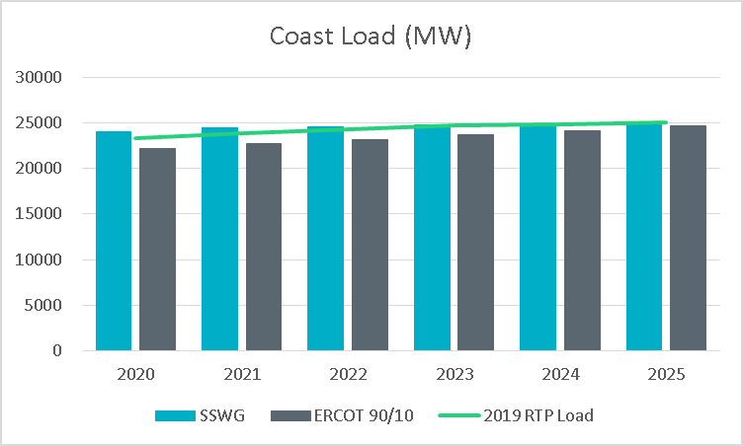
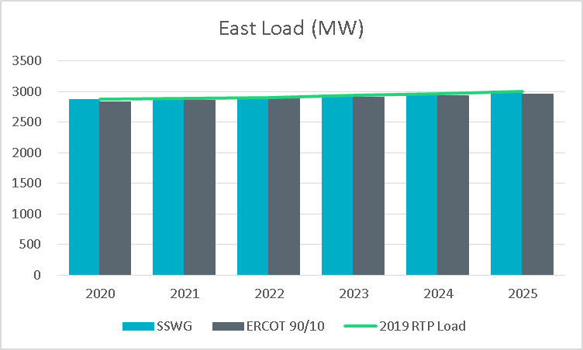
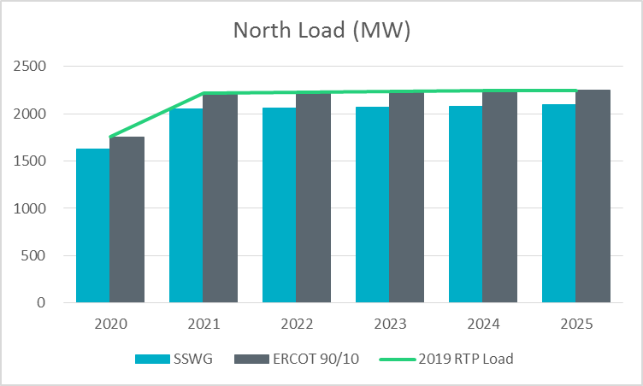
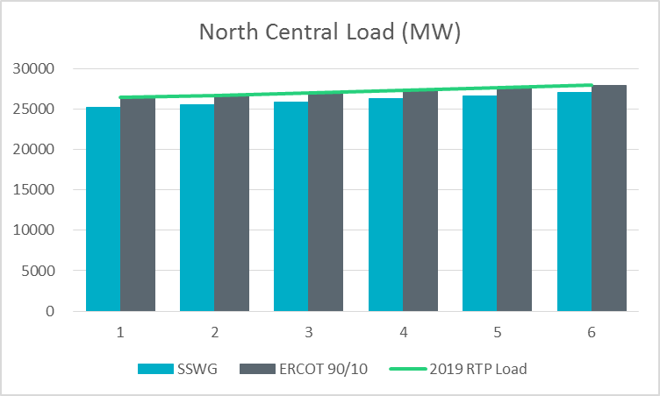
SSWG load v/s ERCOT 90/10 (less losses and self served)

Slide 6
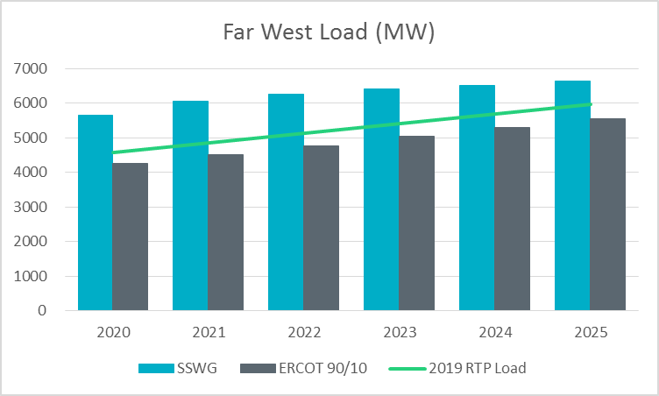
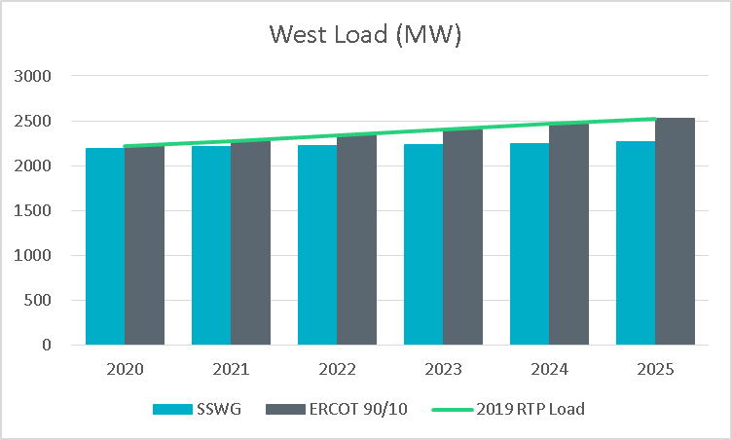
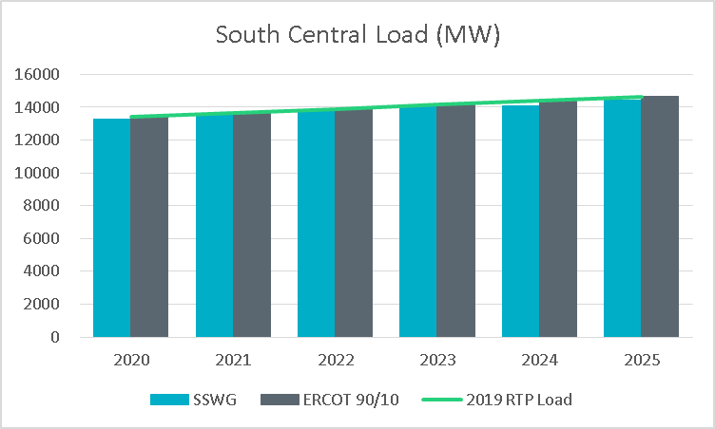
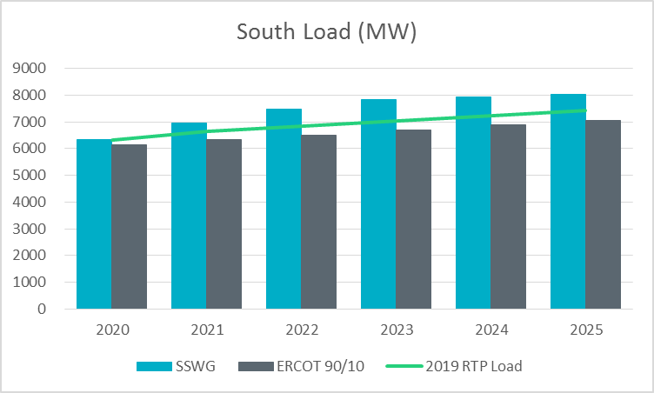
SSWG load v/s ERCOT 90/10 (less losses and self served)

Slide 7
2019 Load review
Preliminary start cases with the proposed load levels have been posted on MIS Secure (no case conditioning steps were applied)
  Grid>Regional Planning>Regional Transmission Planning>2019 Regional Transmission Plan Postings
TSPs are requested to review these and provide feedback on the initial draft
TSPs may choose to accept the load forecast, or
TSPs may choose to provide additional justification for cases where the proposed levels are not consistent with their expectations

Slide 8
Load review: Schedule
Key dates:
January 11, 2019: A preview case with scaled loads based on the bounded methodology posted by ERCOT. RTP preliminary load by weather zone shared with TSPs.
January 31, 2019: TSPs either approve or provide necessary documentation supporting additional loads. No response from TSP inferred as “No Comments”.
February 15, 2019: ERCOT completes load review and RTP load level finalized.
February 28, 2019: TSPs submit IDEVs to ERCOT to reflect the load review results.

Slide 9
Next steps
TPs and TOs to provide feedback on proposed load level (by January 31 2019)
Feedback provided to
  Calvin Opheim (Calvin.Opheim@ercot.com)
  Sandeep Borkar (Sandeep.Borkar@ercot.com)
  Ping Yan (Ping.Yan@ercot.com)
ERCOT to complete Load Review and finalize RTP load levels (by February 15, 2019)

Slide 10
Questions
Sandeep Borkar
Sandeep.Borkar@ercot.com
512-248-6642
Ping Yan
Ping.Yan@ercot.com
512-248-4153
Calvin Opheim
Calvin.Opheim@ercot.com
512-248-3944

Slide 11
Appendix

Slide 12
References
PG 317 TAC presentation
  (http://www.ercot.com/content/wcm/key_documents_lists/107880/PG_317_LoadThreshold_rev.pptx)
PG 317 RPG presentation (Aug 2017)
  (http://www.ercot.com/content/wcm/key_documents_lists/108880/Load_Forecast_Review.pptx)

Slide 13
Bounded higher-of methodology (x=7.5% for Far West and x=5% for others)

Slide 14
Load review process
Rationale:
Historic load growth
Committed load additions
Forecast methodology
Past forecast performance
Special circumstances
Other?
Preliminary RTP start cases will be shared to allow TDSPs to review the impact of load distribution on pockets within the weather zones.

Slide 15
Load forecast: 2019 RTP load level (with self-served) – preliminary (MW)
Year | Coast | East | Far West | North | North Central | South Central | Southern | West | Total
2020 | 27,273 | 2,916 | 4,568 | 1,755 | 26,430 | 13,424 | 6,840 | 2,332 | 85,538
2021 | 27,783 | 2,928 | 4,848 | 2,218 | 26,719 | 13,658 | 7,006 | 2,390 | 87,550
2022 | 28,299 | 2,946 | 5,130 | 2,226 | 27,022 | 13,906 | 7,195 | 2,452 | 89,176
2023 | 28,724 | 2,984 | 5,412 | 2,234 | 27,330 | 14,156 | 7,393 | 2,515 | 90,748
2024 | 28,867 | 3,009 | 5,685 | 2,243 | 27,633 | 14,399 | 7,588 | 2,577 | 92,000
2025 | 29,048 | 3,045 | 5,961 | 2,251 | 27,935 | 14,639 | 7,927 | 2,637 | 93,442
 | Bounded (based on 5% threshold, Far West based on 7.5% threshold)
 | 90th percentile
 | SSWG Forecast

