Slide 1
2018 LTSA Key Findings
January, 2019
RPG Meeting

Slide 2
Disclaimer
Purpose
This presentation is based on a report prepared for Electric Reliability Council of Texas, Inc. (ERCOT), and is offered for informational purposes only. Neither this presentation, nor the underlying report, should be viewed as advice, containing comprehensive information, or applicable to any potential opportunity in the ERCOT market. All information contained herein is strictly provided “AS IS.”
No Reliance or Warranty
This presentation contains data provided by ERCOT and/or third parties, and may contain conclusions or forecasts that rely on that data. This data, or any other information contained in this presentation, may contain errors or omissions. ERCOT does not warrant or represent that the data, conclusions, forecasts, or any other information contained herein are accurate, reliable, complete, or current, or that they are suitable for any particular purpose. You should independently verify the accuracy, completeness, reliability, and suitability of any information contained herein for any use, and seek your own independent expert advice concerning the information contained herein. ERCOT disclaims any and all express or implied warranties of any kind relating to this presentation.
Limitation of Liability
To the fullest extent permitted by law, ERCOT and its advisers, consultants, and other contributors to this presentation (and their respective associated companies, businesses, partners, directors, officers or employees) shall not be liable for any errors, omissions, defects, or misrepresentations in the information contained in this presentation, or for any loss or damage suffered by persons who use or rely on such information. By reviewing this presentation, you are acknowledging your agreement to the disclaimers, releases, and other terms or language on this Disclaimer page.

Slide 3
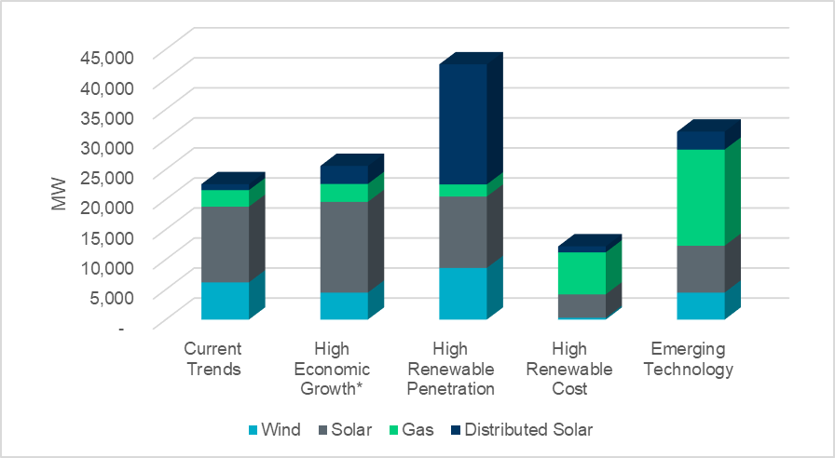
Key finding I: Solar capacity additions
Amount of solar capacity additions ranged from 3.9 GW to 15.1 GW.
Solar generation additions represented the largest resource capacity change on the system in three of the five scenarios.
A mix of solar, wind and natural gas generation capacity was added in every scenario.
Generation capacity additions across LTSA scenarios
* In addition, 20 MW battery storage was added in High Economic Growth scenario

Slide 4
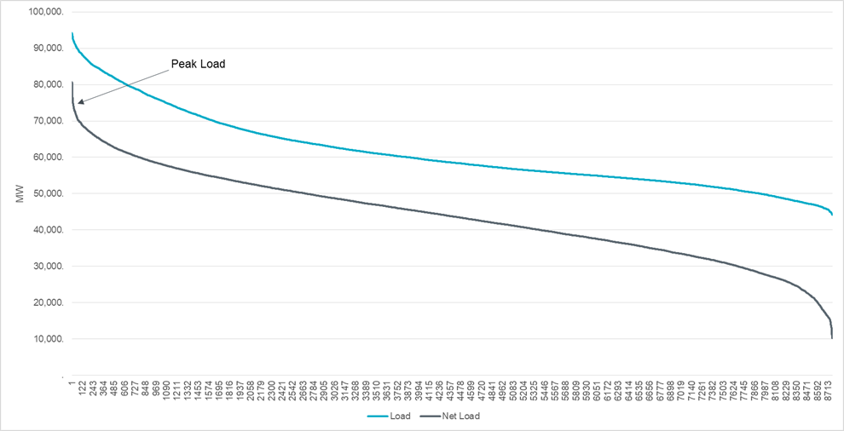
Key finding II: Net-load peak resource adequacy challenge
Load vs Net Load for Current Trends Scenario in 2033
The 2018 LTSA capacity expansion modeling results indicated a potential operational challenge due to capacity shortages in summer evenings when solar generation ramped down.
The potential generation capacity shortage occurred in a relatively small number of hours. To serve the net peak demand, suitable resources will need sufficient ramping capabilities and be financially viable even though they could only be operated a limited number of hours each year.

Slide 5
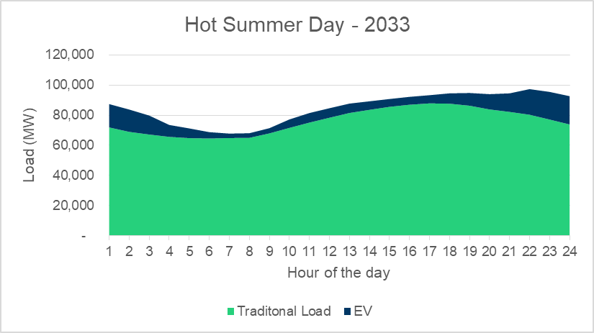
Key finding III: High EV adoption increases demand and shifts hourly load profile significantly
Based on stakeholder inputs, the total peak charging demand was over 18,500 MW at midnight. Approximately 5,000 to 6,000 MW of charging demand showed up for hours ending 1600 through 1800.
The summer peak hour of the day shifted from hour ending 1700 to 2200 in the night.

Slide 6
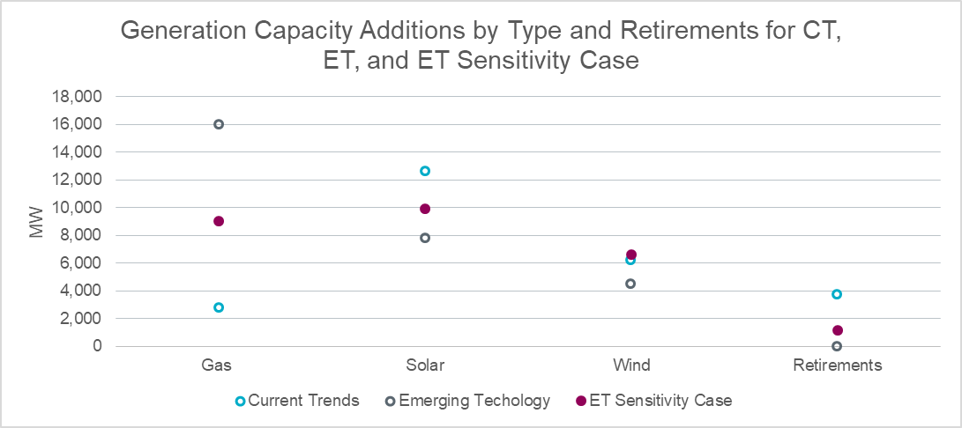
Key finding III: High EV adoption increases demand and shifts hourly load profile significantly
A sensitivity case, in which EV adoption was assumed to be 50% of that in the Emerging Technology scenario, was developed to investigate the relationship between generation expansion results and adoption level of EVs.
The sensitivity analysis showed a positive correlation between EV adoption and gas generation additions, and a negative correlation with solar generation additions and retirements.

Slide 7
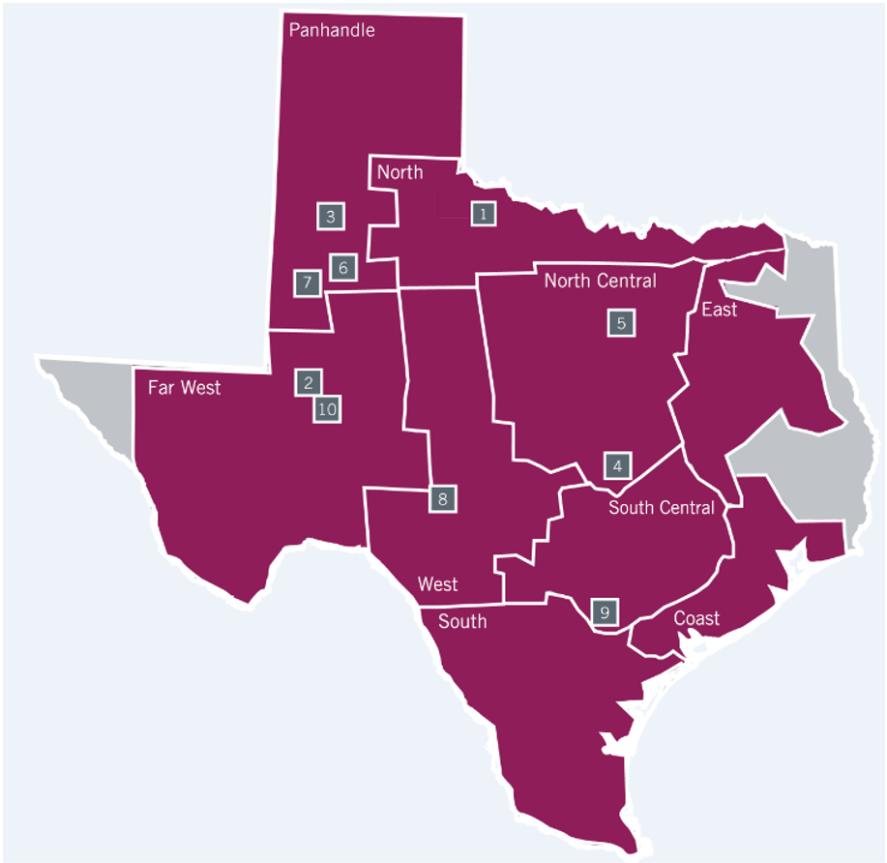
Key finding IV: Transmission Projects in west Texas
1 | Oklaunion to West Krum new 345-kV line
2 | Odessa to Bearkat new 345-kV line
3 | Lubbock Loop (North to New Oliver new 345-kV line and Long Draw to Grassland 345-kV line upgrade)
4 | Northwest Austin Metro new 345-kV line and 345/138-kV transformer
5 | Northwest Dallas-Fort Worth new 345-kV line
6 | Faraday to Morgan Creek new 345-kV line
7 | Long Draw to Dermott new 345-kV line
8 | West Texas to San Antonio new 345-kV line
9 | Bergheim 345/138-kV transformer upgrade
10 | Odessa to North McCamey new 345-kV line

Slide 8
Transmission Projects
Index | Description | In-service Year | Production Cost Savings in 2028 ($M) | Production Cost Savings in 2033 ($M)
1 | Build Oklaunion - West Krum, a new double-circuit 345-kV line | 2028 | 77 | 81
2 | Build Odessa - Bearkat, a new 345-kV line | 2028 | 35 | 42
3 | Lubbock Loop: Build North - Oliver, a 345-kV line on new ROW Upgrade the Long Draw - Grassland 345-kV line | 2028 | 108 | 125
4 | Northwest Austin Metro new 345-kV line and 345/138-kV transformer | 2028 | 20 | 17
5 | Northwest Dallas-Fort Worth new 345-kV line | 2028 | 32 | 31
6, 7 | Lamesa Area Improvements | 2028 | 161 | 197
8 | West Texas to San Antonio new 345-kV line | 2028 | 182 | 183
9 | Upgrade the 345/138 kV autotransformer at Bergheim | 2028 | 10 | 6
10 | Odessa to North McCamey new 345-kV line | 2028 | 41 | 40

Slide 9
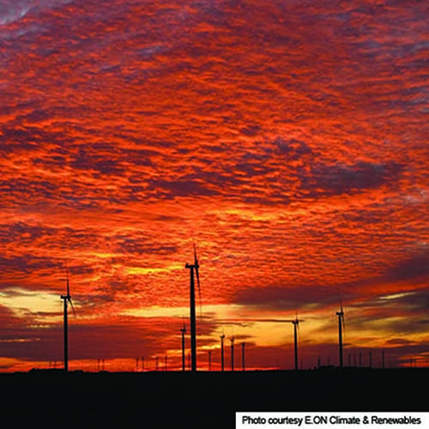
Questions & Feedback
Contact info:
Julie Jin Hong Xiao
julie.jin@ercot.com hong.xiao@ercot.com
512.248.3982 512.248.3983
Sandeep Borkar
sandeep.borkar@ercot.com
512.248.6642

