Slide 1
Supply Analysis Working Group Meeting
ERCOT Proposed Edits to NPRR891 Language in WMS Comments
Pete Warnken
Manager, Resource Adequacy
January 18, 2019

Slide 2
Background
ERCOT submitted comments to PRS on January 16 to request that NPRR891 remain tabled to accommodate SAWG discussion on the following issues:
Incorporation of a NOIE size-based threshold for quarterly aggregate reporting of facility sites 50 kW and less
ERCOT sent out a NOIE survey on January 11 requesting all DG MW quantities interconnected as of December 31, 2018.
Survey eliminates the need to expedite NPRR891.
If SAWG endorses size threshold language today, then ERCOT proposes that it be included in NPRR891, thus avoiding the need for another NPRR
ERCOT’s proposed changes to Section 3.2.5.1(4), dealing with reporting limitations and initial annual report exemption
WMS did not discuss the changes; they were overlooked and not included in the WMS-endorsed version of NPRR891

Slide 3
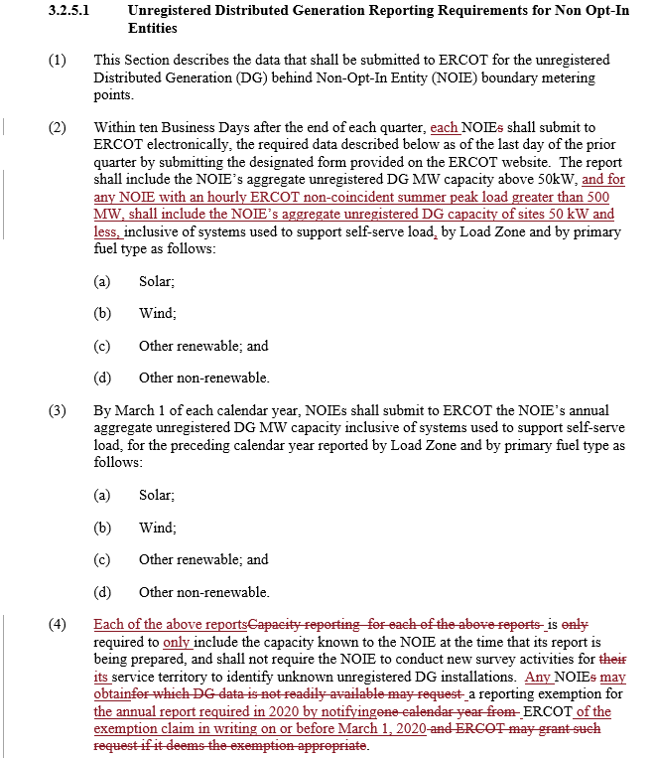
ERCOT’s Proposed Changes to NPRR891
Changes at right are to the WMS-endorsed language
Also includes minor grammatical changes recommended by ERCOT Market Rule Dept.

