Slide 1
Potential Modifications to Wind Capacity Contribution Calculations
Connor Anderson
Resource Adequacy
1/18/2019

Slide 2
Introduction and Goal
Based on wind development patterns, ERCOT would like to re-visit the wind regions and calculation methodology for wind capacity contributions
Our goal is to get stakeholder input and possibly develop an NPRR to improve the calculations

Slide 3
Background
Seasonal Peak Average Wind Capacity as a Percent of Installed Capacity (“Capacity contribution”) is an estimate of what percentage of wind capacity can be expected to be available during the peak hours of a season
For a particular season, the historical HSLs of eligible operational wind units during the top 20 load hours of a season are summed and divided by the installed wind capacity during that season
The final capacity contribution is a simple average of the past 10 eligible years of seasonal values
Currently, capacity contributions are calculated separately for Coastal Wind and Non-Coastal Wind

Slide 4
Notes
Moving an “eligible” operational unit (almost all units) from one region to another does not change the overall wind capacity contribution
The change in its previous region’s contribution percentage is mirrored in the opposite direction in its new region
The overall effect of the proposed changes on the reserve margin depends heavily on how much planned wind is in a particular CDR/SARA

Slide 5
Potential New Regions
Panhandle
Panhandle wind has higher capacity factors than the rest of non-coastal wind
Many planned wind projects are in the Panhandle region
South Non-Coastal
Wind in the south non-coastal region correlates with peak load time better than the rest of non-coastal wind, but usually not as well as coastal wind
The south non-coastal region is beginning to see increased wind development
Exact boundaries of region would need to be defined

Slide 6
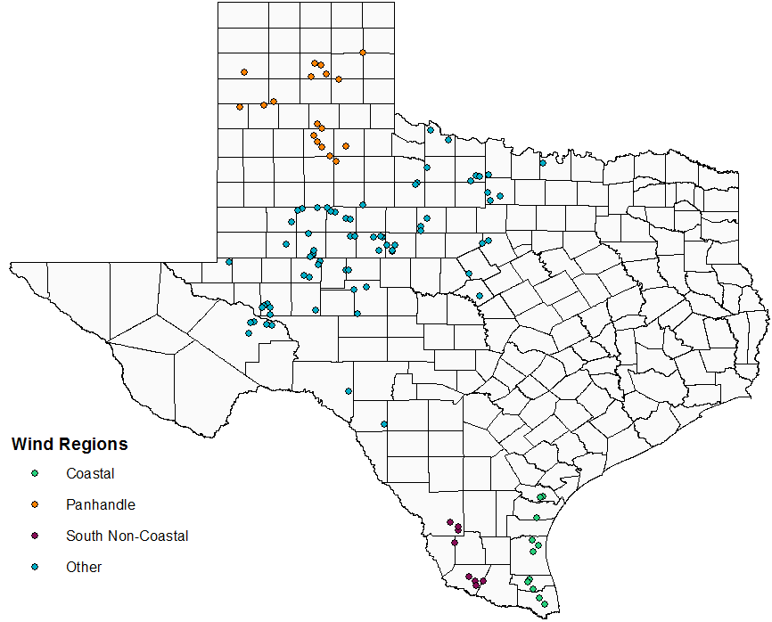
New Wind Region Map (Operational Units)

Slide 7
Current Snapshot of CDR-Eligible Planned Wind
Region | Operational Capacity in Summer 2018 (MW) | Planned 2019 (MW) | Planned 2020 (MW) | Planned 2021 (MW) | Total (Current + Planned) (MW) | Share of Planned Units
Coastal | 2,611 | 1,507 | 447 | 0 | 4,564 | 14%
Panhandle | 4,197 | 1,640 | 1,640 | 0 | 8,049 | 27%
South Non-Coastal | 1,327 | 940 | 0 | 0 | 2,267 | 6%
Other | 13,044 | 4,539 | 2,743 | 255 | 20,582 | 53%
Total | 21,179 | 8,626 | 5,401 | 255 | 35,461 | 100%

Slide 8
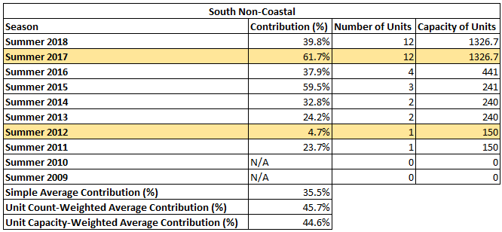
Potential Changes to Calculations
Unit count-weighted average
Gives more weight to years with more units installed in the region
In the absence of retirements, gives more weight to more recent years
Some regions had very few units in older years so they may influence the capacity contribution number more than they should
Unit capacity-weighted average
Almost identical numbers to count-weighted average so far

Slide 9
Effects of Changes on Summer 2019 (May 2018 CDR)
4,657 MW of planned wind
 | Original CDR | Modified CDR | Modified CDR with Count-Weighted Contributions | Modified CDR with Capacity-Weighted Contributions
Coastal Contribution (%) | 58.6% | 58.6% | 62.9% | 62.8%
Panhandle Contribution (%) | N/A | 19.9% | 28.2% | 28.6%
South Non-Coastal Contribution (%) | N/A | 34.9% | 48.5% | 46.9%
Other Contribution (%) | N/A | 12.9% | 13.1% | 13.1%
Non-Coastal Contribution (%) | 14.4% | N/A | N/A | N/A
Reserve Margin (%) | 11.0% | 11.2% | 11.5% | 11.5%
Change in Reserve Margin (%) | N/A | +0.2% | +0.5% | +0.5%

Slide 10
Effects of Changes on Summer 2019 (Dec 2018 CDR)
2,161 MW of planned wind
 | Original CDR | Modified CDR | Modified CDR with Count-Weighted Contributions | Modified CDR with Capacity-Weighted Contributions
Coastal Contribution (%) | 58.0% | 58.0% | 60.9% | 60.9%
Panhandle Contribution (%) | N/A | 20.5% | 27.3% | 27.5%
South Non-Coastal Contribution (%) | N/A | 35.5% | 45.7% | 44.6%
Other Contribution (%) | N/A | 13.0% | 13.4% | 13.4%
Non-Coastal Contribution (%) | 14.8% | N/A | N/A | N/A
Reserve Margin (%) | 8.1% | 8.2% | 8.3% | 8.3%
Change in Reserve Margin (%) | N/A | +0.1% | +0.2% | +0.2%

Slide 11
Next Steps
Spring, fall, and winter calculations at next meeting?
Discuss wind region definitions in more detail?
Ideas for other changes if there is interest in an NPRR?

