Slide 1
Southern Cross Transmission - Directive 9 - Discuss Frequency Overshoot Study and RRS impacts
ERCOT Staff

Slide 2
Scenarios Used for Frequency Overshoot Study
Preliminary
Draft
Scenario Name | Inertia (GW·s) | Load (GW) | Wind (GW) | Synchronous Gen (GW)
CASE 0 | 130 | 34 | 15.5 | 19
CASE 1 | 130 | 34 | 10 | 24.5
CASE 2 | 130 | 32 | 5 | 27.5
CASE 3 | 130 | 32 | 3.5 | 29
CASE 4 | 120 | 29.9 | 3.5 | 26.9
CASE 5 | 110 | 27.2 | 3.5 | 24.2

Slide 3
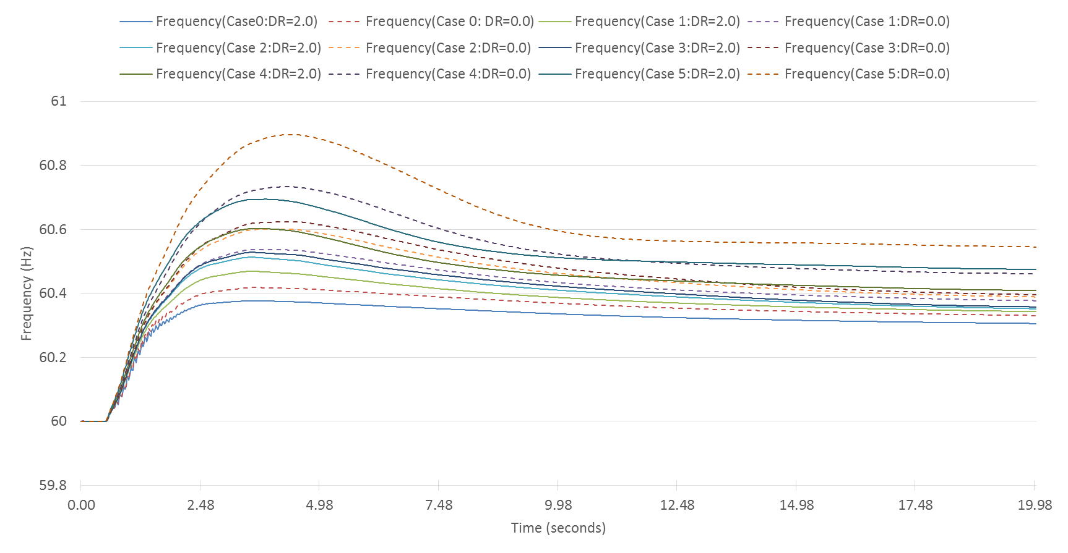
Frequency Response when Tripping SC DC Tie Export at 2,100 MW
Preliminary
Draft
 | Case 0 | Case 1 | Case 2 | Case 3 | Case 4 | Case 5
Highest Frequency Overshoot (Hz) DR=2.0 | 60.38 | 60.47 | 60.51 | 60.53 | 60.60 | 60.70
Highest Frequency Overshoot (Hz) DR=0.0 | 60.42 | 60.54 | 60.60 | 60.62 | 60.73 | 60.89

Slide 4
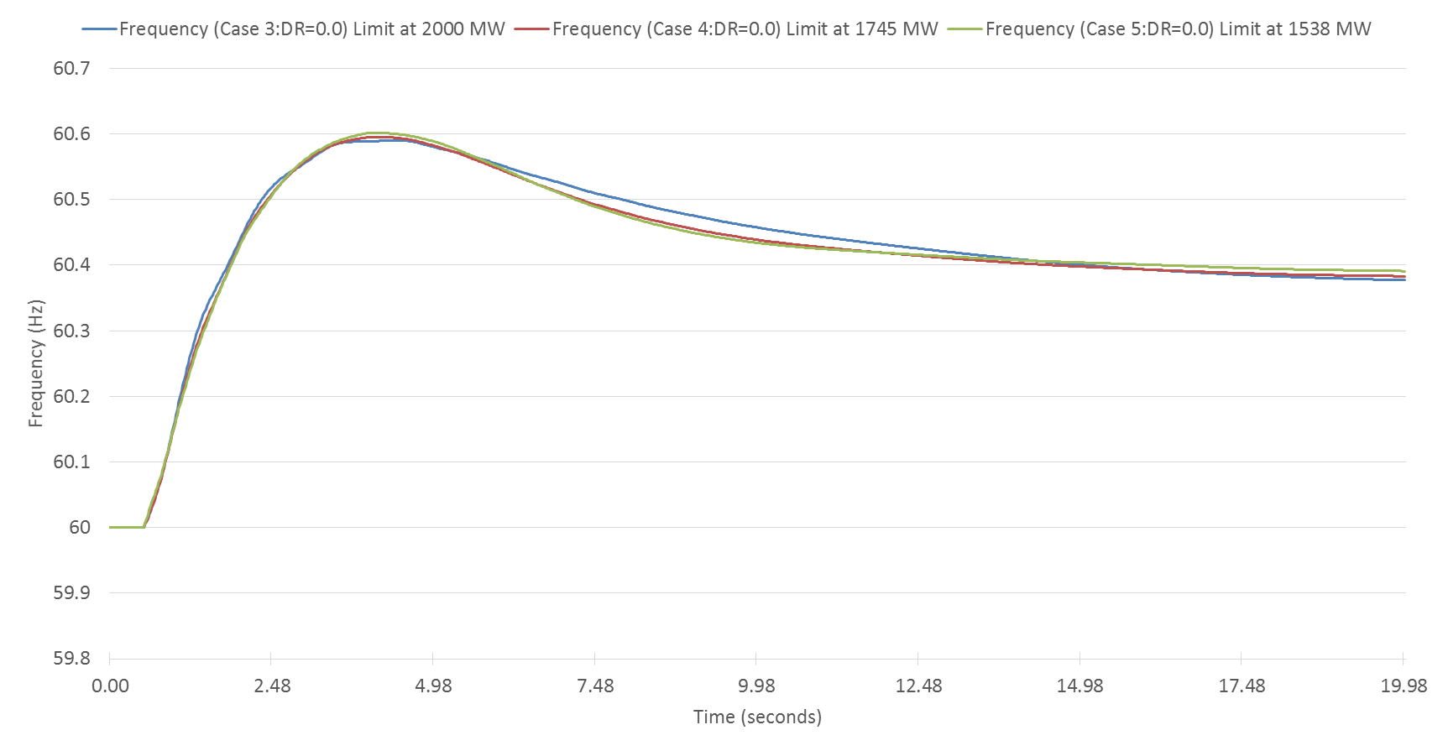
Limit Imposed on SC DC Tie Export
Preliminary
Draft
 | 130 GW·s | 120 GW·s | 110 GW·s
Limit on SC DC tie export | 2,000 MW | 1,745 MW | 1,488 MW

Slide 5
Simulated RRS Case Study
Preliminary
Draft
Case No. | Time | INERTIA (GW·s) | PFR (MW) | LR (MW) |  | LR/PFR Ratio |  | PFR (No LR) (MW)
 |  |  |  | w/o SCDCT | w/ SCDCT | w/o SCDCT | w/ SCDCT | w/o SCDCT | w/ SCDCT
*Case1 | 10-Feb-17 01:00:00 | 130 | 1150 | 1900 | 2650 | 2.39 | 2.94 | 5691 | 8941
Case2 | 31-Mar-14 02:00:00 | 140 | 1150 | 1800 | 3250 | 2.17 | 3.29 | 5056 | 11843
Case3 | 21-Mar-14 02:00:00 | 150 | 1150 | 1750 | 2900 | 1.85 | 2.59 | 4388 | 8661
Case4 | 23-Oct-16 00:00:00 | 160 | 1150 | 1700 | 2550 | 1.85 | 2.43 | 4295 | 7347
Case5 | 28-Oct-13 00:00:00 | 180 | 1150 | 1650 | 2375 | 1.71 | 1.98 | 3972 | 5853
Case6 | 24-Nov-16 15:00:00 | 200 | 1150 | 1450 | 2100 | 1.43 | 1.53 | 3224 | 4363
Case7 | 02-Apr-14 10:00:00 | 220 | 1150 | 1500 | 2150 | 1.55 | 1.68 | 3475 | 4762
Case8 | 05-Oct-13 18:00:00 | 260 | 1150 | 1450 | 2150 | 1.10 | 1.17 | 2745 | 3666
Case9 | 28-May-14 18:00:00 | 290 | 1150 | 1300 | 1950 | 1.00 | 1.06 | 2450 | 3217
Case10 | 03-Sep-13 18:00:00 | 359 | 1150 | 1150 | 1800 | 1.00 | 1.12 | 2300 | 3166
Case11 | 07-Aug-13 17:00:00 | 376 | 1150 | 1050 | 1700 | 1.00 | 0.95 | 2085 | 2765
*Case 1 : With RCC increased to 3,375 MW, ERCOT’s critical inertia goes up to around 130 GW*s. As a result, current RRS mix is insufficient to arrest system frequency above 59.4 Hz. Therefore, for the case with 130 GW*s inertia, LRs’ response time are shortened to 15 cycles to improve frequency nadir.

Slide 6
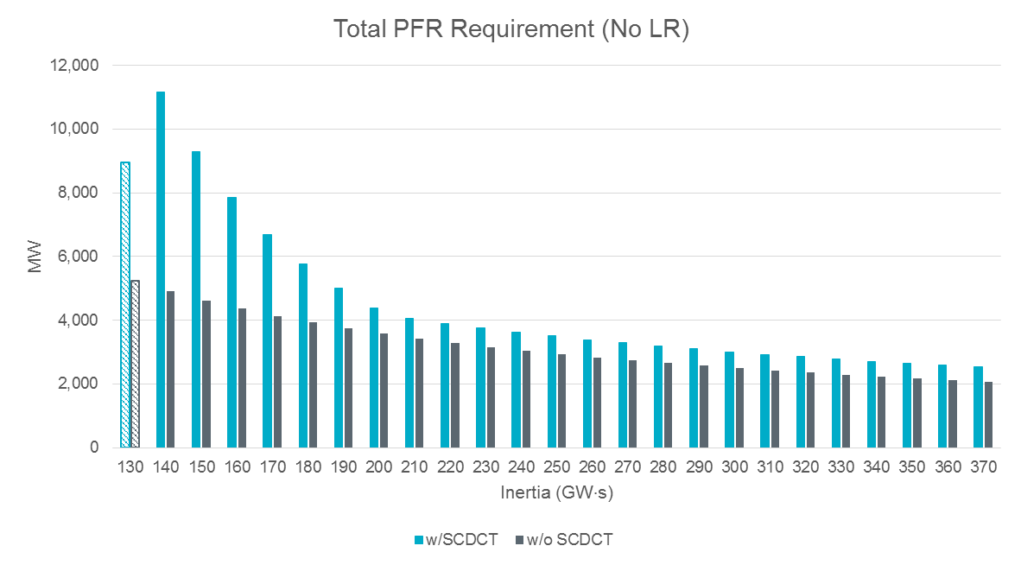
Interpolated PFR (No LR) Quantities
Preliminary
Draft
*Note: With RCC increased to 3,375 MW, ERCOT’s critical inertia becomes 130 GW·s. As a result, current RRS mix is insufficient to arrest system frequency above 59.4 Hz. Therefore, for the case with 130 GW·s inertia, LRs’ response time are shortened to 15 cycles to improve frequency nadir. PFR quantity related to 130 GW·s is not included for interpolation.

Slide 7
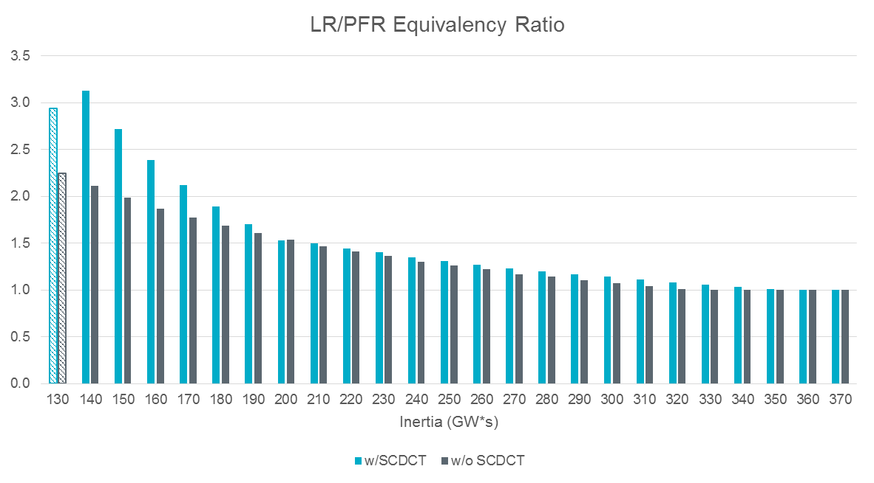
Interpolated LR/PFR Equivalency Ratio
Preliminary
Draft
*Note: With RCC increased to 3,375 MW, ERCOT’s critical inertia becomes 130 GW·s. As a result, current RRS mix is insufficient to arrest system frequency above 59.4 Hz. Therefore, for the case with 130 GW·s inertia, LRs’ response time are shortened to 15 cycles to improve frequency nadir. PFR quantity related to 130 GW·s is not included for interpolation.

Slide 8
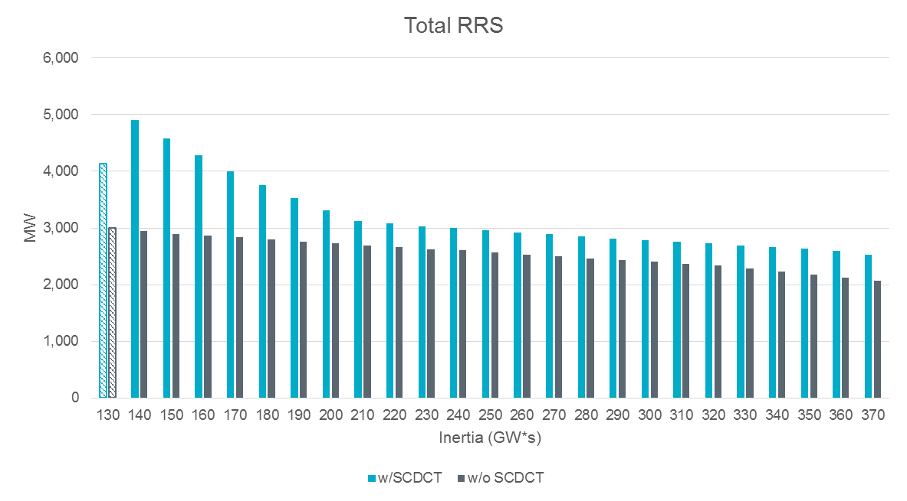
Interpolated RRS Quantities
Preliminary
Draft
*Note: With RCC increased to 3,375 MW, ERCOT’s critical inertia becomes 130 GW·s. As a result, current RRS mix is insufficient to arrest system frequency above 59.4 Hz. Therefore, for the case with 130 GW·s inertia, LRs’ response time are shortened to 15 cycles to improve frequency nadir. PFR quantity related to 130 GW·s is not included for interpolation.

Slide 9
RRS Quantity Increase
Preliminary
Draft
2019 Total RRS (w/o SCDCT) | 2019 Total RRS (w/ SCDCT) | Delta
23,716,368 MWh | 28,986,904 MWh | 5,270,536 MWh

Slide 10
Questions?

