Slide 1
ERCOT Frequency Control Report
December 2018
ERCOT
Operations Planning
PDCWG | January 16th, 2019

Slide 2
Summary of December 2018
CPS1: 175.64%
Current CPS1 12-Month Rolling Average: 175.67%
0 BAAL Exceedance
1 hourly CPS1 scores below 100%
BAAL-003 Events have updated through August
2018 BAAL-003 FRM Performance: -895.19
2018 RMS1 Statistics
Mean: 14.74 mHz
Min: 12.22 mHz
Max: 18.20 mHz
Energy Statistics
Total Energy: 28,697,628 MWh
Wind Energy: 6,106,225 MWh
Percent Energy from Wind Generation: 21.28%
Minimum System Inertia
Mean: 188,781
Max: 254,920 on December 9th
Min: 146,019 on December 27th

Slide 3
Frequency Control
CPS1, BAAL, & RMS1

Slide 4
Hourly CPS1 by Day
December-18 CPS1 (%): 175.64
Notes:
Outliers:
12/27/18 11:00: 81.84%
Large Expected Generation Deviation and Regulation Up Exhausted from 11:00 – 11:20, 11:28 – 11:38, 11:46 – 11:59. Wind ramp down of >2300 MW over the hour.

Slide 5
BAAL Exceedances & Violations
There were no BAAL exceedances

Slide 6
15-Minute Average CPS1%
December-18 CPS1 (%): 175.64

Slide 7
12-Month Rolling Average CPS1
Current 12-Month Rolling Average: 175.67%

Slide 8
Daily RMS1 of ERCOT Frequency by Year
Notes:
Mean is 14.73 mHz

Slide 9
Daily RMS1 of ERCOT Frequency by Month

Slide 10
Daily RMS1 of ERCOT Frequency by Month

Slide 11
Daily RMS1 of ERCOT Frequency by Month
Notes:
Mean: 14.74 mHz
Min: 12.22 mHz
Max: 18.20 mHz

Slide 12
Frequency Profile Comparison

Slide 13
Frequency Profile Comparison

Slide 14
Frequency Profile Comparison

Slide 15
Time Error Correction

Slide 16
ERCOT Daily Time Error

Slide 17
Time Error Corrections Log Summary
There have been no time error corrections since December 2016

Slide 18
BAL-003 Performance

Slide 19
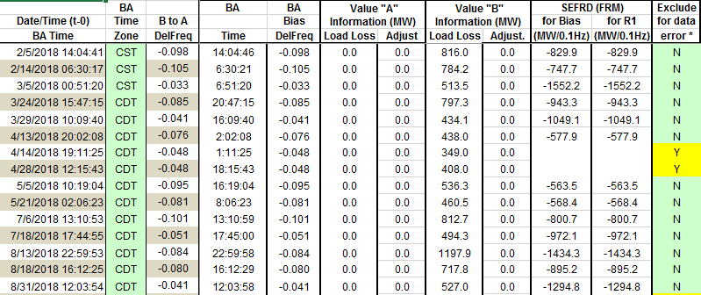
Op. Year 2018 BAL-003 Selected Events
Maybe. Will be valuated at the end of the year.

Slide 20
Op. Year 2018 BAL-003 FRM Performance

Slide 21
ERCOT Energy Statistics

Slide 22
Total Energy
Notes:
28,697,628 MWh

Slide 23
Total Energy from Wind Generation
Notes:
6,106,225 MWh

Slide 24
% Energy from Wind Generation
Notes:
21.28%

Slide 25
ERCOT System Inertia

Slide 26
Daily Minimum System Inertia
Notes:
Minimum Inertia = 128,759 MW*s on 11/3/2018. Need details here.
Previous Minimum was 130,014 MW*s on 10/27/2017. This was also our record wind day.
December:
Mean: 188,781
Max: 254,920 on December 9th
Min: 146,019 on December 27th

Slide 27
Questions?
Thank you!

Slide 28
Op. Year 2017 BAL-003 Selected Events
Notes:
Frequency Bias updated from 764 to 759 in April

Slide 29
Op. Year 2017 BAL-003 FRM Performance

