Slide 1
Supply Analysis Working Group Report to WMS
January 9, 2019

Slide 2
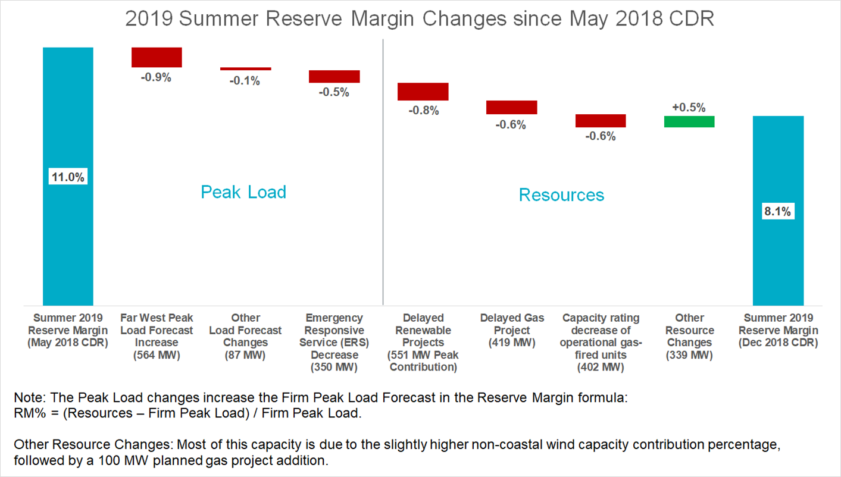
Capacity Demand and Reserves Report – Released 12-4, Discussed at 12-12 SAWG
The planning reserve margin for summer 2019 is forecasted to be 8.1%. This is 2.9% lower than what was reported in the May CDR.
The change was primarily driven by a higher summer peak load forecast and delays and cancellations of planned generation projects; see waterfall chart from ERCOT below.
Stakeholder discussion at 12-12 SAWG identified a need for further discussion about how to better include batteries, DR and DG in the CDR.

Slide 3
DC Tie Capacity Forecast Proposal – Discussed at 12/12 SAWG
ERCOT presented a capacity contribution calculation resulting in 75% capacity contribution
Based on aggregate net imports divided by existing DC tie capacity for just those SCED intervals during which the latest summer EEA events occurred (August 2-5, 2011)
For planned DC ties:
Would apply to expansions of existing DC ties
Large unrelated planned DC ties may need to be treated differently; for example, use available planning study assumptions
Draft NPRR language expected from ERCOT at future SAWG meeting

Slide 4
NPRR891
SAWG “consensus” language from 12-12
No objections at SAWG, posted to SAWG meeting page on 12-13
NOIEs with an aggregate amount of unregistered DG capacity above 50kW will continue to submit information regarding this capacity to ERCOT quarterly
NOIEs would annually report to ERCOT all known DG capacities on their systems, including those less than 50kW, by March 1 for the previous calendar year
NOIEs that do not have the required data can request a one-year exemption from the requirement from ERCOT, and ERCOT may grant the exemption at their discretion
Subsequent comments filed that were not part of 12-12 SAWG consensus:
Golden Spread Electric Cooperative comments filed on 12-27
ERCOT comments filed on 1-4
Need direction from WMS:
Vote today?
Take back to SAWG for more discussion on recent comments

