Slide 1
PDCWG Report to ROS
Chair: Chad Mulholland, NRG
Vice Chair: Percy Galliguez, Brazos Electric Power Cooperative
ROS
January 10th, 2019

Slide 2
Report Overview & Notes
Report Overview
  Meeting Minutes
  BAL-001-TRE-1 FMEs & IMFR
    1 FME in the month of November
  Frequency Control Report

Slide 3
Meeting Minutes
PDCWG Meeting 12/17/18
  Review of Open Action Items- 6 Items primarily for ERCOT(1 New)
  Review of Future Action Items- 8 Items
  Review 2019 PDCWG ERCOT Calendar
  Discuss future PDCWG Leadership-possible new leaders in 2019
  Texas RE Report
    -BAL-001-TRE-01 Standard drafting team Kickoff
  Chair: NRG Chad Mulholland
  Vice-Chair: Calpine Arthur Macklin
    NERC Resource Subcommittee meeting January 23 and 24 at ERCOT Metro Center in Austin
    BAL-003 SDT Initial drafts upcoming
    PRC-24 and PRC-19 also have some revisions in work, largely relating to protection systems, and impacting renewables
  Regulation & Frequency Control Reports

Slide 4
Frequency Measurable Events Performance

Slide 5
Frequency Measurable Events
There was 1 FME in November
  11/10/2018 09:25:21
    Loss of 516 MW
    Interconnection Frequency Response:
    2 of 39 Evaluated Generation Resources(0 of 23 RRS Providers) had less than 75% of their expected Initial Primary Frequency Response.
    2 of 39 Evaluated Generation Resources (0 of 23 RRS Providers) had less than 75% of their expected Sustained Primary Frequency Response.

Slide 6
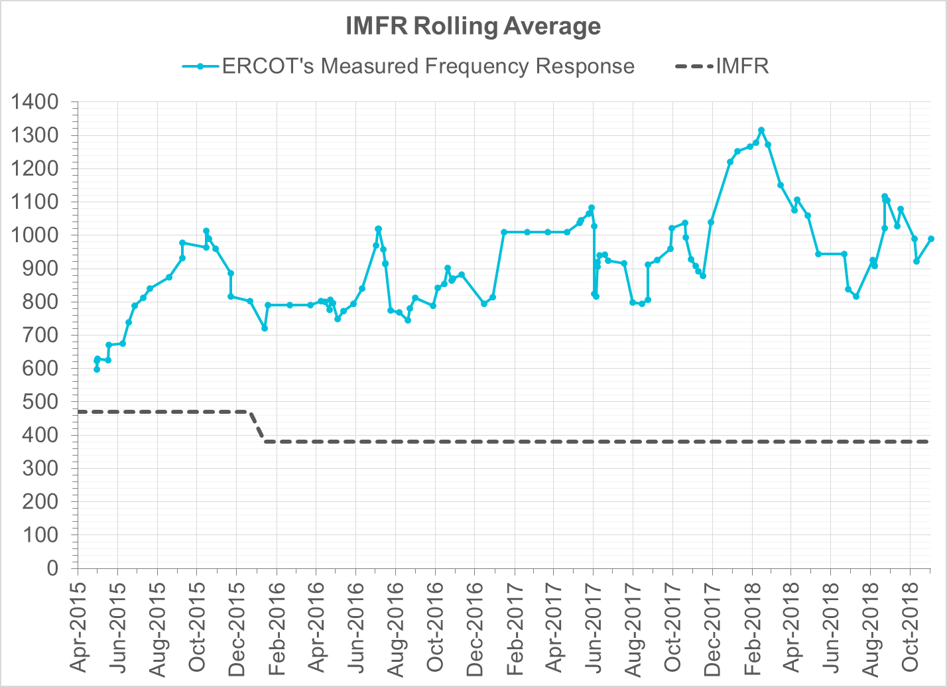
Interconnection Minimum Frequency Response (IMFR) Performance
IMFR Performance currently 990.39 MW/0.1Hz

Slide 7
Frequency Control Report
November 2018

Slide 8
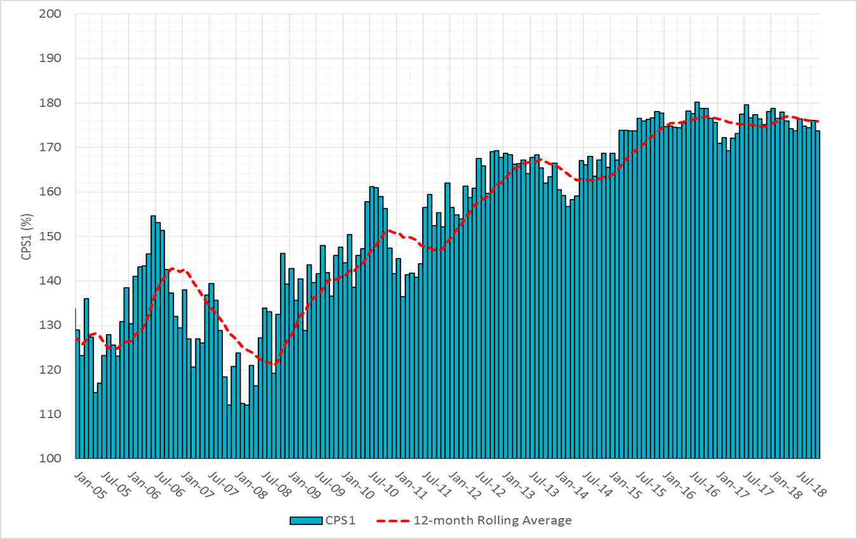

CPS1 Performance

Slide 9
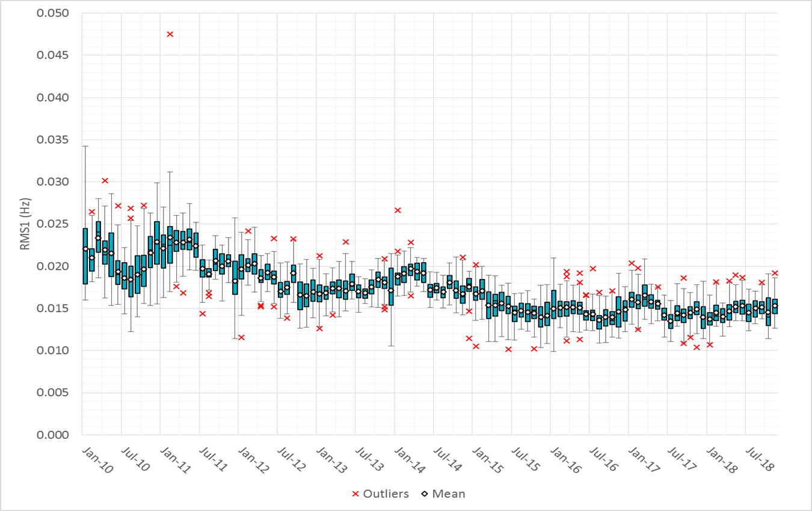
RMS1 Performance of ERCOT Frequency

Slide 10
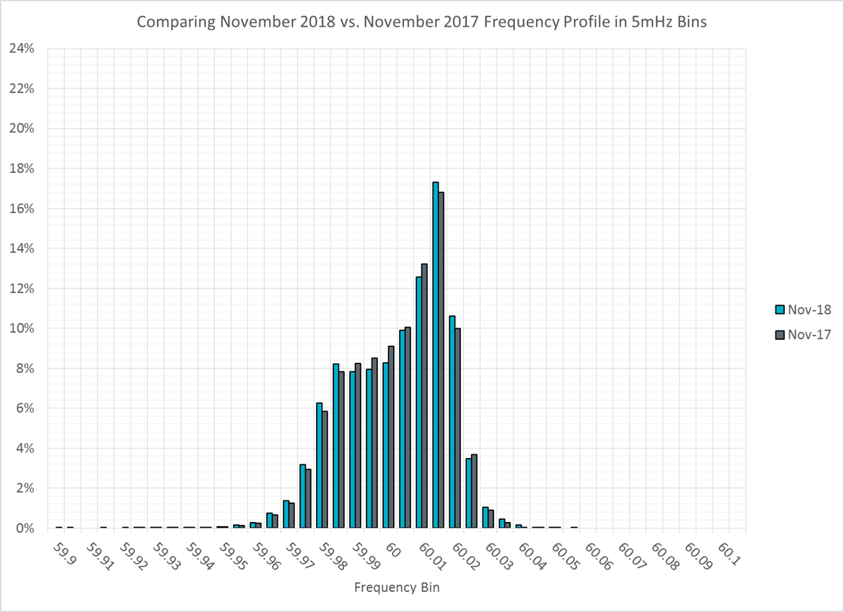
Frequency Profile Analysis

Slide 11
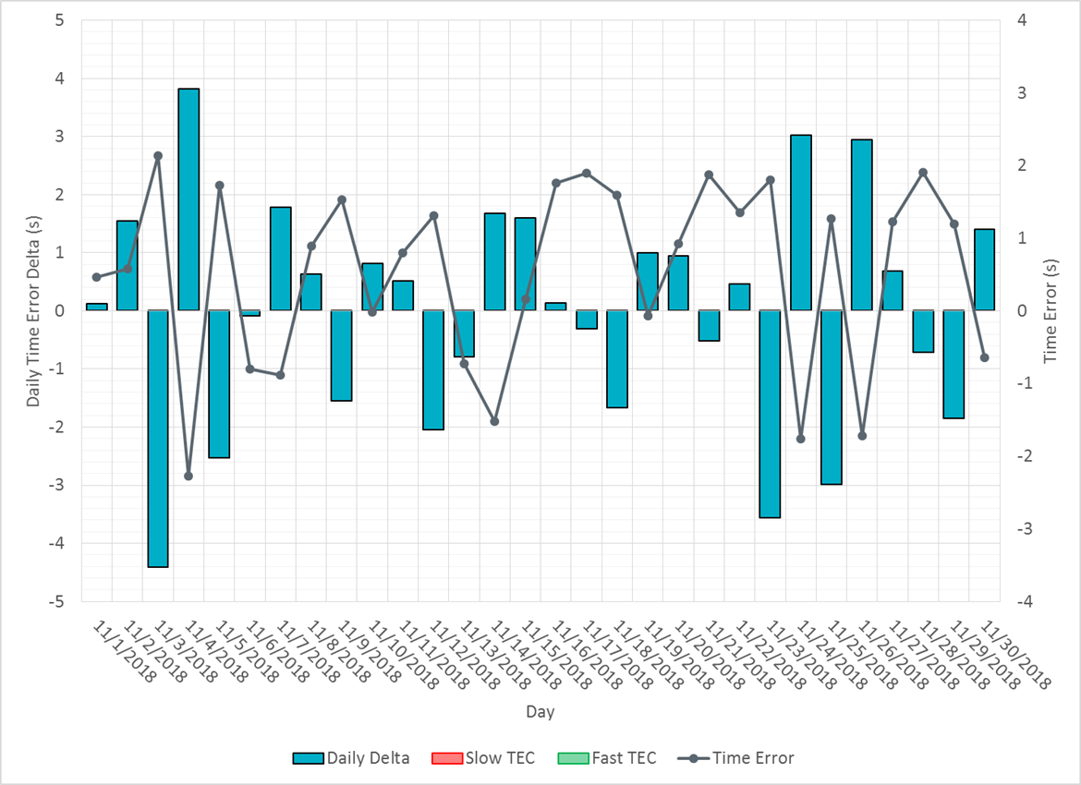
Time Error Corrections

Slide 12
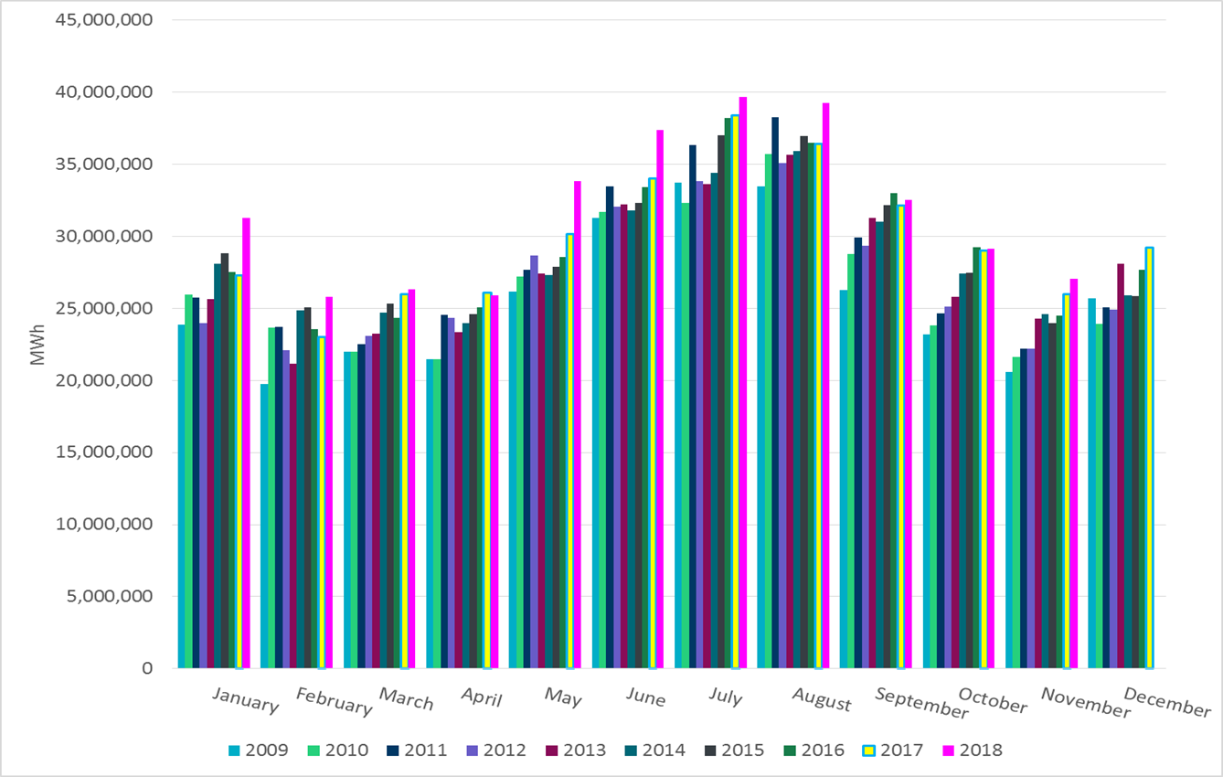
ERCOT Total Energy

Slide 13
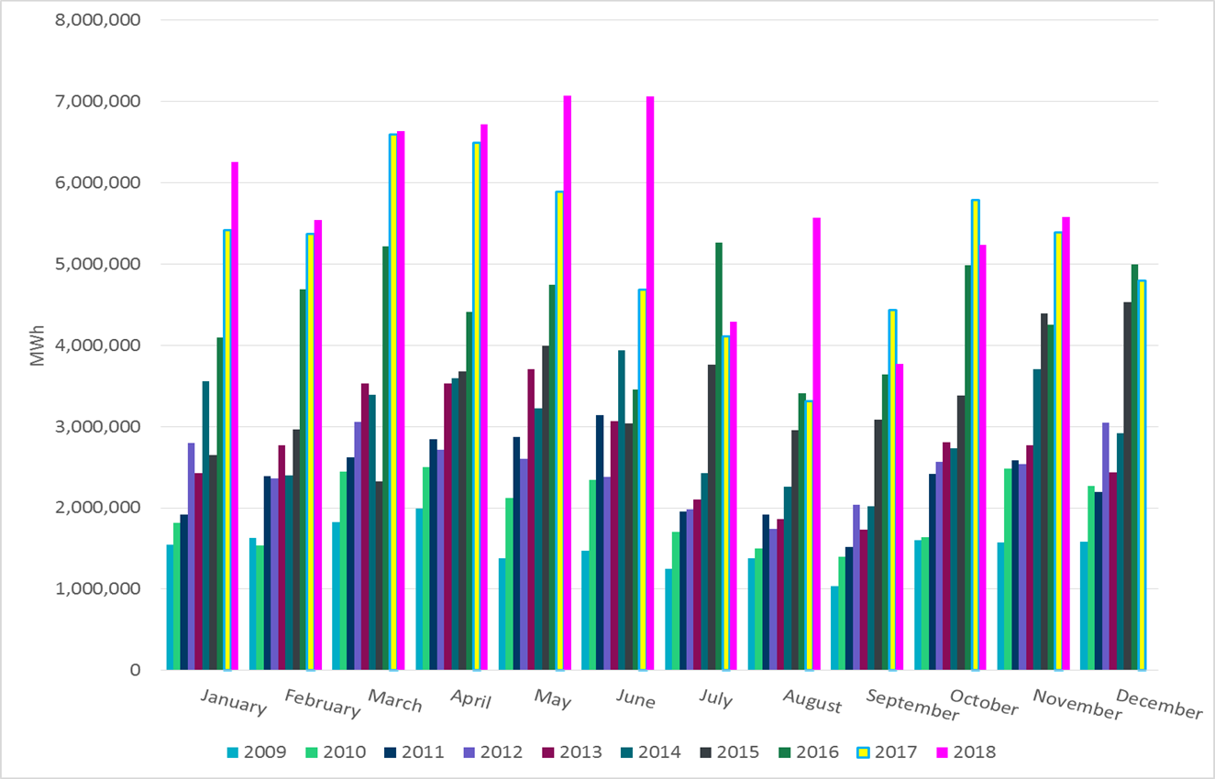
ERCOT Total Energy from Wind Generation

Slide 14
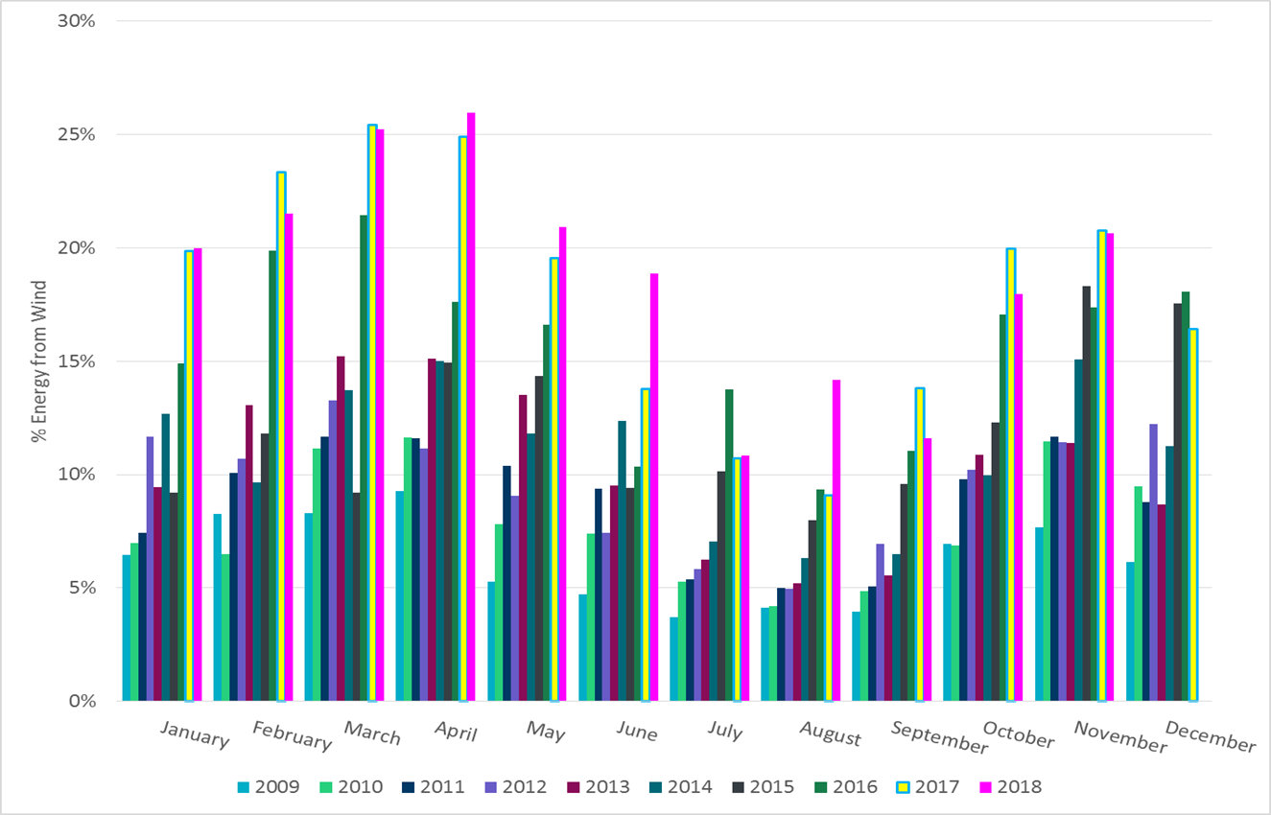
ERCOT % Energy from Wind Generation

Slide 15
Questions?

