Slide 1
ERCOT Frequency Control Report
November 2018
ERCOT
Operations Planning
PDCWG | December 17th, 2018

Slide 2
Summary of November 2018
CPS1: 173.73%
Current CPS1 12-Month Rolling Average: 175.87%
2 BAAL Exceedance
3 hourly CPS1 scores below 100%
BAAL-003 Events have updated through August
2018 BAAL-003 FRM Performance: -895.19
2018 RMS1 Statistics
Mean: 15.31 mHz
Min: 12.66 mHz
Max: 19.18 mHz
Energy Statistics
Total Energy: 27,042,180 MWh
Wind Energy: 5,577,203 MWh
Percent Energy from Wind Generation: 20.62%
Minimum System Inertia
Mean: 178,025
Max: 266,848 on November 14th
Min: 128,759 on November 3rd

Slide 3
Frequency Control
CPS1, BAAL, & RMS1

Slide 4
Hourly CPS1 by Day
November-18 CPS1 (%): 173.73
Notes:
Outliers:
11/3/18 18:00: 8.9%
Wind ramp down of >500 MW over 15 mins. Frequency was dragging due large expected generation deviation. Reg Up exhausted from 18:01 until 18:39.
11/3/18 21:00: 83.4%
Wind ramp down of >2,500 MW throughout the hour. Frequency was dragging due to wind ramp and large expected generation deviation. Reg Up exhausted from 21:20 until 21:55.
11/14/18 10:00: 90.9%
Small Wind ramp up, load declining through mid day. Frequency was above upper deadband 10:09 to 10:23. Reg Down exhausted from 10:18 until 11:00.

Slide 5
BAAL Exceedances & Violations
There was 2 BAAL exceedance
November 3, 2018
Wind was ramping down quickly
Unit loss when there was already a large expected generation deviation
Less than 59.91 Hz for 1 minute

Slide 6
15-Minute Average CPS1%
November-18 CPS1 (%): 173.73

Slide 7
12-Month Rolling Average CPS1
Current 12-Month Rolling Average: 175.87%

Slide 8
Daily RMS1 of ERCOT Frequency by Year
Notes:
Mean is 14.73 mHz

Slide 9
Daily RMS1 of ERCOT Frequency by Month

Slide 10
Daily RMS1 of ERCOT Frequency by Month

Slide 11
Daily RMS1 of ERCOT Frequency by Month
Notes:
Mean: 15.31 mHz
Min: 12.66 mHz
Max: 19.18 mHz

Slide 12
Frequency Profile Comparison

Slide 13
Frequency Profile Comparison

Slide 14
Frequency Profile Comparison

Slide 15
Time Error Correction

Slide 16
ERCOT Daily Time Error

Slide 17
Time Error Corrections Log Summary
There have been no time error corrections since December 2016

Slide 18
BAL-003 Performance

Slide 19
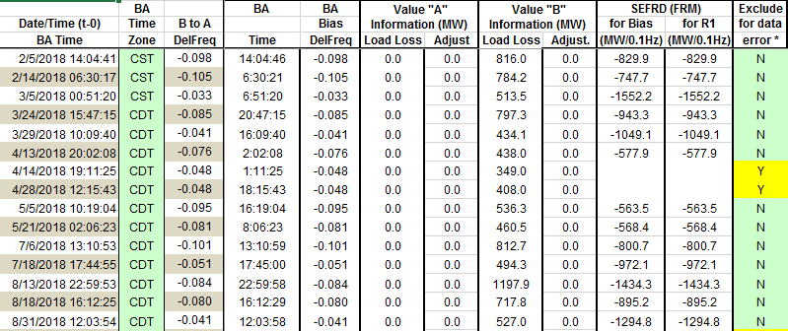
Op. Year 2018 BAL-003 Selected Events
Maybe. Will be valuated at the end of the year.

Slide 20
Op. Year 2018 BAL-003 FRM Performance

Slide 21
ERCOT Energy Statistics

Slide 22
Total Energy
Notes:
27,042,180 MWh

Slide 23
Total Energy from Wind Generation
Notes:
5,577,203 MWh

Slide 24
% Energy from Wind Generation
Notes:
20.62%

Slide 25
ERCOT System Inertia

Slide 26
Daily Minimum System Inertia
Notes:
Minimum Inertia = 128,759 MW*s on 11/3/2018. Need details here.
Previous Minimum was 130,014 MW*s on 10/27/2017. This was also our record wind day.
November:
Mean: 178,025
Max: 266,848 on November 14th
Min: 128,759 on November 3rd

Slide 27
Questions?
Thank you!

Slide 28
Op. Year 2017 BAL-003 Selected Events
Notes:
Frequency Bias updated from 764 to 759 in April

Slide 29
Op. Year 2017 BAL-003 FRM Performance

