Slide 1
Intra-Hour Wind Forecast Accuracy Updates
QMWG
Operations Analysis
10/15/2018

Slide 2
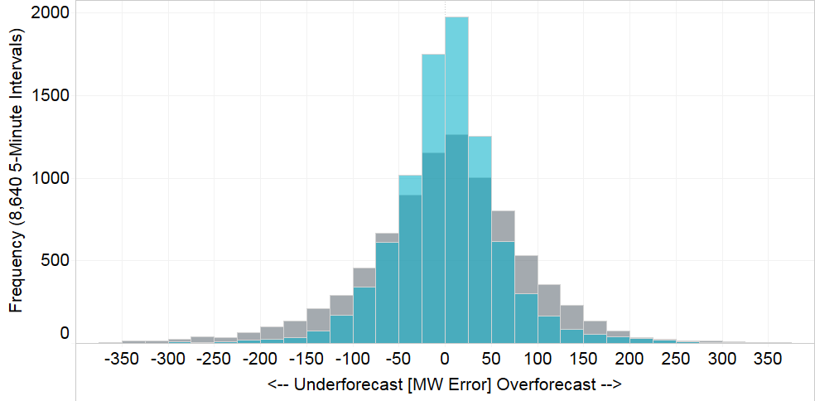
Intra-Hour Wind Forecast Error (September 2018)
Performance Metric | Vendor A | Vendor B | Persistence*
Monthly MAE (MW) | 43 | 152 | 66
Monthly MAE when 5-Min. Wind Ramp > 100 MW | 91 | 305 | 178
AWS
Persistence
* Persistence metric uses same historical data sent to vendors for fair comparison

Slide 3
Monthly Trends
* Persistence metric uses same historical data sent to vendors for fair comparison

Slide 4
Monthly Trends (Wind Ramp > 100 MW)
* Persistence metric uses same historical data sent to vendors for fair comparison

Slide 5
SCR795 Update – Projected Wind Ramp Rate (PWRR)
Alarm: If wind is ramping in opposite direction than PWRR for X amount of intervals, i.e. not tracking, alarm is issued to operator
Persistence Option: Will go into persistence (i.e. PWRR = 0) if PWRR is not tracking with actual ramp for X+Y amount of intervals
Updated GTBD Equation:
GTBD = Total Gen + K1*10*System Load Frequency Bias + K2*[(net non-conforming Load) – (net filtered non-conforming Load)] + K3*5*PLRR + K4*Regulation Deployed + K5*ACE Integral – K6*5*PWRR
|PWRR| ≤ Max PWRR Thresh

Slide 6
Projected Wind Ramp Rate (PWRR) Trends
Ramp error will be actual error seen by SCED GTBD
* Only Vendor A’s forecast was used to calculate PWRR

Slide 7
Projected Wind Ramp Rate (PWRR) Trends
Trends during times when Wind Ramp > 100 MW (both directions)
* Only Vendor A’s forecast was used to calculate PWRR

Slide 8
Example Impact of Projected Wind Ramp to GTBD

Slide 9
Next Steps
ERCOT will implement SCR795 during 2018 R5 between October 23 and October 25, 2018
Initially, K6 will be set to 0 so that it will not impact GTBD calculation
A market notice will be sent out prior to initial activation of K6 to a non-zero value
Market notice was sent out on September 24, 2018:
http://www.ercot.com/services/comm/mkt_notices/archives/2916

