Slide 1
Proposed Changes to ERS Time Period
Sandip Sharma
Manager Operations Planning
Dec. 14, 2018

Slide 2
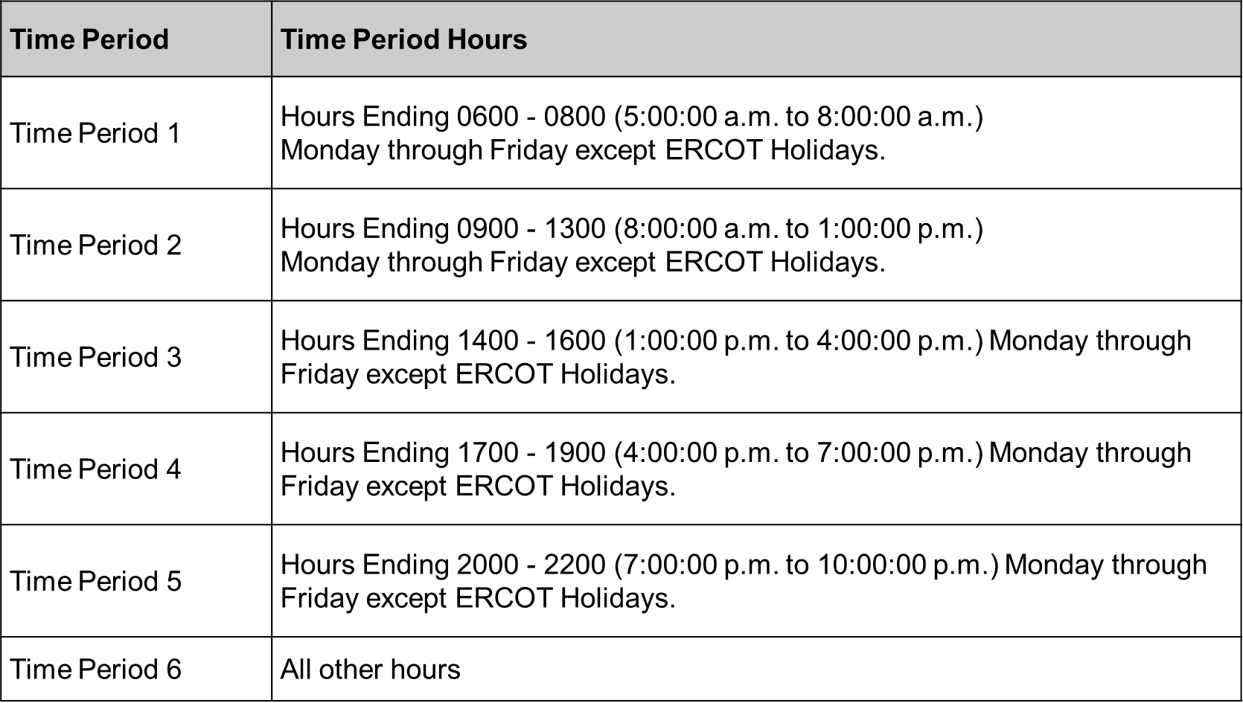
Existing ERS Time Periods

Slide 3
Proposed ERS Time Periods

Slide 4
Comparison between Existing and Proposed Time Periods
Weekday
Weekend
HE01 | Time Period 6 | Time Period 7*
HE02 | Time Period 6 | Time Period 7*
HE03 | Time Period 6 | Time Period 7*
HE04 | Time Period 6 | Time Period 7*
HE05 | Time Period 6 | Time Period 7*
HE06 | Time Period 1 | Time Period 1*
HE07 | Time Period 1 | Time Period 1*
HE08 | Time Period 1 | Time Period 1*
HE09 | Time Period 2 | Time Period 1*
HE10 | Time Period 2 | Time Period 2*
HE11 | Time Period 2 | Time Period 2*
HE12 | Time Period 2 | Time Period 2*
HE13 | Time Period 2 | Time Period 2*
HE14 | Time Period 3 | Time Period 2*
HE15 | Time Period 3 | Time Period 2*
HE16 | Time Period 3 | Time Period 3*
HE17 | Time Period 4 | Time Period 3*
HE18 | Time Period 4 | Time Period 3*
HE19 | Time Period 4 | Time Period 4*
HE20 | Time Period 5 | Time Period 4*
HE21 | Time Period 5 | Time Period 4*
HE22 | Time Period 5 | Time Period 7*
HE23 | Time Period 6 | Time Period 7*
HE24 | Time Period 6 | Time Period 7*
HE01 | Time Period 6 | Time Period 7*
HE02 | Time Period 6 | Time Period 7*
HE03 | Time Period 6 | Time Period 7*
HE04 | Time Period 6 | Time Period 7*
HE05 | Time Period 6 | Time Period 7*
HE06 | Time Period 1 | Time Period 5*
HE07 | Time Period 1 | Time Period 5*
HE08 | Time Period 1 | Time Period 5*
HE09 | Time Period 2 | Time Period 5*
HE10 | Time Period 2 | Time Period 7*
HE11 | Time Period 2 | Time Period 7*
HE12 | Time Period 2 | Time Period 7*
HE13 | Time Period 2 | Time Period 7*
HE14 | Time Period 3 | Time Period 7*
HE15 | Time Period 3 | Time Period 7*
HE16 | Time Period 3 | Time Period 6*
HE17 | Time Period 4 | Time Period 6*
HE18 | Time Period 4 | Time Period 6*
HE19 | Time Period 4 | Time Period 6*
HE20 | Time Period 5 | Time Period 6*
HE21 | Time Period 5 | Time Period 6*
HE22 | Time Period 5 | Time Period 7*
HE23 | Time Period 6 | Time Period 7*
HE24 | Time Period 6 | Time Period 7*

Slide 5
Net Load Ramp Risk Factor

Slide 6
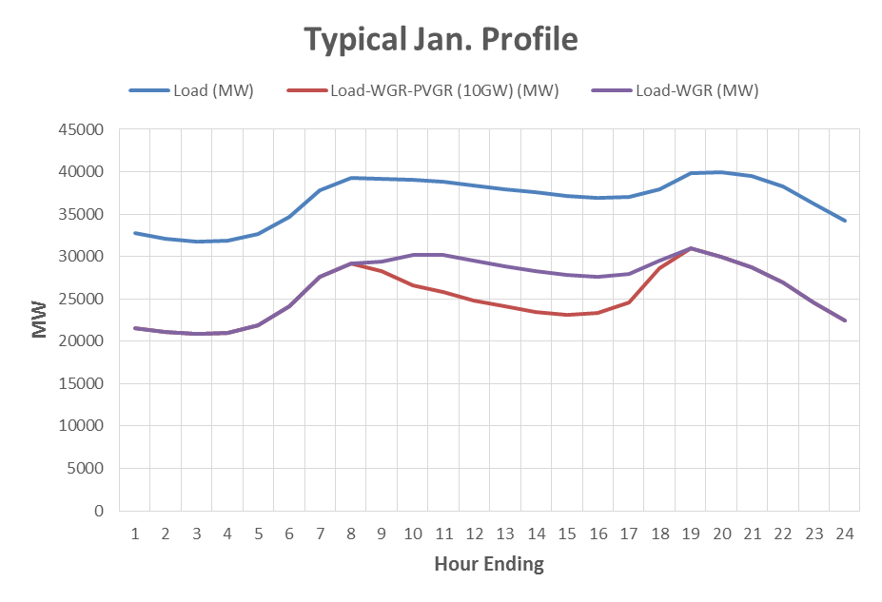
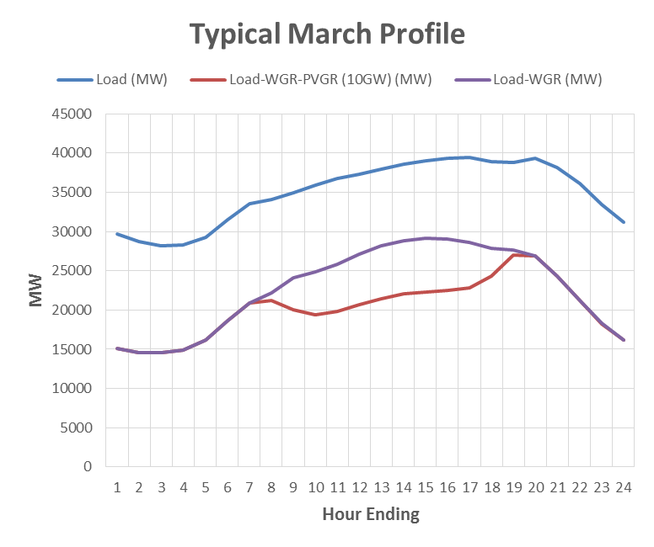
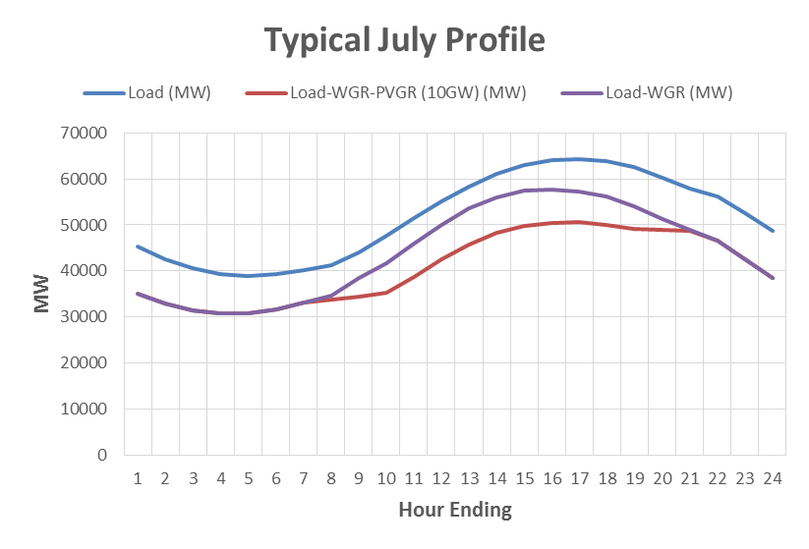
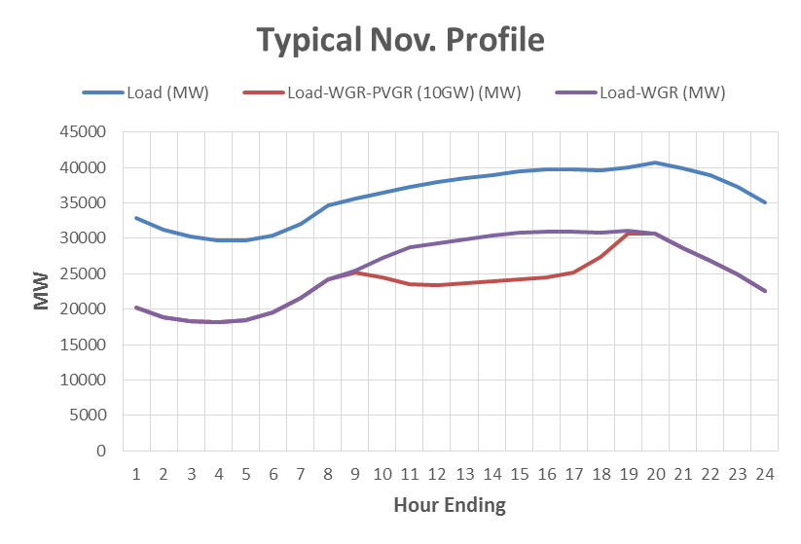
Net Load Profile

Slide 7
Questions?

Slide 8
Wind Generation Capacity – October 2018
Future outcomes uncertain
Steady growth continues, with some spikes.
Largest annual increase: 3,294 MW in 2015
(A close second: 3,220 MW in 2008)
Incentives, uncertainty and other factors affect construction decisions and schedules.
Not all planned projects will get built.
Texas continues to lead U.S. in wind capacity.
The data presented here is based upon the latest registration data provided to ERCOT by the resource owners and can change without notice. Any capacity changes will be reflected in current and subsequent years' totals. Scheduling delays will also be reflected in the planned projects as that information is received. This chart reflects planned units in the calendar year of submission rather than installations by peak of year shown.
Financial security posted for funding interconnection facilities does not include CREZ security deposits, which are refunded to the Interconnecting Entity when an IA is signed.
As of October 31, 2018

Slide 9
Utility Scale Solar Generation Capacity – October 2018
The data presented here is based upon the latest registration data provided to ERCOT by the resource owners and can change without notice. Any capacity changes will be reflected in current and subsequent years' totals. Scheduling delays will also be reflected in the planned projects as that information is received. This chart reflects planned units in the calendar year of submission rather than installations by peak of year shown.
As of October 31, 2018

