Slide 1
MSWG
Wholesale Communication Review
December 2018

Slide 2
Commercial Operations Market Guide
http://www.ercot.com/mktrules/guides/commercialops/current
In Section 3, WMS is currently responsible, by default, for the gap left by COPS inactivation.
3.2 Wholesale Market Subcommittee (WMS)
(1) The Wholesale Market Subcommittee (WMS), reporting to the Technical Advisory Committee (TAC), addresses the processes through which ERCOT market data is translated into Settlements. Commercial operations include the application of Data Aggregation, Congestion Revenue Rights (CRRs) Settlements, Qualified Scheduling Entity (QSE) Settlements, invoicing, and dispute resolution.
(2) WMS improves commercial operations by integrating the retail variance and wholesale market Settlements processes, including dispute resolution. WMS also addresses the Settlement Calendar, Settlement-related performance metrics and tracking, Market Participant data needs for shadow Settlements, and the market's overall needs for data extracts, delivery and presentation.
(3) WMS has several working groups that are in place to allow Market Participants the opportunity to participate in developing business rules and practices that govern the commercial operations of the ERCOT electric market. Additional information about the working groups is available on the ERCOT website.
Section 5 Market Notice Communication Process is blank (deleted by COPMGRR047). RMS has in their new charter, “the Market Participant communication needs for retail operations,” but the Wholesale needs were to be addressed in a new guide subsequent to the COPS dissolution. WMS approved goals do not contain a communication directive. Market Notice Communication Process is contained in ERCOT Retail Market Guide Section 12.
Section 8 Has been updated to reflect shortened Settlement Timeline
There have been no COPMGRRs filed since this handoff. How do we get Settlement items to flow to a non-voting body after COMGRR047?

Slide 3
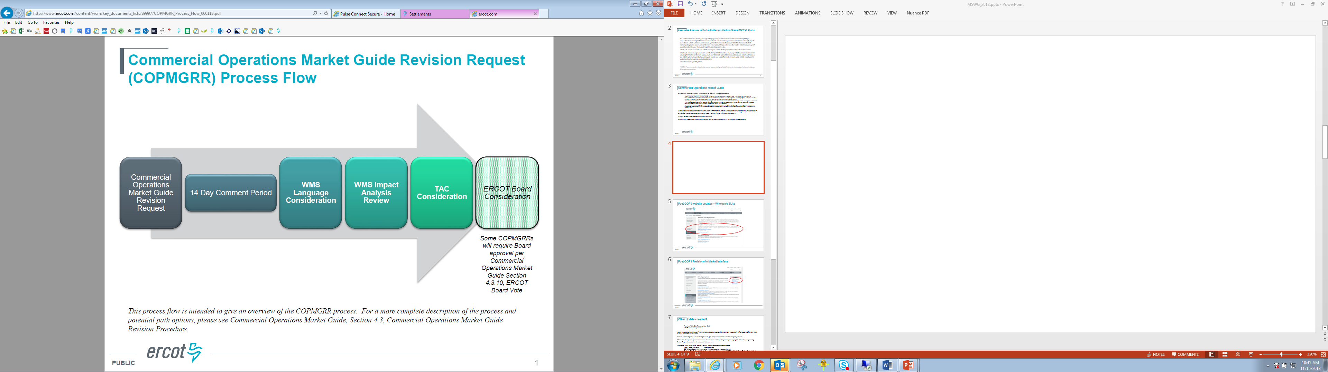

Slide 4
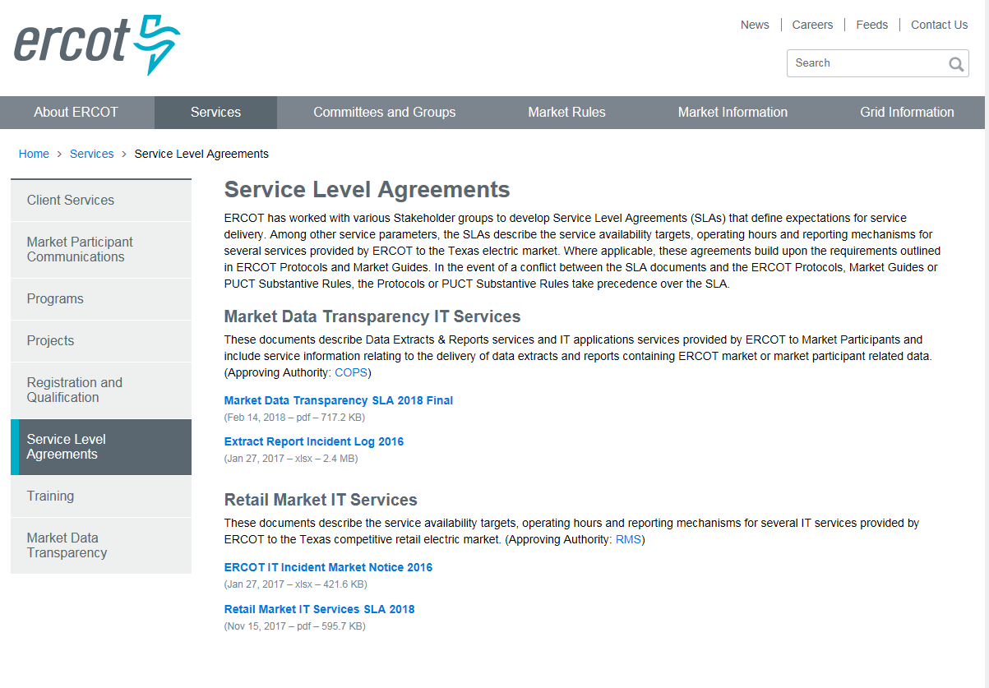
Post-COPS website updates – Wholesale SLAs

Slide 5
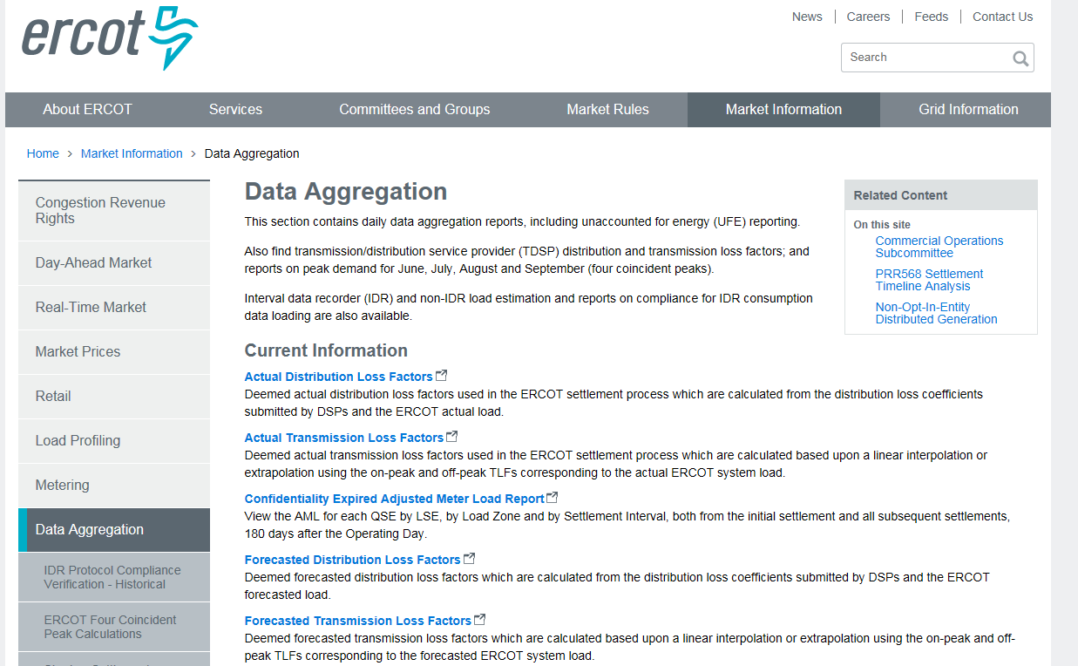
Post-COPS Revisions to Market Interface

Slide 6
Other Updates needed?
    From the Public Data Reference User Guide
    1.3.1 Service Level Agreement
“The Settlements & Extracts Working Group (SEWG) which falls under the Commercial Operations Subcommittee (COPS) is responsible for helping to maintain and manage the Data Extract and Reports SLA. This report currently falls under the Extract and Reporting SLA. Please refer to the SLA section on ERCOT.com for the most up to date information on this extract.”
There is no Extract and Reporting SLA. We have the Report Incident Log (no changes since 2016) and the Market Data Transparency Agreement.
Market Data Transparency Agreement needs annual review “in a workshop setting or through an appropriate stakeholder group meeting”
Section 7 approvals are blank and need a stakeholder sponsor.
Appendix B: COPS Market Guide, Section 5: ERCOT Market Notice Communication Process,
Table 2: E-mail Notification Subscription Lists
COPS Market Guide: http://www.ercot.com/mktrules/guides/commercialops/current
Section 5, Table 2: E-mail Notification Subscription Lists (this is located in ERCOT Retail Market Guide Section 12: Market Notice Communication Process

Slide 7
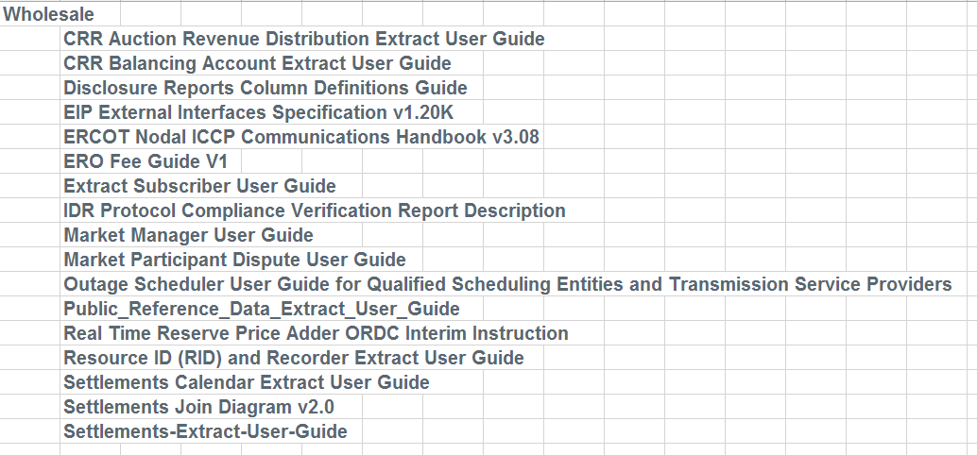
Other updates needed (contain references to defunct WGs, old settlement timelines or other)
http://www.ercot.com/services/mdt/userguides

Slide 8

QUESTIONS?

