Slide 1
2019 Long-Term Load Forecast
Sarah Moore
Calvin Opheim
Load Forecasting & Analysis
SAWG
December 12, 2018

Slide 2
Agenda
Load Forecasting Framework
Growth Driver
Normal Weather (P50) Forecast
ERCOT P50 Forecast

Slide 3
Agenda
Assumptions and Challenges
Active Models
Weather Zone P50 and P90 Forecasts
Questions

Slide 4
Load Forecasting Framework

Slide 5
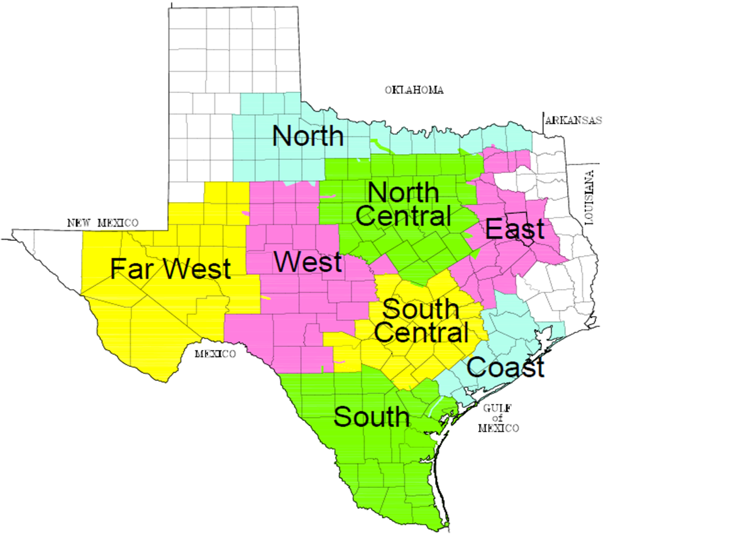
Weather Zones
2 or 3 Weather Stations in each Weather Zone

Slide 6
Load Models
Unique Model for
Each Weather Zone
Each Temperature Group
Hot
Medium
Cold

Slide 7
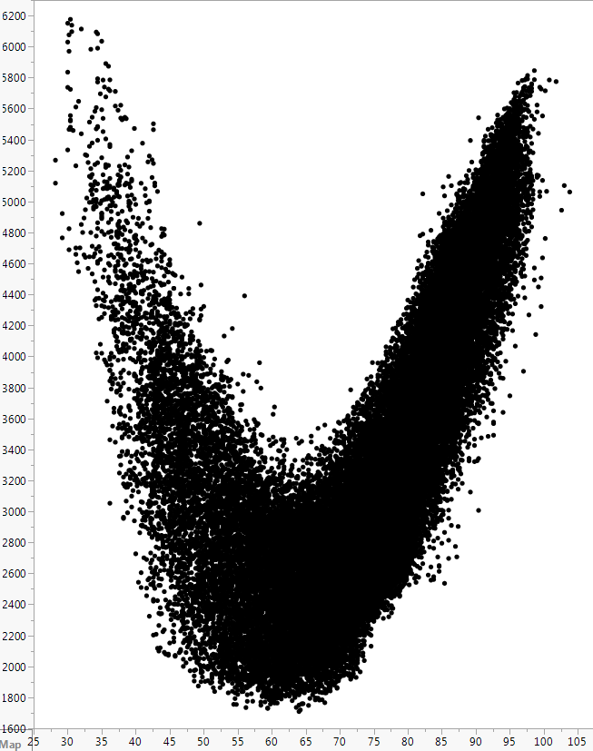
Load Models
South Load vs. Temperature
Unique Model for
Each Weather Zone
Each Temperature Group
Hot
Medium
Cold
MW
Temperature

Slide 8
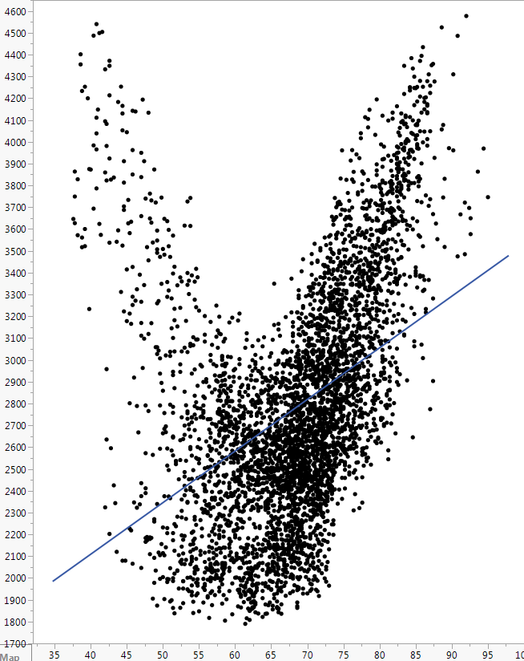
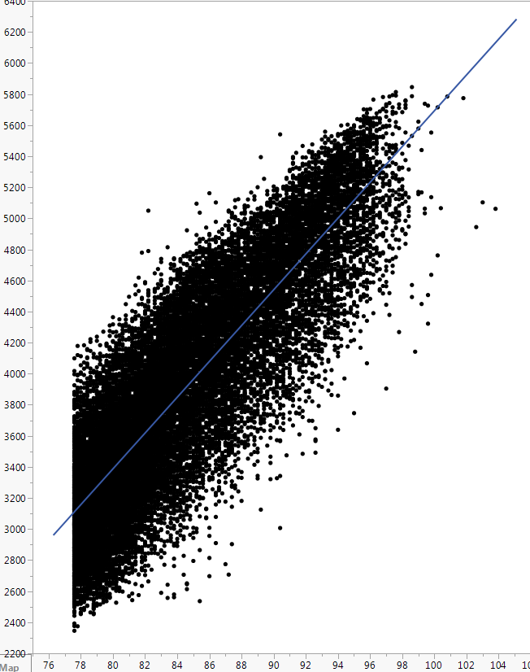
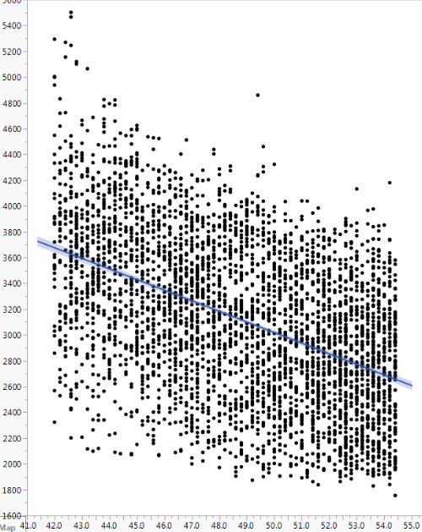
Temperature Groups
South March
South Hot
South Medium Cold
MW
MW
Temperature
Temperature

Slide 9
Months vs. Temperature Groups
South March
MW
Temperature

Slide 10
Months vs. Temperature Groups
South March
South Hot
MW
MW
Temperature
Temperature

Slide 11
Input Data
Hourly Models
From January 2013 through August 2018
Recent Snapshot
Appliance Stock
Energy Efficiency
Demand Response
Price Responsive Load

Slide 12
Input Data
Weather
Calendar
Actual Load

Slide 13
Input Data
Weather
Temperature, Temperature Squared, and Temperature Cubed
Cooling Degree Days and Heating Degree Days
Cloud Cover
Wind Speed
Dew Point

Slide 14
Input Data
Calendar
Month
Day of the Week
Holidays
Hour
Interact Hour with Day of the Week

Slide 15
Input Data
Variable Interactions
Interact a Weather Variable with a Calendar Variable
Temperature with Hour
Dew Point with Hour
Interact multiple Weather Variables with a Calendar Variable
Temperature with Dew Point and Hour

Slide 16
Growth Driver

Slide 17
Premise Forecast
Unique Model for
Each Weather Zone
Each Premise Class
Residential
Commercial
Industrial
Monthly Models

Slide 18
Input Data
From January 2013 through August 2018
Economic Measures
Population
Non-Farm Employment
Housing Stock
Error Correction Term

Slide 19
Challenges
Premise Counts increased significantly via opt-in

Slide 20
Challenges
Premise Counts increased significantly via opt-in

Slide 21
Growth Driver for Far West and West
Economic Measures from Moody’s Base Scenario
Population
Non-Farm Employment
Housing Stock

Slide 22
Normal Weather (P50) Forecast

Slide 23
Normal Weather (P50) Forecast
Coast 2019 Summer Forecasts
Year | Month | Day | Hour | Rank | Forecast based on 2003’s Weather
2019 | 8 | 18 | 17 | 1 | 21,257
2019 | 8 | 17 | 16 | 2 | 21,211
2019 | 8 | 18 | 18 | 3 | 21,191
2019 | 8 | 16 | 16 | 4 | 21,059
2019 | 8 | 18 | 16 | 5 | 20,923
Rank | 2003 | 2004 | 2005 | 2006 | 2007 | 2008 | 2009 | 2010 | 2011 | 2012 | 2013 | 2014 | 2015 | 2016 | 2017 | P50
1 | 21,257 | 20,994 | 20,757 | 20,752 | 21,015 | 20,748 | 21,295 | 21,047 | 21,857 | 21,799 | 21,132 | 20,842 | 21,582 | 21,349 | 20,738 | 21,144
2 | 21,211 | 20,840 | 20,099 | 20,542 | 20,981 | 20,368 | 21,162 | 20,950 | 21,830 | 20,910 | 20,979 | 20,839 | 21,558 | 21,064 | 20,689 | 20,935
3 | 21,191 | 20,763 | 20,095 | 20,422 | 20,769 | 20,330 | 20,938 | 20,851 | 21,631 | 20,904 | 20,926 | 20,746 | 21,353 | 20,998 | 20,542 | 20,831
4 | 21,059 | 20,740 | 20,088 | 20,294 | 20,726 | 20,305 | 20,934 | 20,814 | 21,617 | 20,825 | 20,926 | 20,718 | 21,249 | 20,977 | 20,470 | 20,783
5 | 20,923 | 20,446 | 19,976 | 20,221 | 20,708 | 20,144 | 20,844 | 20,797 | 21,568 | 20,804 | 20,897 | 20,677 | 21,211 | 20,968 | 20,462 | 20,710

Slide 24
Normal Weather (P50) Forecast
Coast 2019 Summer Forecasts
Year | Month | Day | Hour | Rank | Forecast based on 2003’s Weather
2019 | 8 | 18 | 17 | 1 | 21,257
2019 | 8 | 17 | 16 | 2 | 21,211
2019 | 8 | 18 | 18 | 3 | 21,191
2019 | 8 | 16 | 16 | 4 | 21,059
2019 | 8 | 18 | 16 | 5 | 20,923
Sort from high to low
Rank | 2003 | 2004 | 2005 | 2006 | 2007 | 2008 | 2009 | 2010 | 2011 | 2012 | 2013 | 2014 | 2015 | 2016 | 2017 | P50
1 | 21,257 | 20,994 | 20,757 | 20,752 | 21,015 | 20,748 | 21,295 | 21,047 | 21,857 | 21,799 | 21,132 | 20,842 | 21,582 | 21,349 | 20,738 | 21,144
2 | 21,211 | 20,840 | 20,099 | 20,542 | 20,981 | 20,368 | 21,162 | 20,950 | 21,830 | 20,910 | 20,979 | 20,839 | 21,558 | 21,064 | 20,689 | 20,935
3 | 21,191 | 20,763 | 20,095 | 20,422 | 20,769 | 20,330 | 20,938 | 20,851 | 21,631 | 20,904 | 20,926 | 20,746 | 21,353 | 20,998 | 20,542 | 20,831
4 | 21,059 | 20,740 | 20,088 | 20,294 | 20,726 | 20,305 | 20,934 | 20,814 | 21,617 | 20,825 | 20,926 | 20,718 | 21,249 | 20,977 | 20,470 | 20,783
5 | 20,923 | 20,446 | 19,976 | 20,221 | 20,708 | 20,144 | 20,844 | 20,797 | 21,568 | 20,804 | 20,897 | 20,677 | 21,211 | 20,968 | 20,462 | 20,710

Slide 25
Normal Weather (P50) Forecast
Coast 2019 Summer Forecasts
Year | Month | Day | Hour | Rank | Forecast based on 2003’s Weather
2019 | 8 | 18 | 17 | 1 | 21,257
2019 | 8 | 17 | 16 | 2 | 21,211
2019 | 8 | 18 | 18 | 3 | 21,191
2019 | 8 | 16 | 16 | 4 | 21,059
2019 | 8 | 18 | 16 | 5 | 20,923
Rank | 2003 | 2004 | 2005 | 2006 | 2007 | 2008 | 2009 | 2010 | 2011 | 2012 | 2013 | 2014 | 2015 | 2016 | 2017 | P50
1 | 21,257 | 20,994 | 20,757 | 20,752 | 21,015 | 20,748 | 21,295 | 21,047 | 21,857 | 21,799 | 21,132 | 20,842 | 21,582 | 21,349 | 20,738 | 21,144
2 | 21,211 | 20,840 | 20,099 | 20,542 | 20,981 | 20,368 | 21,162 | 20,950 | 21,830 | 20,910 | 20,979 | 20,839 | 21,558 | 21,064 | 20,689 | 20,935
3 | 21,191 | 20,763 | 20,095 | 20,422 | 20,769 | 20,330 | 20,938 | 20,851 | 21,631 | 20,904 | 20,926 | 20,746 | 21,353 | 20,998 | 20,542 | 20,831
4 | 21,059 | 20,740 | 20,088 | 20,294 | 20,726 | 20,305 | 20,934 | 20,814 | 21,617 | 20,825 | 20,926 | 20,718 | 21,249 | 20,977 | 20,470 | 20,783
5 | 20,923 | 20,446 | 19,976 | 20,221 | 20,708 | 20,144 | 20,844 | 20,797 | 21,568 | 20,804 | 20,897 | 20,677 | 21,211 | 20,968 | 20,462 | 20,710

Slide 26
Normal Weather (P50) Forecast
Coast 2019 Summer Forecasts
Year | Month | Day | Hour | Rank | Forecast based on 2003’s Weather
2019 | 8 | 18 | 17 | 1 | 21,257
2019 | 8 | 17 | 16 | 2 | 21,211
2019 | 8 | 18 | 18 | 3 | 21,191
2019 | 8 | 16 | 16 | 4 | 21,059
2019 | 8 | 18 | 16 | 5 | 20,923
Rank | 2003 | 2004 | 2005 | 2006 | 2007 | 2008 | 2009 | 2010 | 2011 | 2012 | 2013 | 2014 | 2015 | 2016 | 2017 | P50
1 | 21,257 | 20,994 | 20,757 | 20,752 | 21,015 | 20,748 | 21,295 | 21,047 | 21,857 | 21,799 | 21,132 | 20,842 | 21,582 | 21,349 | 20,738 | 21,144
2 | 21,211 | 20,840 | 20,099 | 20,542 | 20,981 | 20,368 | 21,162 | 20,950 | 21,830 | 20,910 | 20,979 | 20,839 | 21,558 | 21,064 | 20,689 | 20,935
3 | 21,191 | 20,763 | 20,095 | 20,422 | 20,769 | 20,330 | 20,938 | 20,851 | 21,631 | 20,904 | 20,926 | 20,746 | 21,353 | 20,998 | 20,542 | 20,831
4 | 21,059 | 20,740 | 20,088 | 20,294 | 20,726 | 20,305 | 20,934 | 20,814 | 21,617 | 20,825 | 20,926 | 20,718 | 21,249 | 20,977 | 20,470 | 20,783
5 | 20,923 | 20,446 | 19,976 | 20,221 | 20,708 | 20,144 | 20,844 | 20,797 | 21,568 | 20,804 | 20,897 | 20,677 | 21,211 | 20,968 | 20,462 | 20,710

Slide 27
Normal Weather (P50) Forecast
Coast 2019 Summer Forecasts
Rank | 2003 | 2004 | 2005 | 2006 | 2007 | 2008 | 2009 | 2010 | 2011 | 2012 | 2013 | 2014 | 2015 | 2016 | 2017
1 | 21,257 | 20,994 | 20,757 | 20,752 | 21,015 | 20,748 | 21,295 | 21,047 | 21,857 | 21,799 | 21,132 | 20,842 | 21,582 | 21,349 | 20,738
2 | 21,211 | 20,840 | 20,099 | 20,542 | 20,981 | 20,368 | 21,162 | 20,950 | 21,830 | 20,910 | 20,979 | 20,839 | 21,558 | 21,064 | 20,689
3 | 21,191 | 20,763 | 20,095 | 20,422 | 20,769 | 20,330 | 20,938 | 20,851 | 21,631 | 20,904 | 20,926 | 20,746 | 21,353 | 20,998 | 20,542
4 | 21,059 | 20,740 | 20,088 | 20,294 | 20,726 | 20,305 | 20,934 | 20,814 | 21,617 | 20,825 | 20,926 | 20,718 | 21,249 | 20,977 | 20,470
5 | 20,923 | 20,446 | 19,976 | 20,221 | 20,708 | 20,144 | 20,844 | 20,797 | 21,568 | 20,804 | 20,897 | 20,677 | 21,211 | 20,968 | 20,462

Slide 28
Normal Weather (P50) Forecast

Slide 29
Normal Weather (P50) Forecast
Coast 2019 Summer Forecasts
Rank | 2003 | 2004 | 2005 | 2006 | 2007 | 2008 | 2009 | 2010 | 2011 | 2012 | 2013 | 2014 | 2015 | 2016 | 2017
1 | 21,257 | 20,994 | 20,757 | 20,752 | 21,015 | 20,748 | 21,295 | 21,047 | 21,857 | 21,799 | 21,132 | 20,842 | 21,582 | 21,349 | 20,738
2 | 21,211 | 20,840 | 20,099 | 20,542 | 20,981 | 20,368 | 21,162 | 20,950 | 21,830 | 20,910 | 20,979 | 20,839 | 21,558 | 21,064 | 20,689
3 | 21,191 | 20,763 | 20,095 | 20,422 | 20,769 | 20,330 | 20,938 | 20,851 | 21,631 | 20,904 | 20,926 | 20,746 | 21,353 | 20,998 | 20,542
4 | 21,059 | 20,740 | 20,088 | 20,294 | 20,726 | 20,305 | 20,934 | 20,814 | 21,617 | 20,825 | 20,926 | 20,718 | 21,249 | 20,977 | 20,470
5 | 20,923 | 20,446 | 19,976 | 20,221 | 20,708 | 20,144 | 20,844 | 20,797 | 21,568 | 20,804 | 20,897 | 20,677 | 21,211 | 20,968 | 20,462

Slide 30
Normal Weather (P50) Forecast
Coast 2019 Summer Forecasts
Rank | 2003 | 2004 | 2005 | 2006 | 2007 | 2008 | 2009 | 2010 | 2011 | 2012 | 2013 | 2014 | 2015 | 2016 | 2017 | P50
1 | 21,257 | 20,994 | 20,757 | 20,752 | 21,015 | 20,748 | 21,295 | 21,047 | 21,857 | 21,799 | 21,132 | 20,842 | 21,582 | 21,349 | 20,738 | 21,144
2 | 21,211 | 20,840 | 20,099 | 20,542 | 20,981 | 20,368 | 21,162 | 20,950 | 21,830 | 20,910 | 20,979 | 20,839 | 21,558 | 21,064 | 20,689 | 20,935
3 | 21,191 | 20,763 | 20,095 | 20,422 | 20,769 | 20,330 | 20,938 | 20,851 | 21,631 | 20,904 | 20,926 | 20,746 | 21,353 | 20,998 | 20,542 | 20,831
4 | 21,059 | 20,740 | 20,088 | 20,294 | 20,726 | 20,305 | 20,934 | 20,814 | 21,617 | 20,825 | 20,926 | 20,718 | 21,249 | 20,977 | 20,470 | 20,783
5 | 20,923 | 20,446 | 19,976 | 20,221 | 20,708 | 20,144 | 20,844 | 20,797 | 21,568 | 20,804 | 20,897 | 20,677 | 21,211 | 20,968 | 20,462 | 20,710

Slide 31
Normal Weather (P50) Forecast
Coast 2019 Summer Forecasts
Rank | 2003 | 2004 | 2005 | 2006 | 2007 | 2008 | 2009 | 2010 | 2011 | 2012 | 2013 | 2014 | 2015 | 2016 | 2017 | P50
1 | 21,257 | 20,994 | 20,757 | 20,752 | 21,015 | 20,748 | 21,295 | 21,047 | 21,857 | 21,799 | 21,132 | 20,842 | 21,582 | 21,349 | 20,738 | 21,144
2 | 21,211 | 20,840 | 20,099 | 20,542 | 20,981 | 20,368 | 21,162 | 20,950 | 21,830 | 20,910 | 20,979 | 20,839 | 21,558 | 21,064 | 20,689 | 20,935
3 | 21,191 | 20,763 | 20,095 | 20,422 | 20,769 | 20,330 | 20,938 | 20,851 | 21,631 | 20,904 | 20,926 | 20,746 | 21,353 | 20,998 | 20,542 | 20,831
4 | 21,059 | 20,740 | 20,088 | 20,294 | 20,726 | 20,305 | 20,934 | 20,814 | 21,617 | 20,825 | 20,926 | 20,718 | 21,249 | 20,977 | 20,470 | 20,783
5 | 20,923 | 20,446 | 19,976 | 20,221 | 20,708 | 20,144 | 20,844 | 20,797 | 21,568 | 20,804 | 20,897 | 20,677 | 21,211 | 20,968 | 20,462 | 20,710

Slide 32
Normal Weather (P50) Forecast

Slide 33
Normal Weather (P50) Forecast
For every weather zone
For every forecasted year (2019-2028)

Slide 34
Normal Weather (P50) Forecast
Forecasted values are
Ranked from high to low
Averaged by Rank
Coast 2019 Summer Forecasts
Rank | 2003 | 2004 | 2005 | 2006 | 2007 | 2008 | 2009 | 2010 | 2011 | 2012 | 2013 | 2014 | 2015 | 2016 | 2017 | P50
1 | 21,257 | 20,994 | 20,757 | 20,752 | 21,015 | 20,748 | 21,295 | 21,047 | 21,857 | 21,799 | 21,132 | 20,842 | 21,582 | 21,349 | 20,738 | 21,144
2 | 21,211 | 20,840 | 20,099 | 20,542 | 20,981 | 20,368 | 21,162 | 20,950 | 21,830 | 20,910 | 20,979 | 20,839 | 21,558 | 21,064 | 20,689 | 20,935
3 | 21,191 | 20,763 | 20,095 | 20,422 | 20,769 | 20,330 | 20,938 | 20,851 | 21,631 | 20,904 | 20,926 | 20,746 | 21,353 | 20,998 | 20,542 | 20,831
4 | 21,059 | 20,740 | 20,088 | 20,294 | 20,726 | 20,305 | 20,934 | 20,814 | 21,617 | 20,825 | 20,926 | 20,718 | 21,249 | 20,977 | 20,470 | 20,783
5 | 20,923 | 20,446 | 19,976 | 20,221 | 20,708 | 20,144 | 20,844 | 20,797 | 21,568 | 20,804 | 20,897 | 20,677 | 21,211 | 20,968 | 20,462 | 20,710

Slide 35
ERCOT P50 Forecast

Slide 36
ERCOT P50 Forecast
Historical Year | Month | Day | Hour | Rank | Actual Load
2007 | 8 | 13 | 16 | 1 | 18,227
2007 | 8 | 13 | 17 | 2 | 18,032
2007 | 8 | 13 | 15 | 3 | 17,991
2007 | 8 | 14 | 16 | 4 | 17,990
2007 | 8 | 14 | 17 | 5 | 17,923
Coast 2007 Summer Actual Load

Slide 37
ERCOT P50 Forecast
Historical Year | Month | Day | Hour | Rank | Actual Load
2007 | 8 | 13 | 16 | 1 | 18,227
2007 | 8 | 13 | 17 | 2 | 18,032
2007 | 8 | 13 | 15 | 3 | 17,991
2007 | 8 | 14 | 16 | 4 | 17,990
2007 | 8 | 14 | 17 | 5 | 17,923
Sort from high to low
Coast 2007 Summer Actual Load

Slide 38
ERCOT P50 Forecast
Historical Year | Month | Day | Hour | Rank
2007 | 8 | 13 | 16 | 1
2007 | 8 | 13 | 17 | 2
2007 | 8 | 13 | 15 | 3
2007 | 8 | 14 | 16 | 4
2007 | 8 | 14 | 17 | 5
Coast 2007 Summer Actual Load Ranks

Slide 39
ERCOT P50 Forecast
Historical Year | Month | Day | Hour | Rank | P50 Forecast | Forecast Year
2007 | 8 | 13 | 16 | 1 | 21,144 | 2019
2007 | 8 | 13 | 17 | 2 | 20,935 | 2019
2007 | 8 | 13 | 15 | 3 | 20,831 | 2019
2007 | 8 | 14 | 16 | 4 | 20,783 | 2019
2007 | 8 | 14 | 17 | 5 | 20,710 | 2019
Coast 2007 Summer Actual Load Ranks
and Coast 2019 Forecast

Slide 40
ERCOT P50 Forecast
Historical Year | Month | Day | Hour | Rank | P50 Forecast | Forecast Year
2007 | 8 | 13 | 16 | 1 | 21,144 | 2019
2007 | 8 | 13 | 17 | 2 | 20,935 | 2019
2007 | 8 | 13 | 15 | 3 | 20,831 | 2019
2007 | 8 | 14 | 16 | 4 | 20,783 | 2019
2007 | 8 | 14 | 17 | 5 | 20,710 | 2019
ERCOT P50 Coincident Forecast for 2019
Forecast Year | Month | Day | Hour | COAST | EAST | FWEST | NCENT | NORTH | SCENT | SOUTH | WEST | ERCOT
2019 | 8 | 13 | 15 | 20,831 | 2,520 | 3,934 | 25,087 | 1,430 | 12,358 | 6,090 | 1,953 | 74,202
2019 | 8 | 13 | 16 | 21,144 | 2,515 | 3,975 | 25,257 | 1,435 | 12,488 | 6,043 | 1,995 | 74,853
2019 | 8 | 13 | 17 | 20,935 | 2,493 | 3,982 | 25,155 | 1,457 | 12,677 | 5,988 | 2,038 | 74,726
2019 | 8 | 13 | 18 | 20,659 | 2,490 | 3,928 | 24,865 | 1,438 | 12,397 | 5,797 | 2,005 | 73,579
2019 | 8 | 13 | 19 | 20,312 | 2,471 | 3,930 | 24,517 | 1,433 | 12,314 | 5,633 | 1,977 | 72,587

Slide 41
ERCOT P50 Forecast
Historical Year | Month | Day | Hour | Rank | P50 Forecast | Forecast Year
2007 | 8 | 13 | 16 | 1 | 21,144 | 2019
2007 | 8 | 13 | 17 | 2 | 20,935 | 2019
2007 | 8 | 13 | 15 | 3 | 20,831 | 2019
2007 | 8 | 14 | 16 | 4 | 20,783 | 2019
2007 | 8 | 14 | 17 | 5 | 20,710 | 2019
ERCOT P50 Coincident Forecast for 2019
Forecast Year | Month | Day | Hour | COAST | EAST | FWEST | NCENT | NORTH | SCENT | SOUTH | WEST | ERCOT
2019 | 8 | 13 | 15 | 20,831 | 2,520 | 3,934 | 25,087 | 1,430 | 12,358 | 6,090 | 1,953 | 74,202
2019 | 8 | 13 | 16 | 21,144 | 2,515 | 3,975 | 25,257 | 1,435 | 12,488 | 6,043 | 1,995 | 74,853
2019 | 8 | 13 | 17 | 20,935 | 2,493 | 3,982 | 25,155 | 1,457 | 12,677 | 5,988 | 2,038 | 74,726
2019 | 8 | 13 | 18 | 20,659 | 2,490 | 3,928 | 24,865 | 1,438 | 12,397 | 5,797 | 2,005 | 73,579
2019 | 8 | 13 | 19 | 20,312 | 2,471 | 3,930 | 24,517 | 1,433 | 12,314 | 5,633 | 1,977 | 72,587

Slide 42
ERCOT P50 Forecast
P50 Forecasts for each Weather Zone are mapped into a Historical Calendar by Rank
2007 Historical Calendar was selected
Evaluated 2007 through 2017
2007 had the least amount of diversity between Weather Zone peaks and ERCOT peak

Slide 43
ERCOT P50 Coincident Peak Forecast

Slide 44
ERCOT P50 Coincident Peak Forecast

Slide 45
ERCOT P50 Coincident Peak Forecast

Slide 46
Coast P50 Peak Forecast

Slide 47
East P50 Peak Forecast

Slide 48
Far West P50 Peak Forecast

Slide 49
North P50 Peak Forecast

Slide 50
South Central P50 Peak Forecast

Slide 51
South P50 Peak Forecast

Slide 52
West P50 Peak Forecast

Slide 53
North Central P50 Peak Forecast

Slide 54
ERCOT P50 Coincident Peak Forecast

Slide 55
ERCOT Annual Energy

Slide 56
ERCOT Annual Energy
December estimated

Slide 57
Assumptions and Challenges

Slide 58
Assumptions
Inherent Levels from the Input Data of
Appliance Stock and Energy Efficiency
Demand Response
4 CP Impact
Behind-the-Meter DG
Price Responsive Load
Electric Vehicles

Slide 59
Challenges
Weather Volatility
Economic Uncertainty
Policy Impacts

Slide 60
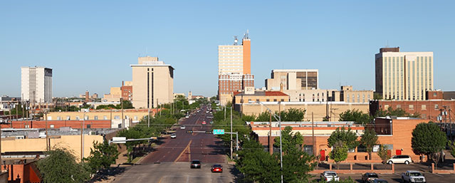
Load Forecast Adjustments
Lubbock added to North Forecast from 2021 on
Based on Lubbock’s Peak Forecast of its growth
“Fiber Services in Lubbock, TX.” About NTS, NTS Communications, Inc., 2018, www.ntscom.com/aboutnts/primary-locations/lubbock-tx.

Slide 61
Load Forecast Adjustments
Adjustments added for Large Industrial Facilities
Coast
200 – 650 MW
Phased in over time
Far West
200 MW

Slide 62
Active Models

Slide 63
Ensemble of Active Models
Neural Network models based on linear and higher order nodes
Neural Network models based on a single linear node
Linear Regression representation of the Neural Network models
Exact same variables and relationships
Easier to share the model form with Market Participants
Results are very close
Models are maintained for daily and hourly energy forecasting

Slide 64
Weather Zone P50 and P90 Forecasts

Slide 65
90th Percentile (P90) Forecast
Coast 2019 Summer Forecasts
Rank | 2003 | 2004 | 2005 | 2006 | 2007 | 2008 | 2009 | 2010 | 2011 | 2012 | 2013 | 2014 | 2015 | 2016 | 2017 | P50
1 | 21,257 | 20,994 | 20,757 | 20,752 | 21,015 | 20,748 | 21,295 | 21,047 | 21,857 | 21,799 | 21,132 | 20,842 | 21,582 | 21,349 | 20,738 | 21,144
2 | 21,211 | 20,840 | 20,099 | 20,542 | 20,981 | 20,368 | 21,162 | 20,950 | 21,830 | 20,910 | 20,979 | 20,839 | 21,558 | 21,064 | 20,689 | 20,935
3 | 21,191 | 20,763 | 20,095 | 20,422 | 20,769 | 20,330 | 20,938 | 20,851 | 21,631 | 20,904 | 20,926 | 20,746 | 21,353 | 20,998 | 20,542 | 20,831
4 | 21,059 | 20,740 | 20,088 | 20,294 | 20,726 | 20,305 | 20,934 | 20,814 | 21,617 | 20,825 | 20,926 | 20,718 | 21,249 | 20,977 | 20,470 | 20,783
5 | 20,923 | 20,446 | 19,976 | 20,221 | 20,708 | 20,144 | 20,844 | 20,797 | 21,568 | 20,804 | 20,897 | 20,677 | 21,211 | 20,968 | 20,462 | 20,710
65

Slide 66
90th Percentile (P90) Forecast
Coast 2019 Summer Forecasts
Rank | 2003 | 2004 | 2005 | 2006 | 2007 | 2008 | 2009 | 2010 | 2011 | 2012 | 2013 | 2014 | 2015 | 2016 | 2017 | P50 | P90
1 | 21,257 | 20,994 | 20,757 | 20,752 | 21,015 | 20,748 | 21,295 | 21,047 | 21,857 | 21,799 | 21,132 | 20,842 | 21,582 | 21,349 | 20,738 | 21,144 | 21,822
2 | 21,211 | 20,840 | 20,099 | 20,542 | 20,981 | 20,368 | 21,162 | 20,950 | 21,830 | 20,910 | 20,979 | 20,839 | 21,558 | 21,064 | 20,689 | 20,935 | 21,667
3 | 21,191 | 20,763 | 20,095 | 20,422 | 20,769 | 20,330 | 20,938 | 20,851 | 21,631 | 20,904 | 20,926 | 20,746 | 21,353 | 20,998 | 20,542 | 20,831 | 21,464
4 | 21,059 | 20,740 | 20,088 | 20,294 | 20,726 | 20,305 | 20,934 | 20,814 | 21,617 | 20,825 | 20,926 | 20,718 | 21,249 | 20,977 | 20,470 | 20,783 | 21,396
5 | 20,923 | 20,446 | 19,976 | 20,221 | 20,708 | 20,144 | 20,844 | 20,797 | 21,568 | 20,804 | 20,897 | 20,677 | 21,211 | 20,968 | 20,462 | 20,710 | 21,354
66

Slide 67
Coast P50 and P90 Peak Forecasts

Slide 68
East P50 and P90 Peak Forecasts

Slide 69
Far West P50 and P90 Peak Forecasts

Slide 70
North P50 and P90 Peak Forecasts

Slide 71
North Central P50 and P90 Peak Forecasts

Slide 72
South P50 and P90 Peak Forecasts

Slide 73
South Central P50 and P90 Peak Forecasts

Slide 74
West P50 and P90 Peak Forecasts

Slide 75
Questions?

Slide 76
Slide 28 Normal Weather (P50) Forecast

Slide 77
Slide 32 Normal Weather (P50) Forecast

Slide 78
Slide 43 ERCOT P50 Coincident Peak Forecast

Slide 79
Slide 44 ERCOT P50 Coincident Peak Forecast

Slide 80
Slides 45 and 54 ERCOT P50 Coincident Peak Forecast

Slide 81
Slide 46 Coast P50 Peak Forecast

Slide 82
Slide 47 East P50 Peak Forecast

Slide 83
Slide 48 Far West P50 Peak Forecast

Slide 84
Slide 49 North P50 Peak Forecast

Slide 85
Slide 50 South Central P50 Peak Forecast

Slide 86
Slide 51 South P50 Peak Forecast

Slide 87
Slide 52 West P50 Peak Forecast

Slide 88
Slide 53 North Central P50 Peak Forecast

Slide 89
Slide 55 ERCOT Annual Energy

Slide 90
Slide 56 ERCOT Annual Energy
December estimated

Slide 91
Slide 67 Coast P50 and P90 Peak Forecasts

Slide 92
Slide 68 East P50 and P90 Peak Forecasts

Slide 93
Slide 69 Far West P50 and P90 Peak Forecasts

Slide 94
Slide 70 North P50 and P90 Peak Forecasts

Slide 95
Slide 71 North Central P50 and P90 Peak Forecasts

Slide 96
Slide 72 South P50 and P90 Peak Forecasts

Slide 97
Slide 73 South Central P50 and P90 Peak Forecasts

Slide 98
Slide 74 West P50 and P90 Peak Forecasts

