Slide 1
Credit Exposure Update
Spoorthy Papudesi
Credit Work Group
ERCOT Public
December 12, 2018

Slide 2
Credit Exposure Update
Inputs and Assumptions:
Only Active Counter-Parties are included
Counter-Parties are classified by rating and market activity
TPE and collateral balances used are averages for October and November of 2018
Counter-Parties that are subsidiaries of, or guaranteed by, rated entities are given the parent/guarantor’s rating, adjusted down one notch

Slide 3
Credit Exposure Update
November 2018 compared to October 2018
Market-wide average TPE increased from $369.3 million to $390.9 million.
TPE increased by $9.1 million for “Load Only” category.
TPE increased by $9.02 million for “Trader” category.
Average Excess collateral decreased from $2,090.9 million to $2,004.3 million.
decreased by $62.5 million for “Load and Gen” category
decreased by $11.1 million for “Trader” category.
decreased by $19.3 million for “Load Only” category.
Number of active Counter-Parties increased from 225 to 229.

Slide 4
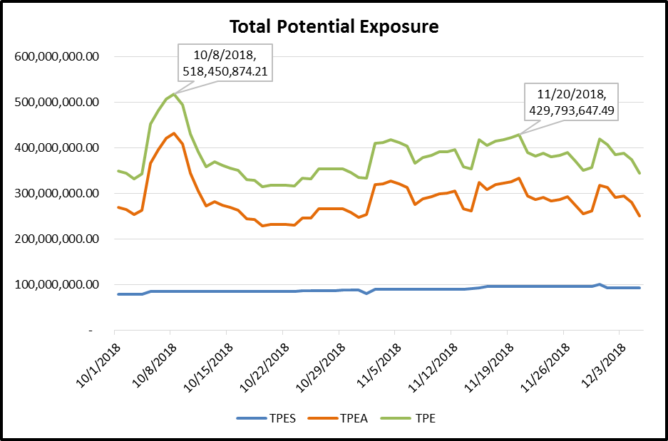
Credit Exposure Update

Slide 5
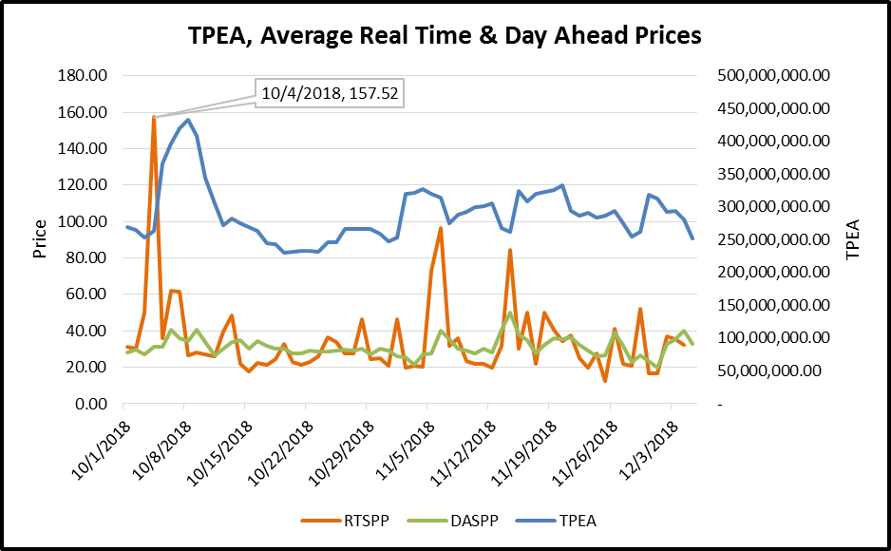
Credit Exposure Update

Slide 6
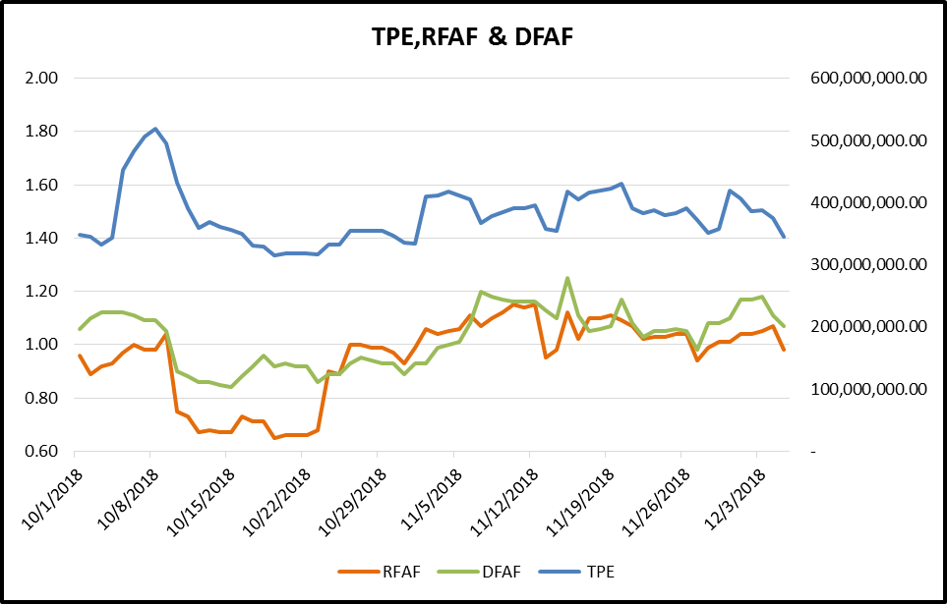
Credit Exposure Update

Slide 7
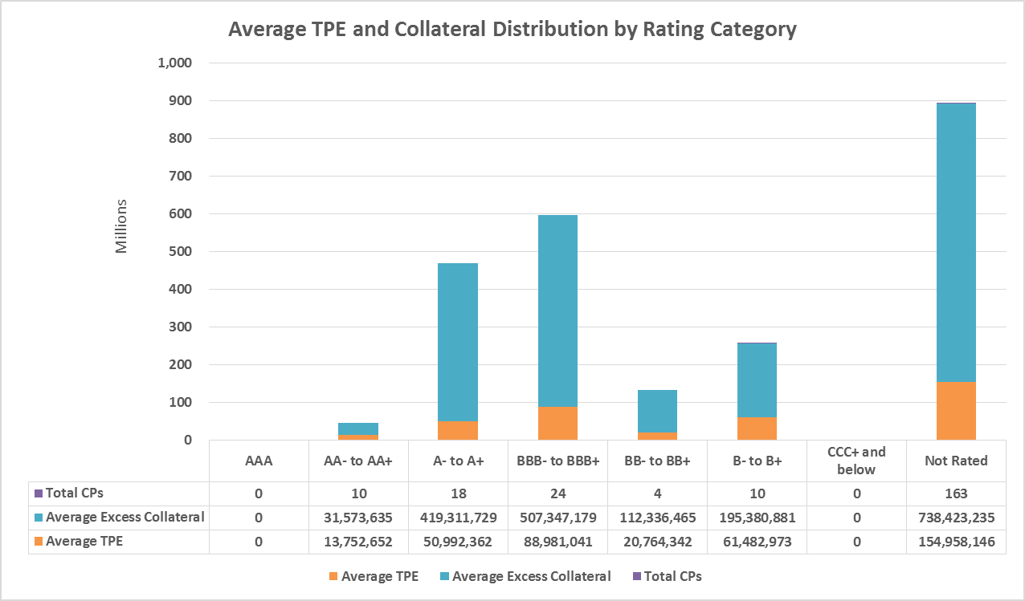
Credit Exposure Update

Slide 8
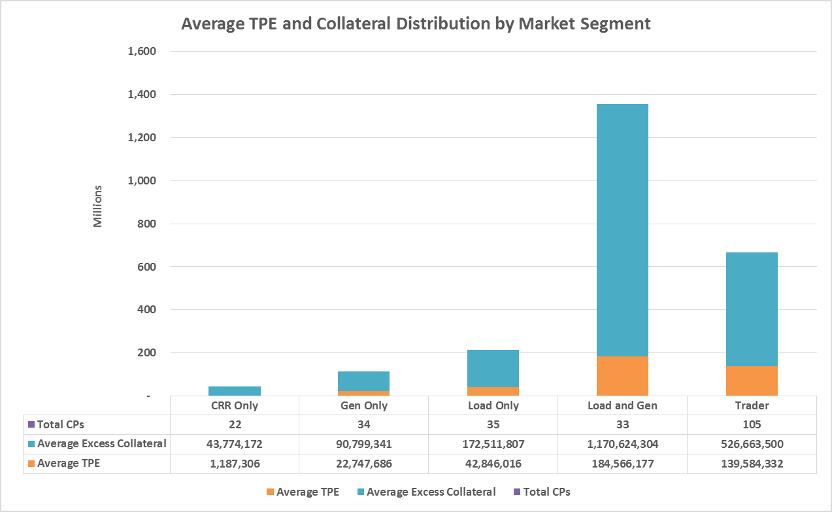
Credit Exposure Update

Slide 9
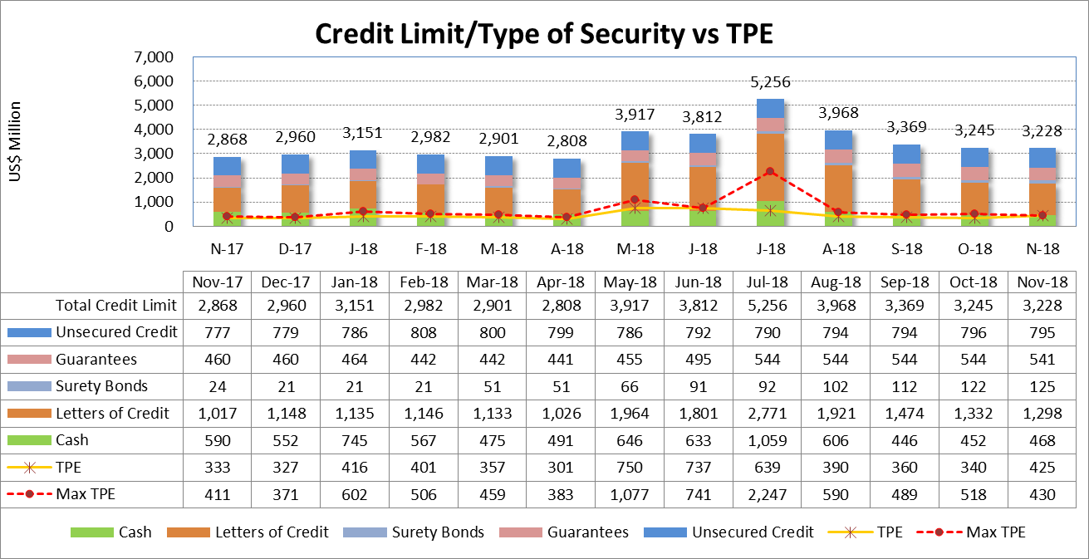
Credit Exposure Update

Slide 10
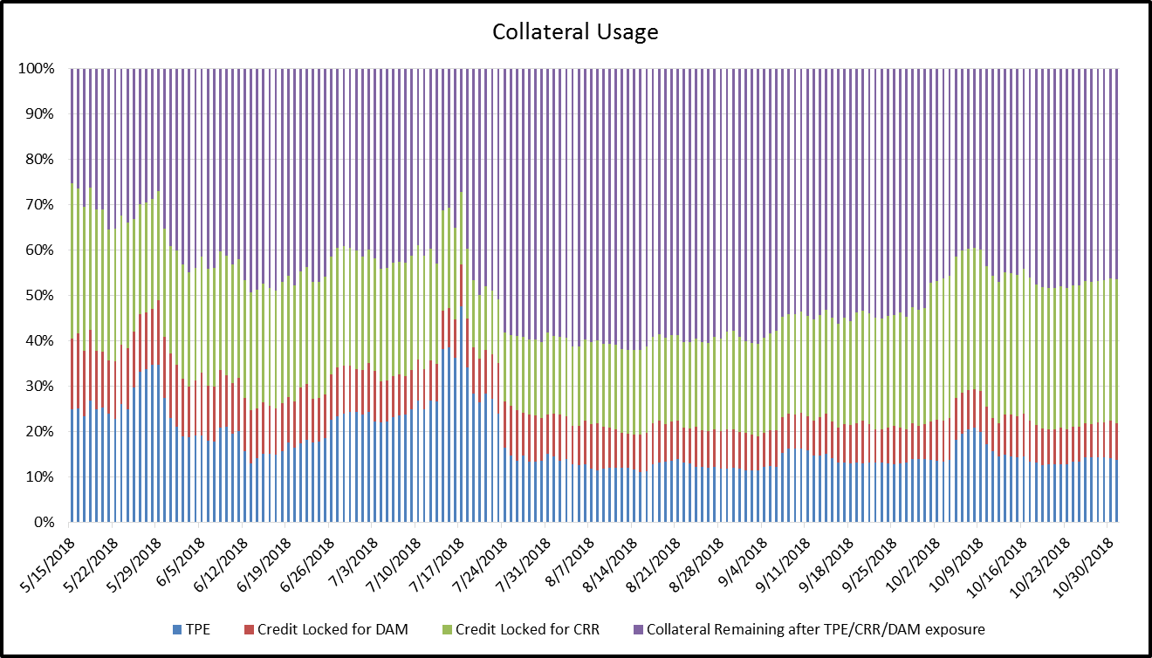
Credit Exposure Update

Slide 11
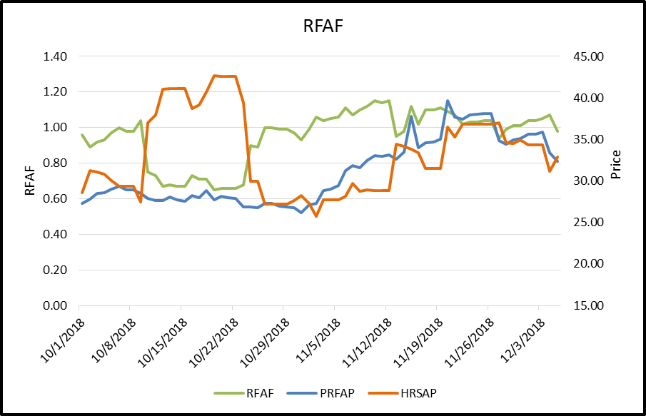
Credit Exposure Update
Real-Time Forward Adjustment Factor (RFAF)
RFAF is calculated using 21 days of ICE future prices and 14 days of ERCOT Real Time Settled Prices for HB_NORTH settlement point

Slide 12
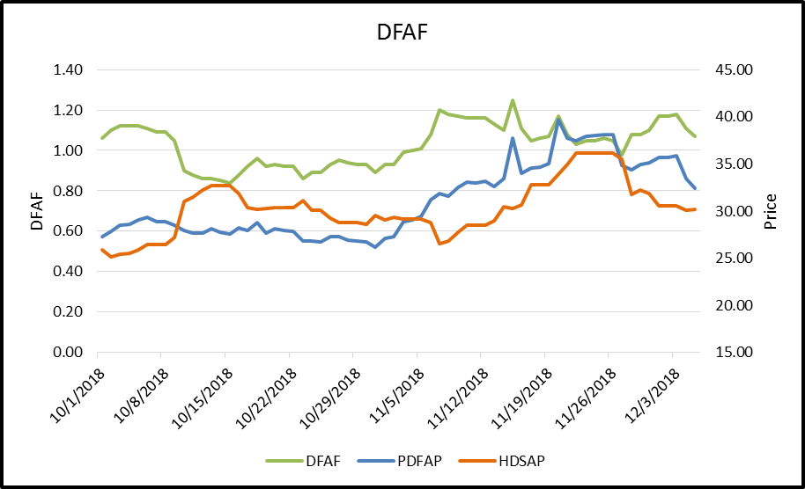
Credit Exposure Update
Day-Ahead Forward Adjustment Factor (DFAF)
DFAF is calculated using 21 days of ICE future prices and 7 days of ERCOT Day Ahead Settled Prices for HB_NORTH settlement point

Slide 13
Credit Exposure Update
Appendix

Slide 14
Credit Exposure Update
Summary statistics by Market Segment

Slide 15
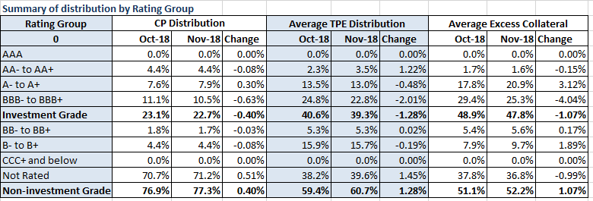
Credit Exposure Update
Summary statistics by Rating Group

Slide 16
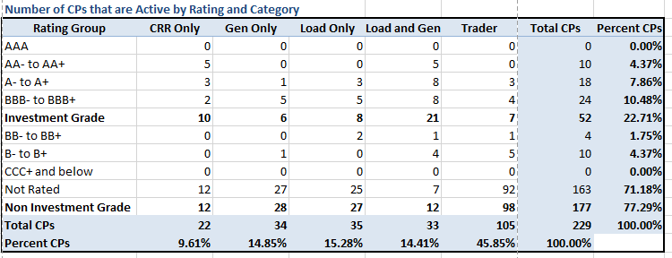
Credit Exposure Update
Active Counter-Parties distribution by rating and category- Nov 2018

Slide 17
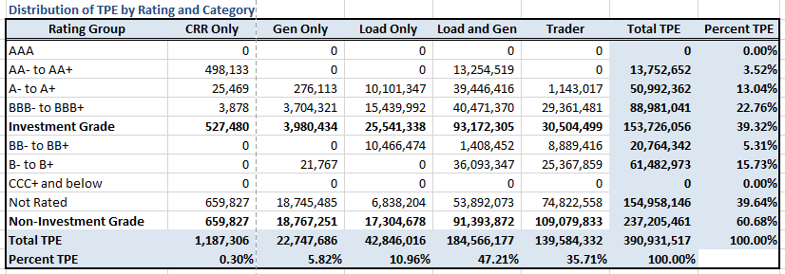
Credit Exposure Update
Average Total Potential Exposure distribution-Nov 2018

Slide 18
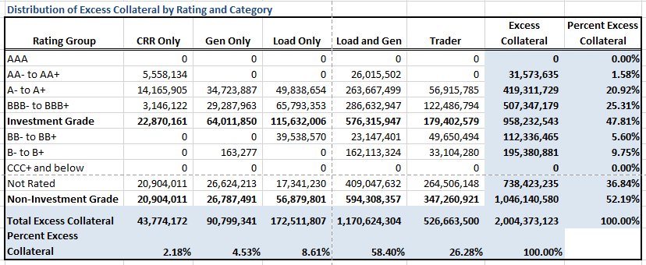
Credit Exposure Update
Average Excess Collateral distribution^{*-}Nov 2018
*Excess Collateral is a voluntary disposition by Counterparty

Slide 19
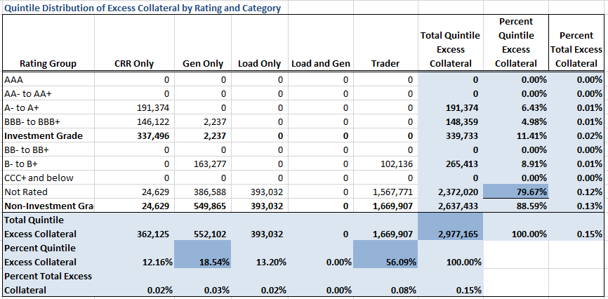
Credit Exposure Update
Distribution in the Bottom Quintile of Excess Collateral^{*-}Nov 2018
*Excess Collateral is a voluntary disposition by Counterparty

Slide 20
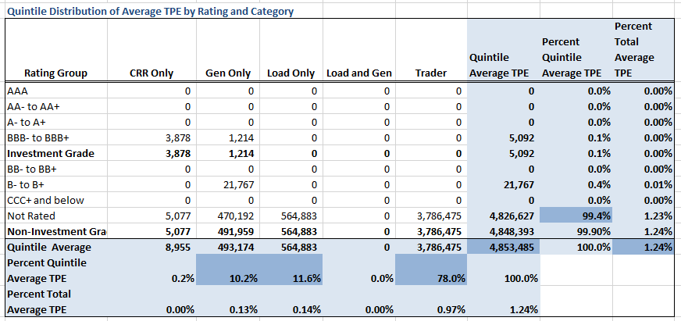
Credit Exposure Update
Distribution of TPE in the Bottom Quintile of Excess Collateral^{*-}Nov 2018
*Excess Collateral is a voluntary disposition by Counterparty

Slide 21
Credit Exposure Update
Questions

