Slide 1
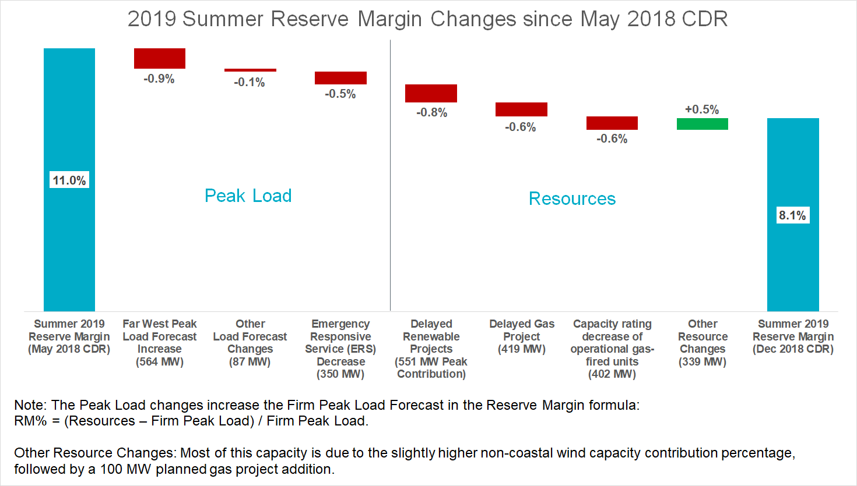
Waterfall Chart

