Slide 1
Texas Data Transport & MarkeTrak Systems
(TDTMS)
Update to RMS
December 4, 2018
Sam Pak (ONCOR) - Chair

Slide 2
November Meeting Summary
MarkeTrak Performance met all SLA targets for Oct 2018
Reviewed ERCOT’s 3rd Qtr 2018 Performance Measures (PUC 36141)
  EDI Transaction Performance Metrics were at 100%:
    Switches
    Standard Move-In
    Same Day Move-In
    Move-Out
    ESI ID Create/Maintain

Slide 3
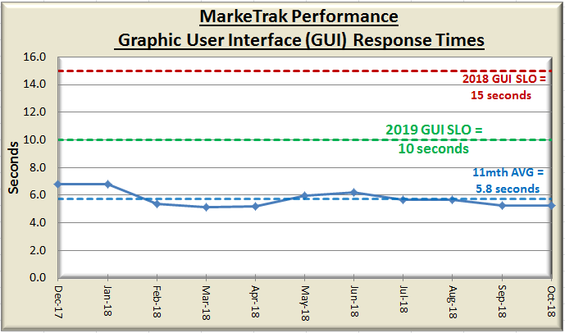
November Meeting Summary Cont’
Endorsement of 2019 Retail Service Level Agreement:
  Updated 2019 release dates
  Minor language revisions to Market Notice reference
  Removal of obsolete COPS Market Guide (ListServ) Appendix
  Revision of 2019 GUI SLO to 10 seconds

Slide 4
Next TDTMS Meeting
Next meeting information:
TDTMS Meeting
Wednesday, January 16, 2018
9:30am
@ ERCOT MET Center
Tentative Agenda:
2019 Leadership Elections
ERCOT System Instances & MarkeTrak Monthly Performance Review
MT Subtype Template & Data Analysis
ERCOT IT Roadmap Update
Review and finalize 2018 & 2019 Goals
TDTMS meeting website:
http://ercot.com/committees/board/tac/rms/tdtms/index.html

Slide 5


