Slide 1
Load Distribution Factors Methodology
Jian Chen
Market Analysis and Validation
CMWG
Dec. 3rd, 2018

Slide 2
Overview
Per Protocol Section 4.5.1, ERCOT shall generate and maintain the appropriate Load Distribution Factors (LDF) libraries for use in the DAM and CRR Auctions. Current LDF methodology was revised and approved by TAC last October.
ERCOT updates the LDF libraries by maintaining the existing LDF sets and generating new LDF sets, normally when system wide load patterns change due to weather change.
ERCOT may also adjust the existing LDF data in the MMS to address significant changes in the load patterns.

Slide 3
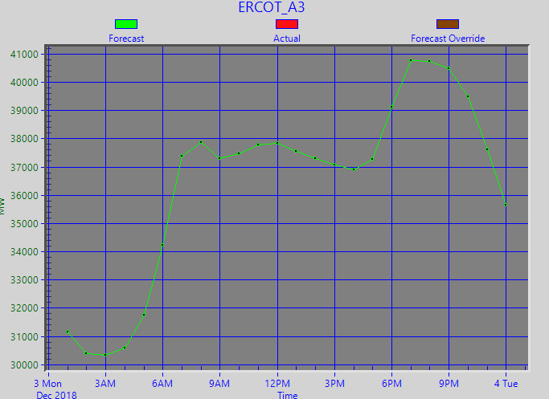
Generating Load Distribution Factors
In order to generate new LDFs, ERCOT shall select one proxy day for weekday and another proxy day for weekend in recent days. The proxy days were selected to represent the possible load patterns in the short future, using the following information as references:
Mid-term load forecast (next 7 days)
Historical load data from last year

Slide 4
LDF for loads Associated with Private Use Network (PUN)
ERCOT uses a different methodology to generate LDFs for Private Use Network (PUN) loads.
ERCOT uses the past 4-week average of net power consumption at the PUN as the initial load distribution at the PUN level, and then distribute the net consumption to each induvial loads inside the PUN site.
Related analysis was presented during the March QMWG meeting.

Slide 5
Load Distribution Factor Validation
During the validation, ERCOT may determine that the initial LDF values of certain loads are not a good representation of their load profile. ERCOT may modify the LDF for those loads by using techniques such as:
Set the value to zero
Use the daily average value for all hours
Interpolate the value for questionable hours based on data from the adjacent hours
Retrieve data from another proxy day
The LDF of the following loads are also set to zero:
Self-served loads
Negative loads
Wholesale storage loads
DC-tie loads

Slide 6
Maintaining Load Distribution Factors
ERCOT may adjust the existing LDF data in the MMS to address significant changes in the load patterns, due to the following reasons:
Load model changes with a database load
Significant PUN net consumption changes due to its Resource outages
Significant Block Load Transfer (BLT) of load into the ERCOT system.

