Slide 1
Intra-Hour Wind Forecast Accuracy Updates (Dec. 2018)
QMWG
Operations Analysis
12/3/2018

Slide 2
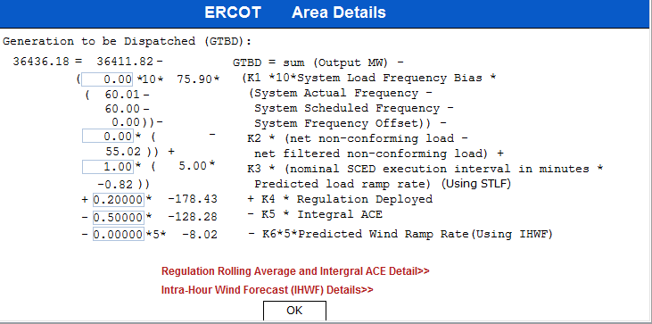
Current Status with SCR 795 Addition of Intra-Hour Wind Forecast to GTBD
Market Notice sent on November 20, 2018
ERCOT will activate SCR 795 on December 4 at 10 AM

