Slide 1
NPRR872 Modifying the SASM Shadow Price Cap
QMWG
December 3rd, 2018

Slide 2
Introduction
NPRR872 proposes changes to the shadow price caps (demand curves) in SASM for all AS products
At this time, ERCOT is not comfortable with any change to the shadow price cap for Regulation or RRS
  Very efficient in procurement of Regulation—routinely exhaust
  The risk associated with missing RRS depends on actual and projected Real-Time conditions, especially PRC
This presentation discusses thoughts on possible changes to the shadow price cap for Non-Spin

Slide 3
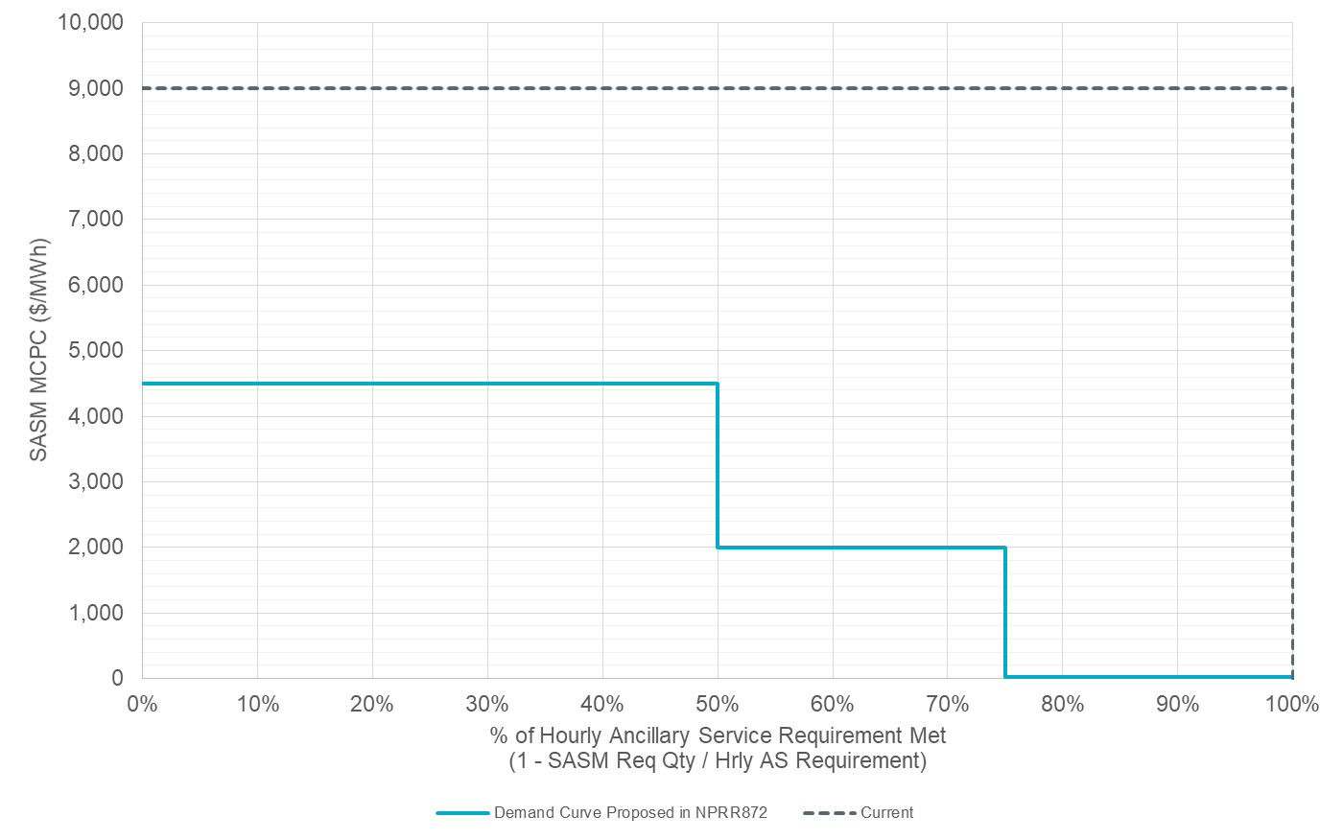
Demand Curve Based on NPRR872 Proposal
VOLL = $9,000/MWh
Demand Curve Proposed in NPRR872:
>=75%: min(VOLL/2, 5*DAM)
>50% & <75%: min(VOLL/2,
max(2000,5*DAM))
<=50%: VOLL/2
Offers below and to the left of Demand Curve line would clear.
Offers above and to the right of Demand Curve line would not clear unless 5 x DAM MCPC > SASM offer
VOLL/2
Min(VOLL/2, 5*DAM MCPC)
DAM MCPC typically ~$5/MWh
Min(VOLL/2, Max($2,000/MWh,5*DAM MCPC))

Slide 4
Shadow Price Caps and Historical SASMs
The following slide plots historical SASM MCPCs for Non-spin versus the percentage of the hourly Non-spin requirement met prior to the SASM
  The horizontal axis is (100% – SASM Requested Quantity / Hourly Non-spin Requirement)
  This format facilitates comparison to the demand curves
The plot shows red dots where the SASM MCPC was greater than 5x the DAM MCPC, indicating that some or all of the MW that cleared in that SASM would not have cleared if there had been a 5x DAM MCPC shadow price cap
  Blue dots would not have been affected by the proposed shadow price cap

Slide 5
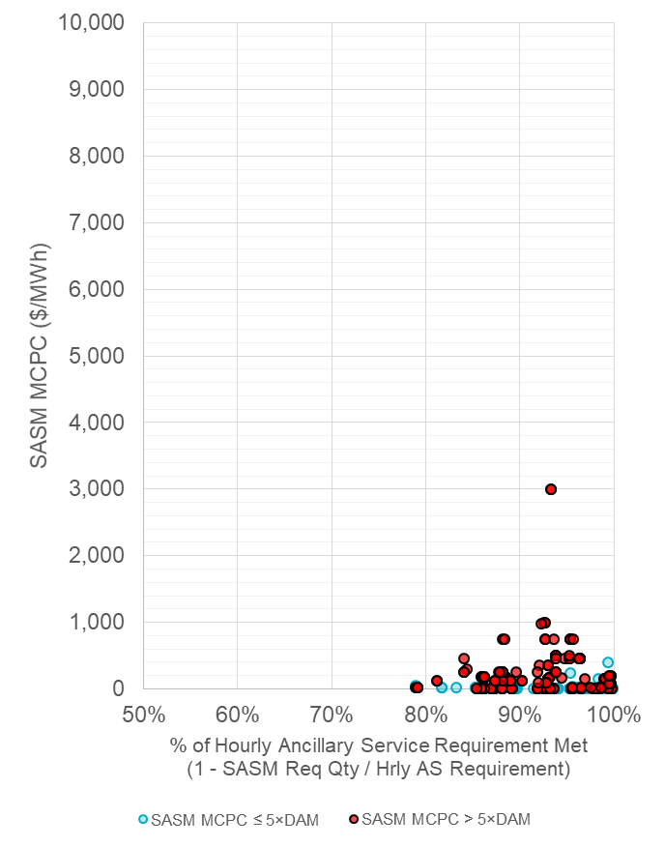
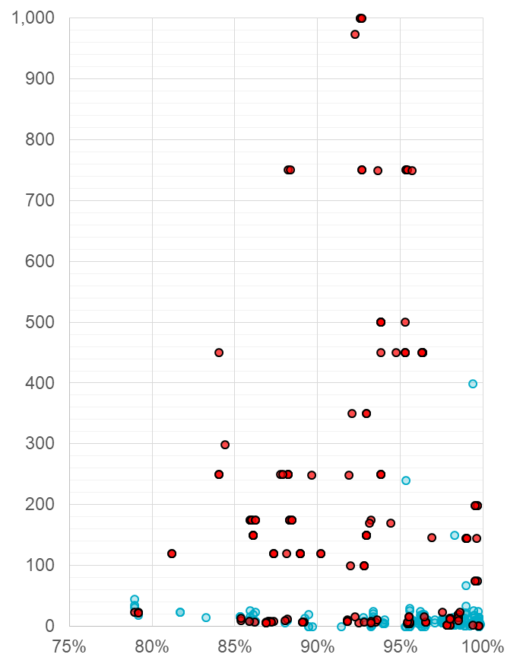
Historical SASM Non-Spin MCPC Data
Demand Curve Proposed in NPRR872:
>=75%: min(VOLL/2, 5*DAM)
>50% & <75%: min(VOLL/2,
max(2000,5*DAM))
<=50%: VOLL/2

Slide 6
Observations from Historical Data
For all of the historical SASMs, the Non-Spin requirement was met by 75% or more prior to the SASM
In many cases, a substantial fraction of the Non-Spin requirement might not have been procured in the SASM with a 5x DAM demand curve
5x the DAM MCPC can be well below $10/MWh, suggesting a floor on the demand curve in this region
  The idea of a floor was raised by others in a previous meeting
  A floor could also be relevant in the extremely rare case where there are not DAM MCPCs for the Operating Day

Slide 7
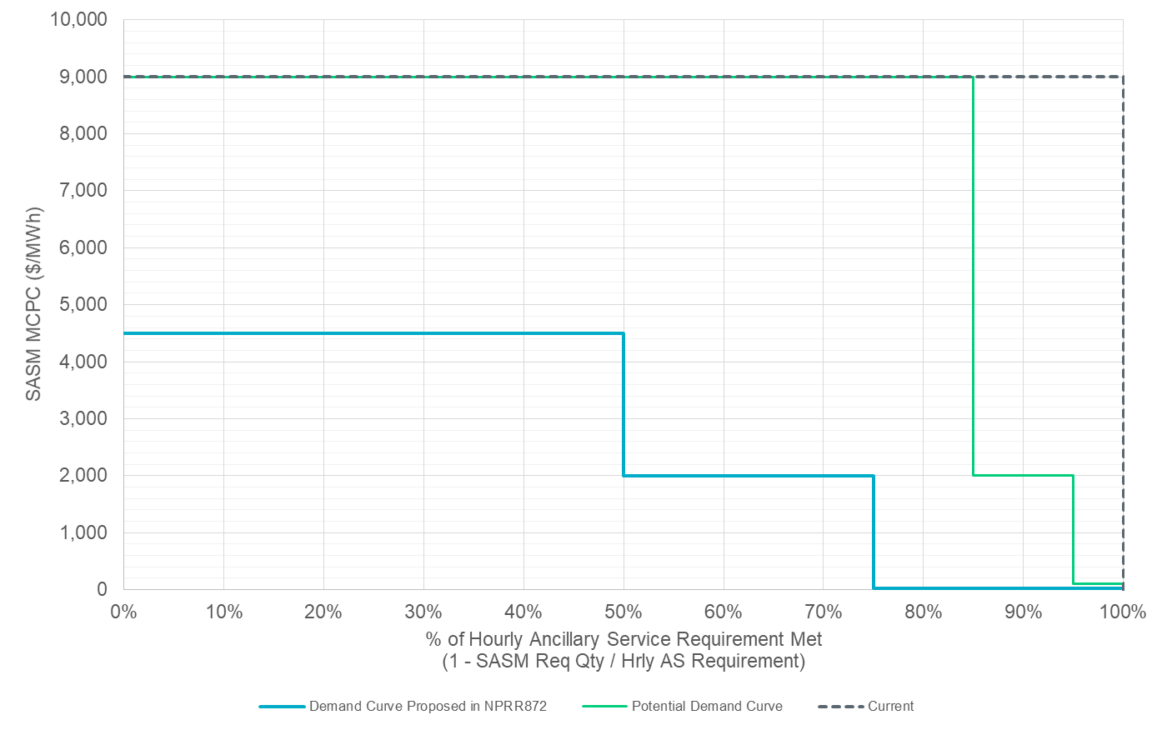
Potential Demand Curve
VOLL = $9,000/MWh
Demand Curve Proposed in NPRR872:
>=75%: min(VOLL/2, 5*DAM)
>50% & <75%: min(VOLL/2,
max(2000,5*DAM))
<=50%: VOLL/2
Min(VOLL, Max($2,000/MWh,5*DAM MCPC))
Min(VOLL, Max($100/MWh, 5*DAM MCPC))

Slide 8
Pricing Outcomes with Insufficient Offers
If there are insufficient offers to fulfil the SASM requirement, the current SASM algorithm effectively sets the MCPC at the highest cleared offer rather than using a demand curve
  SASM was implemented using the same algorithm as DAM
NPRR872 changes this to instead set the MCPC using a demand curve
Pricing outcomes will be different under the two methods and use of a demand curve may increase the MCPC in some cases, relative to the current implementation

Slide 9
Other Important Issues
NPRR872 does not remove a QSE’s obligation to transfer the AS responsibility to another Resource within its portfolio if it is able to do so
NPRR872 does not define a SASM demand curve in situations where there is no DAM published

Slide 10
Questions?
Thank you!

