Slide 1
Southern Cross Transmission (SCT) DC Project Study– Status Update
ERCOT Transmission Planning
November 27, 2018

Slide 2
Overview
The objective of this SCT interconnection study is to identify transmission facility upgrades that will be required to meet the ERCOT and NERC Transmission Planning reliability standards and to manage congestion resulting from power flows over the Southern Cross DC project.
Presented Scope at April RPG: http://www.ercot.com/calendar/2018/4/24/138683-RPG
Scope Revision
  Contingencies for Study Region: will focus on the initial condition as normal system without prior single contingency
    Normal system condition (P0)
    N-1 conditions (P1, P2-1, P7)

Slide 3
SCT Planning Studies Flow Assumptions
Directive 6 Steady State | Summer Peak | 350 MW Import
 | HWLL | 2100 MW Export
Directive 6 Dynamic Stability | Summer Peak | 2000 MW Import/ 2100 MW Export
 | HWLL | 2000 MW Import/ 2100 MW Export
The above transfer level assumptions are based on the “Southern Cross Planning Study Flow Assumptions” discussed at the Jan. 2018 PLWG: http://www.ercot.com/content/wcm/key_documents_lists/140232/ERCOT-Southern_Cross_Flow_Assumptions.pptx
Based on the information provided by Southern Cross
  Southern Cross HVDC will employ Line Commutated Converter (LCC) technology
  Capacitors at HVDC facility are modeled to maintain the HVDC transfer

Slide 4
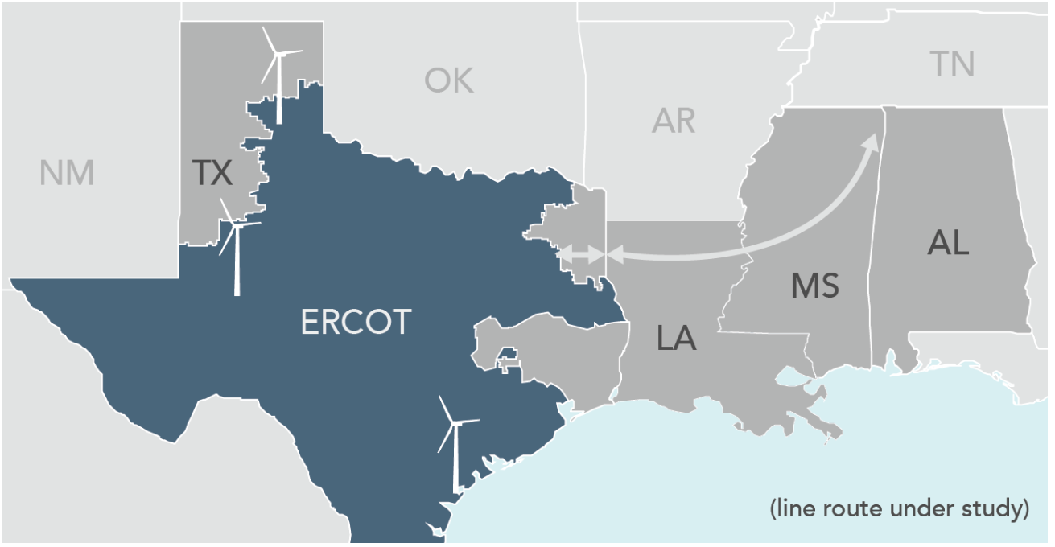
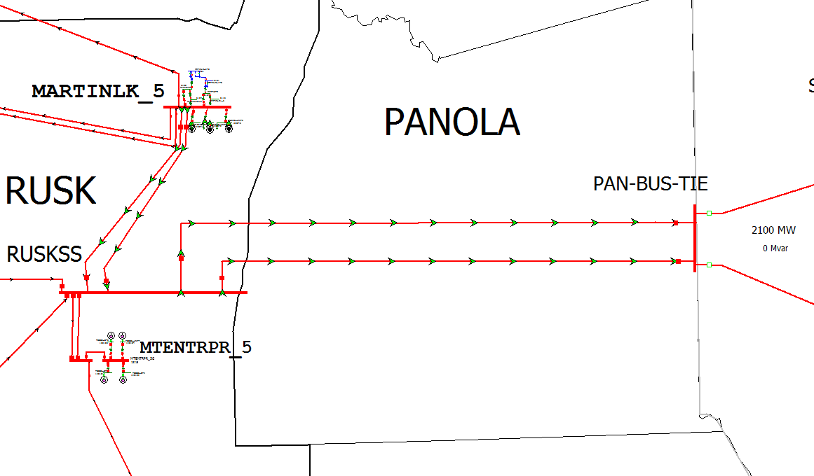
Southern Cross Transmission - Sketched

Slide 5
Preliminary Study Base Cases Steady-State Results
Study base case for 350 MW import
  Seed case: 2018RTP 17SSWG_2021_SUM_NNC_10012018
Study base case for 2,100 MW export
  Seed case: 2018RTP 17SSWG_2021_MIN_U1_Final_10122017_Start_Case_v75___HWLL_v04
( https://mis.ercot.com/pps/tibco/mis/Pages/Reports/PlanningReports#S )
Violation Category | 350 MW Import | 2,100 MW Export
Voltage Collapse | No Violations | Base Case Voltage Collapse
High Voltage | No Violations | Base Case Voltage Collapse
Low Voltage | No Violations | Base Case Voltage Collapse
Thermal Overloads | No Violations | Base Case Voltage Collapse

Slide 6
Preliminary Steady-State Transfer Analysis Results
A preliminary transfer analysis was conducted to identify the SCT import/export limit
  Without transmission upgrades
  Criteria: thermal violations and voltage collapse
Import:
  No thermal violations for 350 MW import
  Violations were observed if the import exceeds 522 MW
  Numerous violations were observed for import up to 2,100 MW
Import Level (MW) | Limiting Condition(1) | Contingency
350 | None | 0
522 | Elkton - Tyler Switch 138 kV | Forney Switch - Elkton Tri Corner - Tyler Grande (P7)
(1) Based on 2% Power Transfer Distribution Factor (PTDF) and Outage Transfer Distribution Factor (OTDF) cutoffs
Notes:
Elkton to Tyler Southwest 138

Slide 7
Preliminary Steady-State Transfer Analysis Results
Export:
  No thermal violations up to 1,280 MW export
  Voltage collapse was observed if the import exceeds 1,300 MW
Export Level (MW) | Limiting Condition(1) | Contingency
1,289 | Voltage Collapse(2) | (P7)
Based on 2% Power Transfer Distribution Factor (PTDF) and Outage Transfer Distribution Factor (OTDF) cutoffs
Voltage Collapse is assumed at 0.80 p.u. voltage

Slide 8
Dynamic Stability Analysis
Cases:
  Developed flat start from latest 2020 SP DWG Case
  Import 2,000 MW: Flat start completed
  Export 2,100 MW: Flat start completed
  Developed flat start from latest 2021 HWLL DWG Case
  Import 2,000 MW: Flat start completed
  Export 2,100 MW: Flat start completed

Slide 9
Next Steps, Deliverables
ERCOT will continue performing steady-state and dynamic stability analysis for the studied import/export transfer levels and identify potential system upgrades
A report documenting key findings with discussion of constraints, limitations, and potential transmission upgrade options related to SCT that are required to meet the NERC TPL and ERCOT Planning Criteria.
ERCOT will file the report at the PUCT in Project 46304
Directive 6 Steady State | Summer Peak | 350 MW Import
 | HWLL | 2100 MW Export
Directive 6 Dynamic Stability | Summer Peak | 2000 MW Import / 2100 MW Export
 | HWLL | 2000 MW Import / 2100 MW Export

Slide 10
QUESTIONS?
Please submit comments to: ben.richardson@ercot.com

