Slide 1
Proposed Change to the Boundary Percentage for Far West
Calvin Opheim
RPG
11/27/2018

Slide 2
Agenda
Review Planning Guide 3.1.7
Far West Load Forecast Chronology and Observations
ERCOT Recommendation

Slide 3
Transmission Planning Load Forecast
3.1.7 Steady State Transmission Planning Load Forecast
(a) ERCOT will compare the ERCOT 90/10 Load forecast with the summed SSWG bus-level Load forecast for each Weather Zone.
(b) If the ERCOT 90/10 Load forecast is higher, ERCOT will use this forecast for the Weather Zone.
(c) If the SSWG Load forecast is higher than or equal to the ERCOT 90/10 Load forecast, but below the ERCOT 90/10 Load forecast plus a boundary threshold determined in accordance with paragraph (f) below, ERCOT will use the SSWG Load forecast for the Weather Zone.
(d) If the SSWG Load forecast is higher than or equal to the ERCOT 90/10 Load forecast plus the boundary threshold, ERCOT will use the ERCOT 90/10 Load forecast plus the boundary threshold for the Weather Zone.

Slide 4
Transmission Planning Load Forecast
3.1.7 Steady State Transmission Planning Load Forecast (continued)
(e) If a TSP(s) believes that the ERCOT 90/10 Load forecast plus the boundary threshold does not adequately represent the Weather Zone or an area within the Weather Zone, the TSP(s) may present ERCOT with additional information to justify using a higher Load forecast, including the SSWG Load forecast, for that Weather Zone. ERCOT, in its sole discretion, may choose to use a higher Load forecast than indicated in paragraph (d) above if it reasonably determines that the Load forecast indicated in paragraph (d) above does not adequately represent the Weather Zone or an area within the Weather Zone. If ERCOT uses a Load forecast higher than the ERCOT 90/10 Load forecast plus the boundary threshold in the evaluation of a Tier 1 project, ERCOT must explain and document the basis for that choice, using aggregated information as needed to shield Protected Information, in its independent review.
(f) ERCOT-proposed revisions to the boundary threshold used to implement the requirements of this section will be recommended by the Technical Advisory Committee (TAC) and approved by the ERCOT Board.

Slide 5
Load Forecast Review Process
Justified?
RTP Load Level
RTP Load Level
TSP Load Forecast
5% Bound
5% Bound
TSP Load Forecast
ERCOT 90th percentile Forecast
ERCOT 90th percentile Forecast
ERCOT 90th percentile Forecast
TSP Load Forecast
Regional Transmission Plan (RTP)

Slide 6
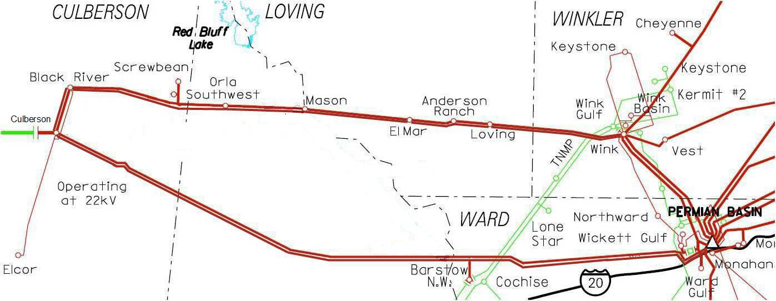
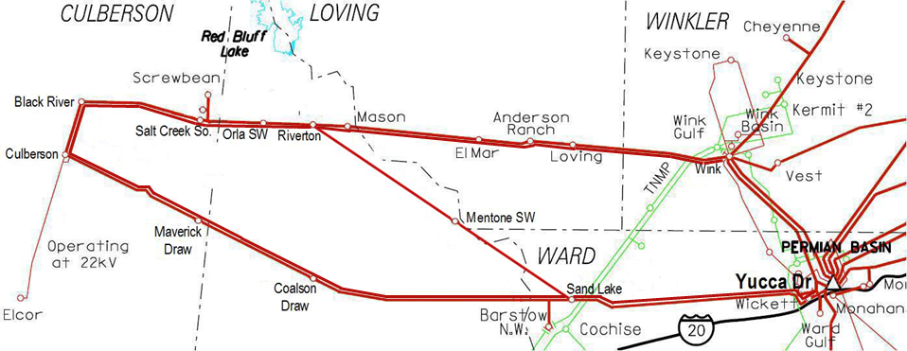
Culberson Loop Projected Load Growth
2018 | 2019 | 2020 | 2021 | 2022
484 MW | 647 MW | 734 MW | 762 MW | 790 MW
Notes:
- It should be noted the projections will vary from station to station by year, these are aggregate totals.
- More loads have been added since the date of the study
- The 2018 total is already greater than Oncor’s original FWTP submittal (425 MW) for 2021

Slide 7
Culberson Loop Projected Load Growth
 | 2018 | 2019 | 2020 | 2021 | 2022
Confirmed | 580 MW | 775 MW | 893 MW | 964 MW | 1,013 MW
Potential | 670 MW | 984 MW | 1,163 MW | 1,292 MW | 1,340 MW

Slide 8
Transmission Planning Load Forecast
Far West Observations
There have been challenges in keeping up with the load growth in Far West
The size of the load additions is significant when compared to the overall load for the Far West zone
Far West Forecast Changes
The 2019 ERCOT load forecast includes a 200 MW adjustment in order to try and keep up with the rapid growth in Far West (see slide 10)
The forecast expects ~500 MW of increase in 2019 as compared to the 2018 actual summer peak
This is consistent with the ~500 MW increase in 2018 as compared to 2017

Slide 9
Far West Load Forecast Comparison

Slide 10
Far West Load Forecast Comparison

Slide 11
Far West Load Forecast Comparison

Slide 12
Transmission Planning Load Forecast
Boundary Percentage Increase to 7.5%
There have been challenges in keeping up with the load growth in Far West
The size of the load additions is significant when compared to the overall load for the Far West zone
Increasing the boundary to 7.5% would support 500 MW of growth per year for 2019 through 2021 (see slide 11) without requiring supporting documentation

Slide 13
ERCOT Recommendation
3.1.7 Steady State Transmission Planning Load Forecast (continued)
(f) ERCOT-proposed revisions to the boundary threshold used to implement the requirements of this section will be recommended by the Technical Advisory Committee (TAC) and approved by the ERCOT Board.
ERCOT recommends that the boundary threshold be increased to 7.5% for the Far West weather zone

Slide 14
Questions?

