Slide 1
SMT Market Update
Oct 2018

Slide 2
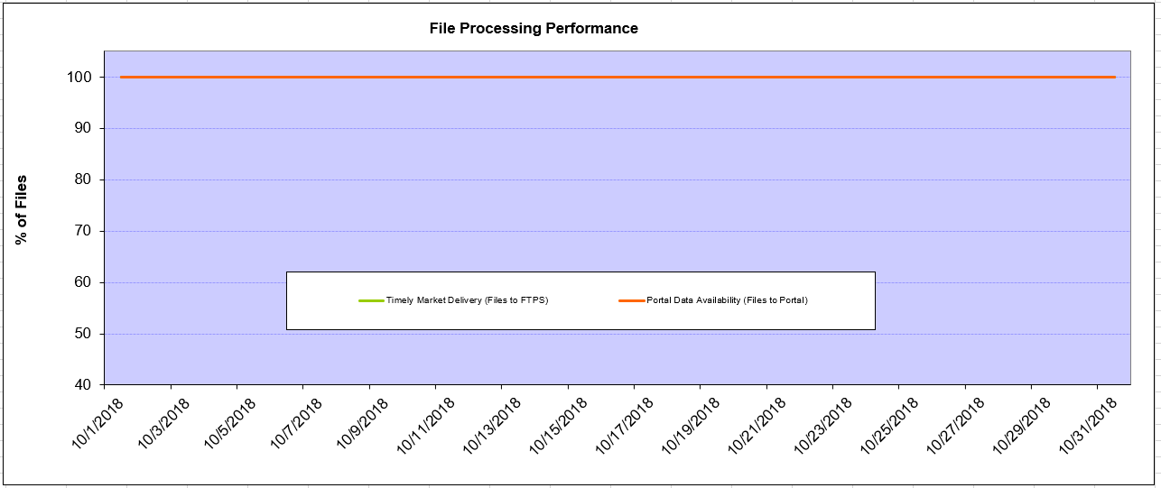
Monthly SMT Data Timelines End to End File Processing Completeness – Oct 2018
% Timely Market Delivery - % of files posted to market (FTPS) by 11:00pm out of # of files received by SMT by 11:00pm.
% Portal Data Availability - % of files loaded to the database for data availability on portal by 6:00am next day for the files received by 11:00pm
A LSE file includes usage data for up to 50,000 ESIIDs.
2

Slide 3
SMT API and FTPS Services Availability – Oct 2018
The service availability is measured as a percentage of number of minutes the service was available out of the total number of minutes in a month, excluding planned outages.
Notes:
3

Slide 4
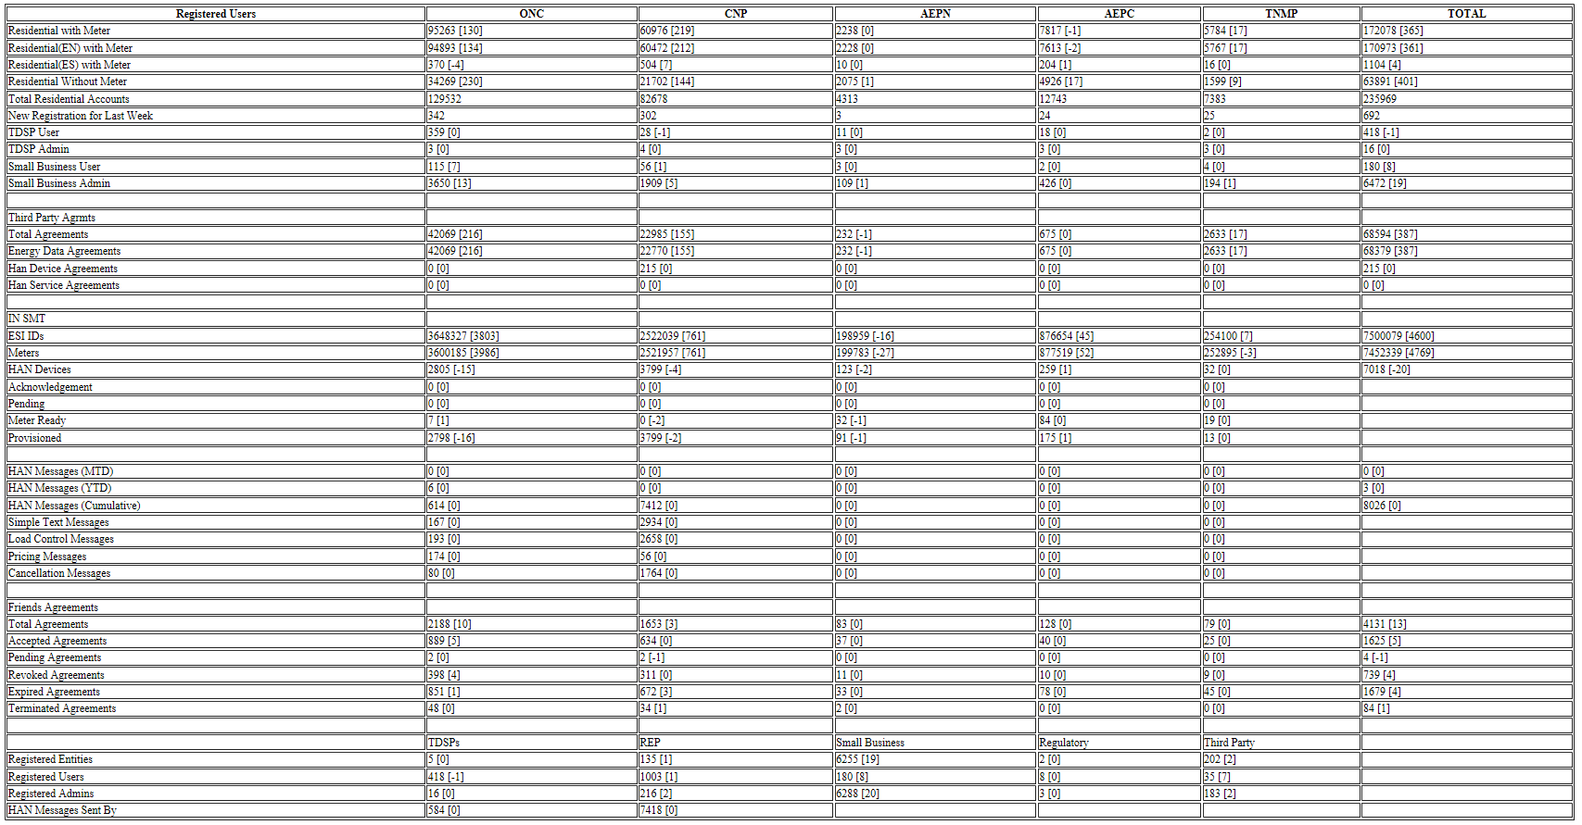
SMT Number of Accounts by Type – Oct 2018

Slide 5
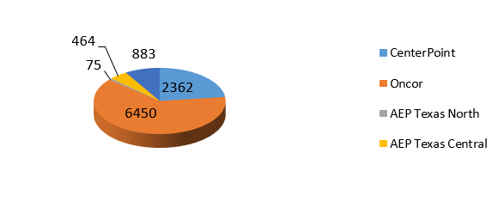
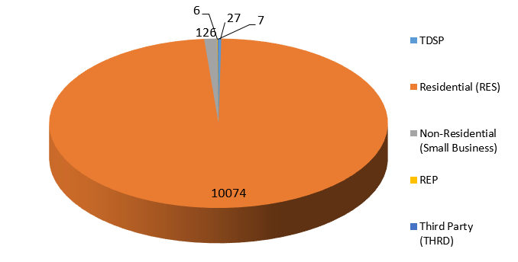
SMT ODR Details – Oct 2018
Total ODR Requests TDSP wise statistics:
Total ODR Requests User type statistics:

