Slide 1
Must-Run Alternative (MRA) Dispatch and Settlement Basis
Ino González
ERCOT
MRA Workshop
Nov 16, 20186

Slide 2
Dispatch Instructions

Slide 3
MRA – Dispatch Instructions
  MRA QSE must be able to receive Verbal Dispatch Instructions (VDI)
      MRA Generation Resources will be issued a VDI not a RUC Instruction
      Other MRA resources will be issued a VDI

Slide 4
MRA Settlements
Standby
Deployment Event
Variable
Contributed Capital Expenditures
Unexcused Misconduct
Service Charge

Slide 5
Standby Payment

Slide 6

Standby - Generation Resource
  Payment _{hr} = Price * CCAP * GRCRF * ARF
  Where,
  GRCRF _{m} = (Testing Capacity + Testing Capacity Adjustment) / CCAP
  And,
  Price ($/MW) = Accepted Offer price per hour per month
  CCAP (MW) = Contract Capacity per hour per month
    GRCRF (MW) = Generation Resource Capacity Reduction Factor
    ARF = Availability Reduction Factor per month¹
    ¹See slide 8 for calculation

Slide 7

Standby - Other Generation & Demand Response
  Payment _{hr} = Price * CCAP * EPRF * ARF
  Where,
  Price ($/MW) = Accepted Offer price per hour per month
  ARF = Availability Reduction Factor per month
    EPRF = Event Performance Reduction Factor
    Availability of EPRF
    If not available for month ➔ Use most recent value from prior month
    If not available for previous month ➔ Set to 1 for current month

Slide 8
ARF – All Generation and Demand Response
  Availability Reduction Factor (ARF)
  For an MRA register as a Generation Resource
  CMAF _{m} = (MAH) / MH
  Where,
  CMAF = Calculated monthly availability factor
  MAH = Monthly available hours for the month, based on both Availability Plan and telemetry
  MH = Monthly contracted hours in month
  For an MRA not register as a Generation Resource
CMAF _{m} = Described under MRA Availability Measurement and Verification

Slide 9
ARF – (cont’d)
  For initial settlement
  ARF = 1
  For all other resettlements
  If CMAF _{m} ≥ 95% * TA _{m} ➔ ARF = 1
  If 85% * TA _{m} ≤ CMAF _{m} < 95% * TA _{m} ➔ ARF = CMAF _{m}
  If CMAF _{m} < 85% * TA _{m} ➔ ARF = (CMAF _{m})^2
  Where,
  CMAF = Calculated monthly availability factor
  TA = Target availability for month

Slide 10
Deployment Event Payment

Slide 11
Deployment Event – Generation Resources
  Payment _{hour} = Max { ED Price , (FIP+FA)* PSUFQ } * FLAG / H
  Where,
  ED Price ($/Deployment Event) = Accepted Deployment Offer price per month
    FIP ($/MMBtu) = Fuel Index Price
    FA ($/MMBtu) = Fuel Adder
    PSUFQ (MMBtu) = Proxy startup fuel quantity
    FLAG = Deployment flag indicator
    H (hr) = Instructed hours

Slide 12


Deployment Event – Other Generation or Demand Response
  Payment _{hr} = Max { ED Price, (FIP+FA)* PSUFQ } * EPRF/ H
  Where,
  ED Price ($/MW) = Accepted Deployment Offer price per month
    FIP ($/MMBtu) = Fuel Index Price
    FA ($/MMBtu) = Fuel Adder
    PSUFQ (MMBtu) = Proxy startup fuel quantity
    EPRF= Deployment Event Performance Reduction Factor
    H (hr) = Instructed hours

Slide 13


Slide 14
Variable Payment for a Generation Resource¹
  a. Contracted Hours with Deployment Instructions
  Payment _{hr} = { GRCVP - RTREV }
  Where,
  GRCVP ($) = Generation Resource calculated variable payment for hour
    RTREV ($) = Existing Real Time revenues for a Generation Resource
Objective: Payment _{hr} = Calculated Variable Payment _{hr} (GRCVP _{hr} )
¹ For hours outside of contract period, MRA GRs shall be settled as other Generation Resources

Slide 15
Variable Payment for a Generation Resource – (cont’d)
  a. Contracted Hours with Deployment Instructions
  Payment _{hr} = { GRCVP - RTREV }
  And,
  GRCVP _{hr} = Max { VPRICE _{hr} , (FIP+FA )* PHR } *Min (RTMG, CCAP/4)
  Where,
  VPRICE ($/MWh) = Accepted Offer variable price per month
  PHR(MMBtu/MWh) = Proxy average heat rate per month
  RTMG(MWh) = Real Time metered generation
  CCAP(MW) = Contracted capacity per hour per month

Slide 16
Variable Payment for a Generation Resource – (cont’d)
  b. Contracted Hours without Deployment Instructions
  Payment _{hr} = Min { GRCVP, RTREV } – RTREV
Objective: Payment _{hr} = MIN { Variable Payment _{hr} , RT Revenues _{hr} }

Slide 17
Variable Payment for Other Generation
  a. Contracted Hours with Deployment Instructions
  Payment _{hr} = { CVP - CRTREV }
  Where,
  CVP ($) = Calculated variable payment for hour
    CRTREV ($) = Calculated Real Time revenues for hour
Objective: Payment _{hr} = Variable Payment _{hr} (CVP _{hr} )

Slide 18
Variable Payment for Other Generation – (cont’d)
  a. Contracted Hours with Deployment Instructions
  Payment _{hr} = { CVP - CRTREV }
  And,
  CVP _{hr} = [Max { VPRICE _{hr} , (FIP+FA )* PHR } * RTVQ]
  CRTREV _{hr} = [Max(0, Min { RTVQ , CCAP/4 } * RTSPP]
  RTVQ = MRAIPF * CCAP/4
  Where,
  RTVQ (MWh) = Real Time variable quantity for the interval
    MRAIPF (none) = MRA Interval Performance Factor
    CCAP (MW) = Contract capacity per hour per month
    PHR (MMBtu/MWh) = Proxy heat rate per month

Slide 19
Variable Payment for Other Generation – (cont’d)
  b. Contracted Hours without Deployment Instructions
  Payment _{hr} = Min { CVP , CRTREV } – CRTREV
Objective: Compensation _{hr} = MIN { Variable Payment _{hr} , RT Revenues _{hr} }

Slide 20
Variable Payment for Demand Response
  Contracted Hours with Deployment Instructions
  Payment _{hr} = [Max { VPRICE _{hr} , (FIP+FA )* PHR } * RTVQ]
  RTVQ = MRAIPF * CCAP/4
  Where,
  RTVQ (MWh) = Real Time variable quantity for the interval
    MRAIPF (none) = MRA Interval Performance Factor
    CCAP (MW) = Contract capacity per hour per month
    PHR (MMBtu/MWh) = Proxy heat rate per hour per month

Slide 21
Contributed Capital Expenditures

Slide 22
Capital Expenditures Payment (CAPEX)
  Payment _{hr} = MCAPEX _{m} / MH
  Where,
  CAPEX($) = Approved Capital expenses for month
    MH(hr) = Contract hours in a specific month
Objective: Payment _{hr} = Approved CAPEX Expenditures

Slide 23
Refund of Capital Expenditures – PUCT Order
§25.502. Pricing Safeguards in Markets Operated by the Electric Reliability Council of Texas.
Par. (6)
  “A resource entity that owns or controls a resource providing RMR or MRA service shall refund payments for capital expenditures made by ERCOT in connection with the RMR or MRA service agreement if the resource participates in the energy service markets at any time following the termination of the agreement. ERCOT may require less than the entire original amount of capital expenditures to be refunded to reflect the depreciation of capital over time.”
  Implementation
  Par. (7)
  “ERCOT, through its stakeholder process, shall establish protocols and procedures to implement this subsection.”

Slide 24
Capital Expenditures Definition
  Standards for General Accepted Accounting Principles or GAAP, which defines CAPEX as:
    A purchase that a company records as an asset, such as property, plant or equipment
    Purchases must have an expected useful life of more than one year to be considered CAPEX
    Costs can be capitalized if asset value is increased or useful life extended
    Companies can spread the cost over life of asset instead of all at once (expense)
    Assets deliver a probable future benefit

Slide 25
Capital Expenditures Evaluation
  Evaluation Process:
  MRA QSE submits CAPEX budget by month
    ERCOT reviews budgeted costs to ensure costs consistent with GAAP
      QSE and ERCOT discuss budget
    If approved, ERCOT makes a payment
    After costs are incurred, QSE representing MRA files invoices with ERCOT describing actual capital expenditures
    If required, ERCOT will re-calculate book value straight-line depreciation schedule
    If at the end of the MRA Agreement resource remains operating in the energy or Ancillary Service market,
      ERCOT claws back the Book Value, else
      Salvage Value

Slide 26
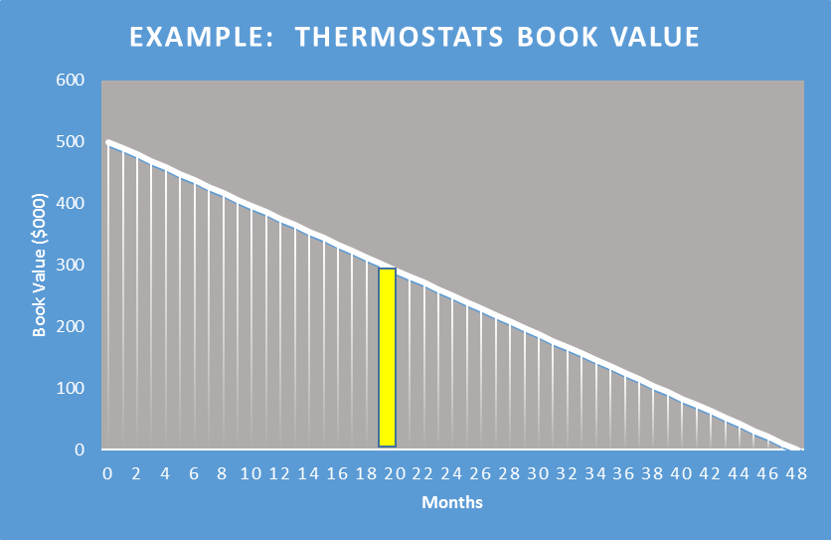
Capital Expenditures Evaluation – (cont’d)

Slide 27
Unexcused Misconduct

Slide 28
Unexcused Misconduct
  MRA Misconduct Events
    A “Misconduct Event” means any MRA Contracted Hour during which the MRA, in a deployment event, is directed to but does not make available to ERCOT the power injection or Demand response in the amount shown in the MRA Availability Plan.
    ERCOT will assess a single charge to the QSE for each Operating Day on which one or more Misconduct Event occurs.
    The QSE may be excused by ERCOT from a Misconduct Event charge if ERCOT determines, in its discretion, that the Misconduct Event was not due to intentionally incomplete or inaccurate reporting to ERCOT regarding the availability of the MRA.

Slide 29
Unexcused Misconduct
  Charge _{hr} = $10,000 * UMFLAG / CH
  Where,
  UMFLAG (none) = Unexcused Misconduct flag for the day
    CH (hr) = Contract hours for the day

Slide 30
MRA Service Charge

Slide 31
Service Charge
  Charge _{hr} = {Standby + Deployment + Variable + CAPEX + Unexcused} * HLRS
  Where,
  Standby ($) = Total Standby payment per hour
  Deployment ($) = Total Deployment payment per hour
    Variable ($) = Total Variable payment per hour
    CAPEX ($) = Total Capital Expenditures payments per hour
    HLRA (none) = QSE hourly load ratio share for hour

Slide 32
The End
Questions?

