Slide 1
Changes to ERCOT’s Hourly Wind Forecast Delivery Time
QMWG
Operations Analysis
11/12/2018

Slide 2
Introduction
Currently, ERCOT receives the hourly forecast (STWPF & WGRPP) from both vendors (UL and E&M) at the top of the hour (XX:00)
Selected forecast is sent to Wind COPs (i.e. MMS) & Wind QSEs by 35 minutes past the hour (XX:35)
When Reliability Unit Commitment (RUC) executes at XX:03, it uses forecast data received over an hour ago. The forecast can vastly improve if the delivery timeline is pushed back to receive forecasts later in the hour

Slide 3
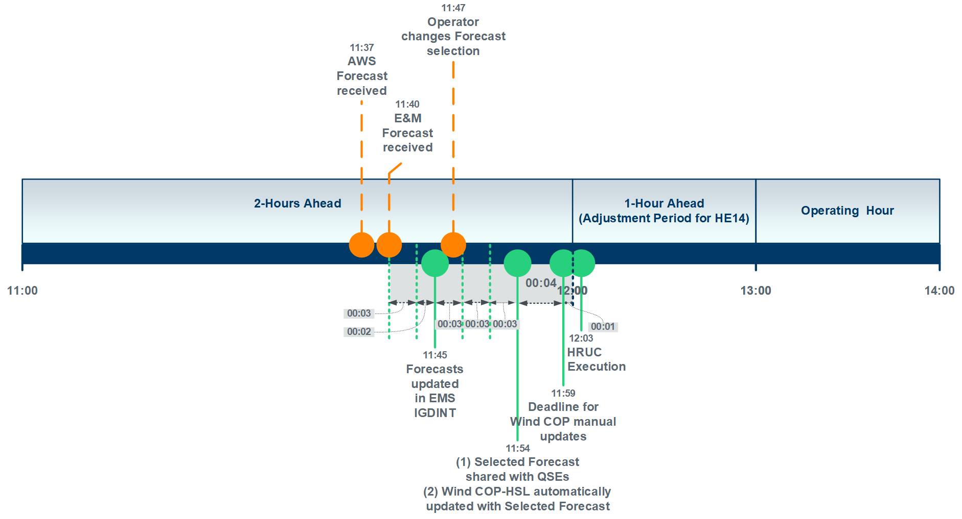
Changes to Wind Forecast Delivery Time (Graphic)

Slide 4
Changes to Wind Forecast Delivery Time (Text)
ERCOT will receive both forecasts between XX:35 and XX:40
Selected forecast is sent to Wind COPs (i.e. MMS) & Wind QSEs by 45 minutes past the hour (XX:45)
When Reliability Unit Commitment (RUC) executes at XX:03, it uses forecast data received 23 minutes ago.
Wind QSEs will continue to have the ability to lower the COP HSLs. The most ideal time for this update will be between XX:54 and the top of the next hour.

Slide 5
Impacted Reports
This forecast delivery time change will impact three reports.
Query extraction time for the most recent wind COP HSL in the Public Dashboard – COP HSL for Current Day Forecasted and Actual Wind Power Production will be changed from XX:42 to XX:55
The following MIS report posting times will change from XX:42 to XX:55:
Wind Power Production – Hourly Averaged Actual and Forecasted Values
Wind Power Production – Hourly Averaged Actual and Forecasted Values by Geographical Region
These changes will be implemented by 11/28/2018. A market notice will be sent by CoB November 12, 2018 providing a heads up on these changes.
Please send any comments/questions regarding these changes to Sean Chang (schang@ercot.com) or Nitika Mago (nmago@ercot.com).

