Slide 1
From State Estimator to SCED
Jian Chen
Market Analysis and Validation
CMWG/QMWG
Nov. 12th, 2018

Slide 2
Overview
An overview of how the ERCOT Energy Management System (EMS) performs network analysis and, following operator review, passes information on active constraints to the Security-Constrained Economic Dispatch (SCED) engine.
The focus will be on the following applications:
State Estimator
Real Time Contingency Analysis (RTCA)
Transmission Constraint Manager (TCM)

Slide 3
Real-Time Operations

Slide 4
Real-Time Network Security Analysis
State Estimator
Real Time Contingency Analysis

Slide 5
Functions of State Estimator
SCADA Telemetry
Manage Transmission Constraint
State Estimator
Network Security Analysis
Provides the best estimate of system states (bus voltage, line flows, generator outputs, loads…)
Execute automatically every 5 minutes, and upon manual triggering
Core of RT network security analysis
SCED

Slide 6
Why does ERCOT need State Estimator?
Not all station or equipment is telemetered in Real-Time
For the telemetry received, the information doesn’t always line up correctly
Power Flow Analysis
Solving power flow requires knowing all PQ bus’s MW and MVar injections and PV bus’s MW injection and voltage magnitude
Solving power flow alone cannot detect a bad input
State Estimator
State Estimator can cover the station even with loss of local RT telemetry
State Estimator can utilize redundant measurements to detect bad input

Slide 7
Power Flow Solution vs. State Estimator
Input
Input
Output
Output
Solve the power flow case by solving the equations,
where the number of inputs is same as the number of unknowns
Estimate the system state by solving the optimization in State Estimator, where the number of inputs is larger than the number of unknowns

Slide 8
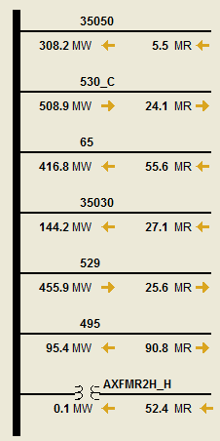
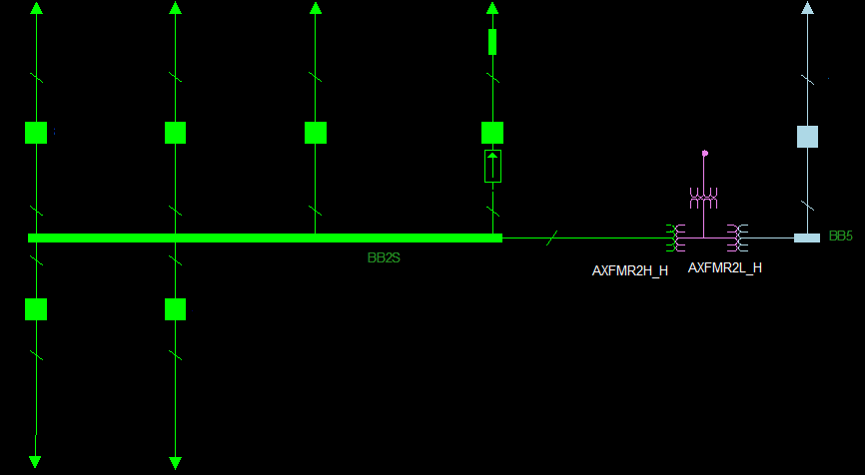
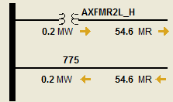
Topology Builder
Bus-Branch Model
Bus-Breaker Model
Gathers status data about the circuit breakers and switches
Configures bus topology and diagrams of the system
Checks consistency of the topology and flags inconsistencies between status and flow values

Slide 9
State Estimator – Weighted Least Square Optimization
Input: Analog measurements on the equipment
Output: Voltage magnitude and angle on each bus
Algorithm: Weighted Least Square method (WLS)
G
V,θ
V,θ
V,θ
G

Slide 10
Real Time Contingency Analysis
Real Time Contingency Analysis (RTCA) also runs automatically every 5 minutes, immediately after State Estimator completes
RTCA evaluates the post-contingency conditions with the pre-defined contingency sets and equipment ratings
RTCA flags both voltage or flow violations under post-contingency conditions, but voltage violations are not solved through SCED.
State Estimator

Slide 11
The Definitions of Three C’s
Contingency
An event that could jeopardize reliability: loss of transmission lines, autotransformers, or generation units
Constraint
A limiting element exceeds a System Operating Limit (SOL) in the base case or under a specific contingency
Congestion
When a specific constraint prevents SCED from using the cheapest power available, we say that the system is experiencing congestion

Slide 12
Congestion Management Plans and Remedial Action Schemes
Remedial Action Schemes (RAS)
A scheme designed to detect predetermined ERCOT System conditions and automatically take corrective actions that may include, but are not limited to, adjusting or tripping generation (MW and MVAr), tripping Load, or reconfiguring a System(s) to maintain a secure system.
Remedial Action Plans (RAP)
A set of pre-defined manual actions to execute post-contingency to address voltage issues or in order to reduce loading on one or more given, monitored Transmission Facilities to below their Emergency Rating within 15 minutes.

Slide 13
Model RAS/RAP in RTCA
If any post-contingency power flow meets a RAS/RAP trigger condition, RTCA runs another full power flow on this contingency, to analyze the post-RAP or post-RAS power flow and identify if any violation still exists.
 | RAP | RAS
Applicable contingencies | Only applicable for the specific contingency | Applicable for any contingency
Pre-RAS/RAP condition | Still needs to be monitored in RTCA and TCM to control the flow below the load shedding limit | No need to be monitored
Post-RAS/RAP condition | Monitored in RTCA and TCM, will be activated if violated | Monitored in RTCA and TCM, will be activated if violated

Slide 14
Manage Transmission Constraint
Constraints must be reviewed and activated by ERCOT operators before being sent to SCED
Manage Transmission Constraint
Real Time Contingency Analysis
SCED

Slide 15
Operator Review of the Constraints
Manage Transmission Constraint
ERCOT operators review the following information:
Verify the contingency definition associated with the constraint
Verify SCADA and estimated flow on the overloaded equipment
Verify the limit (equipment rating) of the overloaded equipment
Verify at least one resource with shift factor above 2% or less than -2%
Verify the constraint limit is still exceeded post-RAS/RAP execution
Verify no other similar constraint activated
ERCOT posts all active and inactive constraints on the site of Market Information System (MIS) Secure Area.

Slide 16
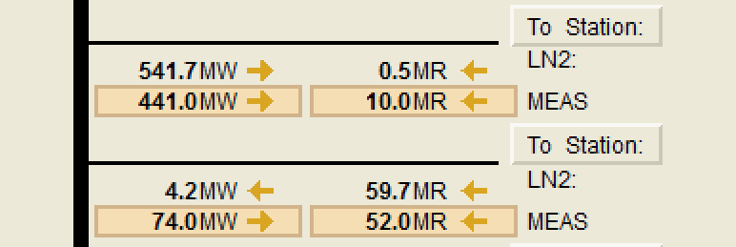
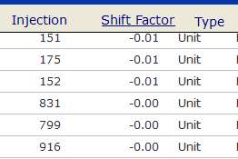
Example of case in which an operator wouldn’t activate a constraint
Mismatch between SE results and the flow they are actually observing on the line
No resource shift factor is more than 2% or less than -2%

Slide 17
Constraint Limit
Contingency Analysis Rating: The equipment rating in EMS model, where normal rating is used for base case constraint, and emergency rating is used for a post-contingency constraint
Modified Rating: The rating after the discount factor (%rating). The default discount factor is 100%, but it could be modified with operators’ input
SCED Rating: The rating sent to SCED. RTCA flows and ratings are both in the format of AC flow (MW and MVar) while SCED only dispatches MW flow. The SCED rating (MW) is calculated from the Modified Rating (MVA), based on the MW/MVAR conditions of the constraint flow

Slide 18
SCED Input from EMS
Constraint information from RTCA/TCM
Constraint Flow/Limit
Constraint Shift Factors
Base case information from State Estimator
Resource output MW
Load SE MW
Resource information from RLC
Resource Limit (HDL & LDL)
Resource Status
GTBD

