Slide 1
ERCOT Frequency Control Report
October 2018
ERCOT
Operations Planning
PDCWG | November 9th, 2018

Slide 2
Summary of October 2018
CPS1: 176.03%
Current CPS1 12-Month Rolling Average: 175.98%
1 BAAL Exceedance
5 hourly CPS1 scores below 100%
BAAL-003 Events have updated through August
2018 BAAL-003 FRM Performance: -895.19
2018 RMS1 Statistics
Mean: 14.55 mHz
Min: 11.40 mHz
Max: 19.12 mHz
October Energy Statistics
Total Energy: 29,156,994 MWh
Wind Energy: 5,239,561 MWh
Percent Energy from Wind Generation: 17.97%
October Minimum System Inertia
Mean: 190,188
Max: 228,144 on October 9th
Min: 145,241 on October 30th

Slide 3
Frequency Control
CPS1, BAAL, & RMS1

Slide 4
Hourly CPS1 by Day
October-18 CPS1 (%): 176.03
Notes:
Outliers:
10/6/18 01:00: 0.48%
Wind ramp down of >2,000 MW throughout the hour. Frequency was dragging due to wind ramp and large expected generation deviation. Reg Up exhausted from 01:04 until 01:36. Loss of approx. 500 MW at 01:23 due to unit trip/run back
10/8/18 16:00: 95.47%
Wind ramp down of >1,000 MW throughout the hour. Solar ramp down of 400 MW from 16:42 until the end of the hour. Reg Up exhausted from 16:20.
10/8/18 20:00: 77.58%
Wind ramp down of >1,000 MW throughout the hour. Reg Up exhausted for the majority of the hour.
10/12/18 16:00: 89.58%
Large expected generation deviation, a couple units not following base point during the first 15 min of the hour. Solar ramp down of approx. 200 MW. Wind ramp down of approx. 400 MW. Reg Up exhausted for the majority of the hour
10/15/18 19:00: 82.84%
Wind ramp down of approx. 1,500 MW. Several units lagging behind base points, large expected generation deviation. Reg Up exhausted for the majority of the hour.

Slide 5
BAAL Exceedances & Violations
There was 1 BAAL exceedance
October 6, 2018
Wind was ramping down quickly
Unit loss when there was already a large expected generation deviation
Less than 59.91 Hz for 1 minute

Slide 6
15-Minute Average CPS1%
October-18 CPS1 (%): 176.03

Slide 7
12-Month Rolling Average CPS1
Current 12-Month Rolling Average: 175.98%

Slide 8
Daily RMS1 of ERCOT Frequency by Year
Notes:
Mean is 14.68 mHz

Slide 9
Daily RMS1 of ERCOT Frequency by Month

Slide 10
Daily RMS1 of ERCOT Frequency by Month

Slide 11
Daily RMS1 of ERCOT Frequency by Month
Notes:
Mean: 14.55 mHz
Min: 11.40 mHz
Max: 19.12 mHz

Slide 12
Frequency Profile Comparison

Slide 13
Frequency Profile Comparison

Slide 14
Frequency Profile Comparison

Slide 15
Time Error Correction

Slide 16
ERCOT Daily Time Error

Slide 17
Time Error Corrections Log Summary
There have been no time error corrections since December 2016

Slide 18
BAL-003 Performance

Slide 19
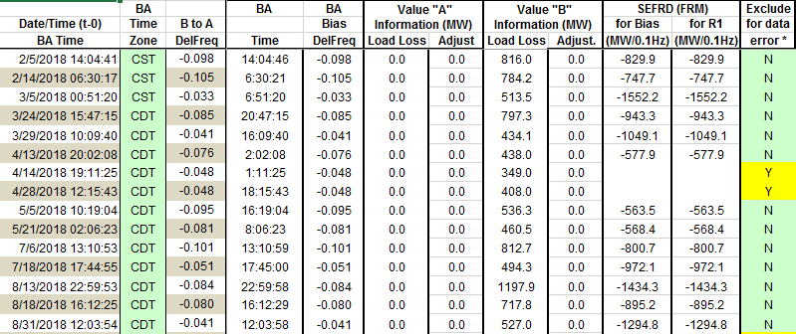
Op. Year 2018 BAL-003 Selected Events
Maybe. Will be valuated at the end of the year.

Slide 20
Op. Year 2018 BAL-003 FRM Performance

Slide 21
ERCOT Energy Statistics

Slide 22
Total Energy
Notes:
29,156,994 MWh

Slide 23
Total Energy from Wind Generation
Notes:
5,239,561 MWh

Slide 24
% Energy from Wind Generation
Notes:
17.97%

Slide 25
ERCOT System Inertia

Slide 26
Daily Minimum System Inertia
Notes:
Minimum Inertia = 130,014 MW*s on 10/27/2017. This was also our record wind day.
October
Mean: 190,188
Max: 228,144 on October 9th
Min: 145,241 on October 30th

Slide 27
Questions?
Thank you!

Slide 28
Op. Year 2017 BAL-003 Selected Events
Notes:
Frequency Bias updated from 764 to 759 in April

Slide 29
Op. Year 2017 BAL-003 FRM Performance

