Slide 1
MSWG Update to WMS 11/6/2018

Slide 2
MSWG Meeting 10/17/18
ON Going Activities
Nodal Handbook – ongoing
Settlement Stability Report – Appendix A
Special Webex on October 23 on NPRR884
Concerns about availability of flags
ERCOT will bring the Settlement Matrix Calculation to MSWG prior to implementation
Varying Definitions on beforeCCGR and afterCCGR
ERCOT was able to address concerns regarding the use of the varying definitions.
MSWG Requested that when NPRR’s with Settlement equations are approved that MSWG review the Settlement Matrix prior to implementation to help identify issues .

Slide 3
Questions?
Next Meeting 11/14/2018
Webex Only

Slide 4
8.2(2)(c)(i) Track number of price changes
Appendix A
Reporting Period: 2018 Q3
Operating Day | # of Corrected Settlement Point Prices |  |  |  | # of Intervals Affected
 | DASPP | RTSPP | RTRMPR | ORDC Adders | DASPP | RTSPP | RTRMPR | ORDC Adders
7/18/2018 | - | 5,238 | 4,274 | 10 | - | 9 | 9 | 6
Notes:
The price changes above were a result of incorrect definitions of two double-circuit contingencies. These incorrect definitions led to a Data Input error and resulted in incorrect Real-Time prices as explained in Market Notice W-A072018-01.
The price changes reported on this slide display the price corrections that have been done after the Settlement Statement has posted for the Operating Day.

Slide 5
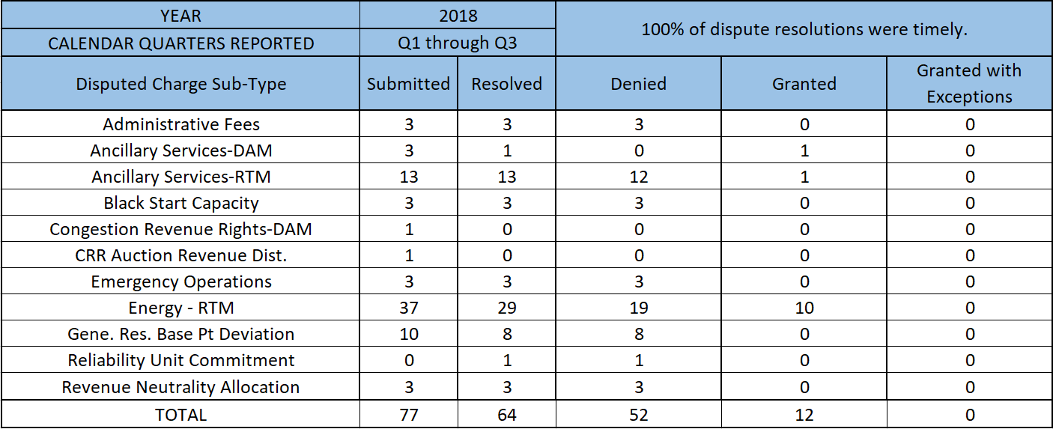
8.2(2)(c)(ii) Track number and types of disputes submitted 8.2(2)(c)(iii) Compliance with timeliness of response to disputes
Submitted but not resolved disputes may be:
Not started
Open
Rejected
Withdrawn

Slide 6
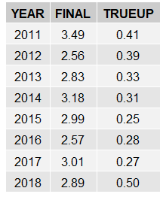
8.2(2)(c)(iv) Other Settlement metrics
NOTE: ERS Final settlement OD data is not represented in graph.
Average percent change

Slide 7
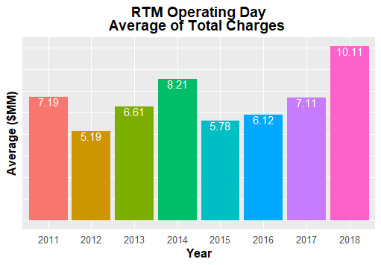
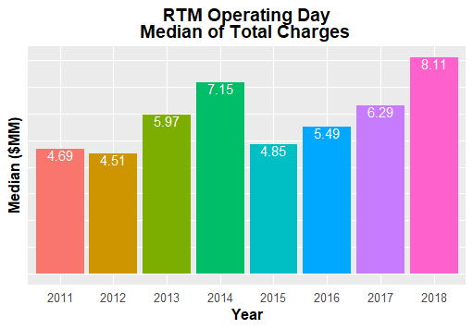
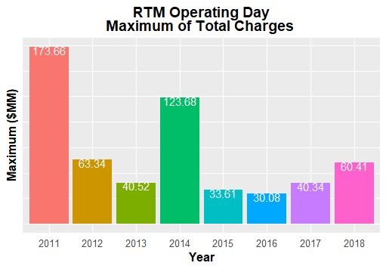
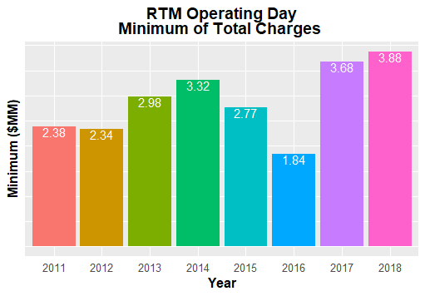
8.2(2)(c)(iv) Other Settlement metrics

Slide 8
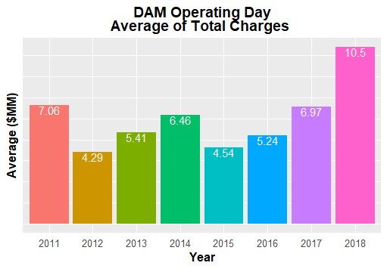
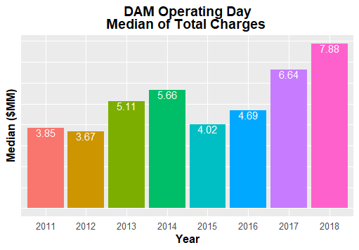
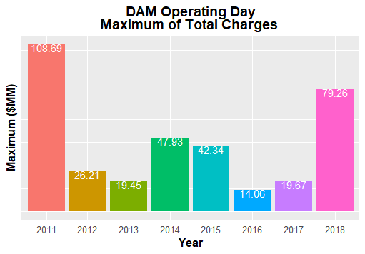
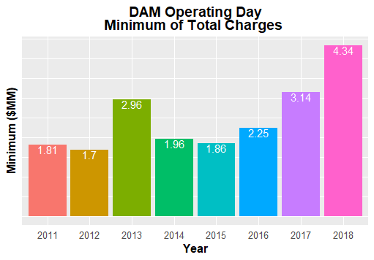
8.2(2)(c)(iv) Other Settlement metrics

Slide 9
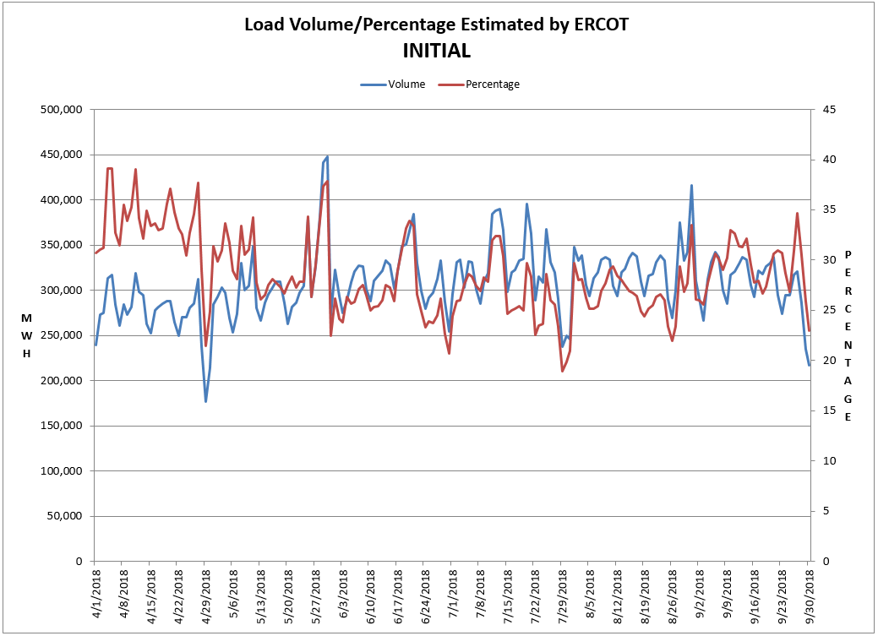
8.2(2)(c)(v) Availability of ESIID consumption data

Slide 10
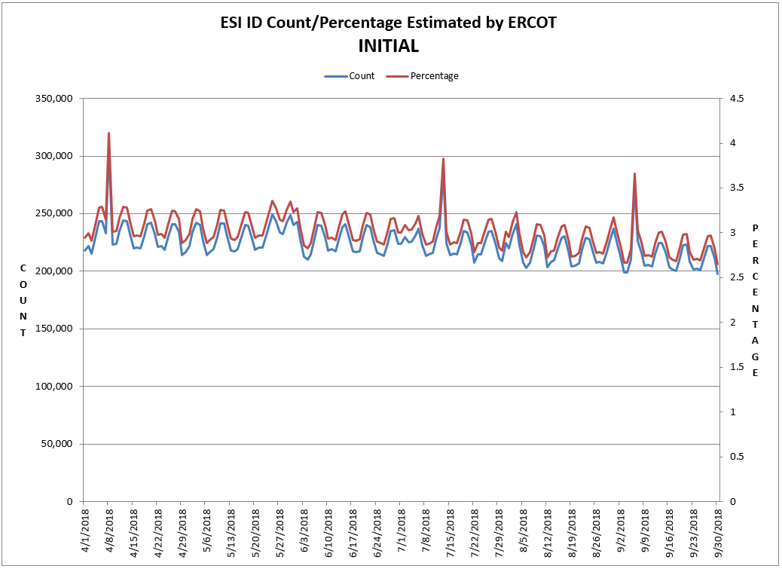
8.2(2)(c)(v) Availability of ESIID consumption data

Slide 11
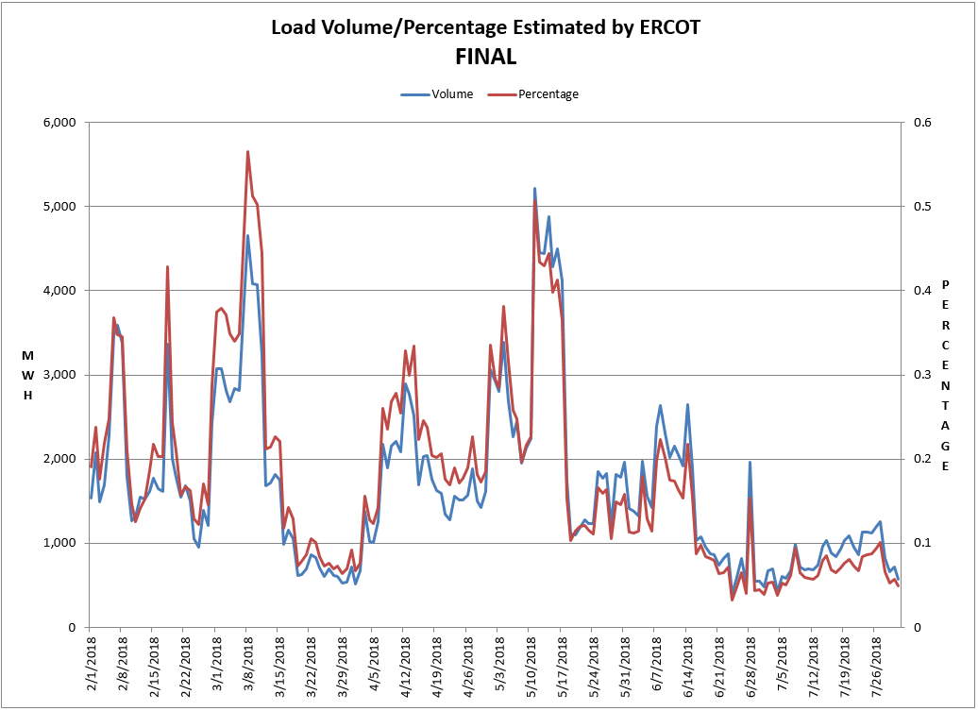
8.2(2)(c)(v) Availability of ESIID consumption data

Slide 12
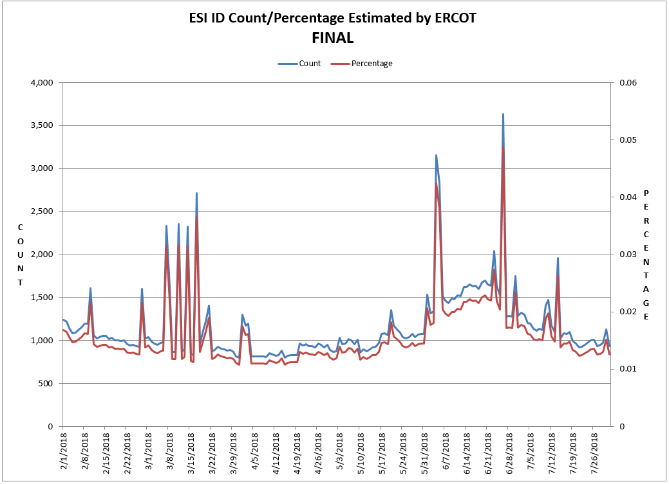
8.2(2)(c)(v) Availability of ESIID consumption data

Slide 13
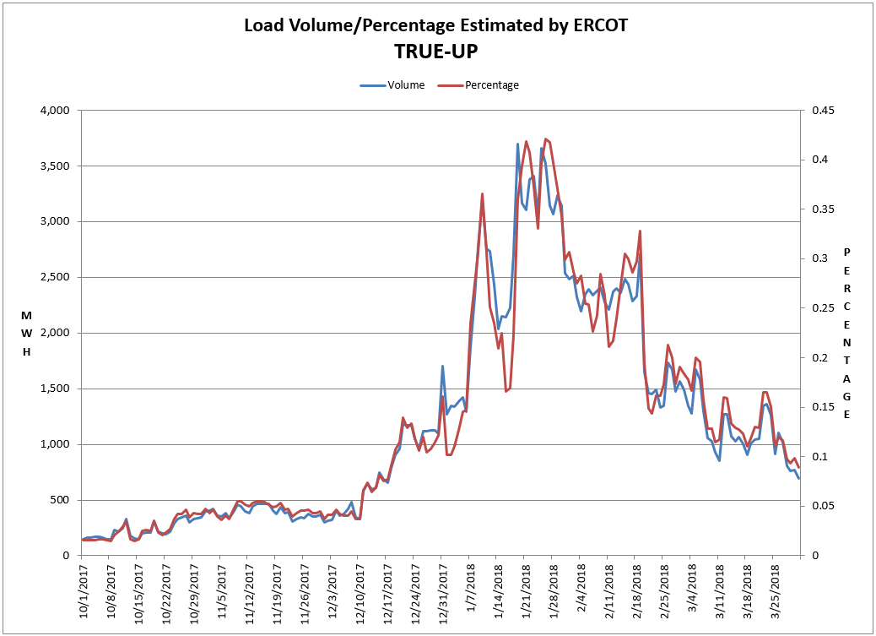
8.2(2)(c)(v) Availability of ESIID consumption data

Slide 14
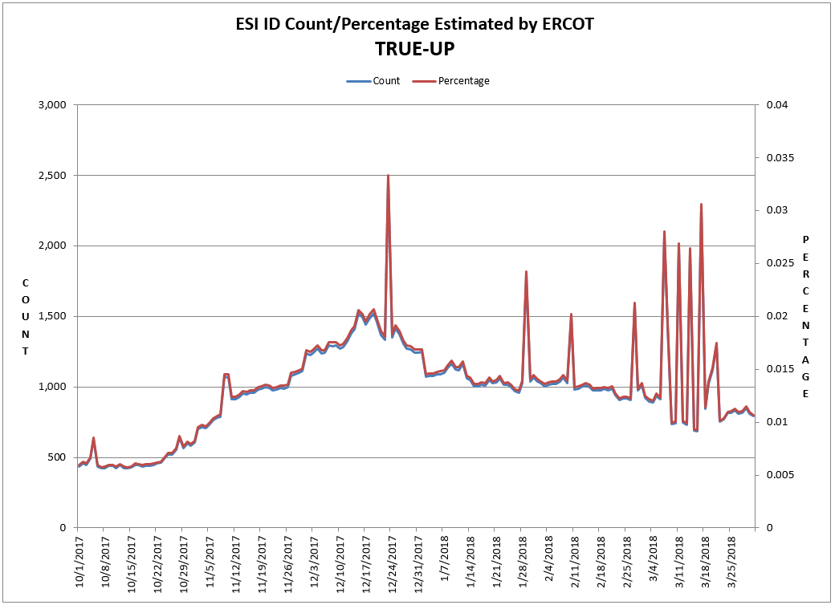
8.2(2)(c)(v) Availability of ESIID consumption data

Slide 15
8.2(2)(g) Net Allocation to Load - Totals and $/MWh
NET ALLOCATION TO LOAD ($M)
 | Sep 2017 | Oct 2017 | Nov 2017 | Dec 2017 | Jan 2018 | Feb 2018 | Mar 2018 | Apr 2018 | May 2018 | Jun 2018 | Jul 2018 | Aug 2018 | Sep 2018
Ancillary Service Settlement | 16.6 | 29.4 | 23.8 | 14.2 | 87.8 | 20.3 | 29.5 | 30.4 | 47.5 | 19.4 | 101.4 | 23.2 | 16.4
Balancing Account Payout to Load | -6.3 | -13.3 | -1.2 | -0.7 | -13.1 | -5.0 | -1.0 | -5.0 | -25.0 | 0.0 | 0.0 | -1.4 | -6.8
Base Point Deviation Payments | -0.2 | -0.2 | -0.2 | -0.2 | -0.5 | -0.2 | -0.2 | -0.2 | -0.4 | -0.3 | -0.3 | -0.2 | -0.2
Black Start Service Settlement | 0.6 | 0.6 | 0.6 | 0.6 | 0.6 | 0.6 | 0.6 | 0.6 | 0.6 | 0.6 | 0.6 | 0.6 | 0.6
Block Load Transfer Settlement | 0.0 | 0.0 | 0.0 | 0.0 | 0.0 | 0.0 | 0.0 | 0.0 | 0.0 | 0.0 | 0.0 | 0.0 | 0.0
Emergency Energy Charges | 0.4 | 0.1 | 0.3 | 0.2 | 0.2 | 0.2 | 0.1 | 0.3 | 0.3 | 0.1 | 0.2 | 0.2 | 0.1
ERCOT Admin Fee Settlement | 17.9 | 16.2 | 14.6 | 16.3 | 17.4 | 14.4 | 14.6 | 14.4 | 18.8 | 20.9 | 22.1 | 21.9 | 18.1
ERS Settlement¹ | 3.3 | 4.1 | 4.1 | 4.1 | 4.1 | 4.7 | 4.7 | 4.7 | 4.7 | 0.0 | 0.0 | 0.0 | 0.0
High Dispatch Limit Override | 0.0 | 0.0 | 0.0 | 0.0 | 0.0 | 0.0 | 0.0 | 0.0 | 0.0 | 0.0 | 0.0 | 0.0 | 0.0
Non-Zonal Auction Distribution | -11.3 | -12.7 | -8.6 | -7.6 | -11.4 | -9.4 | -15.6 | -16.5 | -14.6 | -11.4 | -8.4 | -7.3 | -8.3
ORDC Settlement | 0.2 | 0.3 | 0.0 | 0.0 | 0.4 | 0.0 | 0.0 | 0.1 | 3.7 | 0.1 | 2.2 | 2.1 | 0.4
Revenue Neutrality Total | 3.6 | 10.1 | 1.0 | 7.4 | 17.4 | 0.7 | 16.8 | 2.0 | 18.8 | 30.4 | 9.0 | 12.5 | 7.0
RMR Settlement | 0.0 | 0.0 | 0.0 | 0.0 | 0.0 | 0.0 | 0.0 | 0.0 | 0.0 | 0.0 | 0.0 | 0.0 | 0.0
RUC Settlement | -0.1 | 0.0 | 0.0 | 0.0 | -0.4 | 0.0 | 0.0 | 0.0 | -2.4 | 0.0 | 0.0 | 0.0 | 0.0
Voltage Services Settlement | 0.0 | 0.0 | 0.0 | 0.0 | 0.0 | 0.0 | 0.0 | 0.0 | 0.0 | 0.0 | 0.0 | 0.0 | 0.0
Zonal Auction Distribution² | -24.3 | -19.7 | -22.6 | -20.8 | -25.7 | -21.4 | -27.2 | -27.2 | -31.9 | -38.3 | -49.6 | -57.5 | -33.4
Total Allocation to Load | 0.4 | 14.9 | 11.8 | 13.5 | 76.8 | 4.9 | 22.3 | 3.6 | 20.1 | 21.5 | 77.2 | -5.9 | -6.1
Adjusted Metered Load (TWh) | 32.2 | 29.2 | 26.3 | 29.4 | 31.4 | 25.9 | 26.4 | 25.9 | 33.9 | 37.6 | 39.8 | 39.4 | 32.6
$/MWh³ | 0.0 | 0.5 | 0.4 | 0.5 | 2.4 | 0.2 | 0.8 | 0.1 | 0.6 | 0.6 | 1.9 | -0.1 | -0.2
Note: The Net Allocation to Load amounts provided in this presentation are for informational purposes only and cannot be relied upon for accurate measurements or forecasts of individual QSE charges and payments.
¹The total ERS charges have been evenly allocated across the contract period.
²Zonal Auction Distribution by 2003 Congestion Management Zone, shown below.
³The $/MWh value as calculated per PR 8.2 (2) g
⁴The $/MWh value by 2003 Congestion Management Zone, as calculated per PR 8.2(2) g

Slide 16
8.2(2)(g) Net Allocation to Load - Totals and $/MWh
ZONAL AUCTION DISTRIBUTION PER CONGESTION MANAGEMENT ZONE ($M)
 | Sep 2017 | Oct 2017 | Nov 2017 | Dec 2017 | Jan 2018 | Feb 2018 | Mar 2018 | Apr 2018 | May 2018 | Jun 2018 | Jul 2018 | Aug 2018 | Sep 2018
HOUSTON | -3.4 | -3.2 | -3.6 | -2.0 | -2.5 | -2.3 | -2.4 | -3.1 | -3.6 | -5.0 | -7.5 | -7.3 | -4.6
NORTH | -7.4 | -4.2 | -4.4 | -4.9 | -6.0 | -4.7 | -5.1 | -5.5 | -7.3 | -10.3 | -13.8 | -16.5 | -9.0
SOUTH | -8.8 | -6.5 | -6.9 | -5.7 | -6.8 | -5.6 | -7.5 | -7.1 | -9.2 | -11.2 | -15.1 | -15.1 | -10.9
WEST | -4.8 | -5.8 | -7.7 | -8.3 | -10.3 | -8.8 | -12.2 | -11.5 | -11.8 | -11.8 | -13.2 | -18.5 | -9.0
TOTAL | -24.3 | -19.7 | -22.6 | -20.8 | -25.7 | -21.4 | -27.2 | -27.2 | -31.9 | -38.3 | -49.6 | -57.5 | -33.4
REAL-TIME ADJUSTED METERED LOAD BY CONGESTION MANAGEMENT ZONE (TWh)
 | Sep 2017 | Oct 2017 | Nov 2017 | Dec 2017 | Jan 2018 | Feb 2018 | Mar 2018 | Apr 2018 | May 2018 | Jun 2018 | Jul 2018 | Aug 2018 | Sep 2018
HOUSTON | 8.8 | 8.2 | 7.3 | 7.4 | 7.7 | 6.5 | 7.2 | 7.0 | 9.2 | 9.9 | 10.5 | 10.5 | 8.9
NORTH | 11.7 | 10.1 | 9.0 | 10.9 | 12.0 | 9.8 | 8.9 | 8.8 | 11.9 | 13.9 | 15.0 | 14.3 | 11.6
SOUTH | 8.8 | 8.1 | 7.2 | 8.0 | 8.5 | 6.8 | 7.3 | 7.1 | 9.4 | 10.2 | 10.7 | 10.9 | 8.9
WEST | 2.9 | 2.8 | 2.8 | 3.1 | 3.2 | 2.8 | 2.9 | 2.9 | 3.4 | 3.5 | 3.6 | 3.7 | 3.2
TOTAL | 32.2 | 29.2 | 26.3 | 29.4 | 31.4 | 25.9 | 26.4 | 25.9 | 33.9 | 37.6 | 39.8 | 39.4 | 32.6
ZONAL AUCTION REVENUE PER CONGESTION MANAGEMENT ZONE ($/MWh)
 | Sep 2017 | Oct 2017 | Nov 2017 | Dec 2017 | Jan 2018 | Feb 2018 | Mar 2018 | Apr 2018 | May 2018 | Jun 2018 | Jul 2018 | Aug 2018 | Sep 2018
HOUSTON | -0.4 | -0.4 | -0.5 | -0.3 | -0.3 | -0.4 | -0.3 | -0.4 | -0.4 | -0.5 | -0.7 | -0.7 | -0.5
NORTH | -0.6 | -0.4 | -0.5 | -0.4 | -0.5 | -0.5 | -0.6 | -0.6 | -0.6 | -0.7 | -0.9 | -1.2 | -0.8
SOUTH | -1.0 | -0.8 | -1.0 | -0.7 | -0.8 | -0.8 | -1.0 | -1.0 | -1.0 | -1.1 | -1.4 | -1.4 | -1.2
WEST | -1.7 | -2.1 | -2.8 | -2.7 | -3.2 | -3.1 | -4.2 | -4.0 | -3.5 | -3.4 | -3.7 | -5.0 | -2.8
TOTAL | -0.8 | -0.7 | -0.9 | -0.7 | -0.8 | -0.8 | -1.0 | -1.1 | -0.9 | -1.0 | -1.2 | -1.5 | -1.0
NET ALLOCATION TO LOAD PER CONGESTION MANAGEMENT ZONE ($/MWh)⁴
 | Sep 2017 | Oct 2017 | Nov 2017 | Dec 2017 | Jan 2018 | Feb 2018 | Mar 2018 | Apr 2018 | May 2018 | Jun 2018 | Jul 2018 | Aug 2018 | Sep 2018
HOUSTON | 0.4 | 0.8 | 0.8 | 0.9 | 3.0 | 0.6 | 1.6 | 0.8 | 1.2 | 1.1 | 2.5 | 0.6 | 0.3
NORTH | 0.2 | 0.8 | 0.8 | 0.8 | 2.8 | 0.5 | 1.3 | 0.6 | 1.0 | 0.9 | 2.3 | 0.1 | 0.0
SOUTH | -0.2 | 0.4 | 0.3 | 0.5 | 2.5 | 0.2 | 0.9 | 0.2 | 0.6 | 0.5 | 1.8 | -0.1 | -0.4
WEST | -0.9 | -0.9 | -1.5 | -1.5 | 0.1 | -2.1 | -2.3 | -2.8 | -1.9 | -1.8 | -0.5 | -3.7 | -2.0
TOTAL | 0.0 | 0.5 | 0.4 | 0.5 | 2.4 | 0.2 | 0.8 | 0.1 | 0.6 | 0.6 | 1.9 | -0.1 | -0.2

