Slide 1
Market Credit Working Group update to the Wholesale Market Subcommittee
Bill Barnes NRG, Chair
Josephine Wan Austin Energy, Vice Chair
11/07/2018

Slide 2
MCWG update to WMS
General Update
October 17th Joint MCWG/CWG Meeting
NPRR850 - Market Suspension and Restart
Tabled and referred back to WMS for discussion on LCRA proposed changes.
M1a Credit Parameter Review
NPRR907 submitted.
Mass Transition Timing (M1b) – Assumes between 2 to 8 days to complete (using 100,000 ESIIDs per day rate floored at 2 and capped at 8). Is that a reasonable assumption?

Slide 3
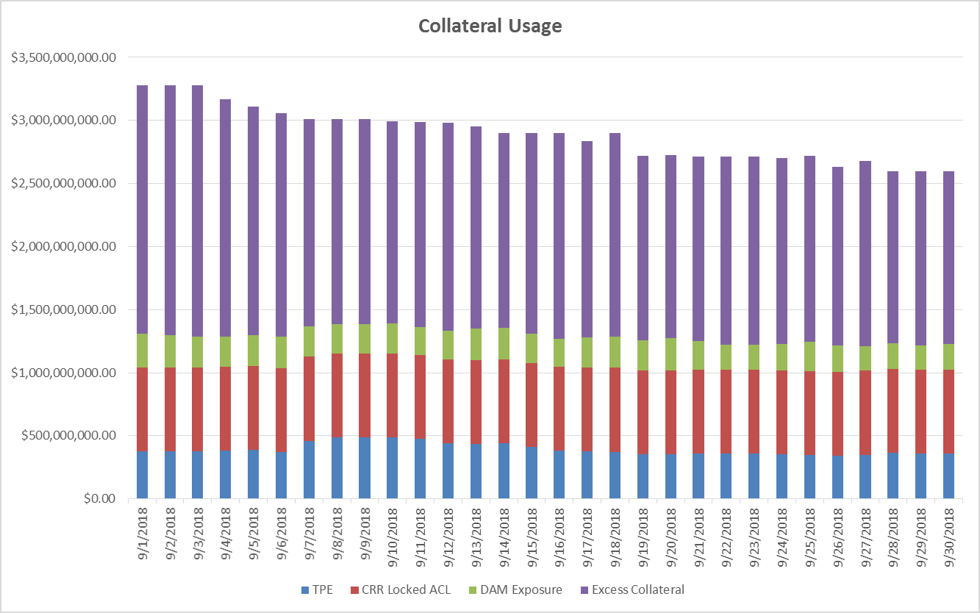
Credit Exposure Update – Excess Collateral

Slide 4
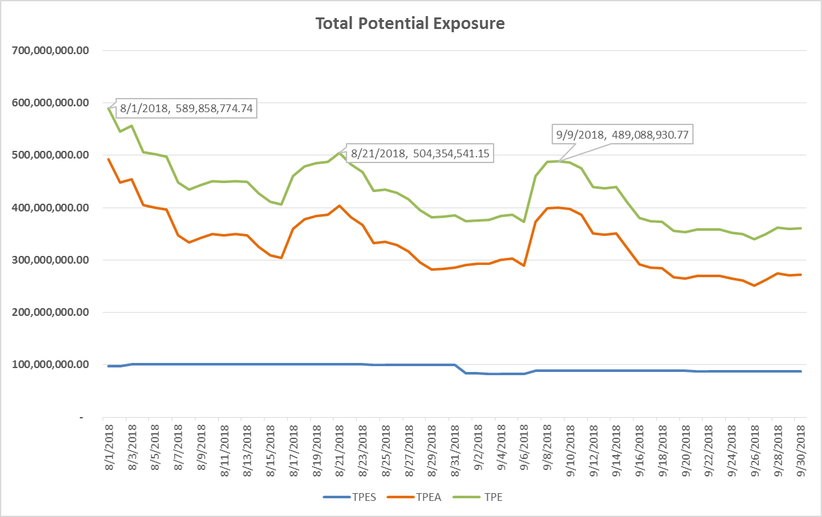
Credit Exposure Update

Slide 5
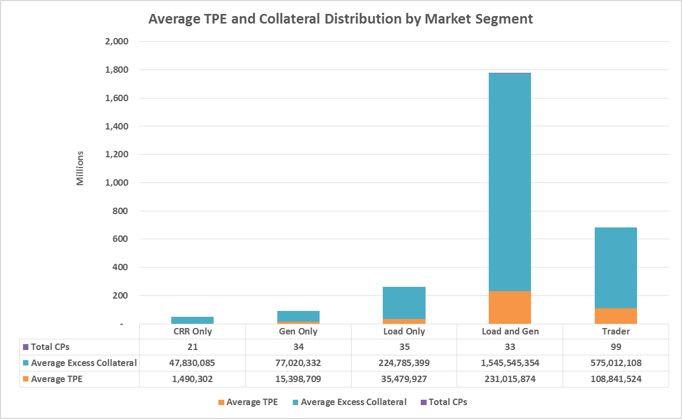
Credit Exposure Update – Summer Review

