Slide 1
Intra-Hour Wind Forecast Accuracy Updates (Nov. 2018)
QMWG
Operations Analysis
11/12/2018

Slide 2
Introduction
ERCOT implemented SCR795 on October 25, 2018
Initial K6 value set to 0
Actively analyzing projected wind ramp accuracy after implementation

Slide 3
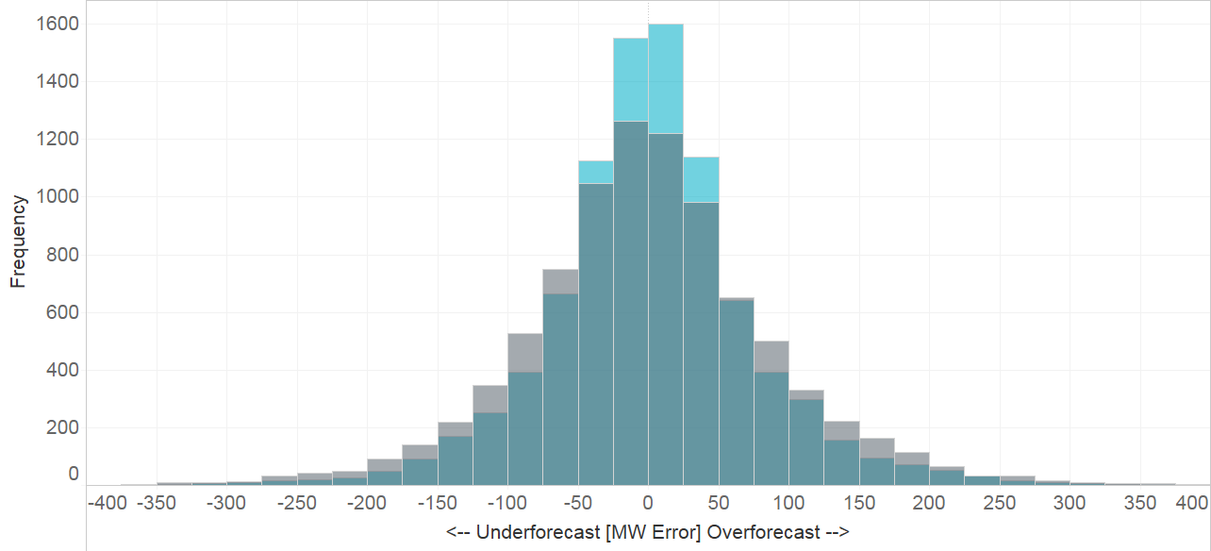
Intra-Hour Wind Ramp Forecast Error (October 2018)
Performance Metric | Projected Ramp | Persistence Ramp*
Monthly MAE (MW) | 54 | 67
Monthly MAE when 5-Min. Wind Ramp > 100 MW | 100 | 158
Projected Ramp
Persistence Ramp*
* Persistence Ramp assumes a 0 MW wind ramp

Slide 4
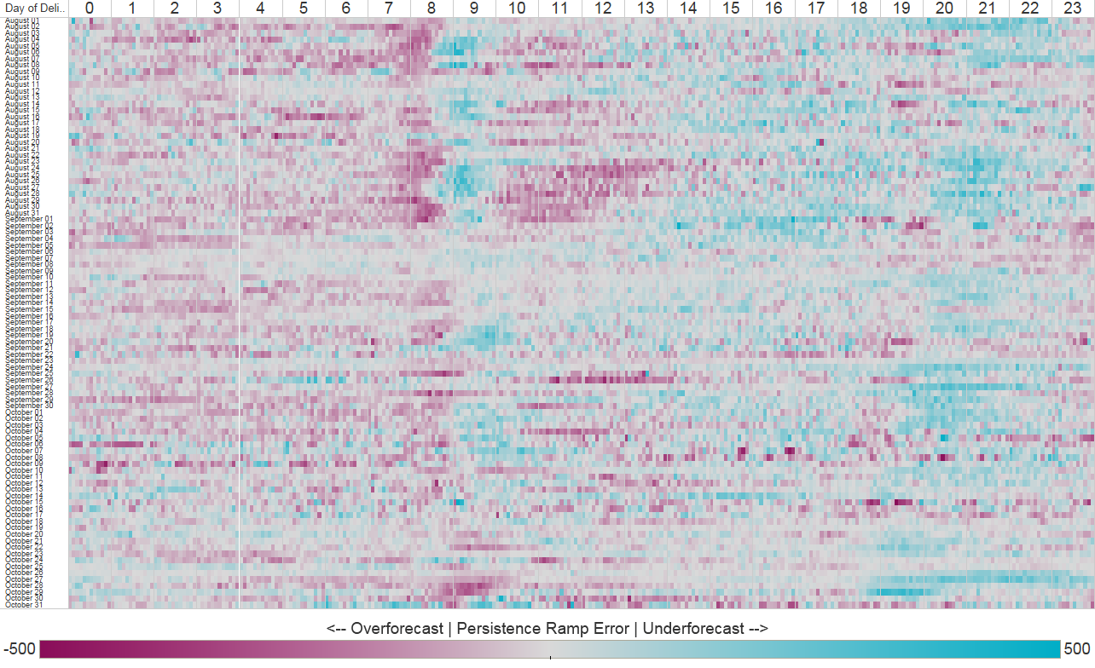
Persistence Ramp Error Heat Map

Slide 5
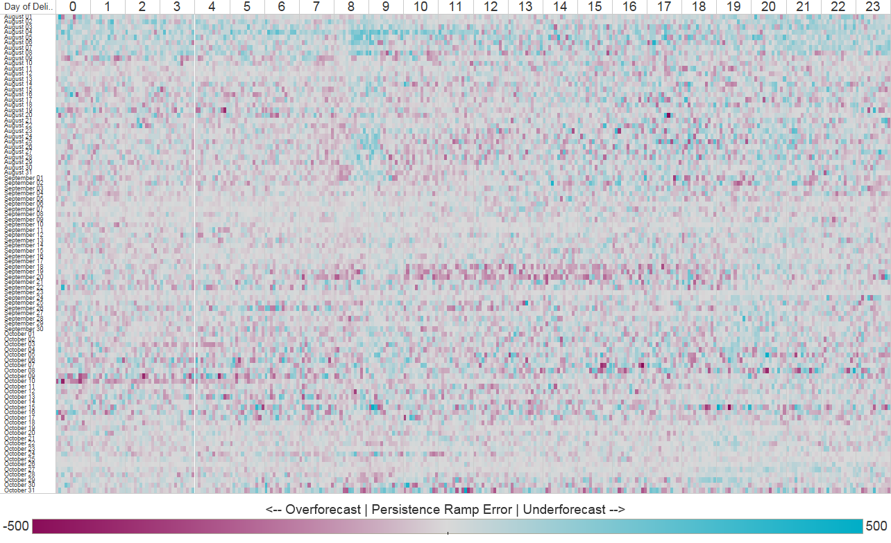
Projected Wind Ramp Rate Error (PWRR) Heat Map

Slide 6
Next Steps
Be on the lookout for a market notice to activate SCR795 changes
In parallel with activation of K6, ERCOT may tune the other Generation-to-be-Dispatched parameters
ERCOT will provide updates on those changes to future PDCWG and QMWG meetings

Slide 7
Appendix

Slide 8
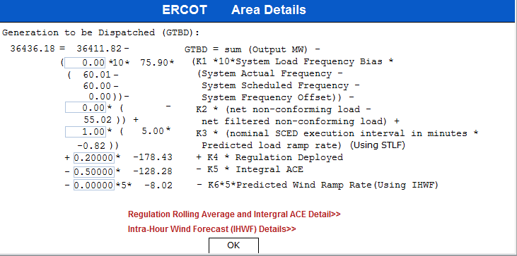
Current GTBD Parameters

