Slide 1
Dynamic Model Templates
(To Facilitate Dynamic Model Collection)
Resource Integration Workshop
October 29, 2018
Presenter: Muhammad Khan

Slide 2
Background
The Dynamic Model Task Force was created to improve process of collecting and using dynamic stability models
The task force finished with several proposals:
  Structured model collection (i.e. templates)
  Guidelines to improve model usability / functionality
  Coordinated model updates and tracking
    MOD 26/27 coordination
Proposals are being adopted

Slide 3
Using Templates to Improve Process

Slide 4
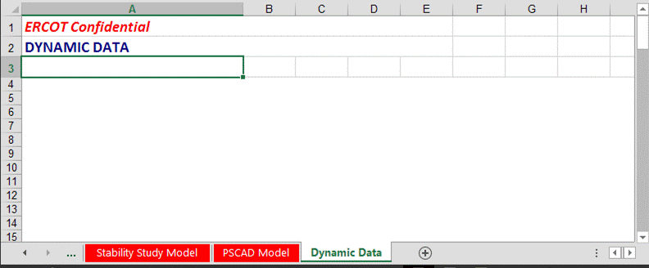

Challenges of Existing RARF Process
Nothing but a blank form!
No Guidance of what’s required
No standard format

Slide 5
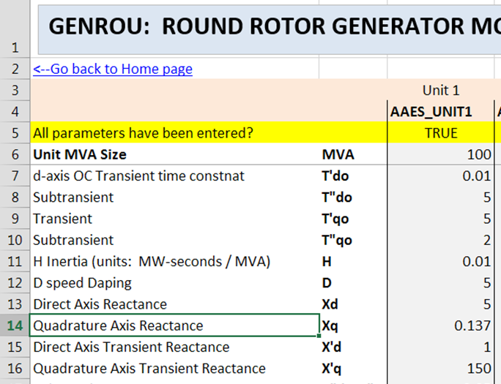
Introducing Dynamic Model Templates
Fill-in-the-blank excel form specific to your type of generator model
Provides guidance
No new data being requested, just a better format
Template
RARF
Embed completed Template into RARF (compatible w/ existing RARF Process)

Slide 6




Process for Resource / Interconnecting Entity
1.
2.
3.
GET
Models will be posted publicly on ercot.com (currently by request)
FILL OUT
(no new data is being requested over old method)
Attach to dynamic data tab of your RARF
Upload to ERCOT RARF hub
And, if applicable, send to TSP for FIS or for MOD 26/27 review
Advantages: Better Guidance.
More structure.

Slide 7
Benefits to Using Template
Provide data to ERCOT/TSP in a ready-to-go format
  Help begin studies faster
  Reduce “telephone game” trying to fix the models
Maintain Models (Permanent Repository)
  Updates are easy
  Keep all files together
  Help ERCOT get latest modeling data into study cases

Slide 8

Aiding Transition
Templates designed for easy transition
  Templates have a handy button
    If you already have .dyr files, you may be able to import them (with care)
  Most questions are fill-in-the-blank

Slide 9
Implementation
Templates available now! Please start using.
It’s easy.
  To get template, email your RI engineer or GINR@ercot.com
  Will soon be posted on www.ercot.com
Implementation to be coordinated with Market Notice
Now – optional but recommended
1/1/2019 – Required for new RARFs
5/1/2019 – Required for RARF updates
? – Required for existing resources

Slide 10
Other Process Improvements
Model Guidelines
  DMTF / DWG documents outlining good model practices
  Will be posted on www.ercot.com
Coordinate MOD 26/27 updates with TSP
  Help latest models get into ERCOT study cases
  You can help by ensuring you always update your RARF dynamic model after performing MOD 26/27

Slide 11

Questions?

