Slide 1
FlighTrak Preview
TX SET / TDTMS
October 23, 2018

Slide 2
Agenda
Define project objectives and scope
Preview the following functionality in FlighTrak –
  CR registering for a Flight (new CR and existing CR)
  MPs providing / updating testing specifications
  TDSPs uploading test bed information
  Test Scripts
  Dashboards
Provide locations to which ETOD documents will be relocated
Provide information on how Service Providers will be interacting with the FlighTrak
Explain additions to the Sign Up Deadlines
List process improvements

Slide 3
PR173-02 ERCOT Flight Certification Website: Project Overview
Replace the external web interface utilized for the purpose of executing Protocol mandated ERCOT certification of retail Market Participants (ETOD).
Refresh the technology associated with the certification interface to incorporate current browser and security requirements
  Comply with ERCOT web access standards
  Enforce visibility and update permissions based on DUNs and assigned roles
Increased visibility of defined steps required to complete ERCOT certification associated primarily with:
  New LSE entering the ERCOT Retail Market
  Existing LSE changing system parameters required to operate in the ERCOT retail market
Capture and make available auditable logs of registration and certification data associated with changes to MP and potential MP specifications
  Minimize the need for one-off mail, email, and phone calls
  Market Participant availability of ERCOT certification and connectivity specifications

Slide 4
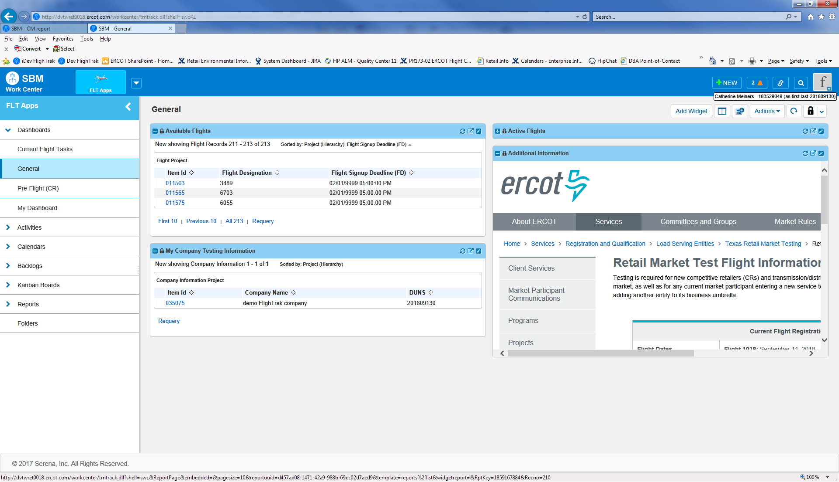
General Dashboard

Slide 5
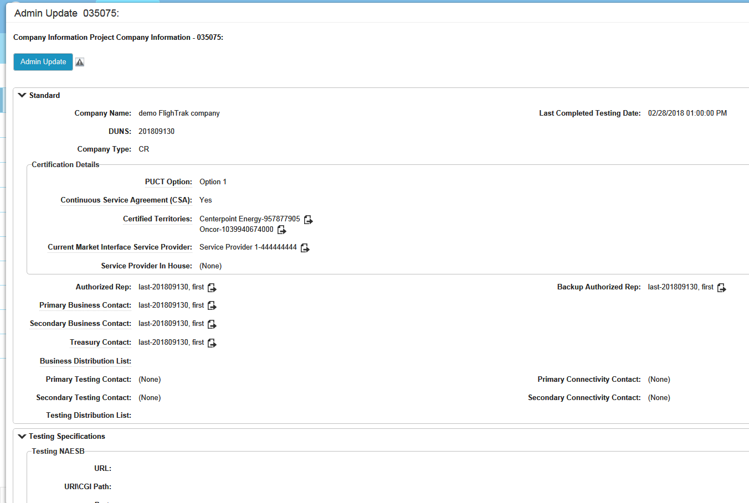
My Company Information

Slide 6
General Dashboard

Slide 7
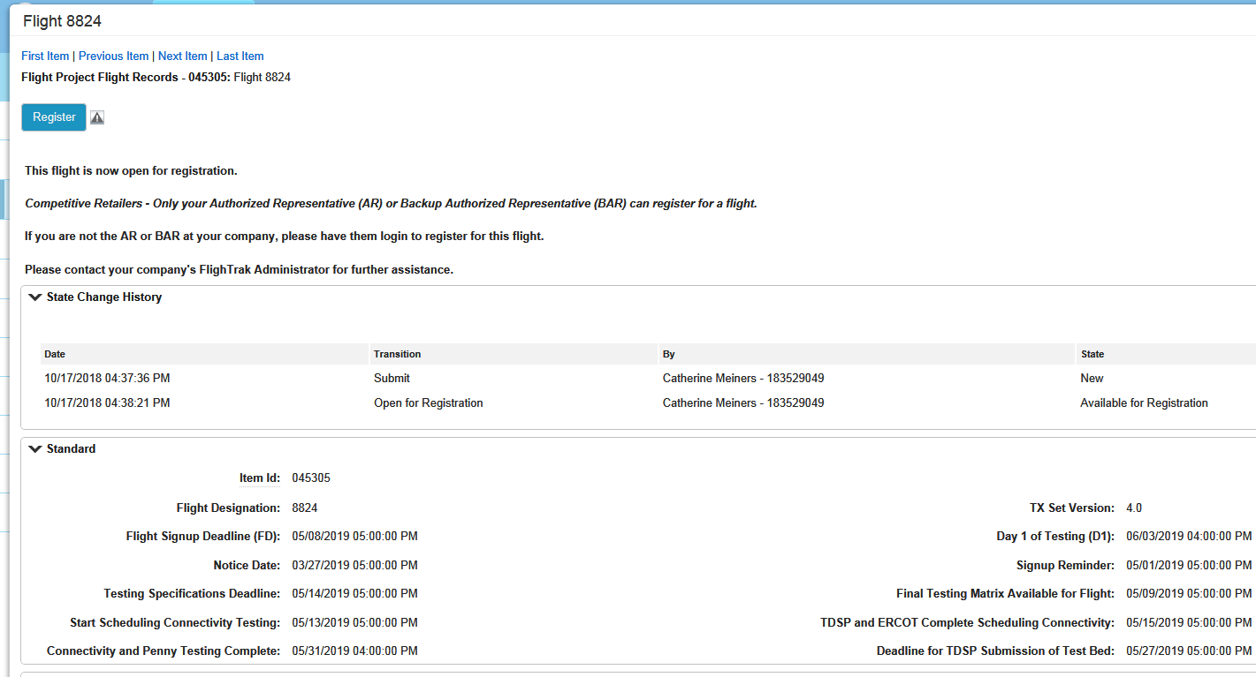
Selecting a Flight

Slide 8
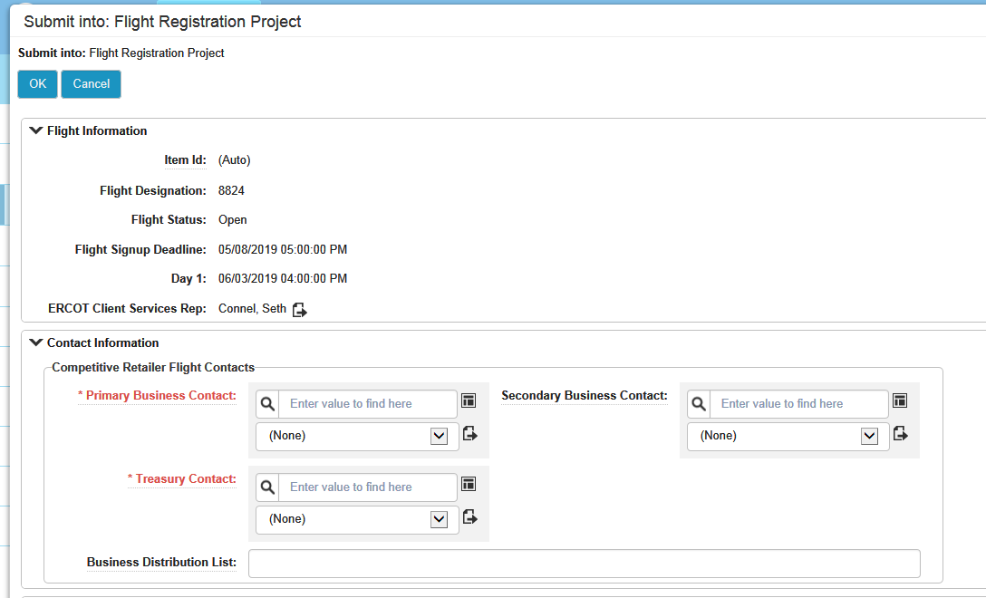
Registering for a Flight – Contact Information

Slide 9
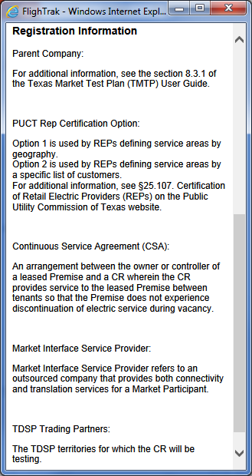
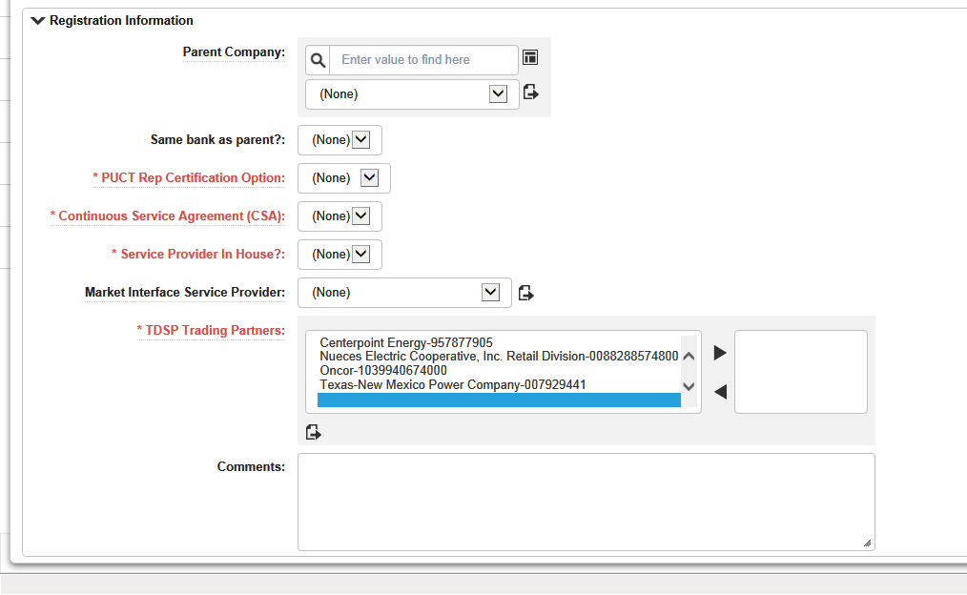
Registering for a Flight – Registration Info – New CR

Slide 10
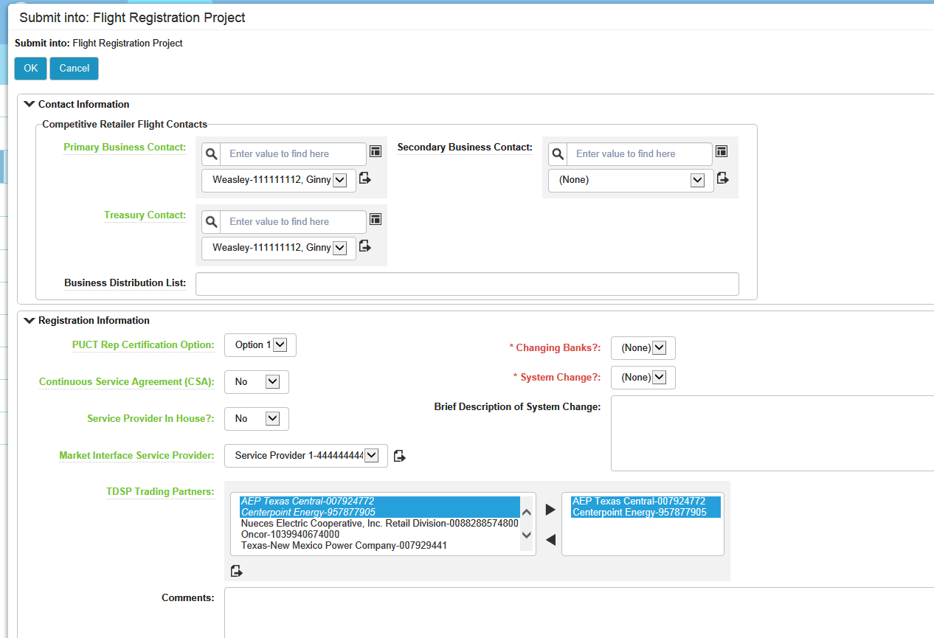
Registering for a Flight – Registration Info – Existing CR

Slide 11
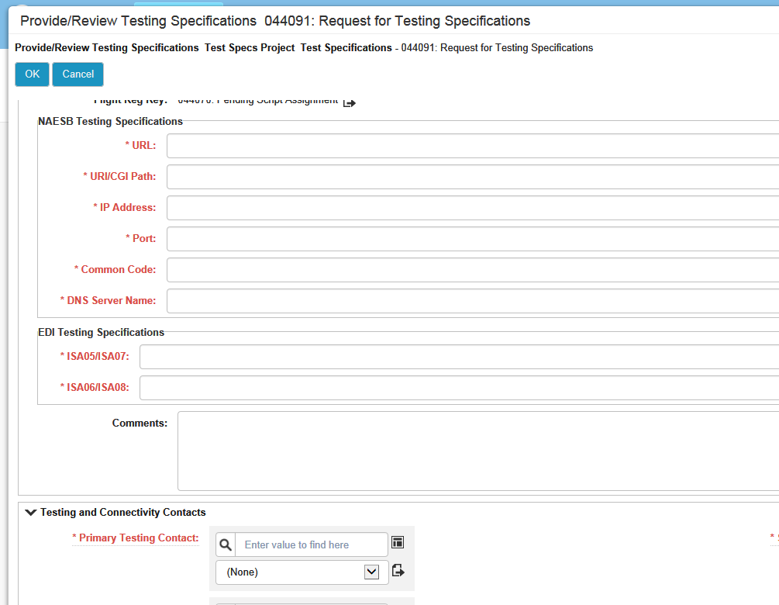
Providing Testing Specifications

Slide 12
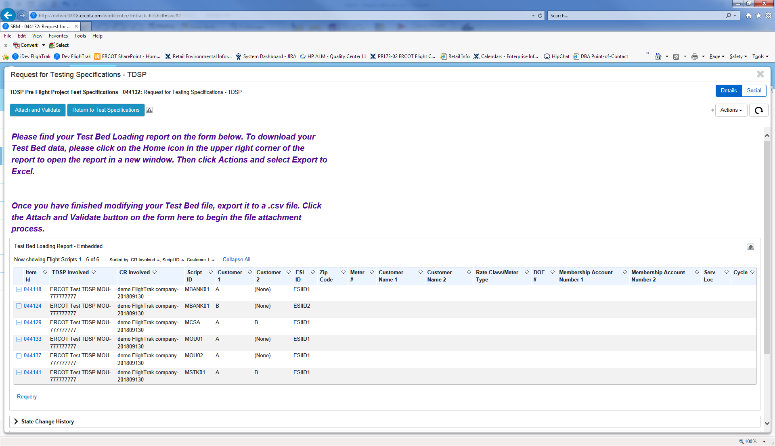
Providing Test Bed Information

Slide 13
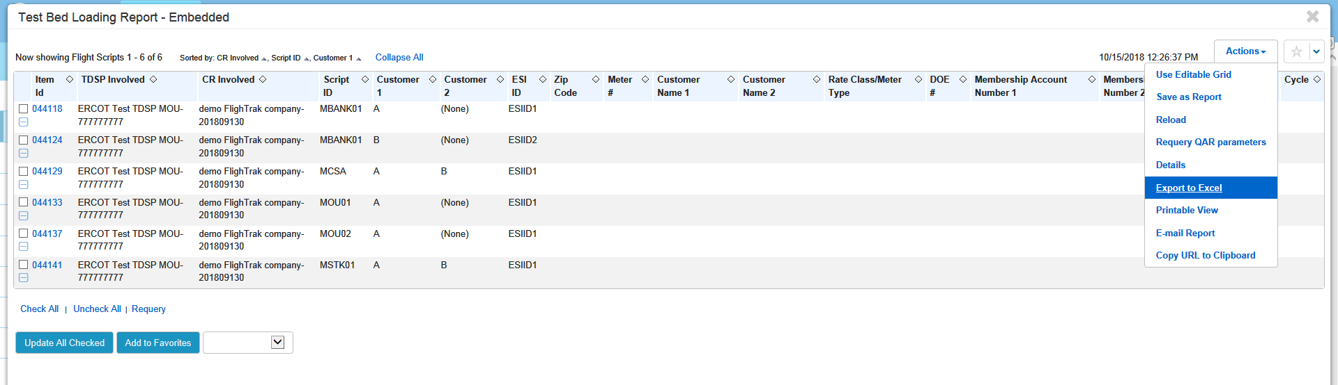
Downloading Test Bed

Slide 14
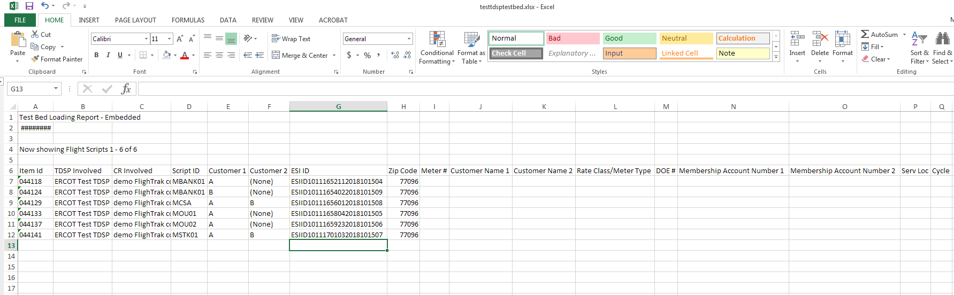
Populating Test Bed

Slide 15
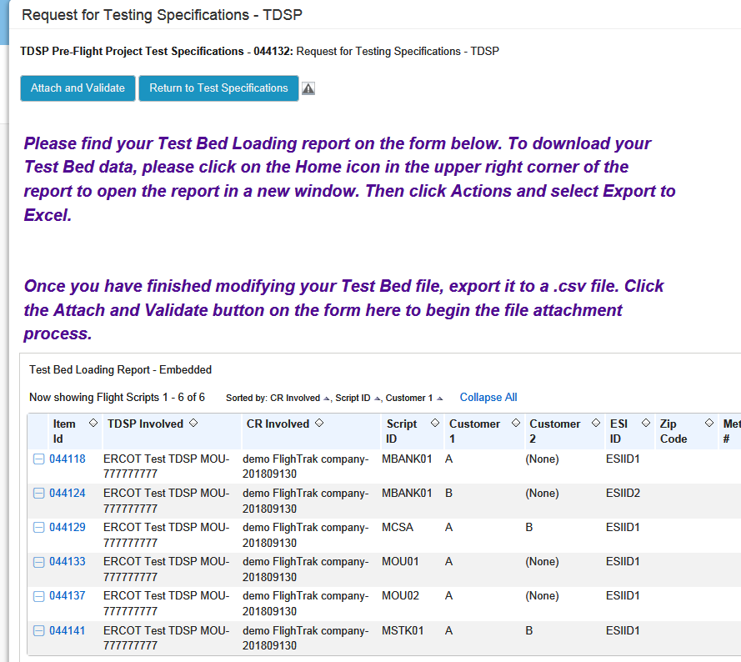
Uploading Test Bed

Slide 16
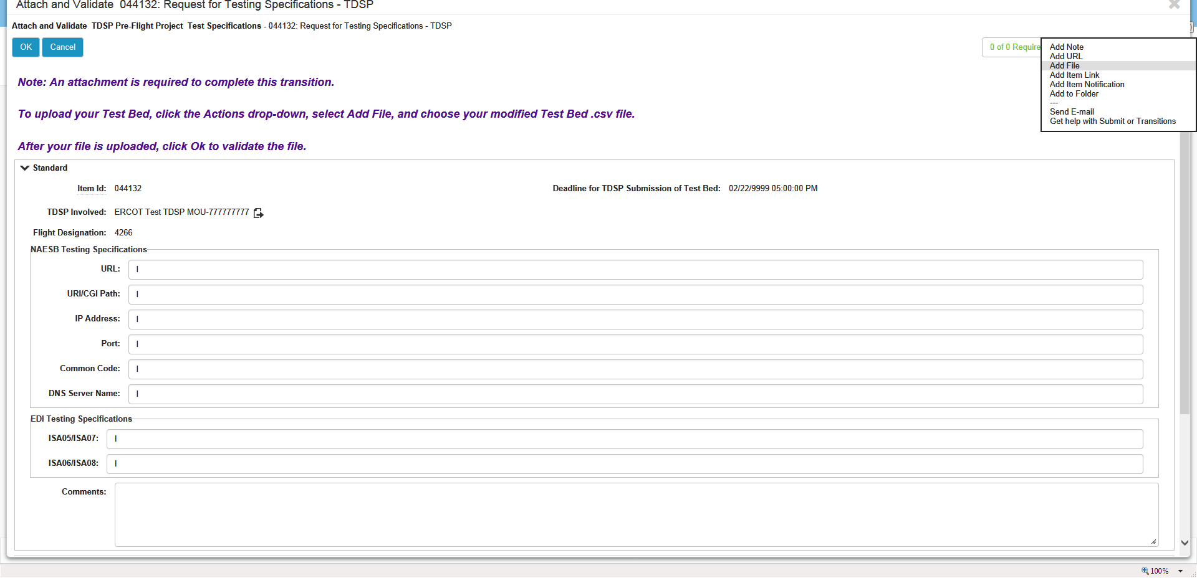
Uploading Test Bed

Slide 17
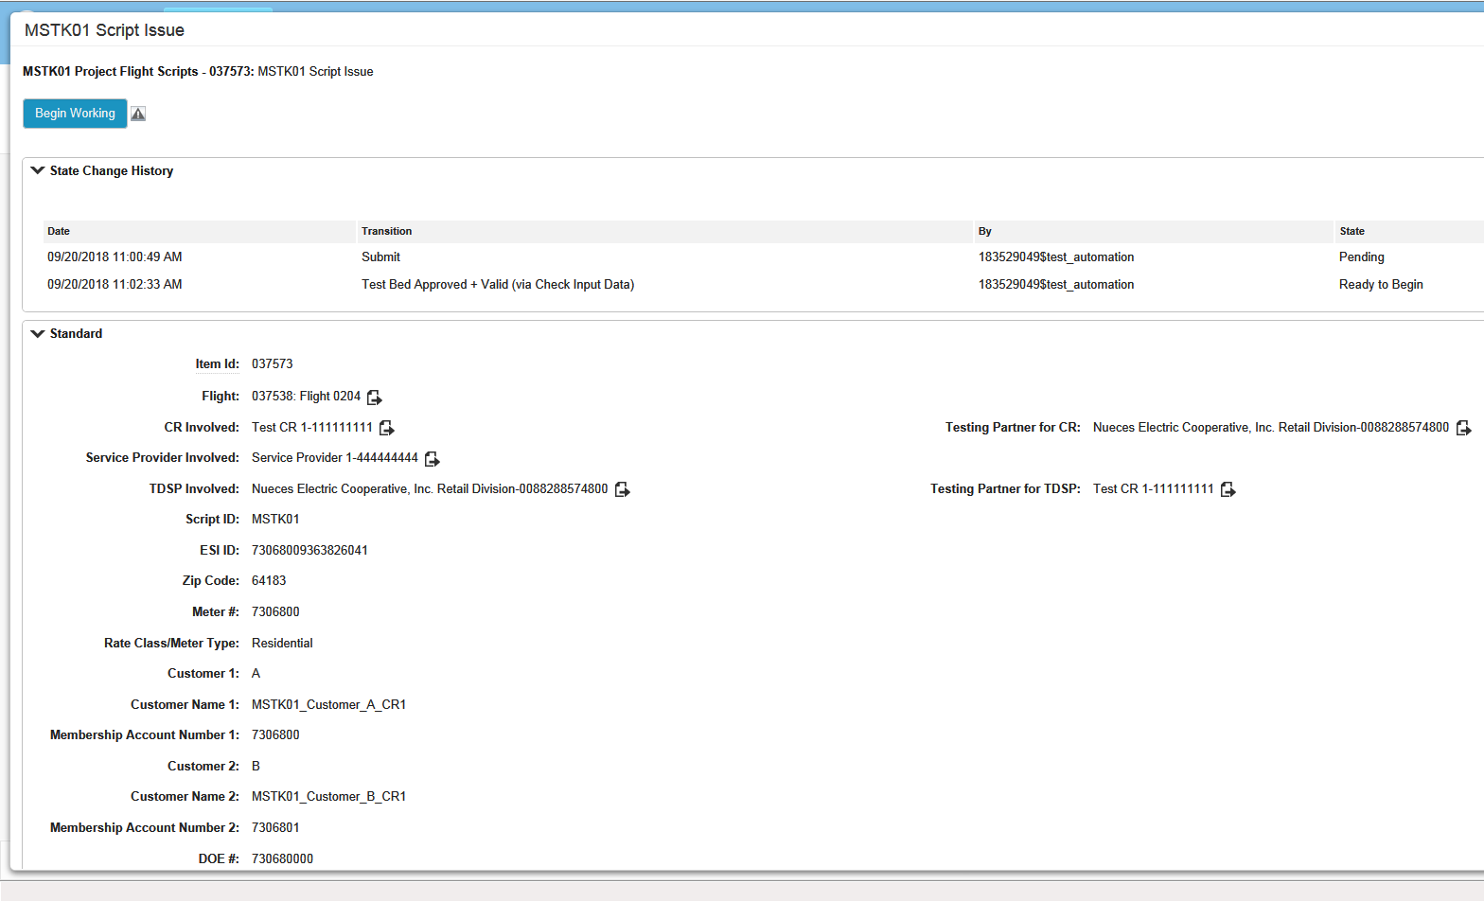
Starting a Script / Test Bed Information

Slide 18
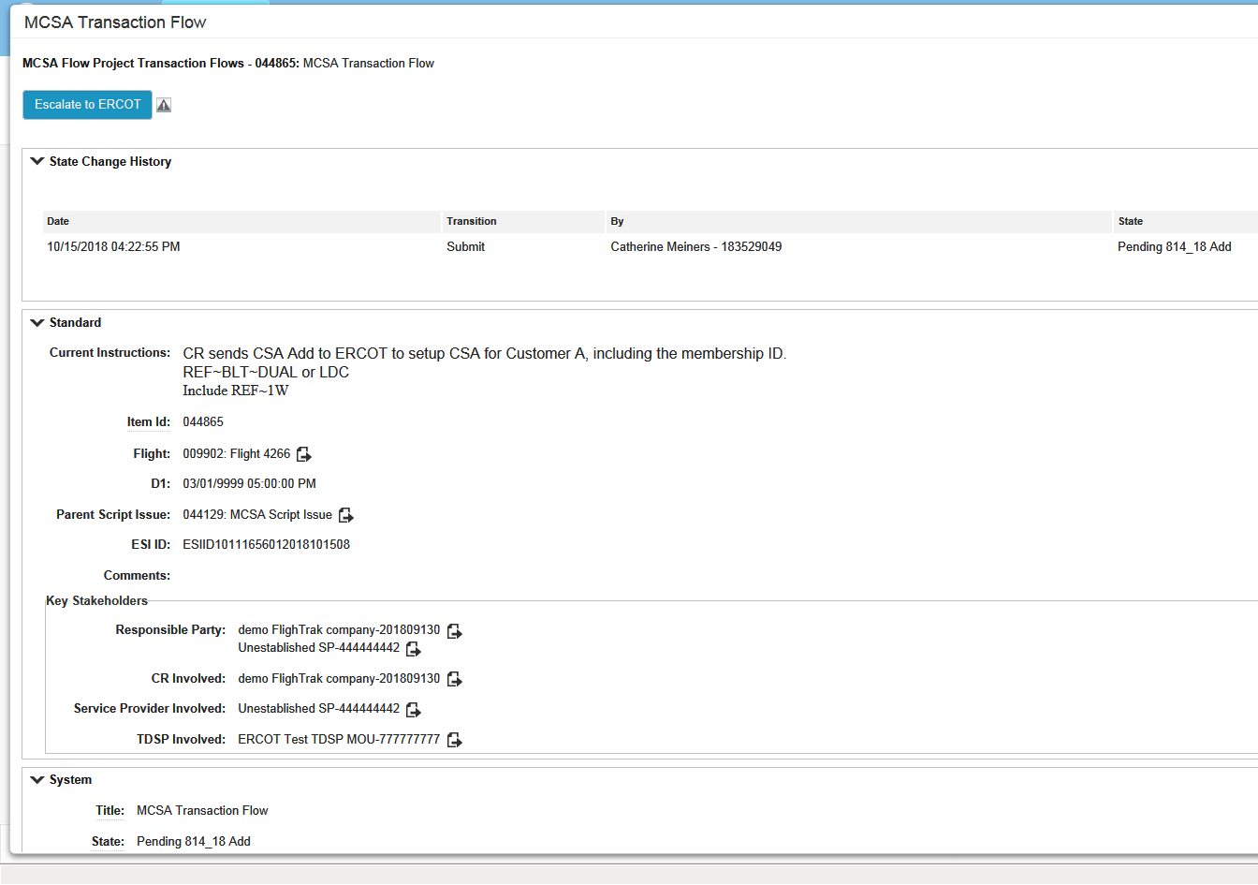
Script Instructions Included in FlighTrak

Slide 19
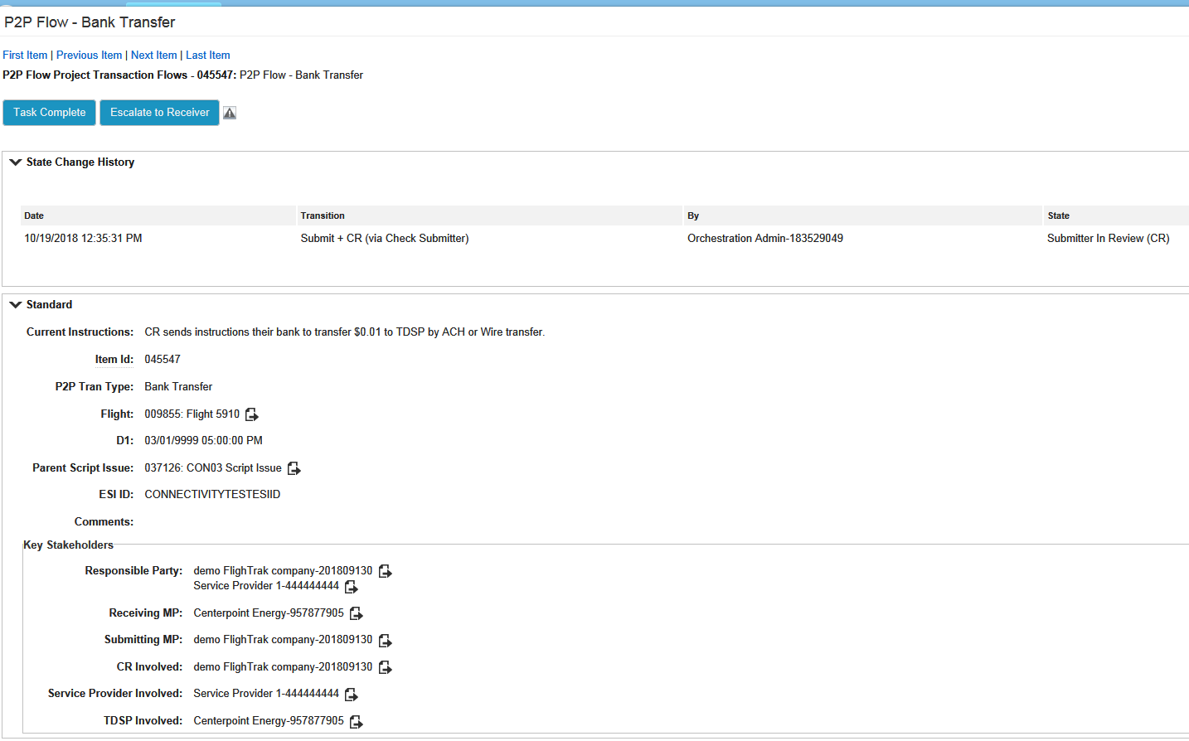
Point to Point Transitions

Slide 20
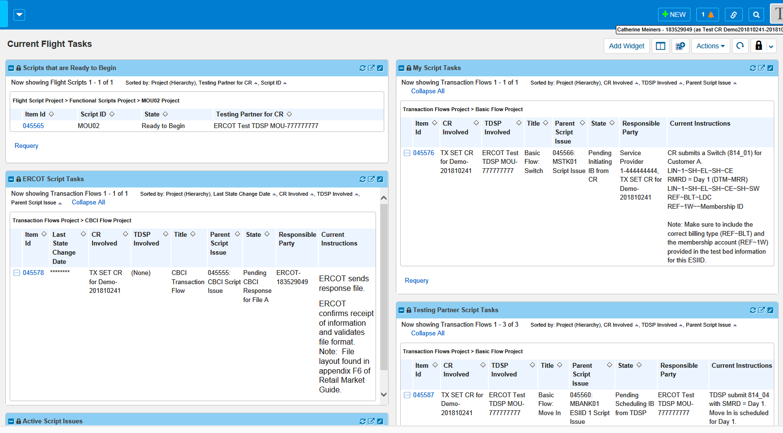
CR Dashboard – Current Flight Tasks

Slide 21
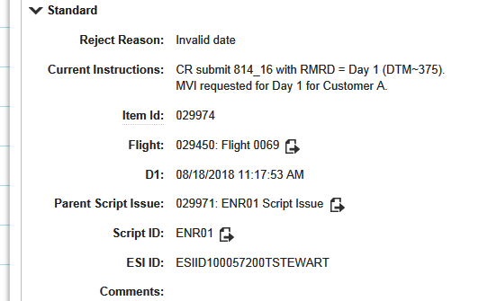
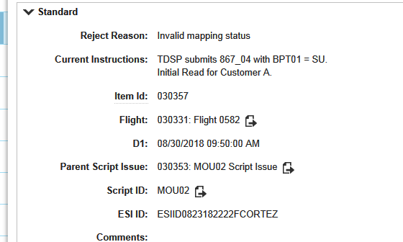
Error Messaging

Slide 22
Updated Documentation Storage
Currently a number of documents are stored on the ETOD site.
  SEF files will be moved to the Texas Standard Electronic Transaction Guides page and stored with the SET Implementation Guides
    http://www.ercot.com/mktrules/guides/txset/version
  The rest of the documentation will be moved to the Retail Market Test Flight Information page on ERCOT.com
    http://www.ercot.com/services/rq/lse/trt/index.html

Slide 23
Service Provider Access to FlighTrak
Service Providers will be set up in FlighTrak as unique entities. They will not being using CR credentials to access the tool.
Implications of this change –
  Service Providers will only be able to see Flights for which they have been selected by the CR to test in.
  Service Providers will only have access to information relevant to them, and not to more general CR information.
  Service Providers will NOT have to switch login credentials to view multiple CRs.
  Service Providers will need to be set up in FlighTrak in order to be selected to test with.
    If a CR wants to test with an unestablished Service Provider, they will need to provide ERCOT with details in advance of the Signup Deadline so ERCOT can add them to the tool.
    Service Providers will need to provide ERCOT with their DUNs number in order to be set up.

Slide 24
Additions to the Flight Sign Up Deadlines
Since Flight Registration will be completed inside the FlighTrak tool, new CRs (brand new CRs and DUNS+4 entities) will need to submit their LSE application and fee to ERCOT far enough in advance for them to be verified and then set up in the tool. This will need to be completed early enough to allow the AR/BAR to complete the Registration form prior to 5 pm on the signup deadline
Since existing CRs are already set up in the system, the only deadline applicable to them is the signup deadline.
Unless the existing CR wishes to test with a Service Provider that is not set up in FlighTrak. In this case, the CR must provide contact information for the New Service Provider to ERCOT so that they can be set up in the system before the deadline for the CR to complete the registration process.

Slide 25
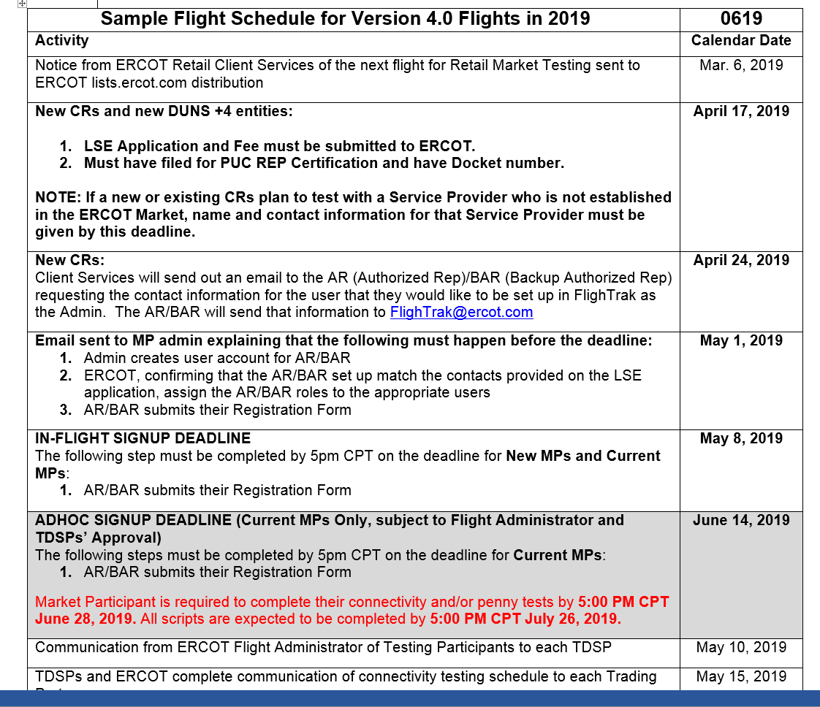
Draft Example of Schedule

Slide 26
Process Improvements
No need to email test beds to individual CRs
No need to send status emails
No need to send an email each time a transaction has been sent
No need to manually update the checklist. Transactions received by ERCOT will automatically move script issues forward.
MPs will only need to manually update scripts in FlighTrak in order to:
  Begin Working a Script
  Indicate that a P2P transaction was sent or received
  Escalate an issue to ERCOT or other involved Market Participant
  Investigate transactions that failed validations
Information provided by FlighTrak on why the transaction failed
Service Providers will be selected by the CR during the Registration process, ensuring confidentiality in that process.

Slide 27
Upcoming Dates
“Shadow” Flight, 0219
Initial Flight, 0619

Slide 28
Questions/Discussion

