Slide 1
Supply Analysis Working Group Meeting
NPRR 891 Update, Removal of NOIE Capacity Reporting Threshold of the Unregistered Distribution Generation Report
Pete Warnken
Manager, Resource Adequacy
October 19, 2018

Slide 2
Other Sources of Unregistered DG Data
Annual Load Data Request (ALDR)
Does not distinguish between Registered and Unregistered categories or primary fuel type
For the 2018 reporting year, all but two NOIEs indicated that DG is treated as negative load; Only two NOIEs that treat DG as negative load reported capacities in their ALDR forms (total of 7.6 MW)
For the 2018 reporting year, of the two NOIEs that treat DG as generation, no DG capacity amounts were reported in their ALDR forms
Unregistered DG is not accounted for in Carl Raish’s 4CP/demand response analysis
A small number of Unregistered DG units are reported as ERS generators (< 7 MW total) through the ERS Resource Identification process
Conclusion: overlap in Unregistered DG data collection is negligible

Slide 3
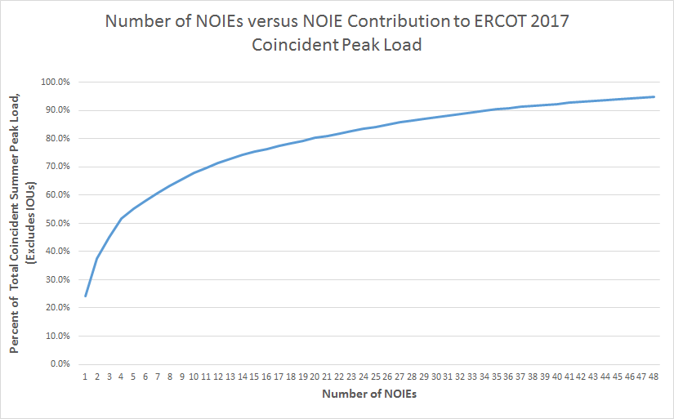
Peak Load Coverage at Various NOIE Load Exemption Thresholds
50 MW
100 MW
300 MW
500 MW
1000 MW
Chart is truncated at 50 MW threshold level; total NOIE population is 127
Data source: January and August 2017 TDSP Load Reports (posted on MIS)

Slide 4
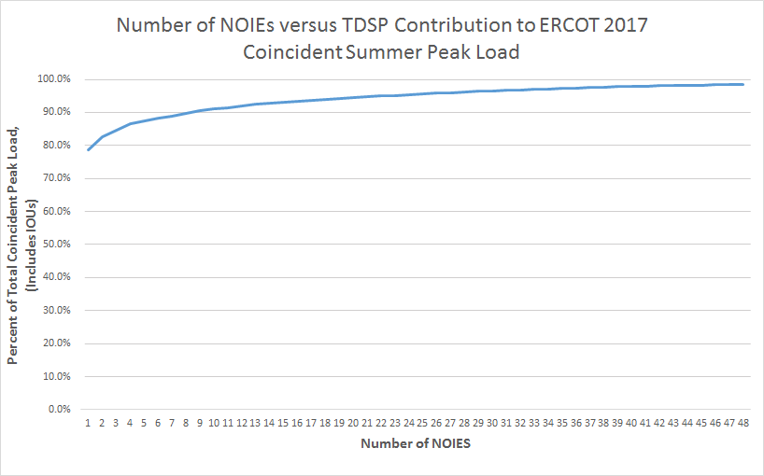
Peak Load Coverage at Various NOIE Load Exemption Thresholds
50 MW
100 MW
300 MW
500 MW
1000 MW
Chart is truncated at 50 MW threshold level; total NOIE population is 127
Data source: January and August 2017 TDSP Load Reports (posted on MIS)

Slide 5
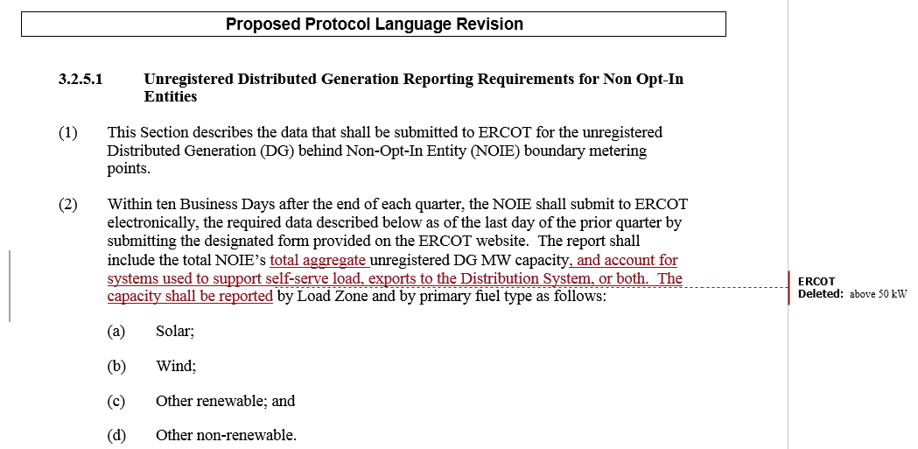
ERCOT’s Original NPRR891 Language

Slide 6
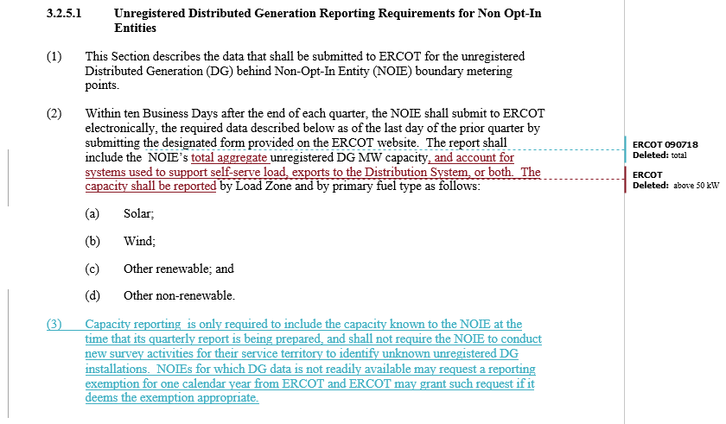
ERCOT’s Modified NPRR891 Language

Slide 7
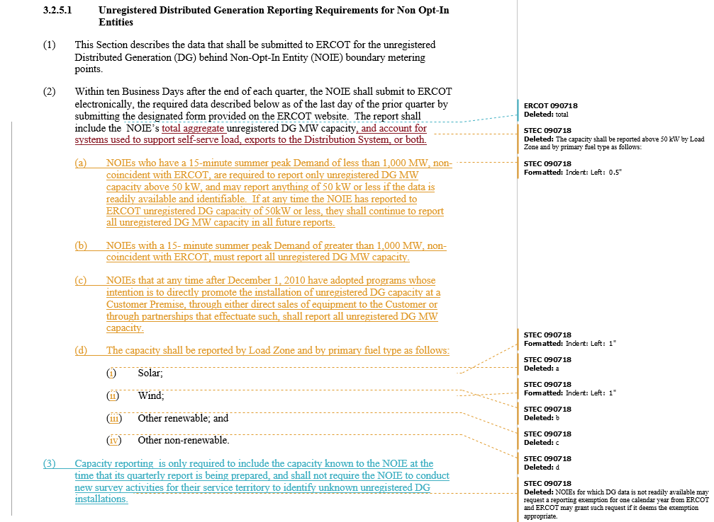
STEC’s Proposed NPRR891 Language

Slide 8
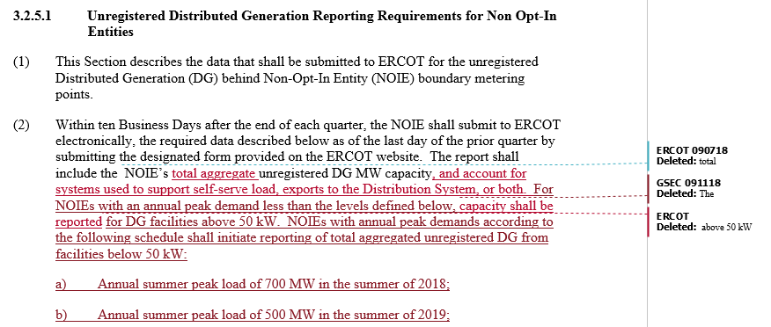
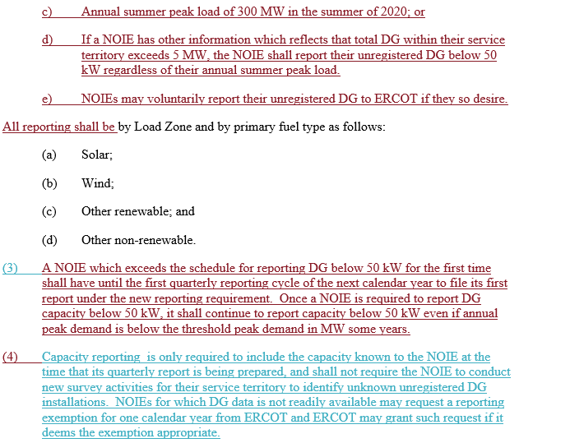
GSEC’s Proposed NPRR891 Language

