Slide 1
Project Update and Summary of
Project Priority List (PPL) Activity
October 18, 2018

Slide 2
Project Update Agenda
Project Portfolio Update p. 3-10
Recent / Upcoming Project Implementations
2018 Release Targets
2019 Release Targets
Planned Project Starts
Aging Items Report
2018 Project Spending Forecast
Revision Request Funding Placeholder Status
Priority/Rank Options for Revision Requests with Impacts
Appendix
Project Portfolio Gantt Chart p. 11-18
Location of Project Priority List (PPL): http://www.ercot.com/services/projects/index

Slide 3
Recent / Upcoming Project Implementations
2018 October Release – 10/23/2018 – 10/25/2018 In Flight
NPRR833(a) – Modify PTP Obligation Bid Clearing Change
DAM changes
Moved to December with part (b)
Performance issues added testing iterations
NPRR843(a) – Short-Term System Adequacy & AS Offer Disclosure Reports Additions
One CDR report, one 48-hour report, and two 7-day reports
NPRR864 – RUC Modifications to Consider Market-Based Solutions
NPRR875 – Clarification for the Implementation of NPRR864, RUC Modifications to Consider Market-Based Solutions
RRGRR015 – Additional Guidance for Transformer and Station Data
Will go live on 11/1/2018
RRGRR016 – Additional Guidance for Solar Data
Being held for now to combine with RRGRR018 and RRGRR019
This will reduce impact on Market Participants
SCR795 – Addition of Intra-Hour Wind Forecast to GTBD Calculation
Note: Projected Go-Live dates are subject to change. Please watch for market notices as the effective dates approach.

Slide 4
2018 Release Targets – Board Approved NPRRs / SCRs / xGRRs
February 2/6 – 2/8 | April 4/5 – 4/9 | May 5/29 – 5/31 | August 8/7 – 8/9 | October 10/23 – 10/25 | December 12/11 – 12/13
NPRR659 NPRR683 NPRR743 NPRR760 NPRR800 NPRR810 PGRR042 NPRR846 | NPRR562(b) SCR792 NPRR776 NOGRR167 | NPRR768 NPRR815 OBDRR002 PGRR057 | NPRR819 NPRR844 NPRR854 SCR791 NPRR702 (partial implementation) | NPRR833(a) NPRR843(a) NPRR864 NPRR875 RRGRR015 RRGRR016 SCR795 NPRR825(a) | NPRR809(b) NPRR833(a/b) NPRR842 NPRR843(b) NPRR858 SCR794 RRGRR015
8 | 4 | 4 | 5 | 5 | 4
ü
ü
ü
ü
ü
ü
ü
ü
ü
ü
ü
ü
ü
ü
ü
ü
ü
E
E
E
E
E
E
E
E
E
CMM Release 1a
1/1 & 2/1
6/1
7/2
9/1
10/1
11/1
1/1
ü
ü
ü
ü
ü
2/1
TBD Items (and point at which they became “TBD”)
2014 | 2015 | 2016 | 2017 | 2018
NPRR664 | None | SCR781 P | NPRR702 P, SCR777, NPRR831(b), NPRR749 E | RRGRR016, NPRR519, NPR620, NPRR741, NPRR755
Go-live dates can differ from Protocol effective dates – Please refer to market notices for more details
APPENDIX
Red Text: New additions and target release changes
Strike-Through Text: Previous target release
(a), (b), etc.: Multiple phase release
Project Status Codes
NS = Not Started
I = Initiation
P = Planning
E = Execution
H = On Hold
NPRR825(a) – NoticeBuilder changes
NPRR562(b) – Reporting/posting system changes
NPRR809(b) – Reporting/posting system changes
NPRR833(a) – DAM system changes
NPRR833(b) – SCED system changes
NPRR843(a) – CDR, 48 hour, & 7 day reports
NPRR843(b) – 60 day reports
Release targets are subject to change

Slide 5
2019 Release Targets – Board Approved NPRRs / SCRs / xGRRs
February Dates TBD | April Dates TBD | May Dates TBD | August Dates TBD | October Dates TBD | December Dates TBD
NPRR842 NPRR866 PGRR061 RRGRR017 SCR794 VCMRR022 | NPRR817 NPRR847 NPRR856 NPRR858 NPRR865 NPRR873 NPRR880 NOGRR174 SCR793 SCR796 | NPRR821 |  |  | NPRR877 Ph2
6 | 10 | 1 | 0 | 0 | 1
E
NS
NS
NS
E
I
I
NS
NS
NS
NS
NS
NS
NS
NS
NS
January
NS
Go-live dates can differ from Protocol effective dates – Please refer to market notices for more details
APPENDIX
Red Text: New additions and target release changes
Strike-Through Text: Previous target release
(a), (b), etc.: Multiple phase release
Project Status Codes
NS = Not Started
I = Initiation
P = Planning
E = Execution
H = On Hold
Release targets are subject to change

Slide 6
Approved Revision Requests “Not Started” – Planned to Start in Future Months
Revision Request | Target Start Date | Release Target | Cost Estimate | Author
NPRR858 – Provide Complete Current Operating Plan (COP) Data | Oct 2018 | 2019-R2 | $25k-$45k | Citigroup Energy
NPRR847 – Exceptional Fuel Cost Included in the Mitigated Offer Cap NPRR817 – Create a Panhandle Hub | Oct 2018 | 2019-R2 | $40k-$60k $150k-$200k | ERCOT DC Energy
VCMRR022 – Determination of Fuel Adder Price for Coal and Lignite Resources | Oct 2018 | Jan 2019 | $20k-$30k | ERCOT
NPRR821 – Eliminate CRR Deration Process for Resource Node to Hub or Load Zone CRRs | Oct 2018 | 2019-R3 | $30k-$50k | DC Energy
NPRR856 – Treatment of OFFQS Status in Day-Ahead Make Whole & RUC Settlement | Oct 2018 | 2019-R2 | $50k-$75k | ERCOT
NPRR865 – Publish RTM Shift Factors for Hubs, Load Zones, and DC Ties NPRR880 – Publish RTM Shift Factors for Private Use Network Settlement Points | Oct 2018 | 2019-R2 | $30k-$40k $30k-$40k | DC Energy
NPRR866 – Mapping Registered DG and Load Resources to Transmission Loads in the Network Operations Model PGRR061 – Related to NPRR866 RRGRR017 – Related to NPRR866 | Oct 2018 | 2019-R1 or 2019-R2 | $10k-$20k <$10k $20k-$40k | ERCOT
SCR793 – SSR Related Telemetry for Transmission Service Provider (TSP) Operators | Oct 2018 | 2019-R2 | $40k-$50k | Cross Texas Transmission
NOGRR174 – AVR and PSS Testing Requirements | Nov 2018 | 2019-R2 | $30k-$50k | Luminant
SCR796 – Change Validation Rules to Preclude Certain Transactions at Resource Nodes within PUNs | Nov 2018 | 2019-R2 | $35k-$55k | ERCOT
NPRR873 – Posting ERCOT-Wide Intra-Hour Wind Power and Load Forecast on MIS Public | Dec 2018 | 2019-R2 | $60k-$80k | ERCOT
Moved from September start
Project Initiations – Next 3 Months

Slide 7
Aging Items Report
Aging Items Report | Last Action | Status
NPRR664 – Fuel Index Price for Resource Definition and Real-Time Make-Whole Payments for Exceptional Fuel Cost Events | Board approved on 12/9/2014 | Board approved NPRR847 in August 2018 ERCOT presented options to WMS in Sept 2018 to resolve remaining gray-boxes QMWG discussed on 10/15/2018

Slide 8
2018 Project Spending
2018 PPL Budget = $20.0M
“Potential Demand” represents internal ERCOT projects that have not been fully approved

Slide 9
Revision Request Funding Placeholder Status
In 2018 and 2019, ERCOT forecasted $4.0M for Revision Request work
Yearly Revision Request Spending Forecast Summary
Project Status | 2018 | 2019
YTD Actuals | $1.83M
Approved – In-Flight / Complete | $2.36M | $0.94M
Approved – Not Started | $0.10M | $0.43M
Remaining Funding | $1.54M | $2.63M
Total Allocation | $4.00M | $4.00M
As of 9/30/2018

Slide 10
Priority / Rank Options for Revision Requests with Impacts
Options for…
Revision Request | Description | Priority | Rank | Comments
NPRR879 | SCED Base Point, Base Point Deviation, and Performance Evaluation Changes for IRRs that Carry Ancillary Services | 2019 | 2550 | IA revised based on 8/3/2018 ERCOT comments Add to end of 2019 list and work into the plan without disrupting in-flight projects
NPRR887 | Monthly Posting of Default Uplift Exposure Information | 2019 | 2560 | IA still in progress at time of mailing Add to end of 2019 list and work into the plan without disrupting in-flight projects
NPRR895 | Inclusion of Photo-Voltaic Generation Resources (PVGRs) in Real-Time Ancillary Service Imbalance Payment or Charge | 2019 | 2570 | Plan to implement in conjunction with OBDRR007 Add to end of 2019 list and work into the plan without disrupting in-flight projects
PPL Rank Information
Next available 2019 Rank in Business Strategy = 2550
Next available Rank in Regulatory = 220

Slide 11
Appendix
10/1/2018 Project Gantt
In-flight items sorted by Project End Date
“Not Started” items sorted by Project Start Date

Slide 12
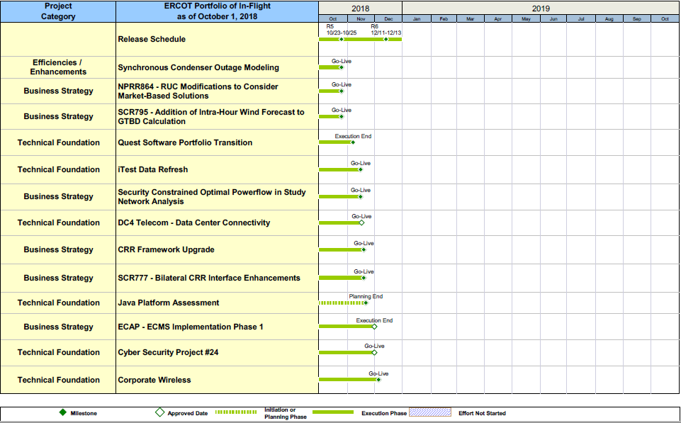
Project Portfolio Status – as of 10/1/2018

Slide 13
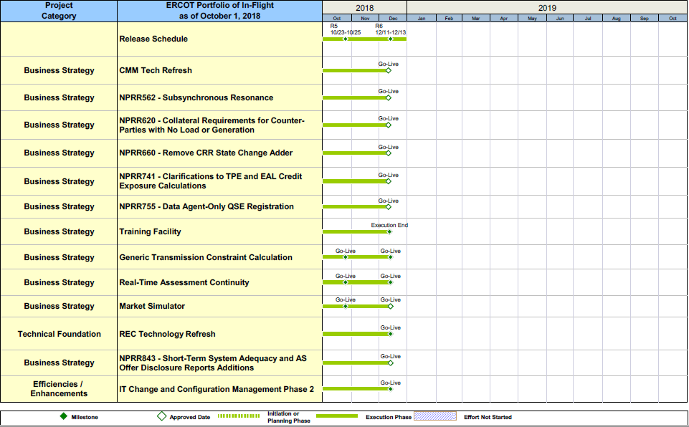
Project Portfolio Status – as of 10/1/2018

Slide 14
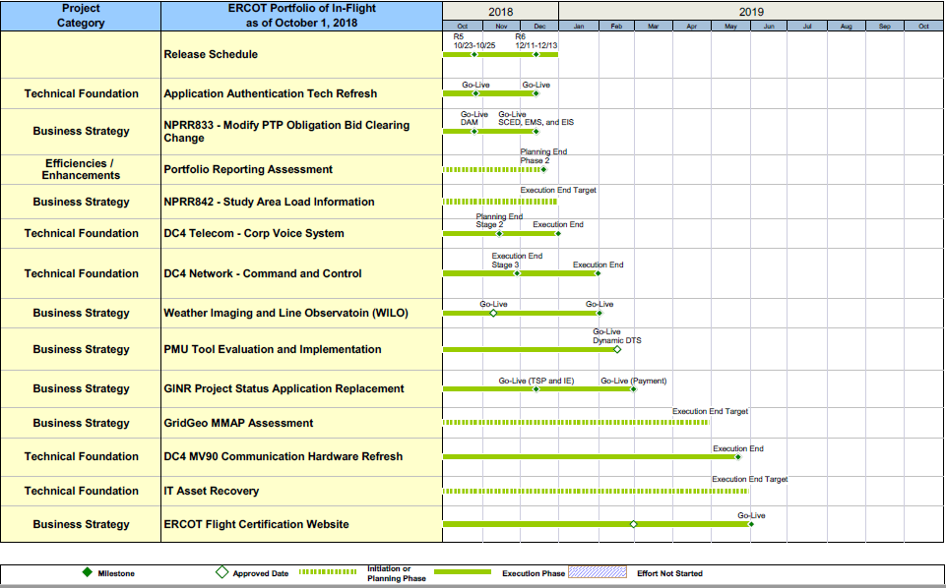
Project Portfolio Status – as of 10/1/2018

Slide 15
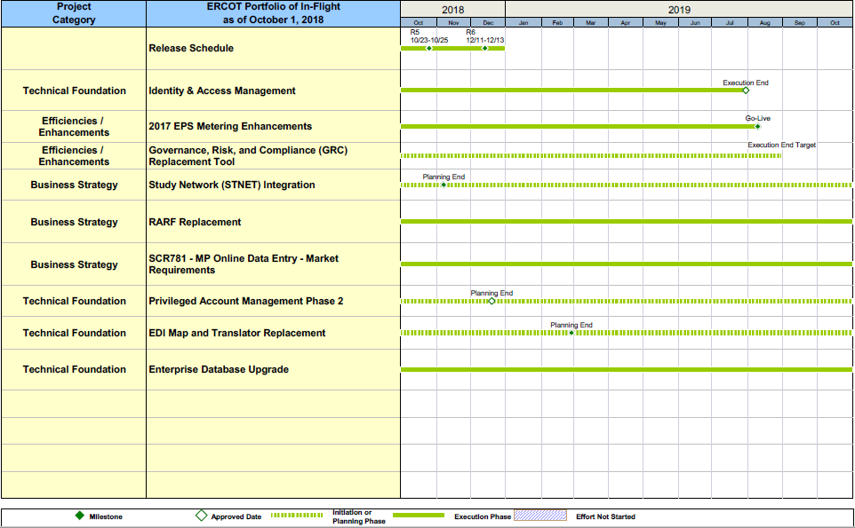
Project Portfolio Status – as of 10/1/2018

Slide 16
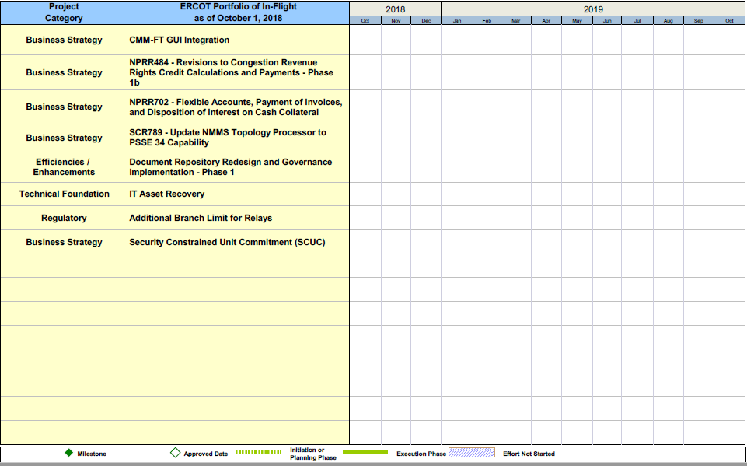
Project Portfolio Status – as of 10/1/2018 – On Hold

Slide 17
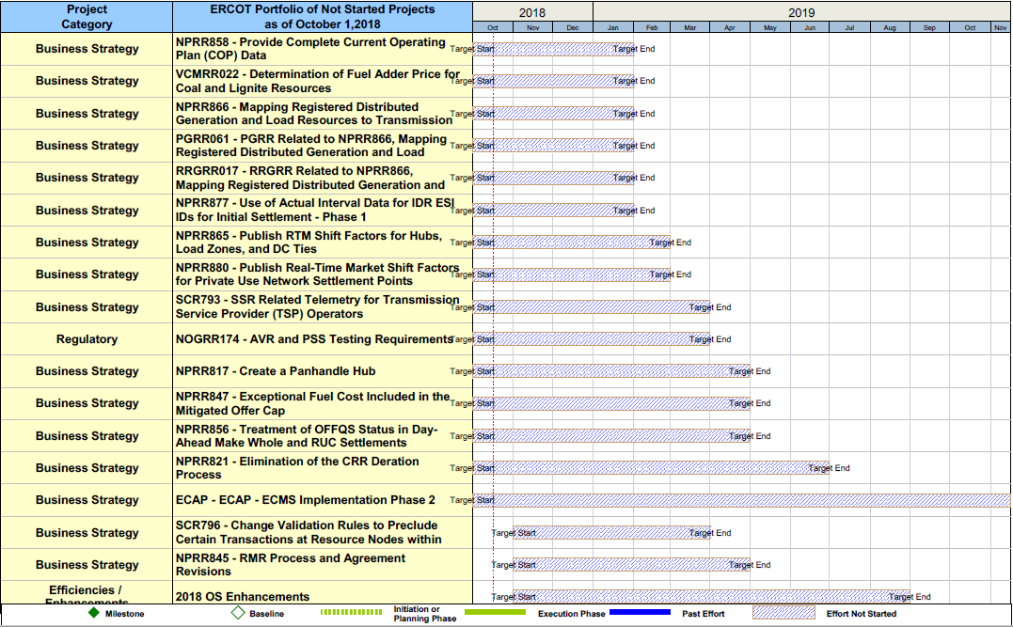
Project Portfolio Status – as of 10/1/2018 – Not Started

Slide 18
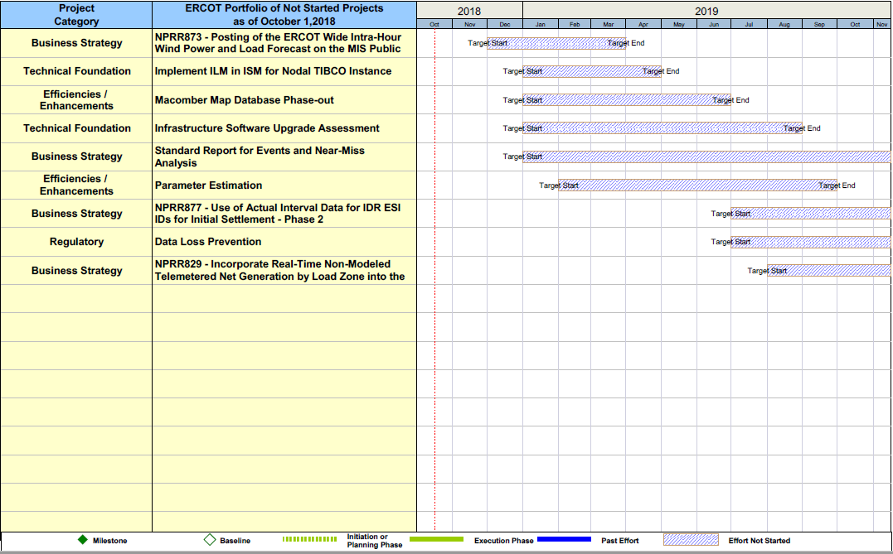
Project Portfolio Status – as of 10/1/2018 – Not Started

