Slide 1
Collateral Usage – September 2018
Excess Collateral is defined as remaining collateral after Total Potential Exposure (TPE). Collateral in excess of TPE is necessary to cover credit locked for CRR auctions and DAM bid exposures.
In the following chart, “CRR Locked ACL” is the sum of credit locked in September 2018 for the 2018 CRR October monthly auction and the 2021 1st6 Annual Auction Seq6.
Average TPE, CRR Locked ACL and DAM Bid Exposure together account for 45% of average collateral for the month of September.

Slide 2
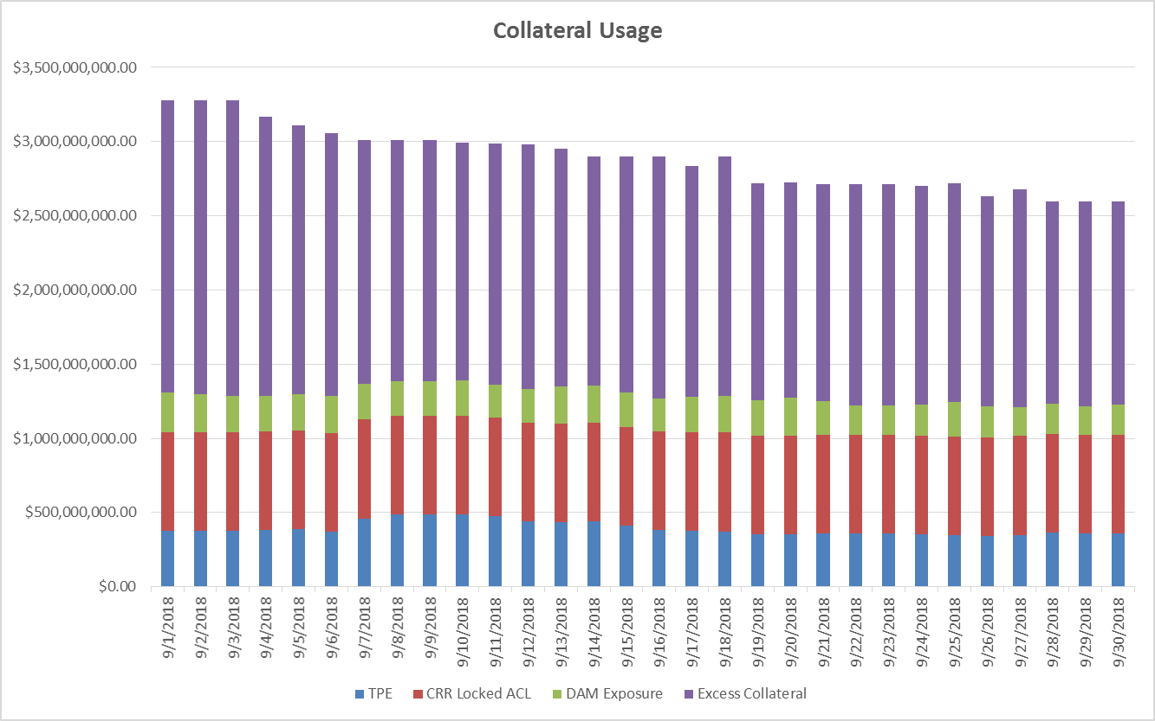
Collateral Usage – September 2018

