Slide 1
Letter of Credit Issuer Limits
ERCOT Public
October 08, 2018

Slide 2
Letter of Credit Issuer Limits
Protocol Section 16.11.3, Alternative Means of Satisfying ERCOT Creditworthiness Requirements, incorporates letter of credit (LC) issuer limits determined by the long-term issuer rating and the Tangible Net Worth of the Issuer.
Protocol Section 16.11.3 requires ERCOT Board approval (upon TAC recommendation) when limits are being revised.
The F&A Committee has requested a semi-annual review of the letter of credit issuer concentration.

Slide 3
Letter of Credit Issuer Limits
LC issuer limits are determined as follows:
Issuer Rating ⁽¹⁾ |  | Maximum Letter of Credit Issuer Limit as a % of Tangible Net Worth
Moody’s | Fitch/S&P
Aaa | AAA | 1.00%
Aa1 | AA+ | .95%
Aa2 | AA | .90%
Aa3 | AA- | .85%
A1 | A+ | .80%
A2 | A | .75%
A3 | A- | .70%
⁽¹⁾ Determined in accordance with ERCOT Protocol Section 16.11.3, based on most recent audited financial statements.
In addition, each issuer is subject to an overall limit of $750 million.

Slide 4
Letter of Credit Issuer Limits
ERCOT computed the issuer limits and reviewed outstanding LCs for the six months ending August 31, 2018
Summary Statistics
Number of issuers: 27
Minimum computed limit: $19.24 million
Issuers with limit at $750 million cap: 5
Minimum current excess capacity: $19.04 million
Maximum current excess capacity: $673.78 million
LC issuances in violation of limits: 0

Slide 5
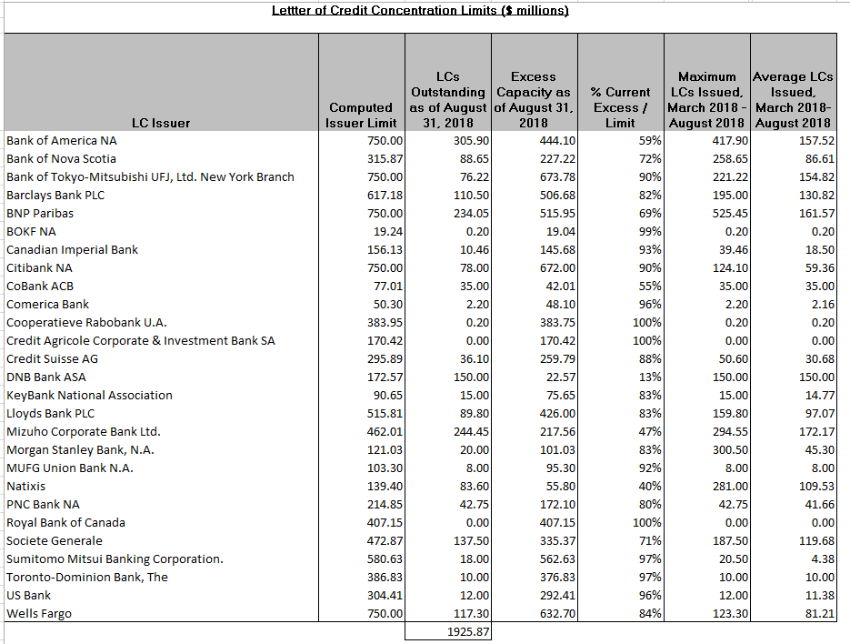
Letter of Credit Issuer Limits

Slide 6
Letter of Credit Issuer Limits
Questions

