Slide 1
ERCOT Frequency Control Report
July 2018
ERCOT
Operations Planning
PDCWG | October 22nd, 2018

Slide 2
Summary of September 2018
CPS1: 174.40%
Current CPS1 12-Month Rolling Average: 176.01%
7 BAAL Exceedances
  Loss of ICCP Event
  Unit Losses
2 hourly CPS1 scores below 100%
BAAL-003 Events have not been updated past May
2018 BAAL-003 FRM Performance: -788.77
2018 RMS1 Statistics
  Mean: 15.15 mHz
  Min: 13.77 mHz
  Max: 17.84 mHz
September Energy Statistics
  Total Energy: 32,513,579 MWh
  Wind Energy: 3,770,566 MWh
  Percent Energy from Wind Generation: 11.60%
September Minimum System Inertia
  Mean: 251,051
  Min: 196,700 on September 30th
  Max: 281,526 on September 6th
Notes:
Wind Energy lower than 2017

Slide 3
Frequency Control
CPS1, BAAL, & RMS1

Slide 4
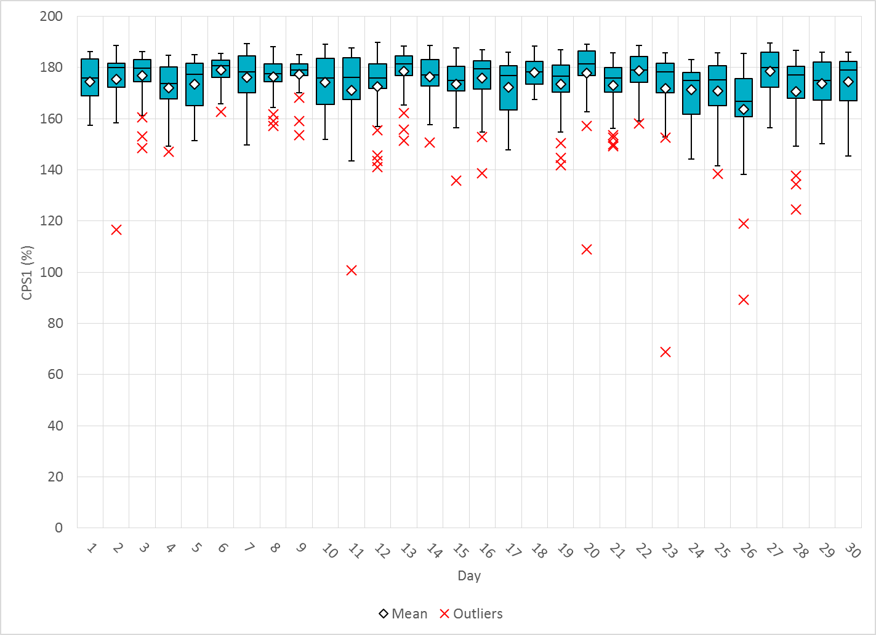
Hourly CPS1 by Day
September-18 CPS1 (%): 174.40
Notes:
Outliers:
9/11/18 16:00: 100.87%
Large expected generation deviation. Regulation exhausted from 4:15 PM until 4:27 PM.
9/23/18 16:00: 68.75%
ICCP Event. Units ramped down by approximately 950 MW. Regulation exhausted several times throughout the hour.
9/26/18 13:00: 89.16%
Wind dropped by approximately 2,257 MW throughout the hour. Regulation exhausted from 13:10 until 13:17. Loss of 1006 MW at 13:54.

Slide 5
BAAL Exceedances & Violations
There were 7 BAAL exceedances
  September 23, 2018
    Loss of ICCP Event
    950 MW of generation ramp down
    Less than 59.91 Hz for 3 minutes
  September 26, 2018
    Unit trip at 13:54:03
    Loss of 1006 MW
    Less than 59.91 Hz for 3 minutes
  September 28, 2018
    Unit trip at 12:00:14
    Loss of 837 MW
    Less than 59.91 Hz for 1 minute

Slide 6
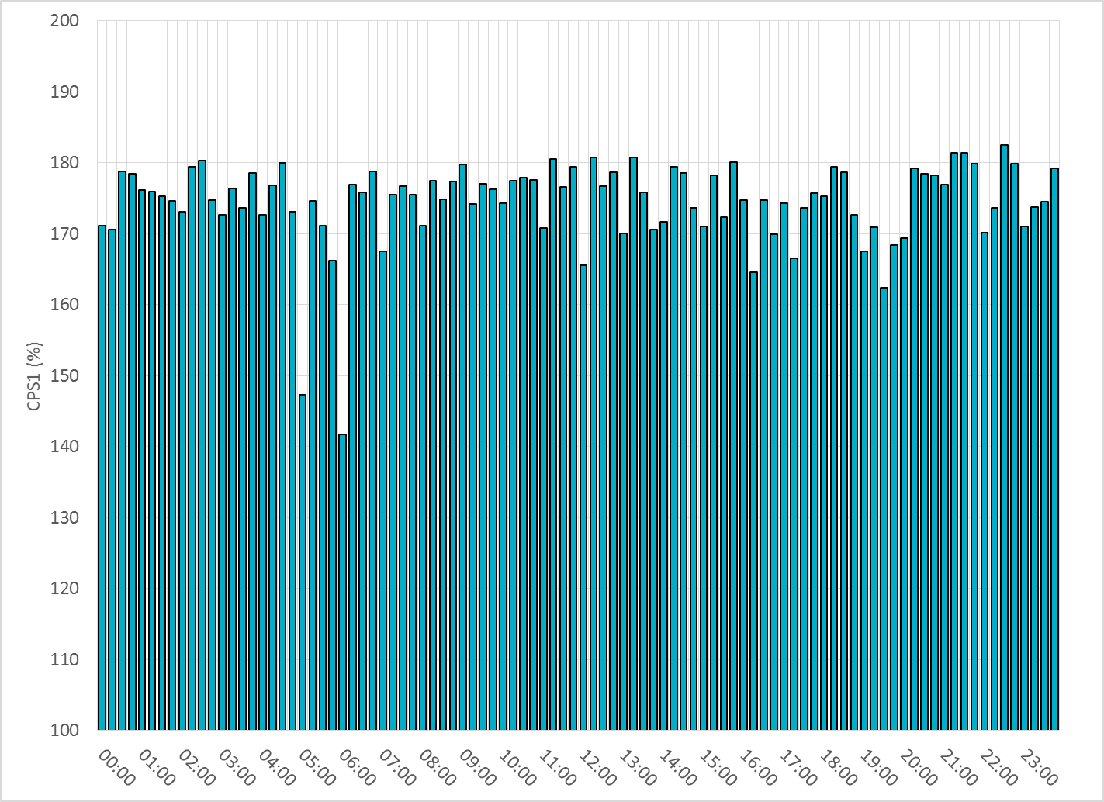
15-Minute Average CPS1%
September-18 CPS1 (%): 174.40

Slide 7
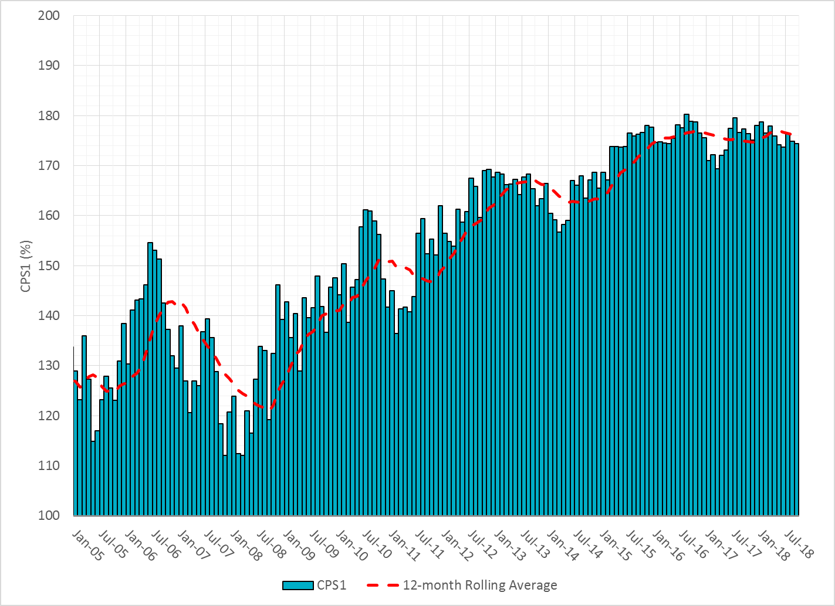
12-Month Rolling Average CPS1
Current 12-Month Rolling Average: 176.01%

Slide 8
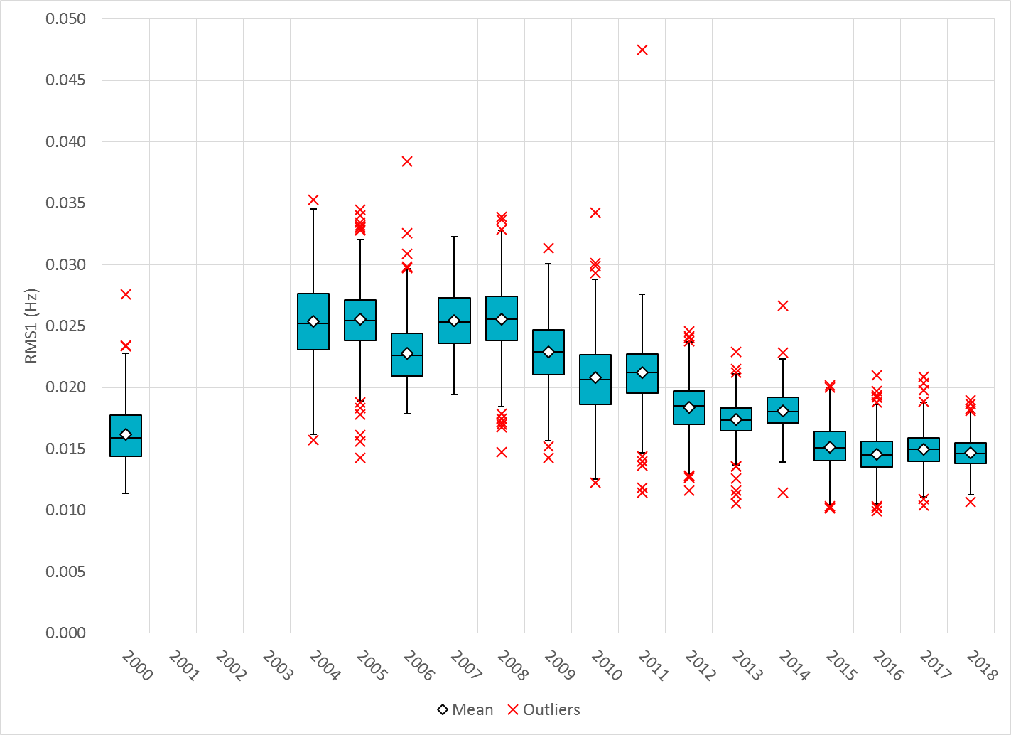
Daily RMS1 of ERCOT Frequency by Year
Notes:
Mean is 14.69 mHz

Slide 9
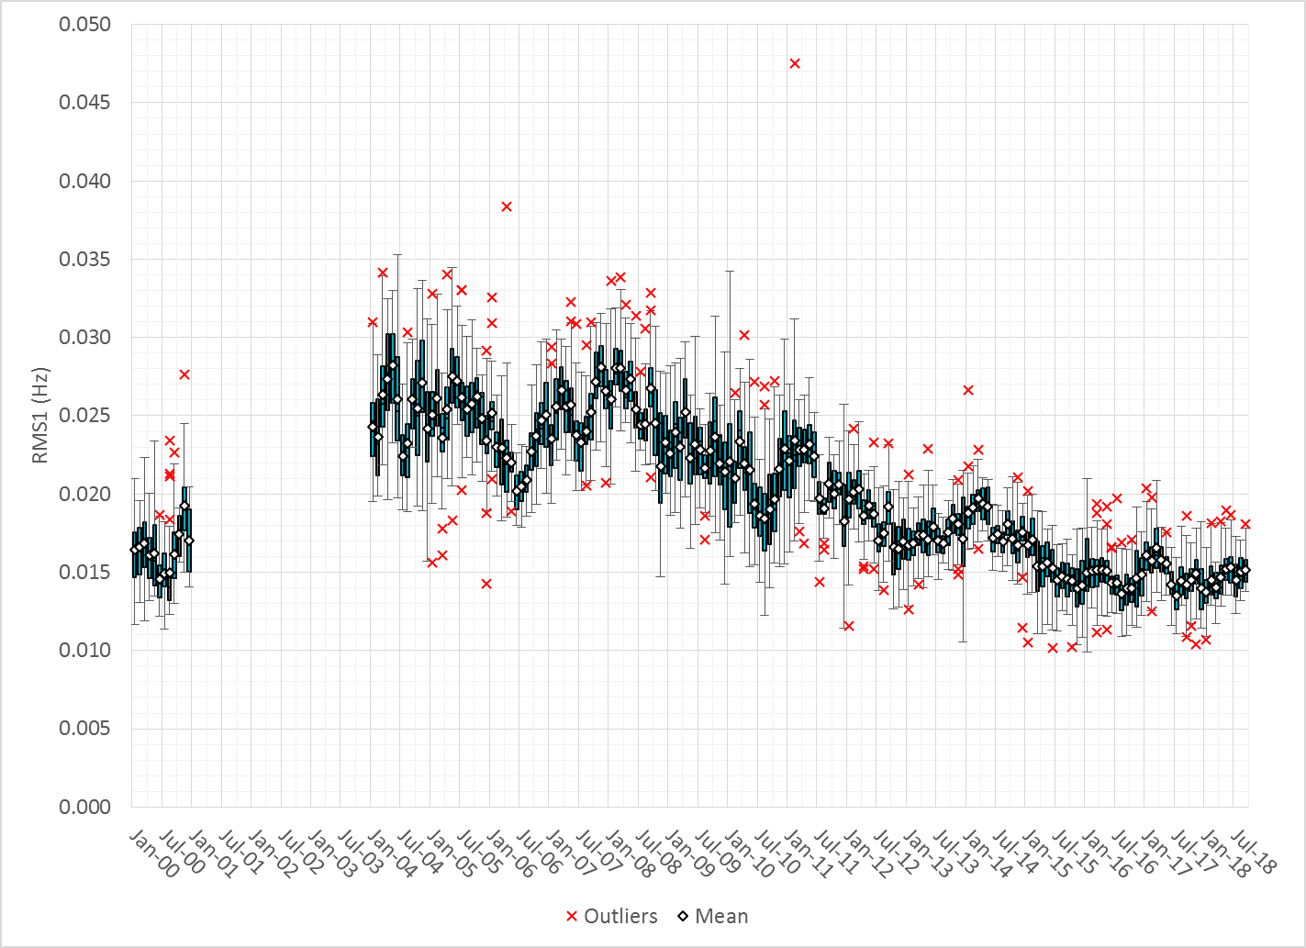
Daily RMS1 of ERCOT Frequency by Month

Slide 10
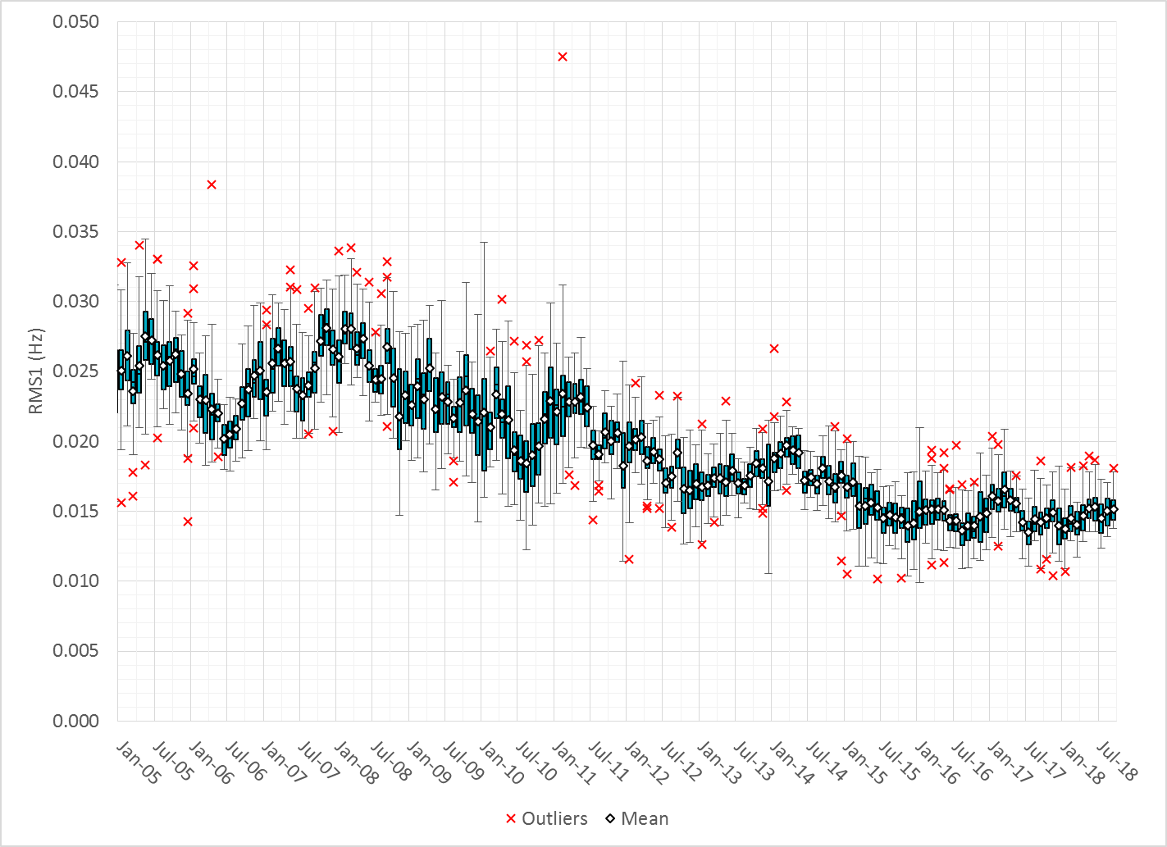
Daily RMS1 of ERCOT Frequency by Month

Slide 11
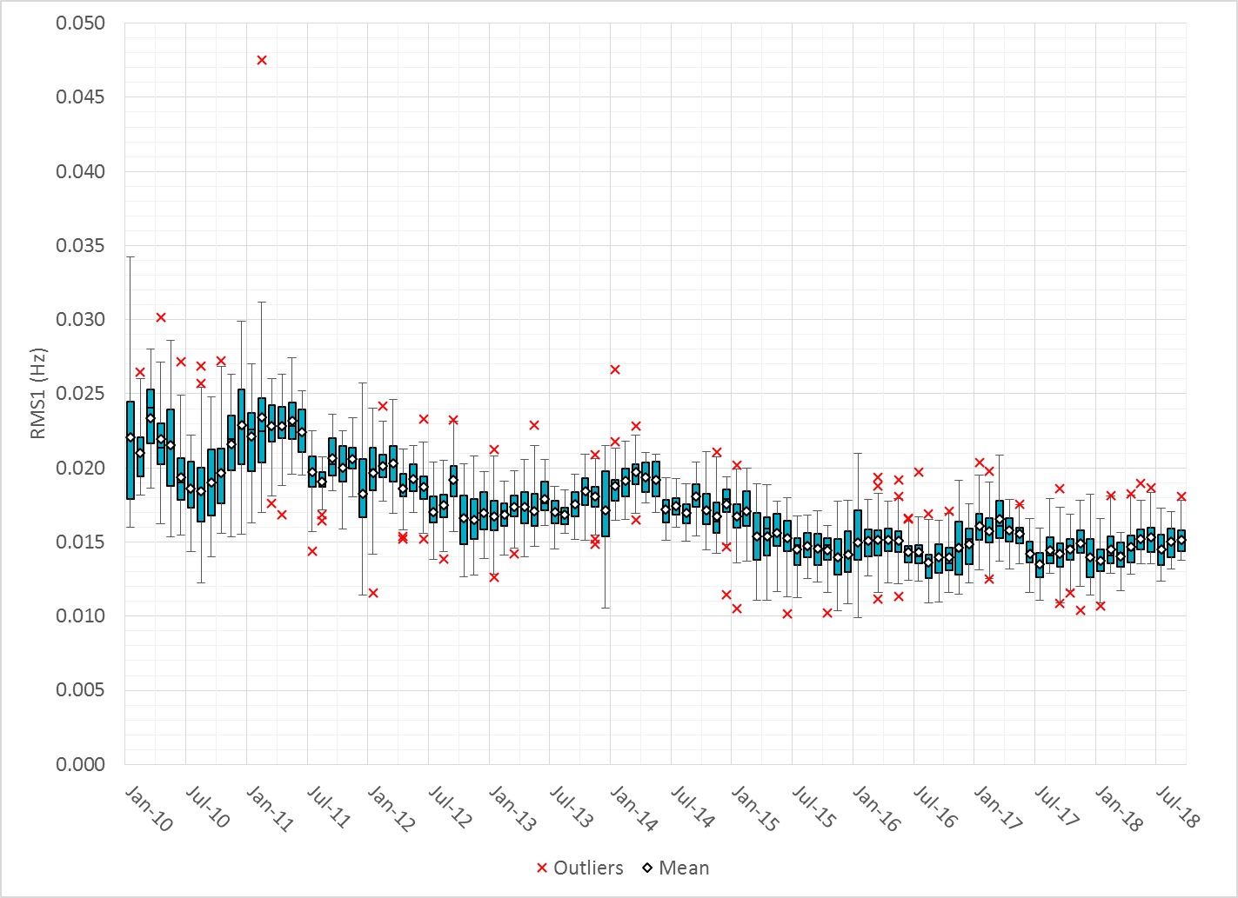
Daily RMS1 of ERCOT Frequency by Month
Notes:
Mean: 15.15 mHz
Min: 13.77 mHz
Max: 17.84 mHz

Slide 12
Frequency Profile Comparison

Slide 13
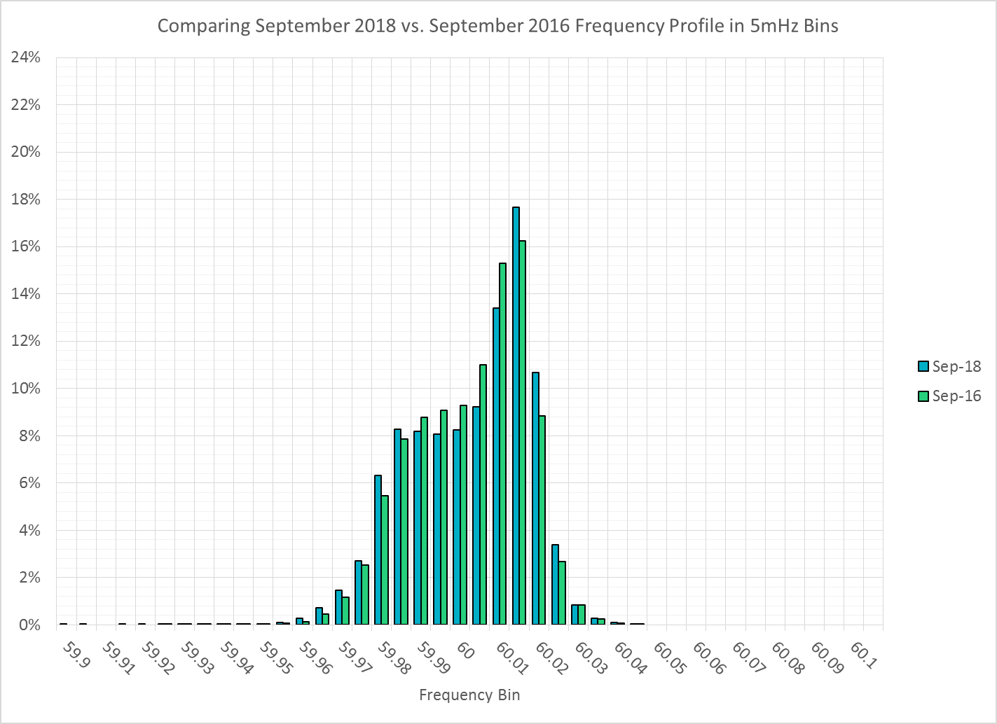
Frequency Profile Comparison

Slide 14
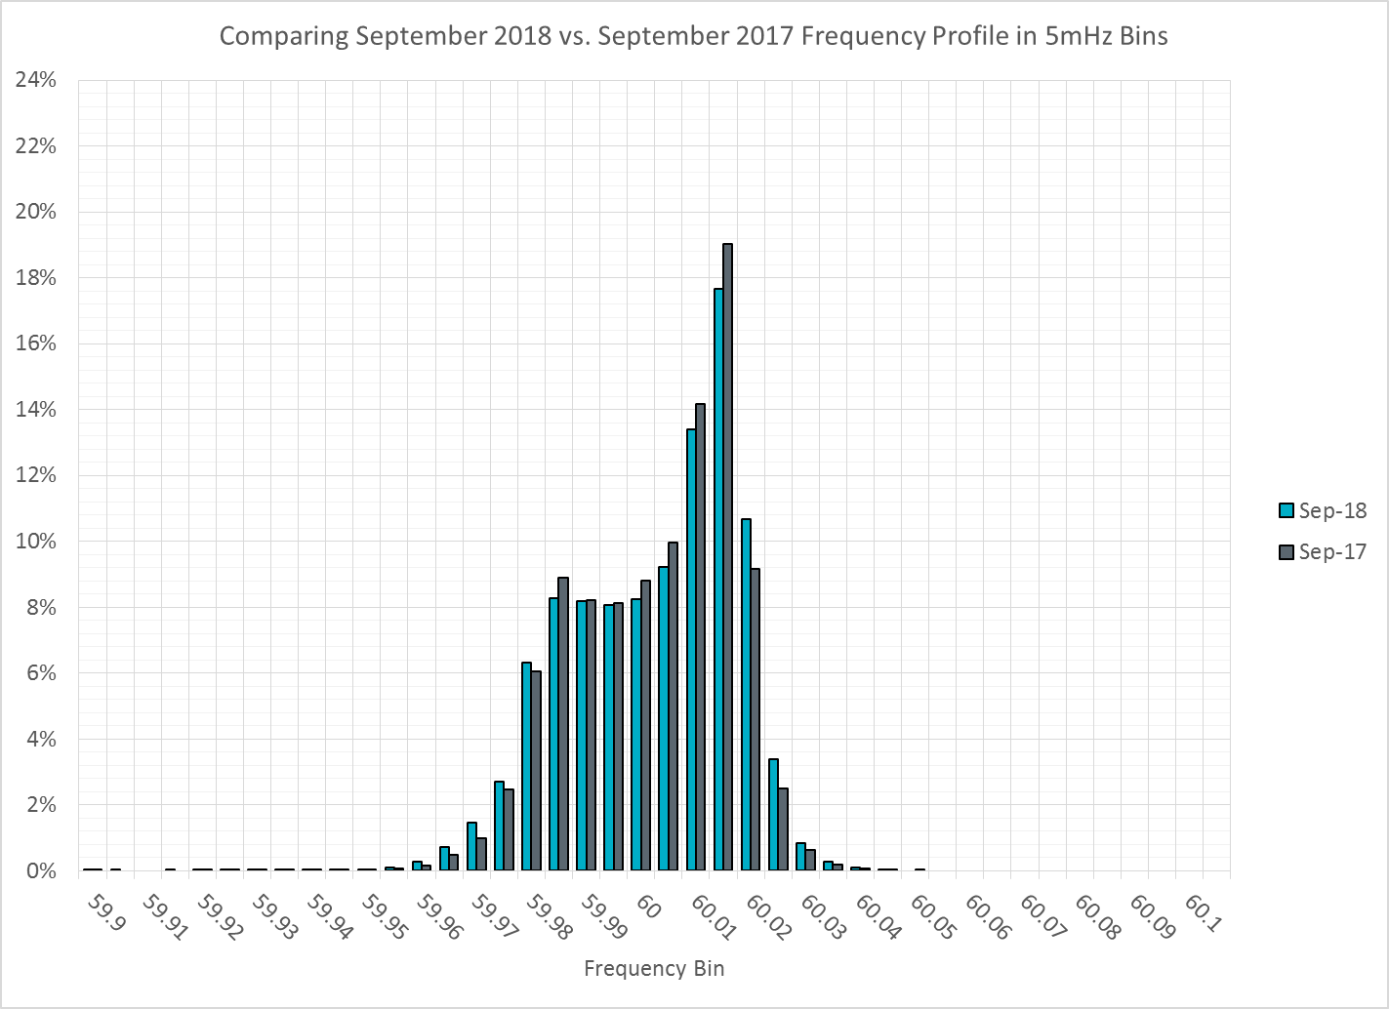
Frequency Profile Comparison

Slide 15
Time Error Correction

Slide 16
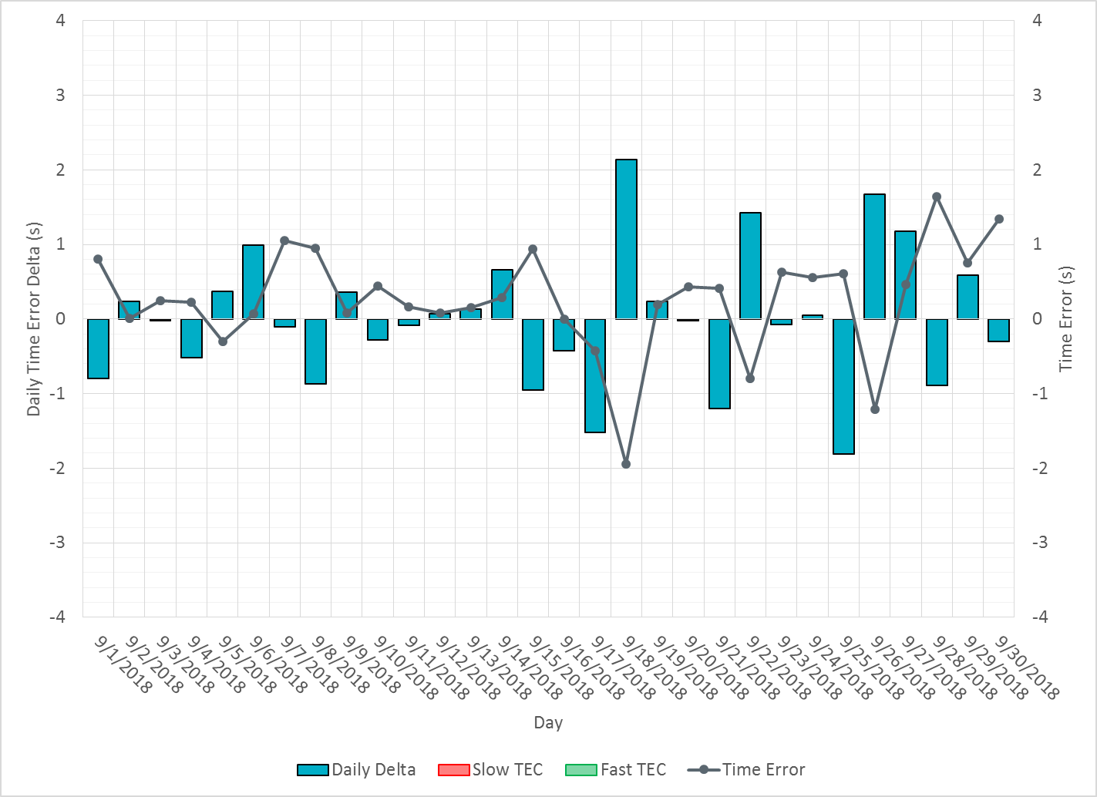
ERCOT Daily Time Error

Slide 17
Time Error Corrections Log Summary
There have been no time error corrections since December 2016

Slide 18
BAL-003 Performance

Slide 19
Op. Year 2018 BAL-003 Selected Events
 | BA |  | BA | BA | Value "A" Information (MW) |  | Value "B" Information (MW) |  | SEFRD (FRM) |  | Exclude
Date/Time (t-0) | Time | B to A |  | Bias |  |  |  |  | for Bias | for R1 | for data
BA Time | Zone | DelFreq | Time | DelFreq | Load Loss | Adjust | Load Loss | Adjust. | (MW/0.1Hz) | (MW/0.1Hz) | error *
2/5/2018 14:04:41 | CST | -0.098 | 14:04:46 | -0.098 | 0.0 | 0.0 | 816.0 | 0.0 | -829.9 | -829.9 | N
2/14/2018 06:30:17 | CST | -0.105 | 6:30:21 | -0.105 | 0.0 | 0.0 | 784.2 | 0.0 | -747.7 | -747.7 | N
3/5/2018 00:51:20 | CST | -0.033 | 6:51:20 | -0.033 | 0.0 | 0.0 | 513.5 | 0.0 | -1552.2 | -1552.2 | N
3/24/2018 15:47:15 | CDT | -0.085 | 20:47:15 | -0.085 | 0.0 | 0.0 | 797.3 | 0.0 | -943.3 | -943.3 | N
3/29/2018 10:09:40 | CDT | -0.041 | 16:09:40 | -0.041 | 0.0 | 0.0 | 434.1 | 0.0 | -1049.1 | -1049.1 | N
4/13/2018 20:02:08 | CDT | -0.076 | 2:02:08 | -0.076 | 0.0 | 0.0 | 438.0 | 0.0 | -577.9 | -577.9 | N
4/14/2018 19:11:25 | CDT | -0.048 | 1:11:25 | -0.048 | 0.0 | 0.0 | 349.0 | 0.0 |  |  | Y
4/28/2018 12:15:43 | CDT | -0.048 | 18:15:43 | -0.048 | 0.0 | 0.0 | 408.0 | 0.0 |  |  | Y
5/5/2018 10:19:04 | CDT | -0.095 | 16:19:04 | -0.095 | 0.0 | 0.0 | 536.3 | 0.0 | -563.5 | -563.5 | N
5/21/2018 02:06:23 | CDT | -0.081 | 8:06:23 | -0.081 | 0.0 | 0.0 | 460.5 | 0.0 | -568.4 | -568.4 | N
Maybe. Will be valuated at the end of the year.

Slide 20
Op. Year 2018 BAL-003 FRM Performance
FRM Performance Results for 2018
2018 | Current data year (December thru November)
-381.0 | Operating Year 2019 BA Frequency Response Obligation (FRO) for next year's FRM
-381.0 | Operating Year 2018 BA Frequency Response Obligation (FRO)
-788.77 | 2018 FRM - Median Estimated Frequency Response MW/0.1Hz for BA Compliance to R1, minimum Frequency Response
-854.0 | 2018 FRM - Average Estimated Frequency Response MW/0.1 Hz using SEFRD for R1
0.0 | 2018 FRM - Regression Estimated Frequency Response MW/0.1Hz using SEFRD for R1

Slide 21
ERCOT Energy Statistics

Slide 22
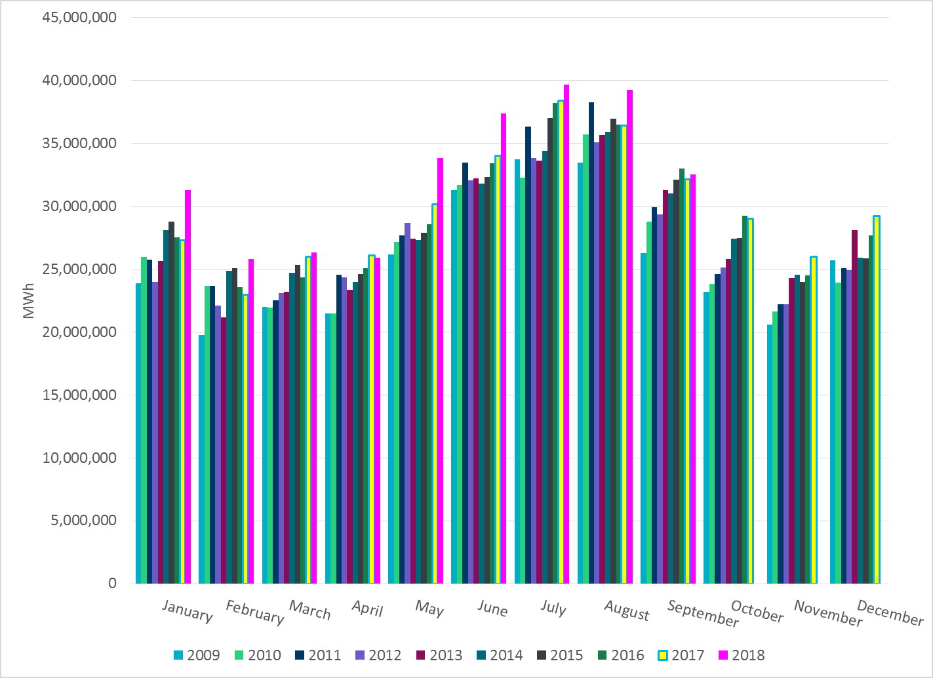
Total Energy
Notes:
32,513,579 MWh

Slide 23
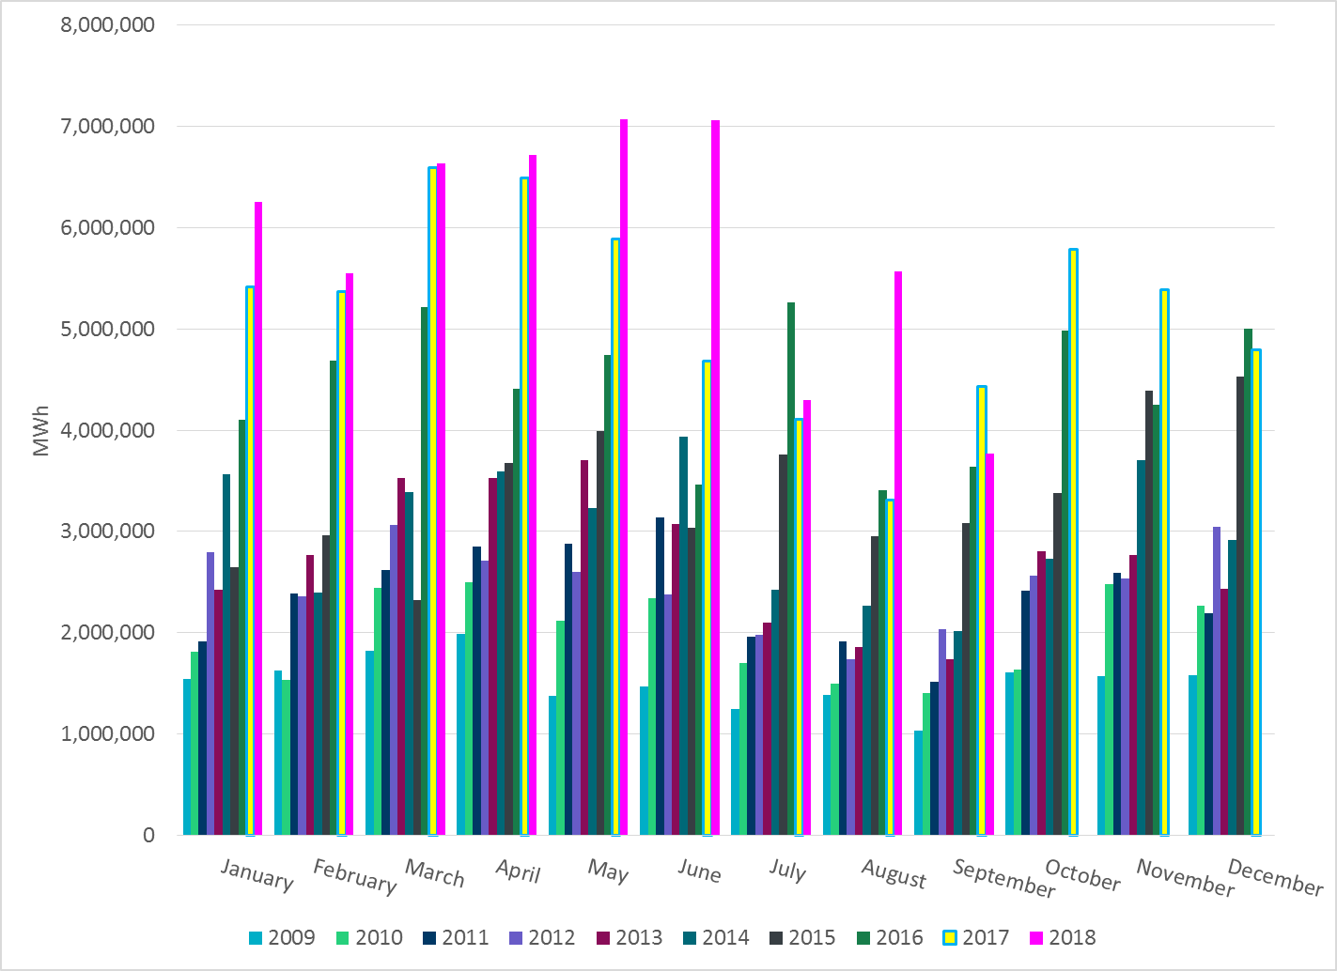
Total Energy from Wind Generation
Notes:
3,770,566 MWh

Slide 24
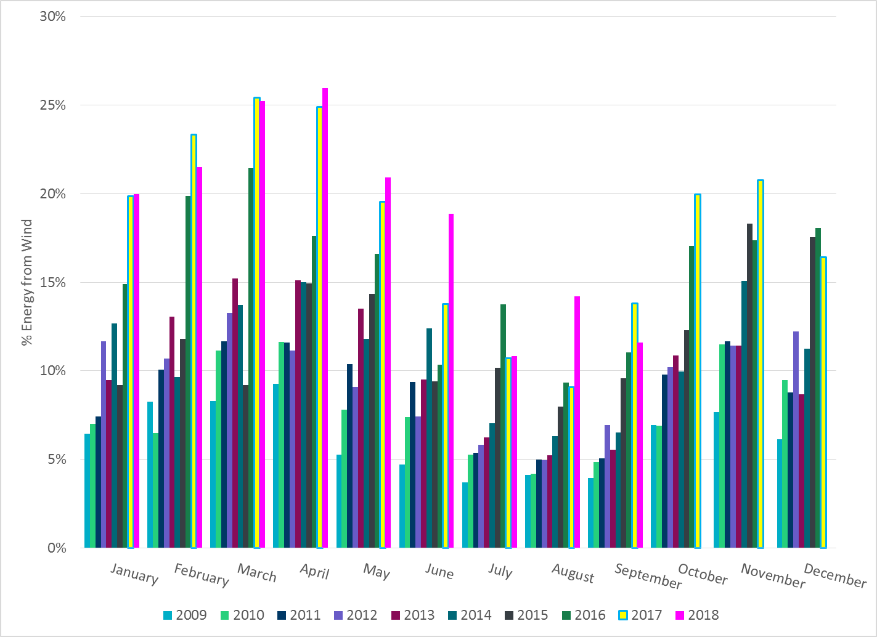
% Energy from Wind Generation
Notes:
11.60%

Slide 25
ERCOT System Inertia

Slide 26
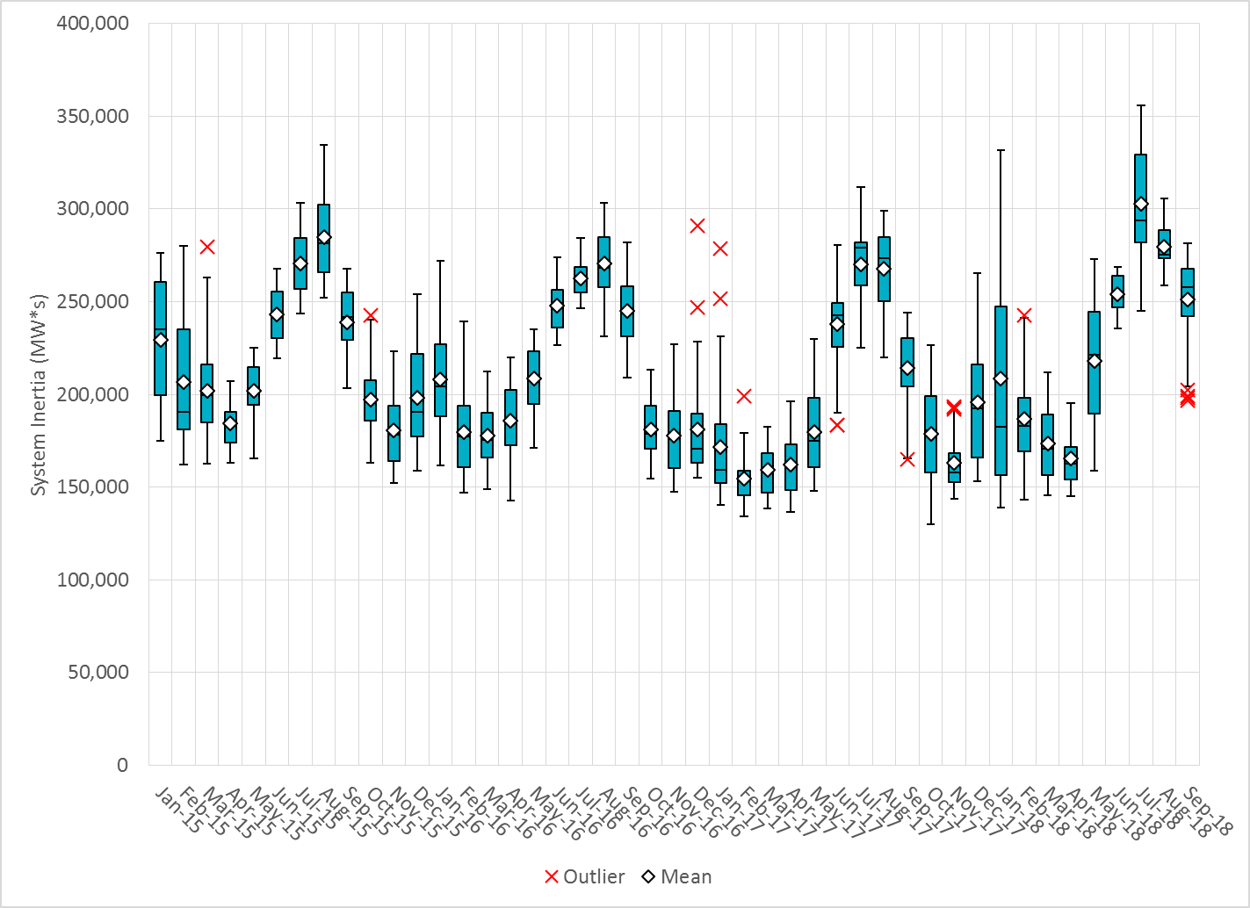
Daily Minimum System Inertia
Notes:
Minimum Inertia = 130,014 MW*s on 10/27/2017. This was also our record wind day.
September
Mean: 251,051
Max: 281,526 on September 6th
Min: 196,700 on September 30th

Slide 27
Questions?
Thank you!

Slide 28
Op. Year 2017 BAL-003 Selected Events
Notes:
Frequency Bias updated from 764 to 759 in April

Slide 29
Op. Year 2017 BAL-003 FRM Performance

