Slide 1
Black Start Working Group

Slide 2
The Most Interesting Baby In the World

Slide 3
BSWG Succession Plan

Slide 4
OTWG Task Force Update

Slide 5
Available Options for Delivery
1. Computer Based Training
2. Regional Training
3. ERCOT Training
Timing
Before System Restoration Training?
Increased participation?

Slide 6
EOP-005-3 R8.5

Slide 7
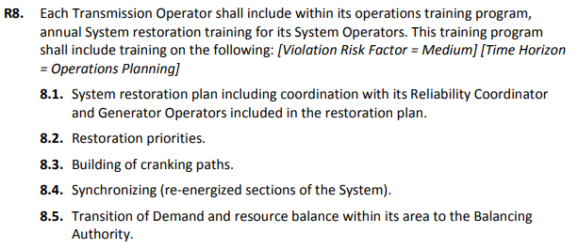
EOP-005-3

Slide 8
All-Hazards System Restoration Strategy
 | Stage | Condition | Operations Training
Return to Normal Operations | 5 | Market Restoration | EOP-006-3: System Restoration Coordination R7.2 – Re-establishing the Interconnection
 | 4 | AGC/LFC | EOP-005-3: System Restoration from Blackstart Resources R8.2 – Restoration Priorities R8.5 – Transition of Demand and resource balance within its area to the Balancing Authority
System Recovery | 3 | Multi-TO CFC
 | 2 | Single-TO CFC | EOP-005-3: System Restoration from Blackstart Resources R8.2 – Restoration Priorities R8.4 – Synchronizing
Black Start | 1 | Isochronous Island | EOP-005-3: System Restoration from Blackstart Resources R8.2 – Restoration Priorities R8.3 – Building Cranking Paths
 | 0 | Initial Blackout
Notes:
Transition between stages.
Command and control.
Priorities
Black Start timeframe. As much as can be done in eight hours and then keep reducing time. Maybe eight hours is the ultimate goal.

Slide 9
Isochronous Unit Validation: Results and Impact

Slide 10
QSE CFC Frequency Source Validation: Results and Impact

Slide 11
Questions?
Wall Outlet
Primary Back-up center
ERCOT Frequency ICCP
Arlington, TX
Grid Power @ TDSP primary control center
Control Room CFC

Slide 12
All-Hazards System Restoration Strategy Adoption

Slide 13
All-Hazards System Restoration Strategy
 | Stage | Condition
Return to Normal Operations | 5 | Market Restoration
 | 4 | AGC/LFC
System Recovery | 3 | ERCOT Dispatch on CFC
 | 2 | TOP Dispatch on CFC
Black Start | 1 | Isochronous Island
 | 0 | Initial Blackout
Notes:
Transition between stages.
Command and control.
Priorities
Black Start timeframe. As much as can be done in eight hours and then keep reducing time. Maybe eight hours is the ultimate goal.

Slide 14
Black Start Load Classification Task Force

Slide 15
Black Start Load Classification Task Force
Victor Vaughn (GPL): Chairman
Deadlines
January 14th, 2019: Completed staffing of task force
June 10th, 2019: Report findings to BSWG for voting
“Loads necessary for the self-sustaining operation of the electric grid following a partial or complete system collapse.”
Need
Identification

Slide 16
Proposals

Slide 17
Proposal Tracking: 15 Approved between 3/13-10/9

Slide 18
Proposals
Request OTWG:
Proposal 1: Approved
Evaluate 2018 Black Start Training Recommendations,
Create action plan, and
Report results to BSWG.

Slide 19
Proposals
Proposal 2: Approved
Request survey to validate which Transmission Operators have Black Start Unit frequency indication in their respective control rooms.

Slide 20
Proposals
Proposal 3: Approved
Request ERCOT create an internal control that captures a generator’s ability to operate on Isochronous Governor Control.
RRGRR or other.

Slide 21
Proposals
Proposal 6: Approved
Create plan to mitigate the effects of Natural Gas Fuel Scarcity during System Restoration.
Coordinated effort with BSGCG

Slide 22
Proposals
Proposal 7: Approved
Evaluate the need for a Black Start/System Restoration Gas Company Single Point of Contact (SPOC).

Slide 23
Proposals
Approved Proposal: Request study and possible test a DER as potential Black Start Resources
Current Railroad Commission of Texas Natural Gas Curtailment Program places DER as a higher priority than Black Start Resources
ERCOT DER penetration warrants study for inclusion.
Mid-October

Slide 24
Please ask me a question

Slide 25
I’ll be keeping my eye on y’all!

