Slide 1
Market Credit Working Group update to the Wholesale Market Subcommittee
Bill Barnes NRG, Chair
Josephine Wan Austin Energy, Vice Chair
10/10/2018

Slide 2
MCWG update to WMS
General Update
September 19th Joint MCWG/CWG Meeting
NPRR850 - Market Suspension and Restart
Credit Working Group will conduct review of NPRR850 after approved as per normal credit impact review process.
Waiting for discussion of LCRA proposed changes.
M1a Credit Parameter Review
ERCOT prepared a draft NPRR to update M1a based on actual weekend and holiday calendar. CWG discussed and directed ERCOT to file after internal review.

Slide 3
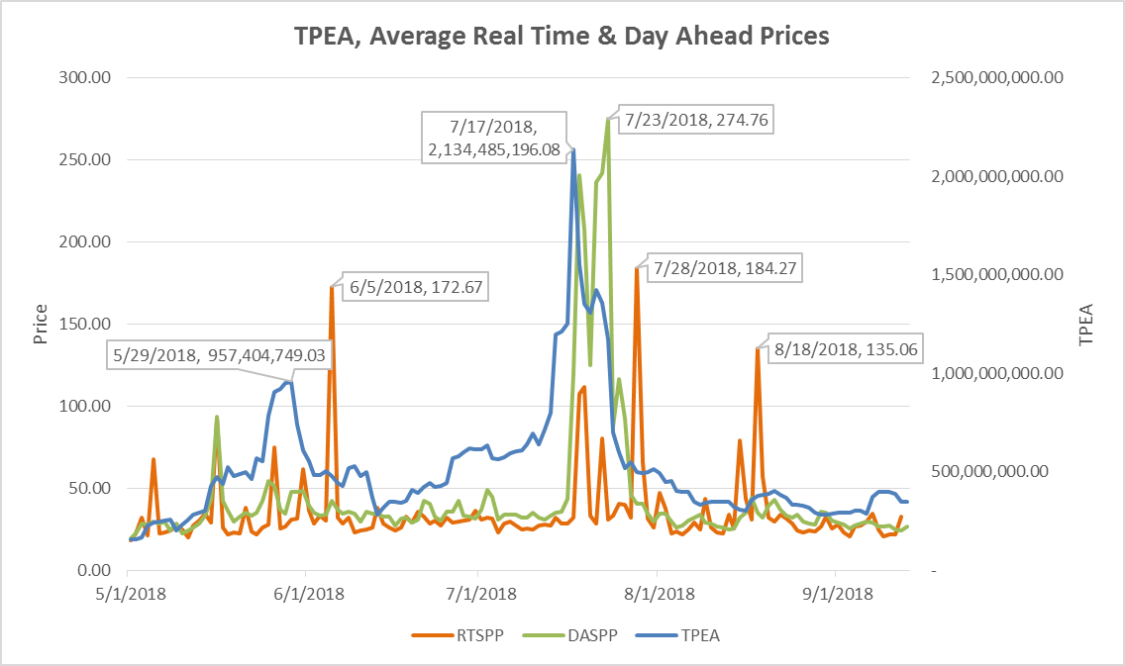
Credit Exposure Update – Summer Review

Slide 4
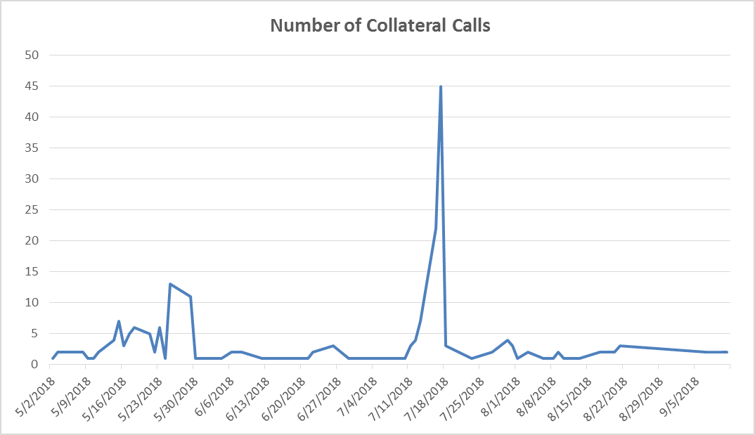
Credit Exposure Update – Summer Review

Slide 5
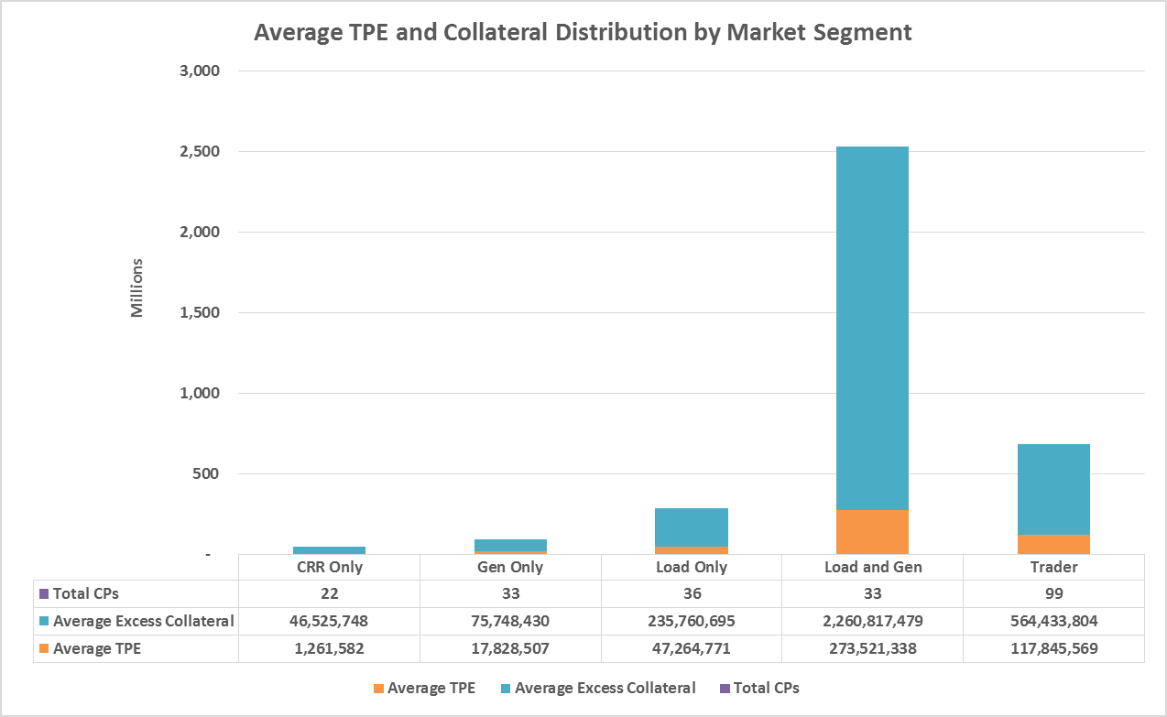
Credit Exposure Update – Summer Review

Slide 6
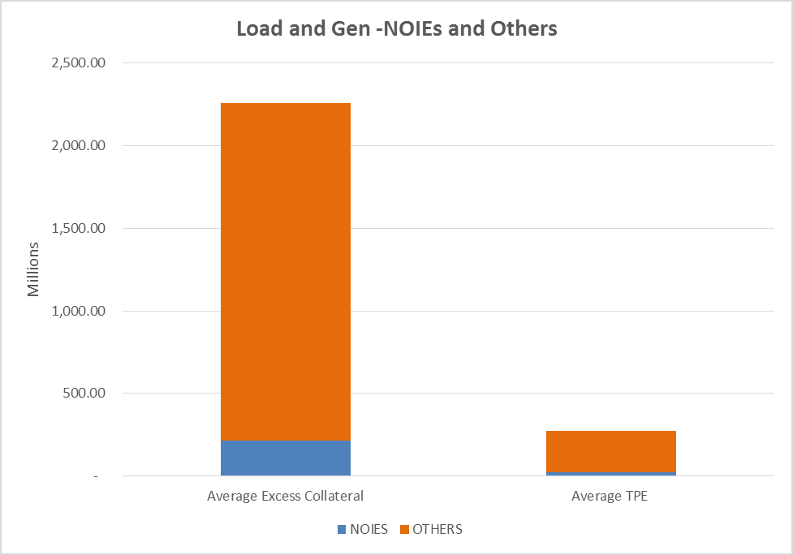
Credit Exposure Update – Summer Review

Slide 7
Greenhat PJM Default
Overview
GreenHat Energy LLC (GreenHat) is a Texas-based financial trading company that joined PJM in 2014
GreenHat, over multiple years, acquired a 890 million MWh Financial Transmission Rights (FTR) portfolio
When GreenHat acquired the majority of the positions starting in 2015 long-term FTR auctions, both historical congestion and FTR auction clearing prices indicated that GreenHat’s portfolio would be profitable
Credit requirements were low for GreenHat based on the credit policy at the time the positions were acquired
In early 2017, primarily due to the impacts of transmission system upgrades it became apparent that GreenHat’s portfolio, which consisted primarily of prevailing flow (positive congestion values) FTRs, were on a path for which future congestion was not expected to be consistent with historical congestion
In June 2017, GreenHat and PJM executed a pledge and assignment agreement committing PJM would receive the revenue stream from certain GreenHat bilateral contracts with a third party that were indicated to have tens of millions of dollars of remaining cash flow. However, PJM did not receive any cash from the agreement with GreenHat.

Slide 8
Greenhat PJM Default
Default Allocation
On June 21, 2018, GreenHat was declared in default by PJM
Notice of the default was provided to PJM members on June 22, 2018
In the default allocation assessment process
the total number of members to be assessed is 992
and the applicable three-month (June, July, and August 2018) gross dollar transaction amount for all members is $42.5 million
The total amount of the default allocation will not be known until all positions are liquidated or until the FTR terms end for any positions that are not liquidated.

