Slide 1
Comparison of preliminary Ancillary Service requirements with and without nprr-863 for 2019
ERCOT Staff
Sep 21, 2018

Slide 2
NPRR 863
There is no difference in Regulation Quantity between 2019 using current methodology and NPRR 863
There is no difference in Responsive Reserve (RRS) Quantity between 2019 using current methodology and NPRR 863
ERCOT Contingency Reserve Service (ECRS) Quantities for select months are included in the presentation, the accompanying excel spreadsheet has ECRS quantities for 2019.
Non-Spin Quantities are compared for 2019 with and without NPRR 863
The deck also includes comparison of Total AS quantity comparison.
Please Note : Red-Bars are proposed 2019 AS Quantities using proposed AS Methodology for 2019.

Slide 3
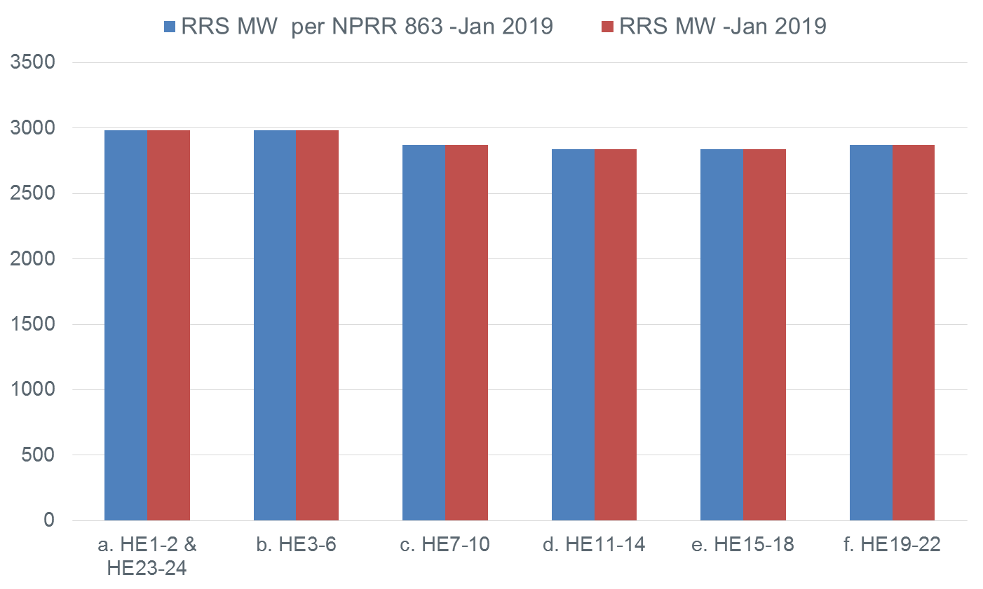
Jan 2019

Slide 4
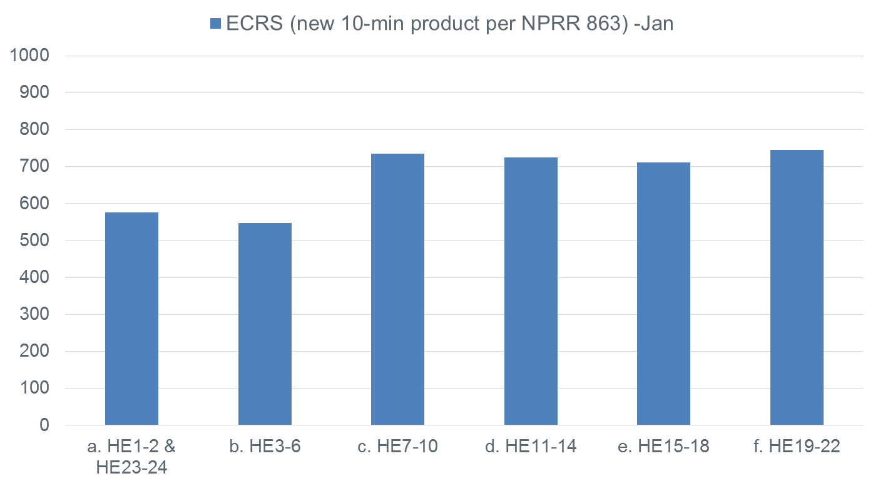
Jan 2019

Slide 5
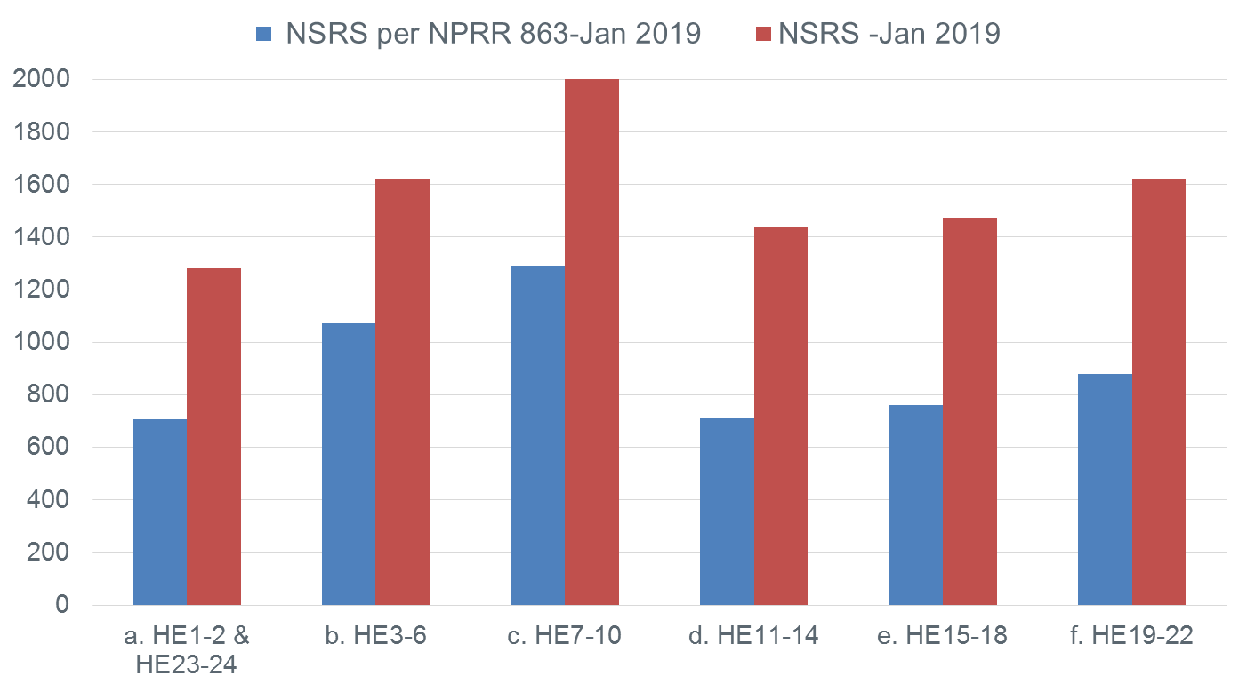
Jan 2019

Slide 6
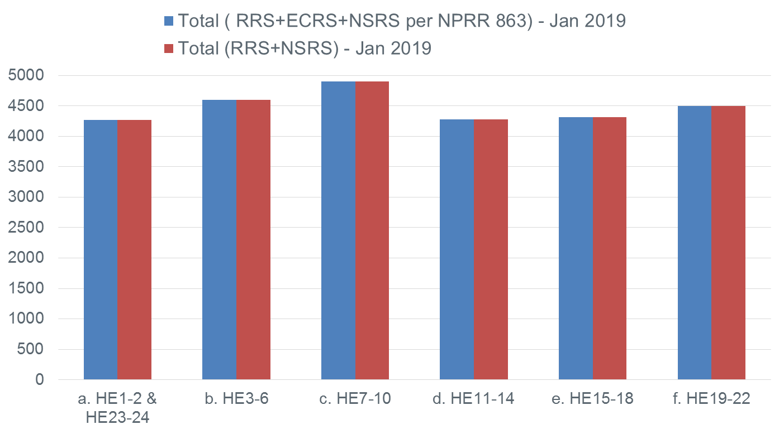
Jan 2019

Slide 7
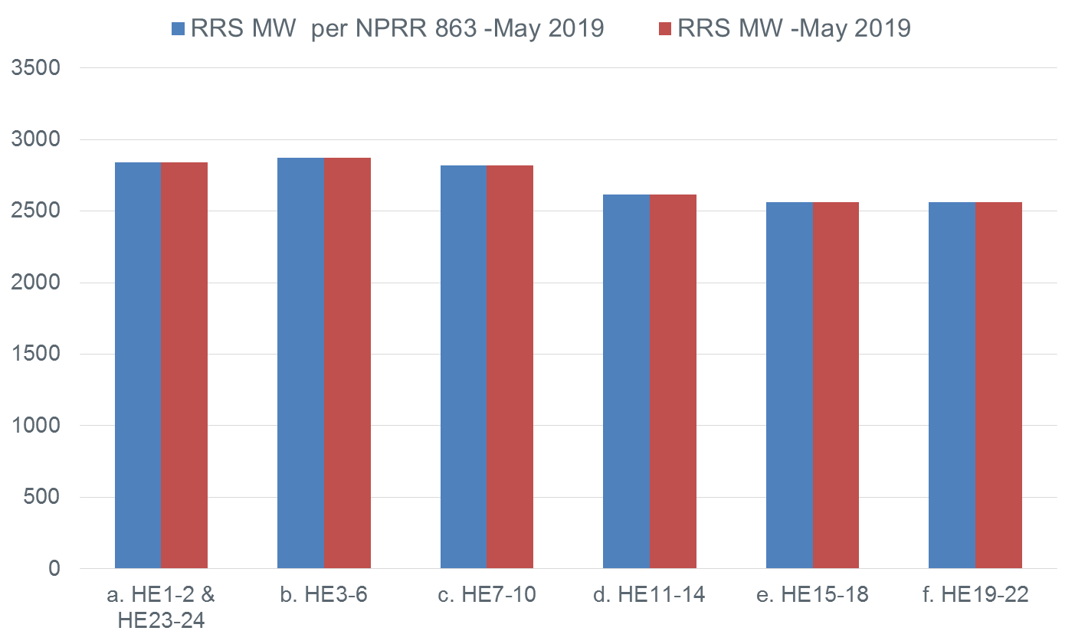
May 2019

Slide 8
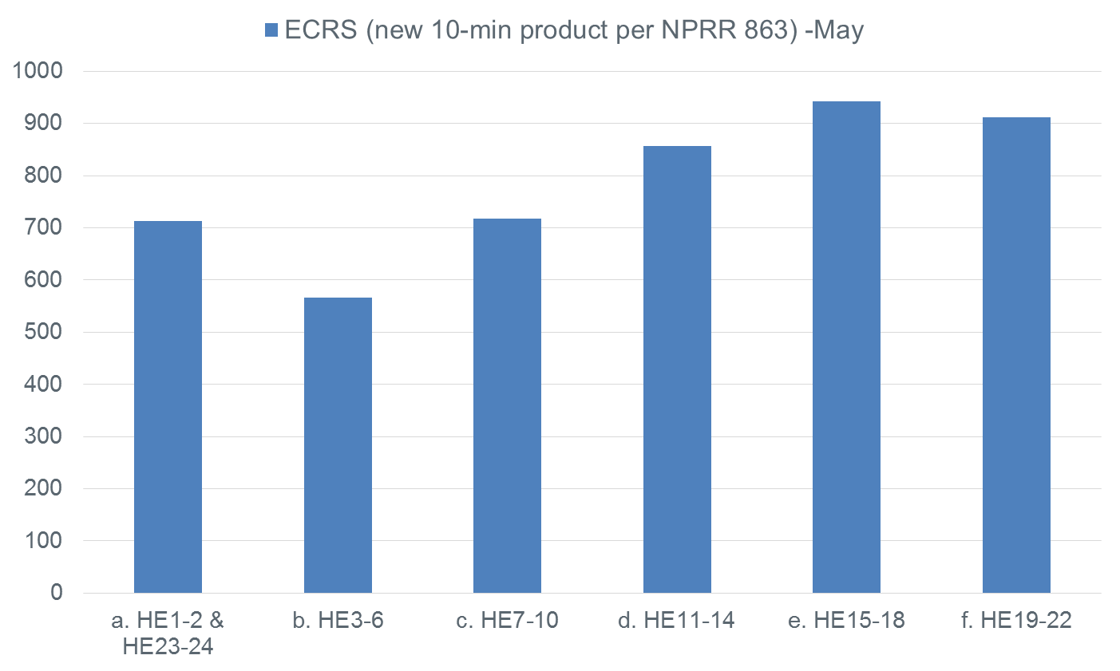
May 2019

Slide 9
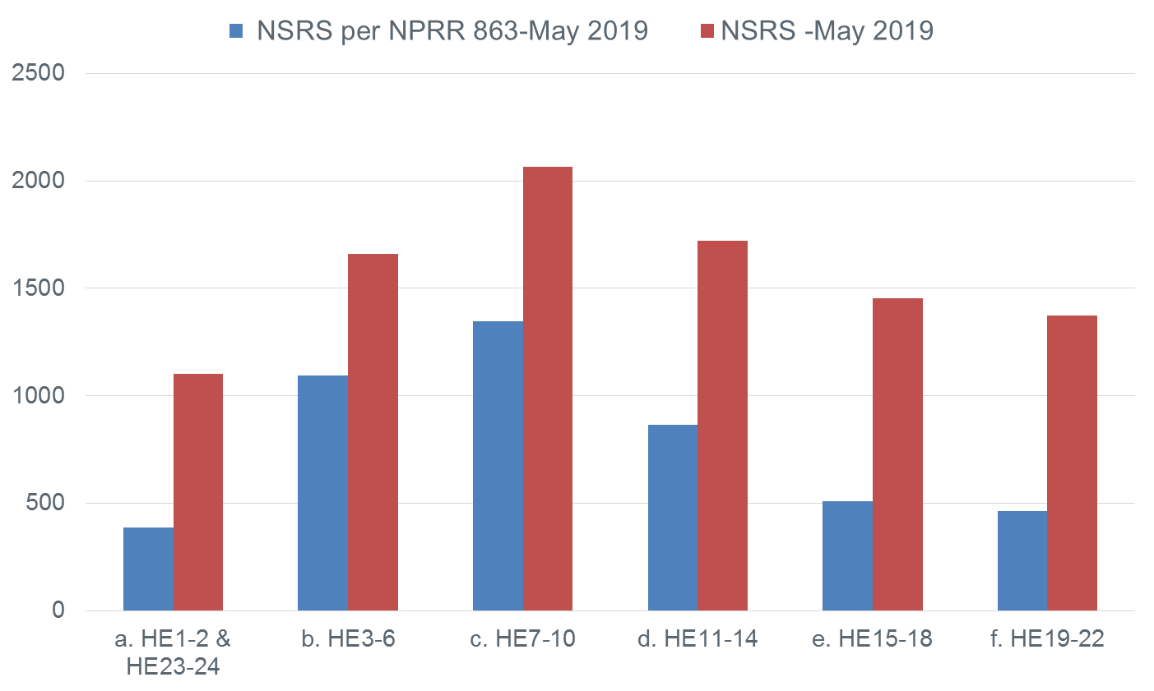
May 2019

Slide 10
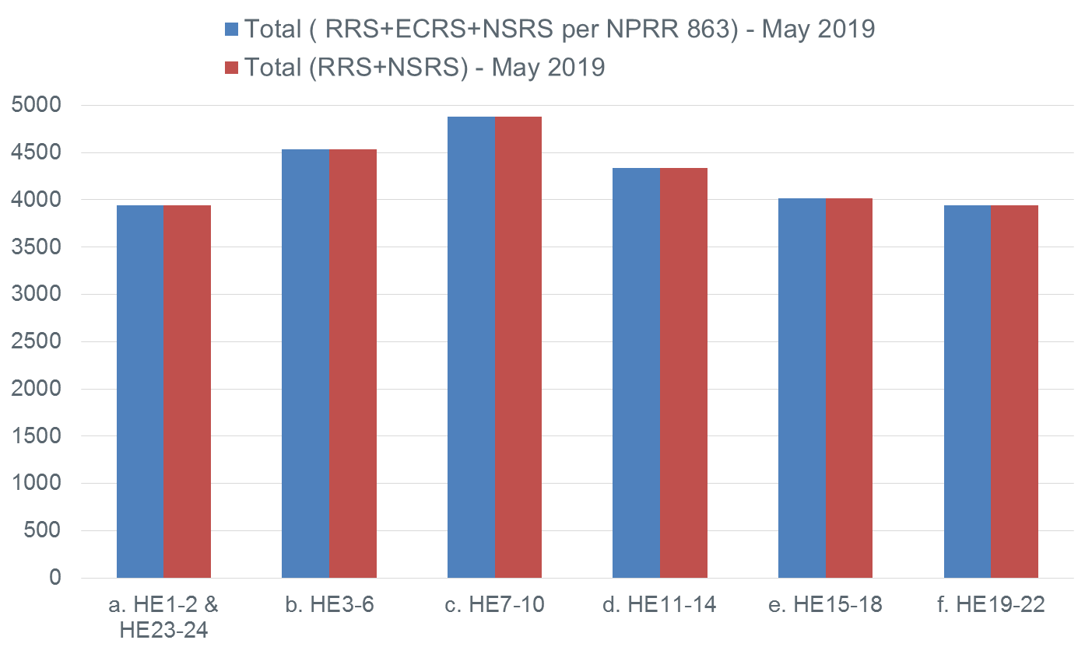
May 2019

Slide 11
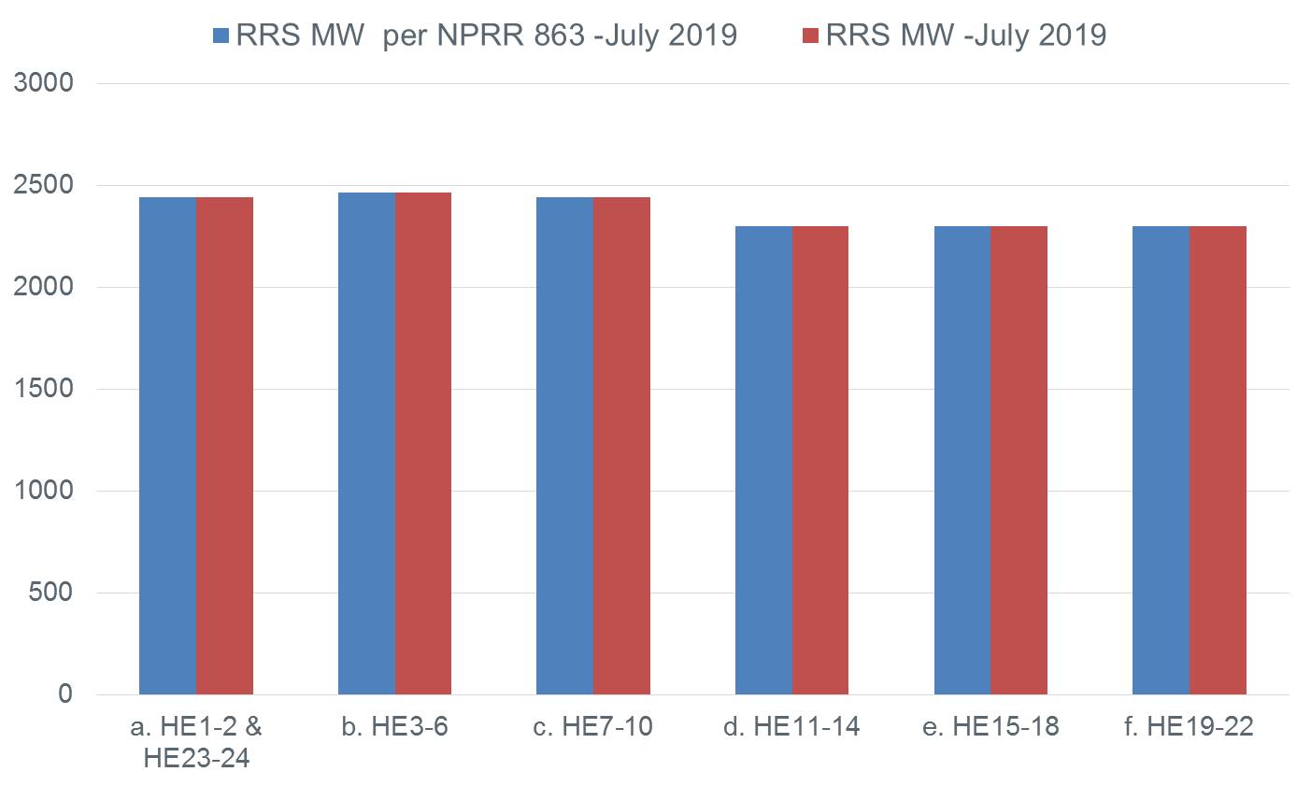
July 2019

Slide 12
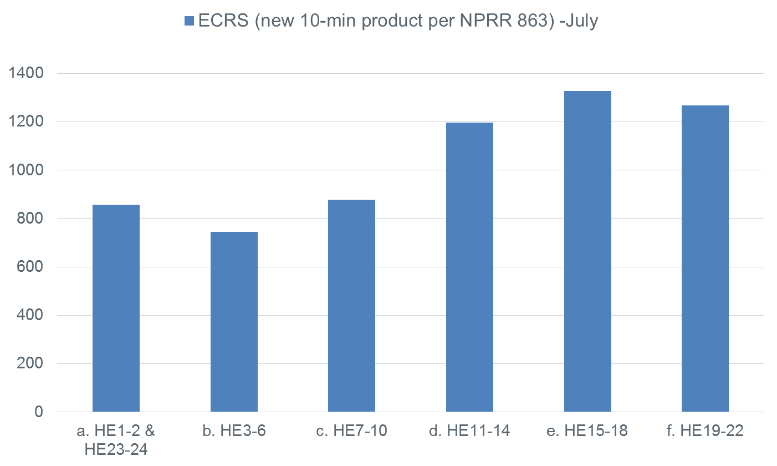
July 2019

Slide 13
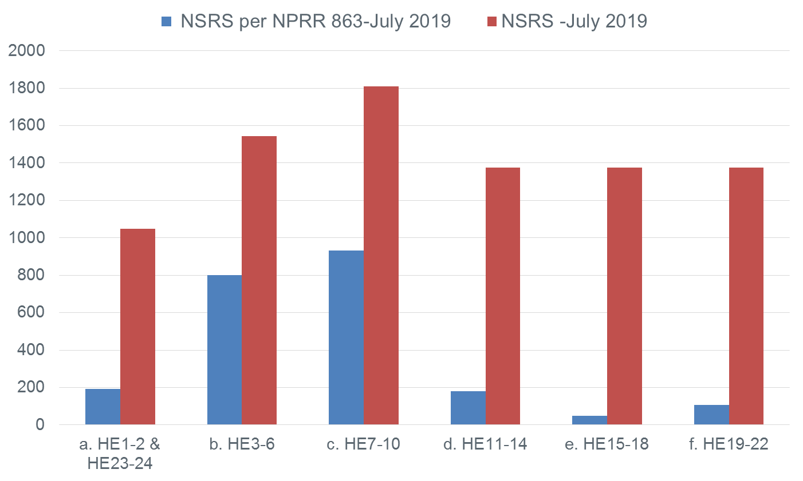
July 2019

Slide 14
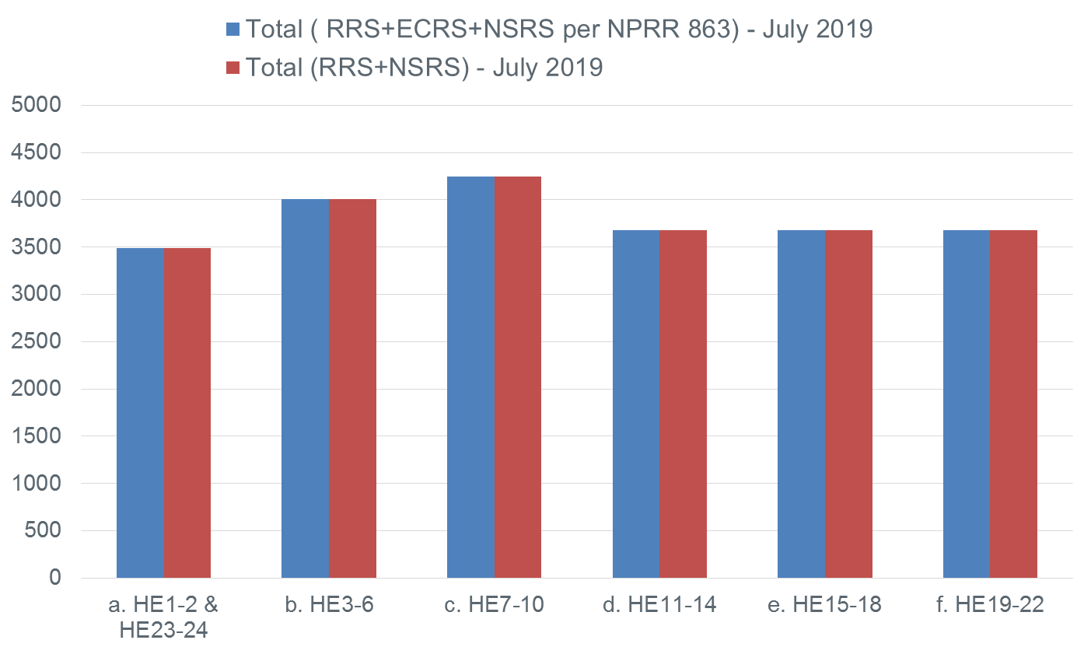
July 2019

Slide 15
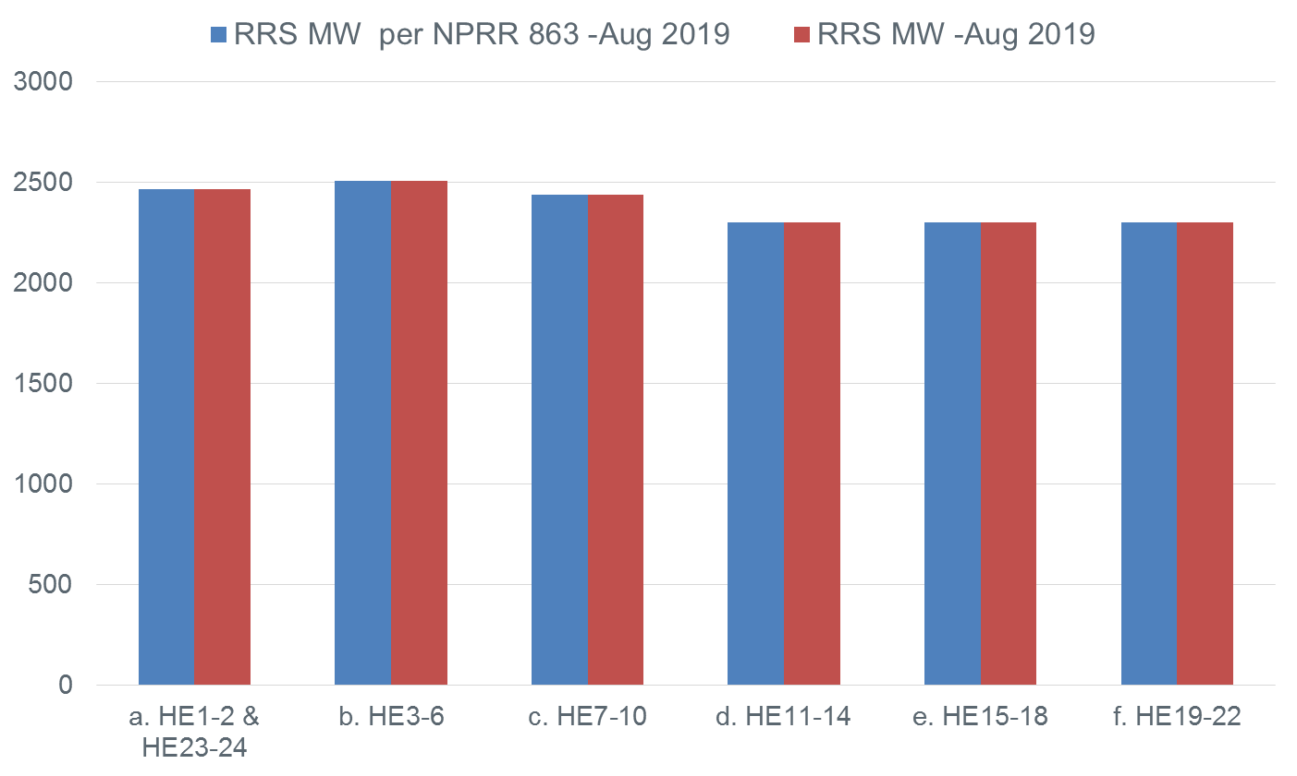
Aug 2019

Slide 16
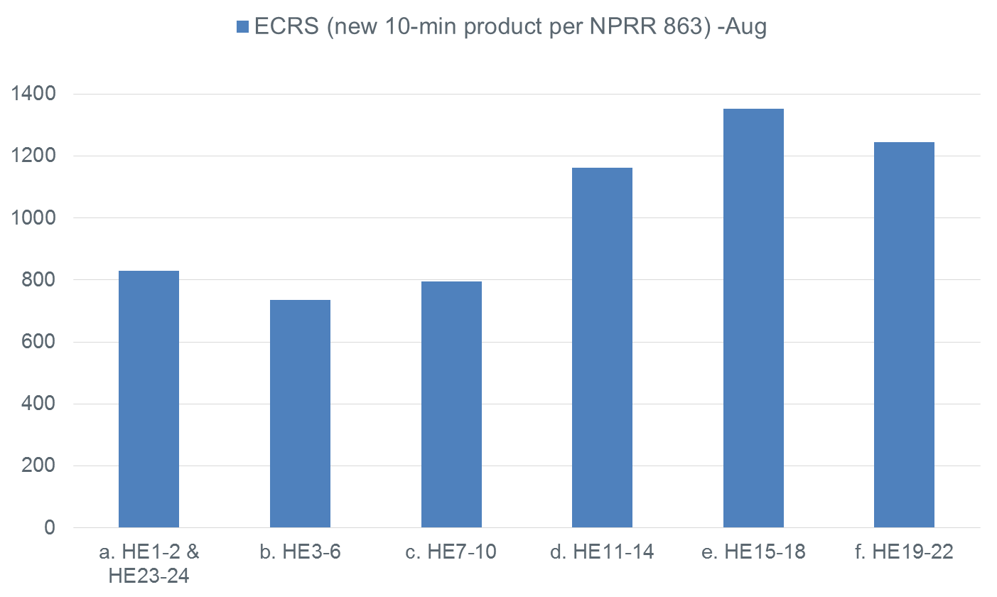
Aug 2019

Slide 17
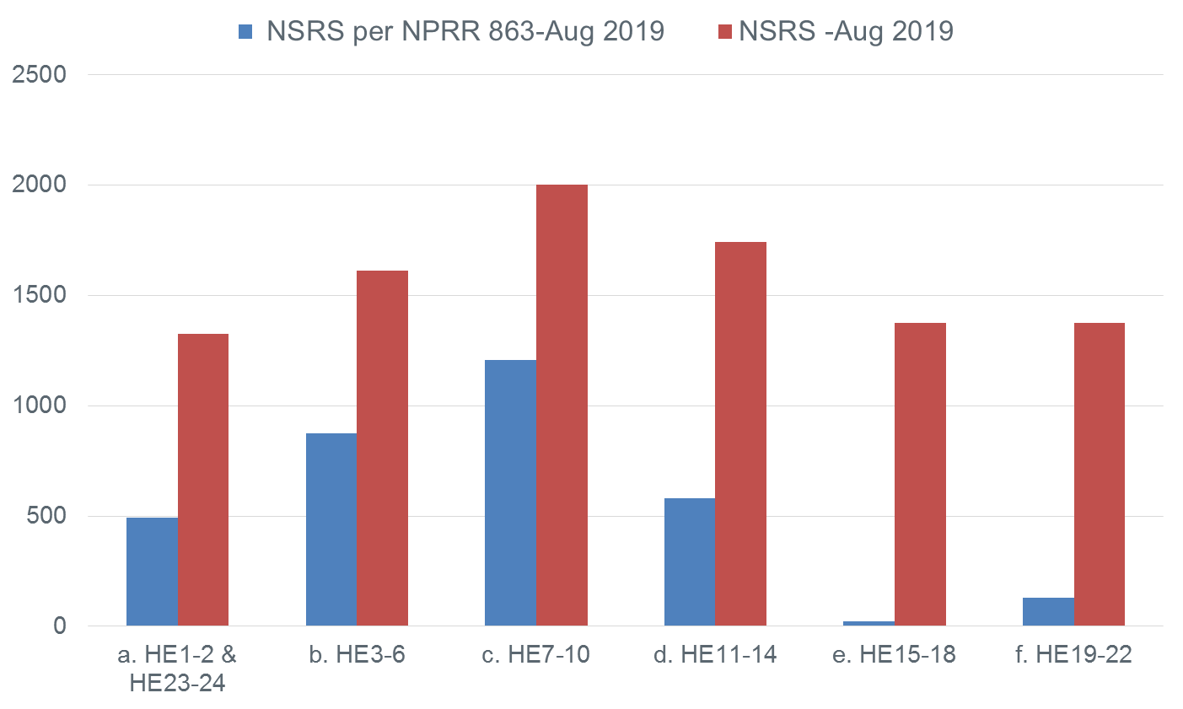
Aug 2019

Slide 18
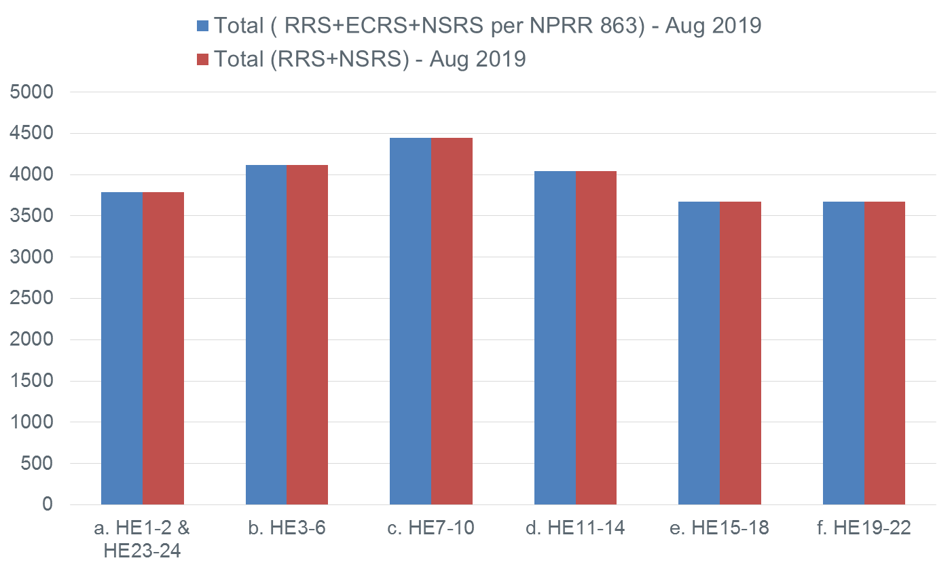
Aug 2019

