Slide 1
Review of June RENA
Jian Chen
Market Analysis and Validation
CMWG
Sept. 21th, 2018

Slide 2
Monthly Sum of RENA
* Data for 2018 is only through August

Slide 3
Daily RENA with RT Congestion
Notes:
The high RENA observed in June was related to the high RT congestion, especially the congestion in Far West Texas.
The highest RENA on some of the days were more related to DAM/RT model difference caused by outages, such as OD 06/04, 06/24, 06/25 and 6/26.

Slide 4
DAM oversold in June

Slide 5
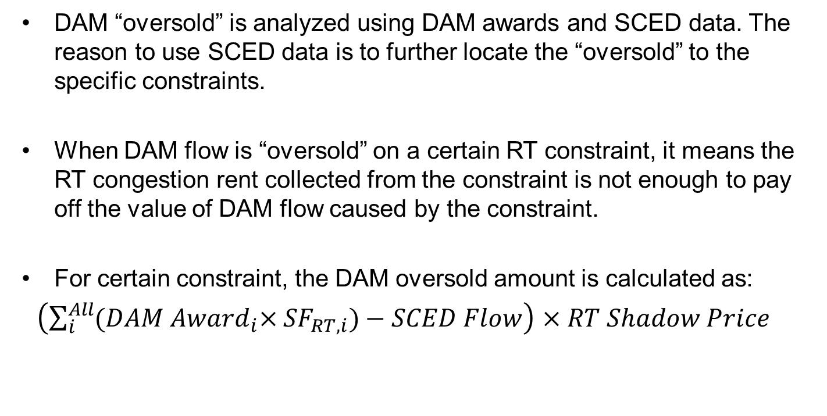
Calculation of DAM oversold
DAM “oversold” is analyzed using DAM awards and SCED data. The reason to use SCED data is to further locate the “oversold” to the specific constraints.
When DAM flow is “oversold” on a certain RT constraint, it means the RT congestion rent collected from the constraint is not enough to pay off the value of DAM flow caused by the constraint.
For certain constraint, the DAM oversold amount is calculated as:
$\left(\sum_{i}^{All}{{(DAM Award}_{i}×{SF}_{RT,i})}−SCED Flow\right)$ $×RT Shadow Price$

Slide 6
Top constraints with DAM oversold
Constraint | Sum of RT_Cong_RENT (million $) | Sum of OVERSOLD (million $)
SWCSBOO8: 6332__A | 112.6 | 14.3
DMTSCOS5: 6437__F | 4.6 | 3.9
SWOORI38: 16TH_WRD2_1 | 4.3 | 1.3
Notes:
Among the total 21.2 million $ oversold in June, 19.5 million $ oversold happened on the following 3 constraints.

Slide 7
PTP w/ Links to Options
Notes:
In June, the impact from PTP with links to options was relatively small. The total amount for June was about 1.4 million $.

Slide 8
Difference between Settlement and SCED

Slide 9
RT Congestion Rent Calculation
SCED Analysis
  Congestion Rent= sum(Shadow Price * SCED flow)
  also should equal to
  sum(BP*LMP)+sum(non-modeled*LMP)-sum(load*LMP)
Settlement
  TOTAL_REVENUE= RESREV + WSLAMTTOT + RTDCIMP + BLTRAMT
  TOTAL_COST= LOAD_COST + RTDCEXP
  CONGESTION_RENT= TOTAL_COST - TOTAL_REVENUE;

Slide 10
Impact of Less Congestion Rent in Settlement

Slide 11
Why Different?
RT congestion rent is the result of SCED dispatch, when the nodal prices separate due to congestion.
Although 15-minute RT Settlement Point Prices and Meter Prices are calculated from 5-mimute SCED LMPs, some factors could result in the final settlement values being different than the SCED values.
Normally the difference is relatively small, but with high congestion rent accumulated through the month, it ended being a more significant number.

Slide 12
Drivers of RENA

Slide 13
Summary
June was the month with the highest RENA.
The major amount of RENA was related to congestion “oversold” in DAM due to the model differences between DAM and RT.
PTP w/ links to options contributed a small amount to RENA in June.
The rest of RENA was caused by differences between SCED and settlement.

