Slide 1
GreenHat Default
Credit Work Group
ERCOT Public
September 19, 2018

Slide 2
GreenHat Energy LLC - Default
Overview
GreenHat Energy LLC (GreenHat) is a Texas-based financial trading company that joined PJM in 2014
GreenHat, over multiple years, acquired a 890 million MWh Financial Transmission Rights (FTR) portfolio
When GreenHat acquired the majority of the positions starting in 2015 long-term FTR auctions, both historical congestion and FTR auction clearing prices indicated that GreenHat’s portfolio would be profitable
Credit requirements were low for GreenHat based on the credit policy at the time the positions were acquired
In early 2017, primarily due to the impacts of transmission system upgrades it became apparent that GreenHat’s portfolio, which consisted primarily of prevailing flow (positive congestion values) FTRs, were on a path for which future congestion was not expected to be consistent with historical congestion
In June 2017, GreenHat and PJM executed a pledge and assignment agreement committing PJM would receive the revenue stream from certain GreenHat bilateral contracts with a third party that were indicated to have tens of millions of dollars of remaining cash flow. However, PJM did not receive any cash from the agreement with GreenHat.

Slide 3
GreenHat Energy LLC - Default
Default Allocation
On June 21, 2018, GreenHat was declared in default by PJM
  Notice of the default was provided to PJM members on June 22, 2018
In the default allocation assessment process
  the total number of members to be assessed is 992
  and the applicable three-month (June, July, and August 2018) gross dollar transaction amount for all members is $42.5 million
The total amount of the default allocation will not be known until all positions are liquidated or until the FTR terms end for any positions that are not liquidated.

Slide 4
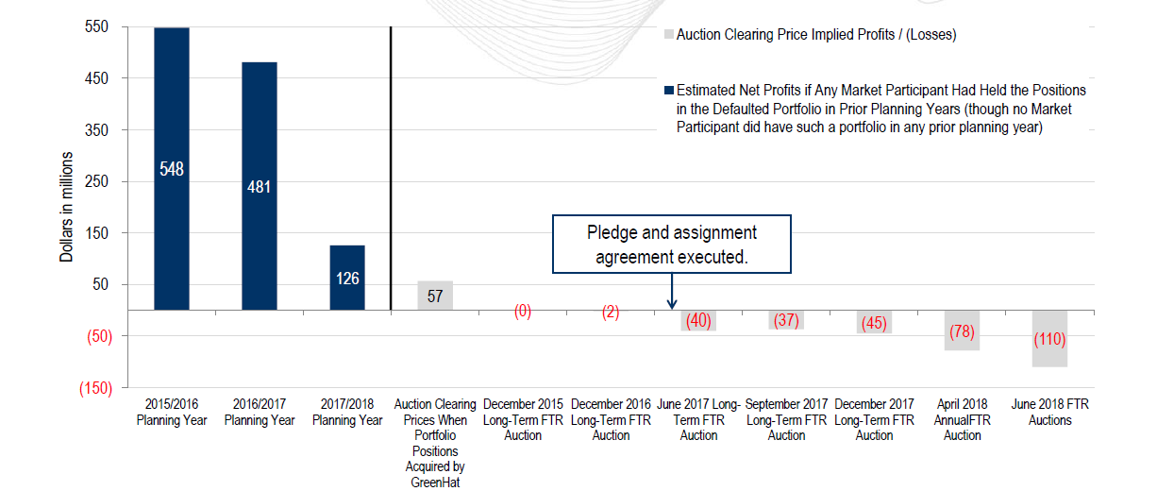
GreenHat FTR Portfolio
Historical and Auction Net Profit/(Loss) Reference Points

Slide 5
GreenHat Energy LLC - Default
Credit Policy Enhancements
April 1, 2018 – PJM modified FTR credit requirements to incorporate congestion on paths that are expected to be materially different in the future compared with historical congestion due to transmission system changes
  As a result, this credit policy change would have established approximately $60 million credit requirement for GreenHat to bid on the FTR portfolio on which it defaulted
September 3, 2018 – proposed FTR credit requirements include a volumetric minimum credit requirement of $.10 per MWh of FTRs cleared
  This process would have established approximately $90 million credit requirement for GreenHat to bid on the FTR portfolio on which is defaulted

Slide 6
Credit Requirements for Congestion Instruments
 | ERCOT – Congestion Revenue Rights (CRRs) | PJM – Financial Transmission Rights (FTRs)
Credit Calculation | The minimum of the: Portfolio Weighted Adder (PWA) 100 percentile of a volume-weighted average price based on 3 years of historical CRR path values or Portfolio Weighted Auction Clearing Price (PWACP) A volume-weighted average price calculated using prices from the most recent CRR Auction | The historical value is a weighted average of the difference of sink minus source of past three calendar years’ day-ahead LMPs (Weighted 50% last year, 30% prior year and 20% two year prior). The historical value is adjusted by 10% in order to provide protection against year-to-year changes in value. The adjustment is a reduction for positive historical values and an increase in magnitude for negative historical values.
Risk Mitigation | If the CRR Account Holder’s Obligations are becoming more risky, this change should reflect in the Auction Clearing Prices. So if the perceived risk, as reflected in the Auction Clearing Prices becomes greater than the historical prices would indicate, the Auction Clearing Prices is used as a measure of the risk. | FTR values for collateral purposes are based strictly on the historic payout on the FTR path.
Valuation of Congestion Instruments | CRRs are valued daily | FTRs are valued annually
Frequency of Auction | Each year we have two Long Term Auction Sequences (LTAS). Each LTAS consists of 6 auctions, each auction is for a 6 month time period, so a total of 36 months (3 years). Each month there is a LTAS auction sequence and a monthly auction. | Long-term FTRs – three rounds each year; each round for the next three planning years Annual Auction – four rounds in April each year Monthly/BOPP auctions – one every month for the balance of the year,
Payment of Congestion Instruments | ERCOT requires payment for awarded CRRs at the close end of each auction | FTRs are not paid for at the time of the auction. Instead, the purchase price is charged to the holder for each month of the FTR duration

Slide 7
GreenHat Default
Questions

