Slide 1
Oncor Far West TX Update
ERCOT MET Center
7620 Metro Center Dr
Austin, TX 78744
Sept 18, 2018

Slide 2
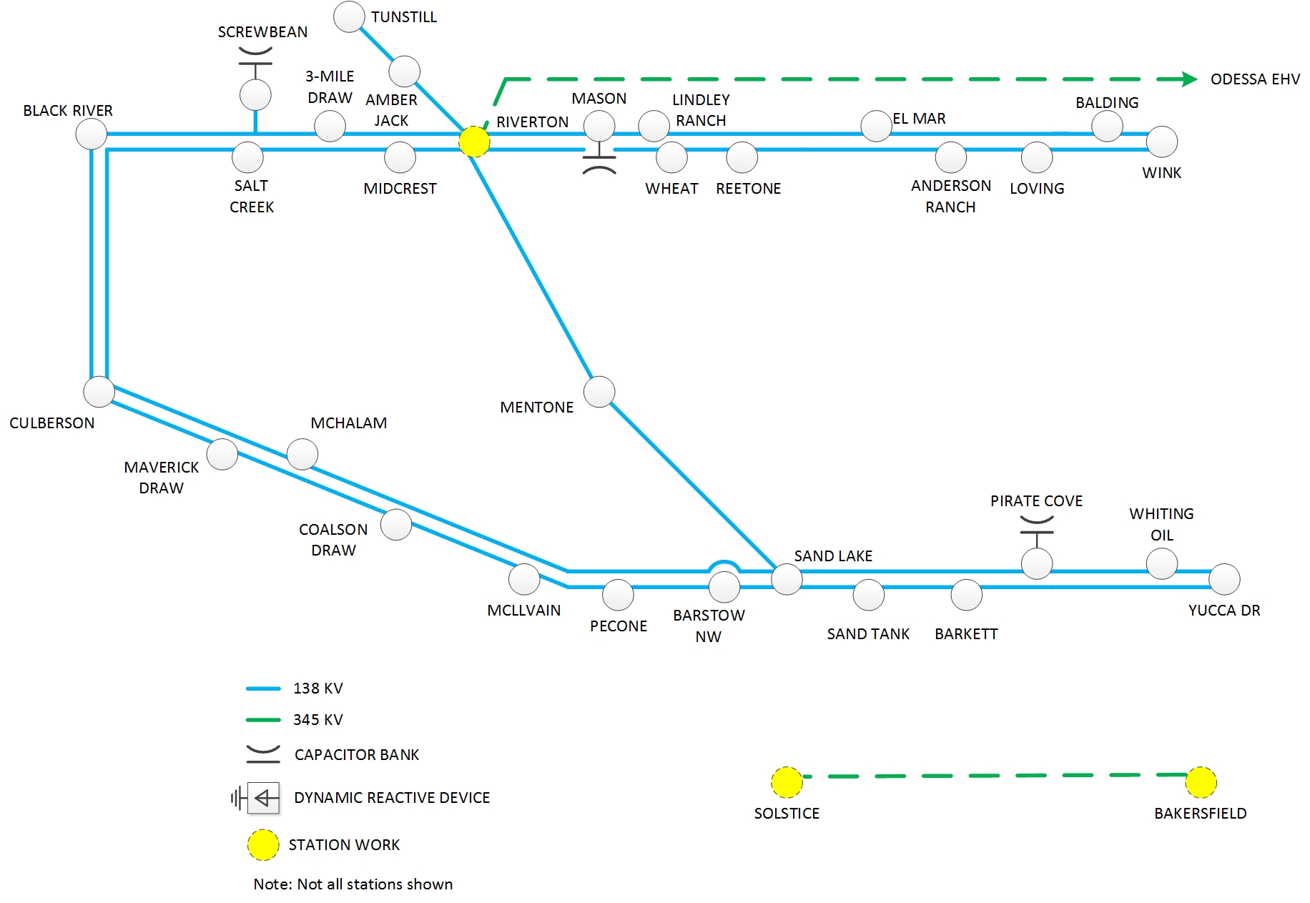
FWTx1 Project
Notes:
***Utilization of CREZ infrastructure
Focus is on customer communication, quick hit upgrades and maximizing existing capabilities while implementing long-term solutions
Progress is increasingly challenging given the limitations of permissible outages and clearances from ERCOT, and the overall state of congestion.
Capex:
2011/2012 = ~$7M
2013 = ~$44M
2014+ = ~$195M (includes two CCN projects)

Slide 3
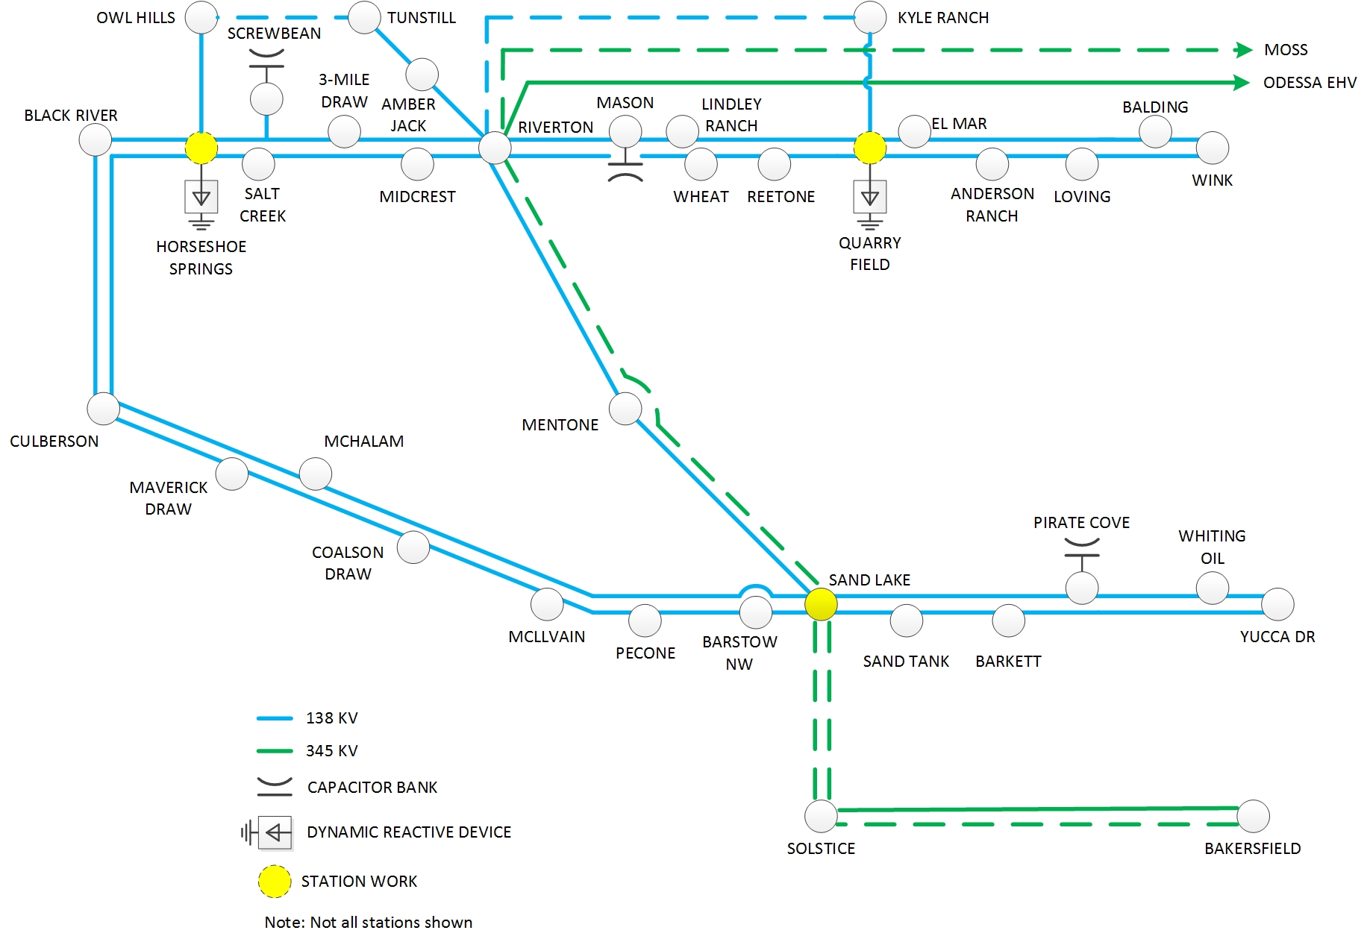
FWTx2 Project/DRD Project
Notes:
***Utilization of CREZ infrastructure
Focus is on customer communication, quick hit upgrades and maximizing existing capabilities while implementing long-term solutions
Progress is increasingly challenging given the limitations of permissible outages and clearances from ERCOT, and the overall state of congestion.
Capex:
2011/2012 = ~$7M
2013 = ~$44M
2014+ = ~$195M (includes two CCN projects)

Slide 4
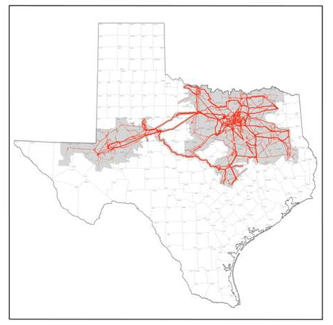
Far West Texas Projects
Far West Texas Project
Approved by ERCOT Board of Directors in Jun 2017
Odessa EVH – Riverton 345 kV Line
Bakersfield – Solstice 345 kV Line
Far West Texas Project 2
Approved by ERCOT Board of Directors on June 2018
Close 345 kV loop and new 138 kV lines
Dynamic Reactive Devices Project
Approved by ERCOT Board of Directors on June 2018
Immediate voltage support needs due to load increases
Expected in-service in 2019
Odessa EHV – Riverton 345 kV Line
Critical Status approved by ERCOT BOD Feb 2018
CCN filed at PUC in March 2018
On 9/14/18 PUC Agenda for discussion/possible approval.
Riverton – Sand Lake – Solstice – Bakersfield 345 kV Lines
Critical Status approved by ERCOT BOD June 2018
CCNs planned to be filed Fall 2018

Slide 5
2018 Planned Transmission Projects
Spring 2018 – In-Service
Construct New Riverton 138 kV Switch
Install second circuit on Wink – Culberson 138 kV Line
Install Pirate Cove 138 kV Capacitors
Construct New Fullerton 138 kV Switch
Rebuild Holt 138 kV Switch
Fall 2018 – Scheduled In-Service
Install Wink – Yukon 138 kV Line
Install Holt – Andrews County South/North Andrews 138 kV Line
Rebuild Yucca (Oncor) – Barilla Junction (AEP) 138 kV Line
Construct New Littman – Fullerton 138 kV Line

Slide 6
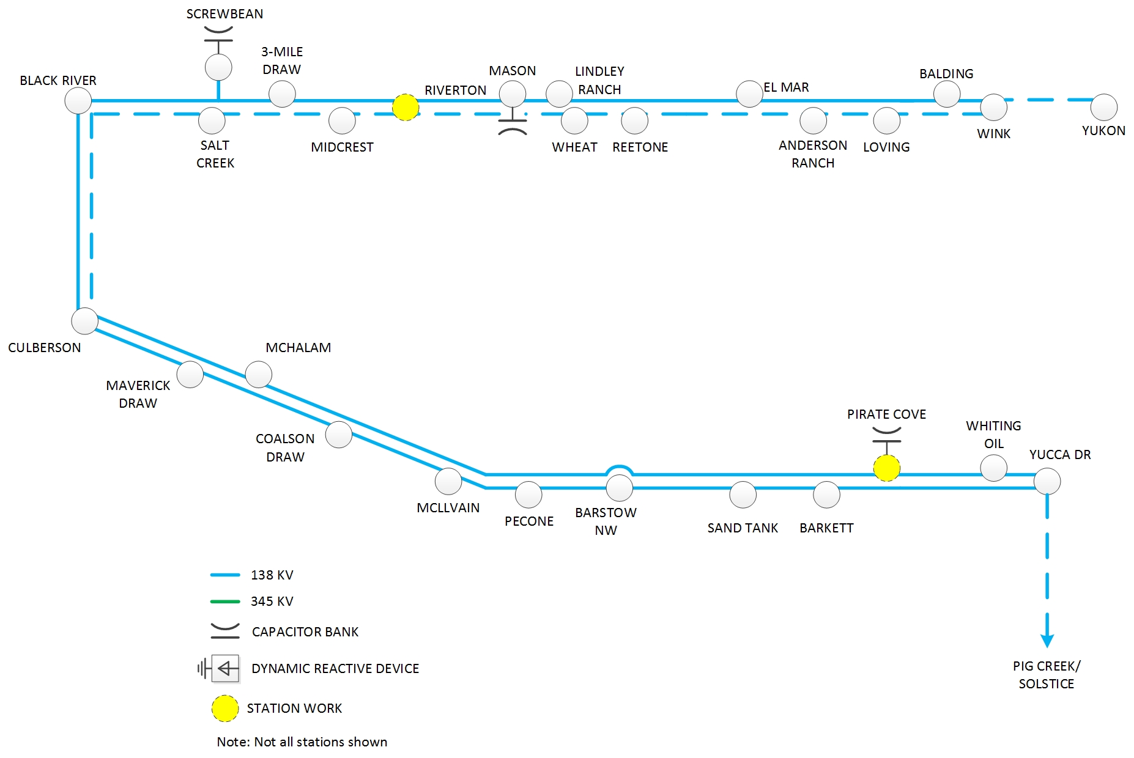
2018 Transmission Improvements

Slide 7
2019 Planned Transmission Projects
Spring 2019 – Scheduled In Service
Construct New Sand Lake 138 kV Switch
Construct New Riverton – Sand Lake 138 kV Line
Construct Horseshoe Springs 138 kV Switch
Install Horseshoe Springs 138 kV Capacitors
Install Horseshoe Draw Dynamic Reactive Device
Install second circuit on Wink – Yukon 138 kV Line
Rebuild Wink – No Trees 138 kV Line
Install series reactor at Wolf & Yucca 138 kV Switch
Install Moss 345/138 kV autotransformer #2
Fall 2019 – Scheduled In Service
Construct Quarry Field 138 kV Switch
Install Quarry Field 138 kV capacitors
Install Rondo Dynamic Reactive Device
Construct New Horseshoe Springs – Owl Hills 138 kV Line
Construct New Owl Hills – Tunstill 138 kV Line

Slide 8
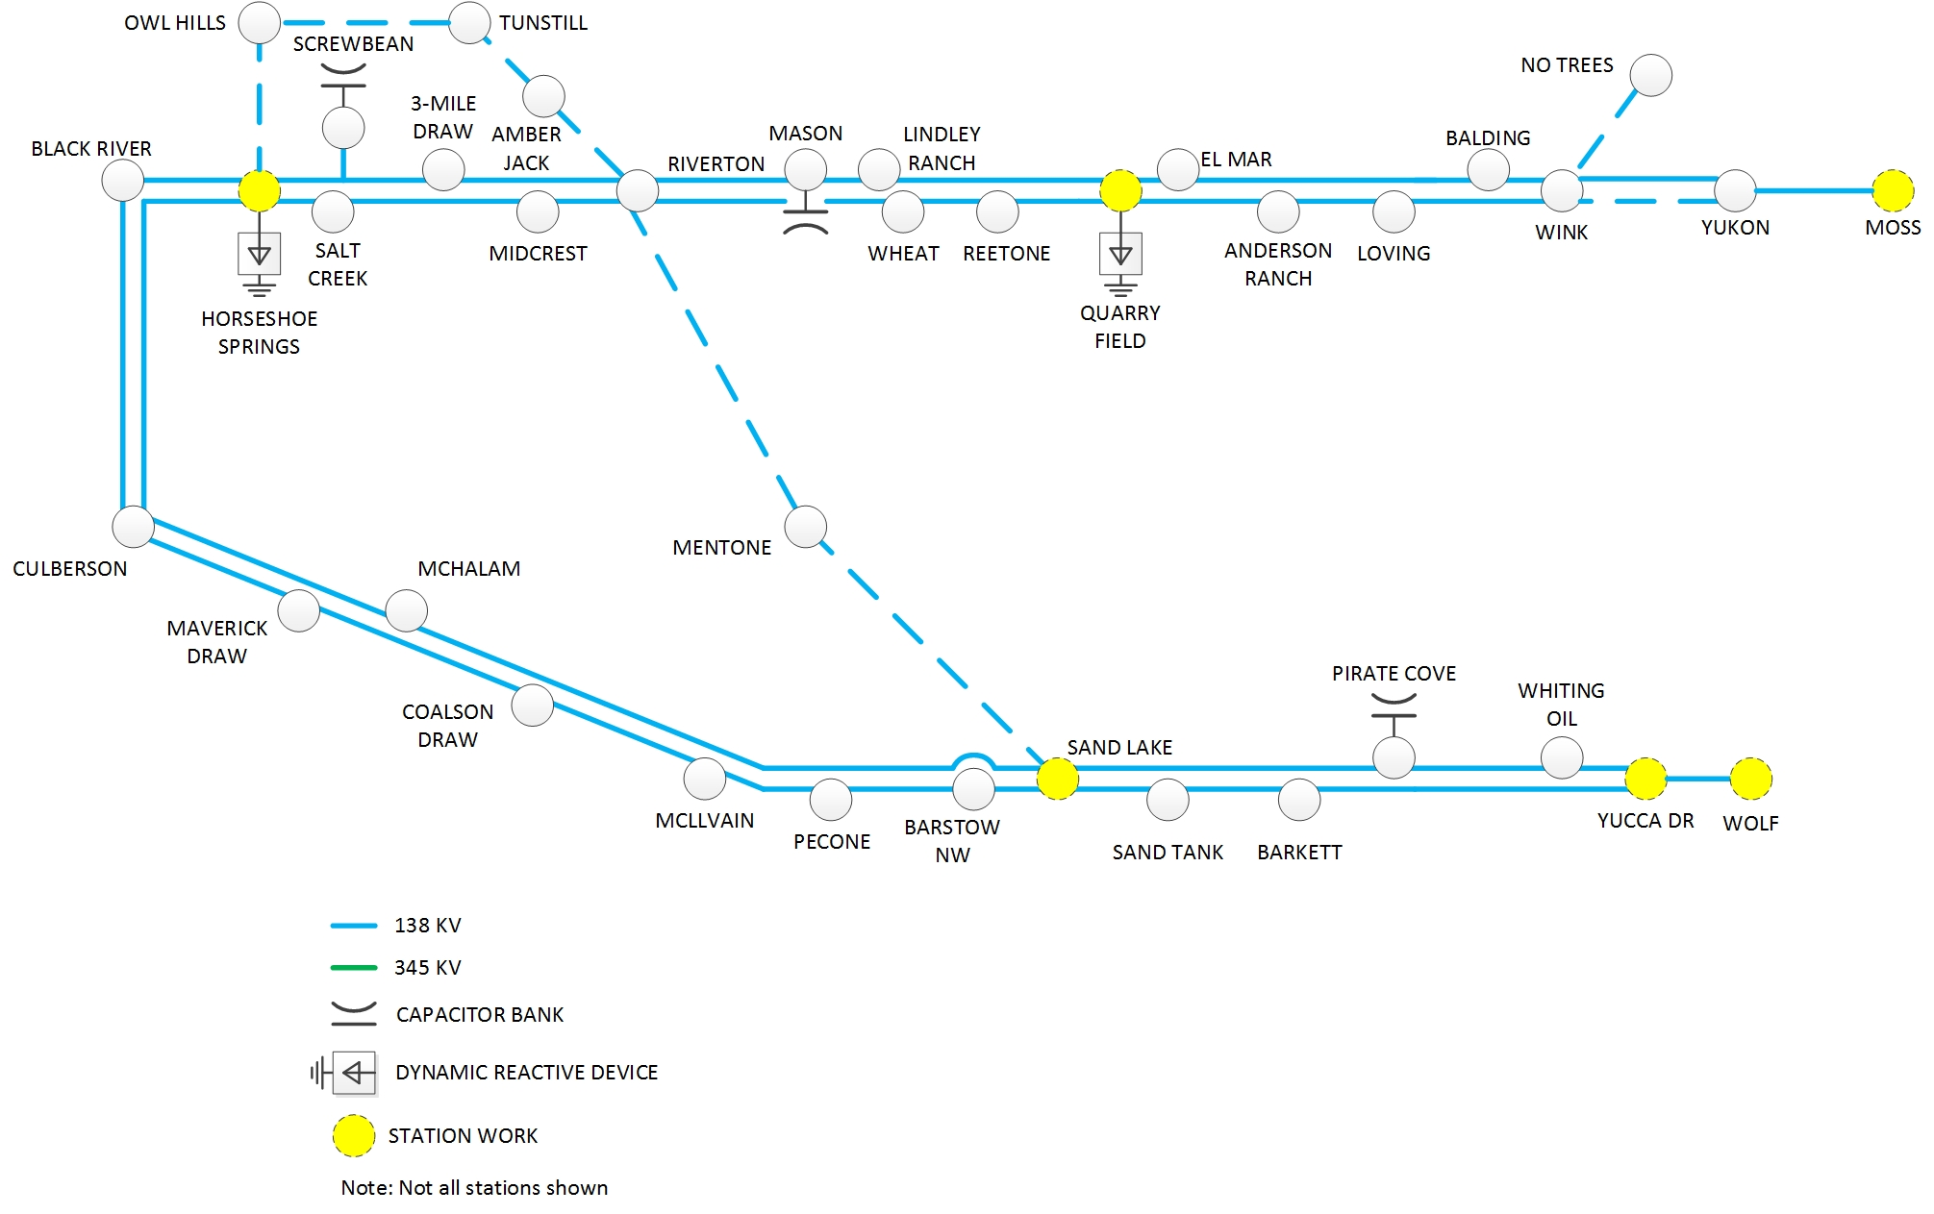
2019 Transmission Improvements

Slide 9
2020 Planned Transmission Projects
Spring 2020 – Scheduled In Service
Rebuild Cowden North – Odessa North 138 kV Line
Rebuild Andrews County South – No Trees 138 kV Line
Construct New Kyle Ranch – Quarry Field 138 kV Line
Construct New Riverton – Kyle Ranch 138 kV Line
Fall 2020 – Scheduled In Service
Construct New Riverton – Odessa EHV / Moss 345 kV Line
Construct New Riverton 345 kV Switch
Install Riverton – Sand Lake 345 kV Line
Construct New Sand Lake 345 kV Switch
Construct New Sand Lake – Solstice 345 kV Line

Slide 10
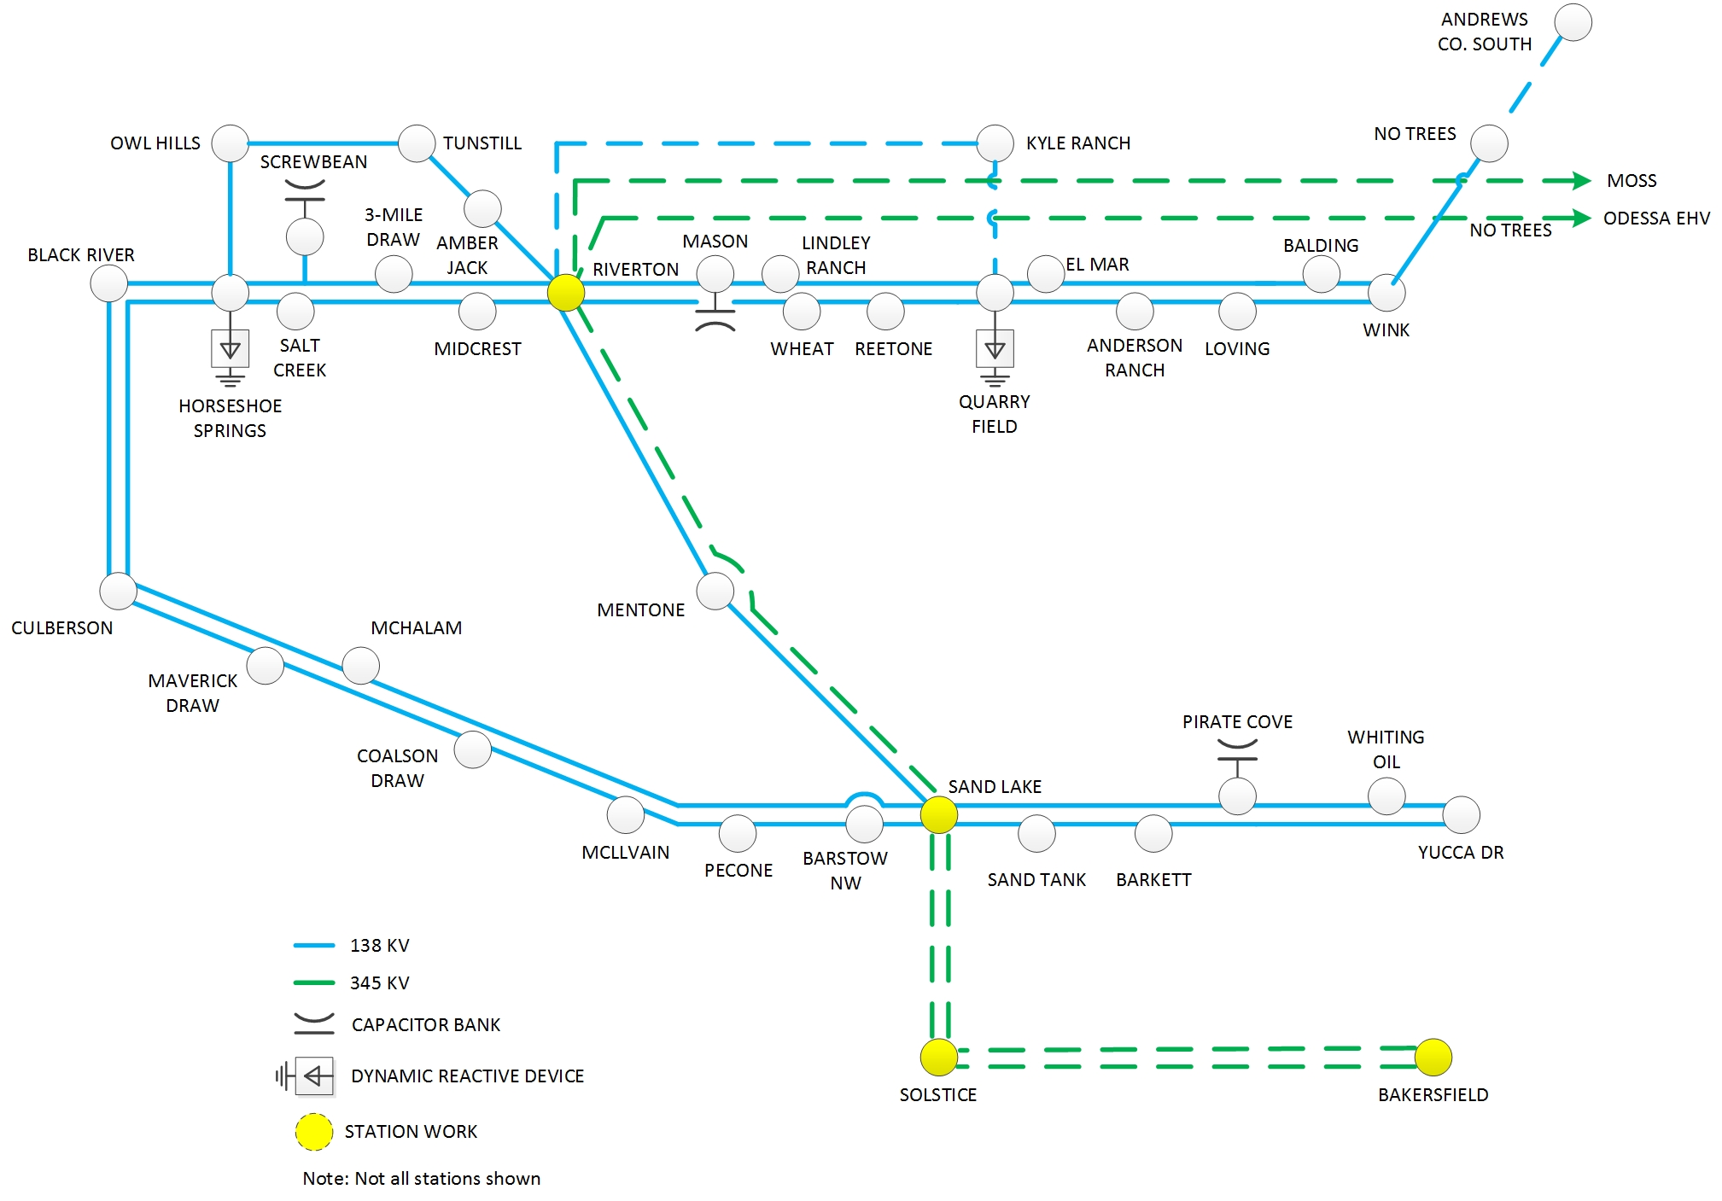
2020 Improvements

Slide 11
QUESTIONS/DISCUSSION

