Slide 1
Credit Exposure Update
Spoorthy Papudesi
Credit Work Group
ERCOT Public
September 19, 2018

Slide 2
Credit Exposure Update
Inputs and Assumptions:
Only Active Counter-Parties are included
Counter-Parties are classified by rating and market activity
TPE and collateral balances used are averages for July and August 2018
Counter-Parties that are subsidiaries of, or guaranteed by, rated entities are given the parent/guarantor’s rating, adjusted down one notch

Slide 3
Credit Exposure Update
August 2018 compared to July 2018
Market-wide average TPE decreased from $965.6 million to $457.7 million.
TPE decreased by
$368.6 million for “Load and Gen” category.
$87.1 million for “Trader” category.
$46.7 million for “Load Only” category.
$5.3 million across other categories.
Average Excess collateral increased from $2,989.5 million to $3,183.2 million.
Excess Collateral increased by
$76.2 million for “Load and Gen” category.
$62.8 million for “Trader” category.
$44.8 million for “Load Only” category.
$9.8 million across other categories.
Number of active Counter-Parties decreased from 224 to 223.

Slide 4
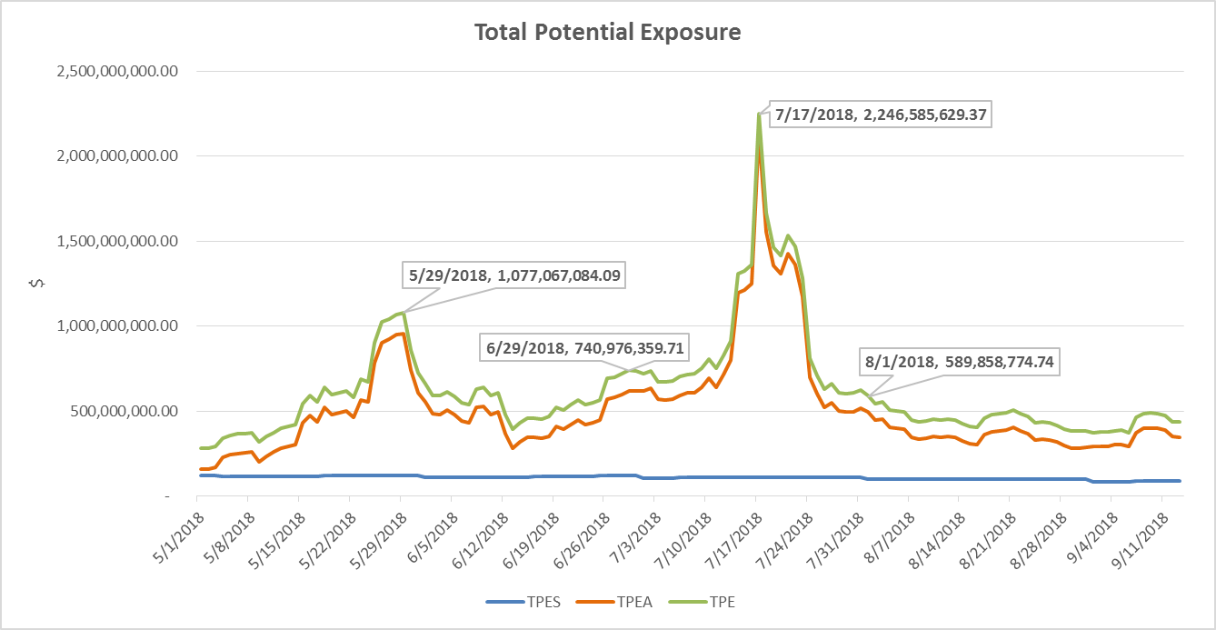
Credit Exposure Update

Slide 5
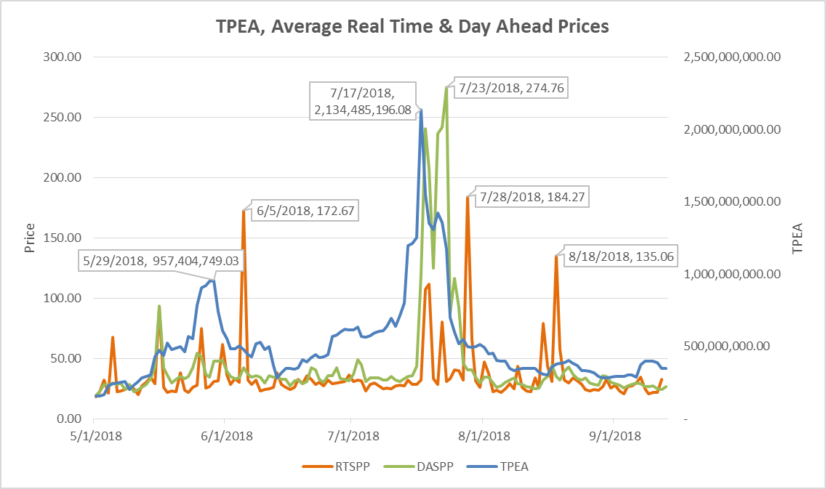
Credit Exposure Update

Slide 6
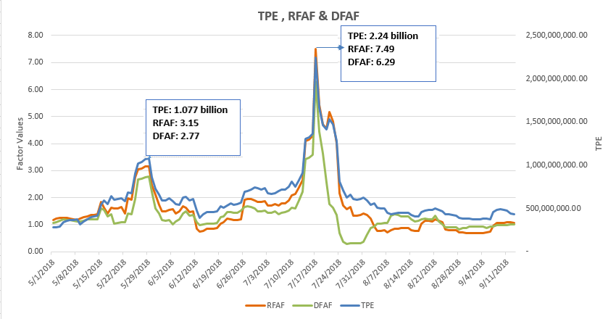
Credit Exposure Update

Slide 7
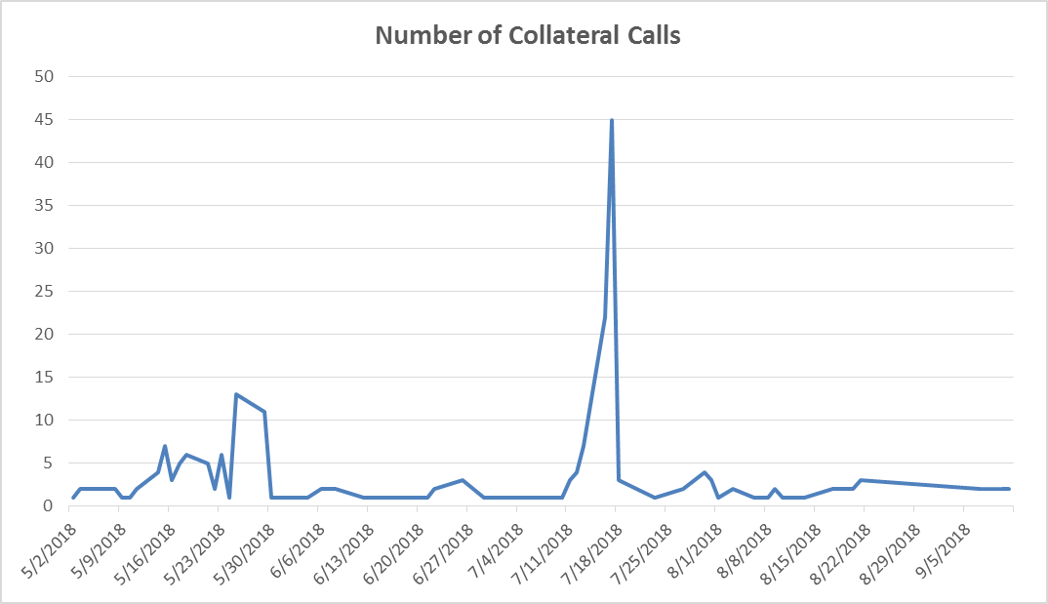
Credit Exposure Update

Slide 8
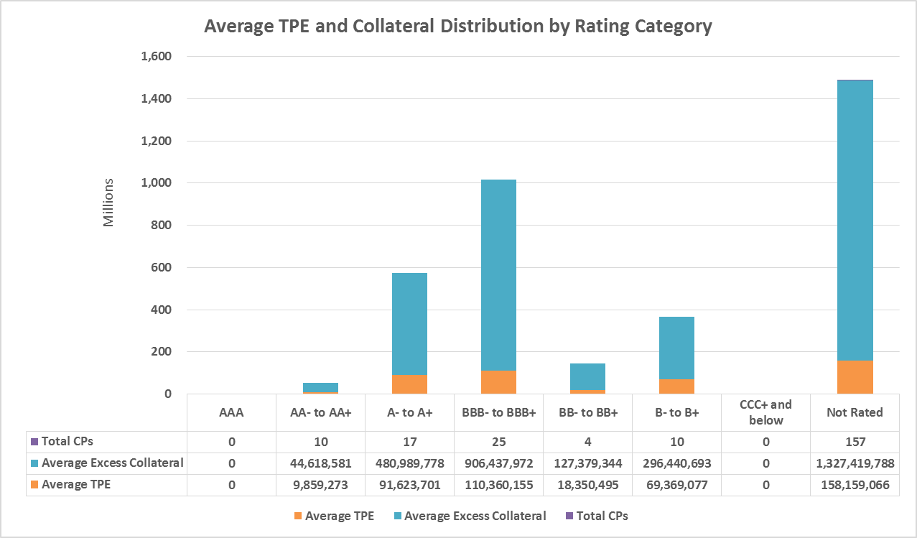
Credit Exposure Update

Slide 9
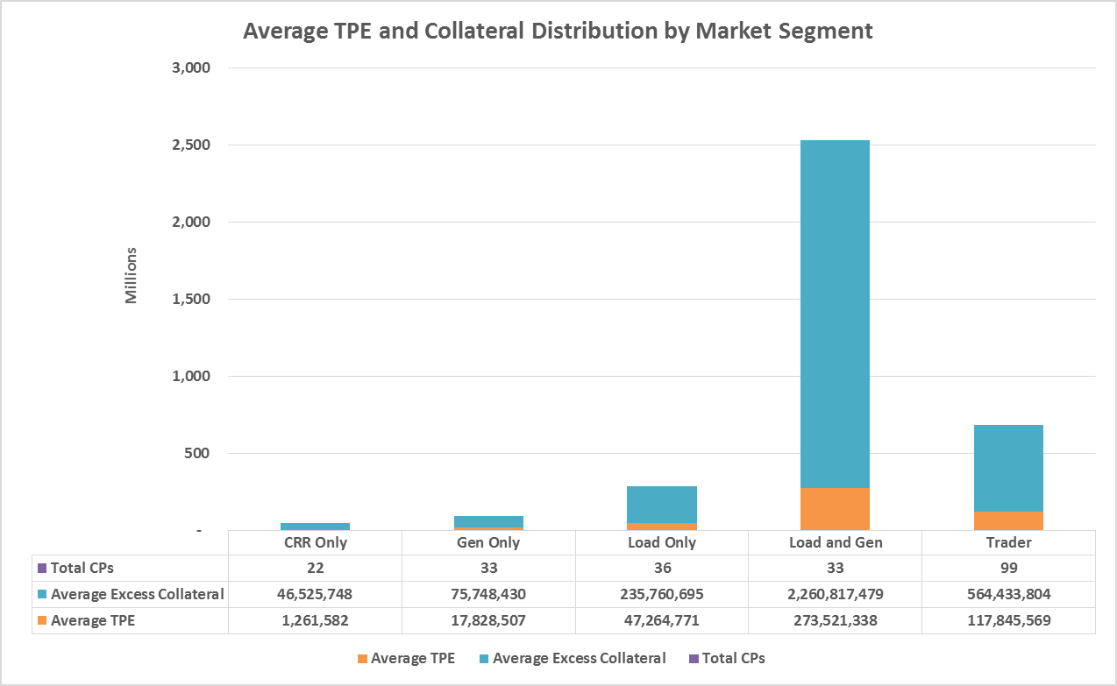
Credit Exposure Update

Slide 10
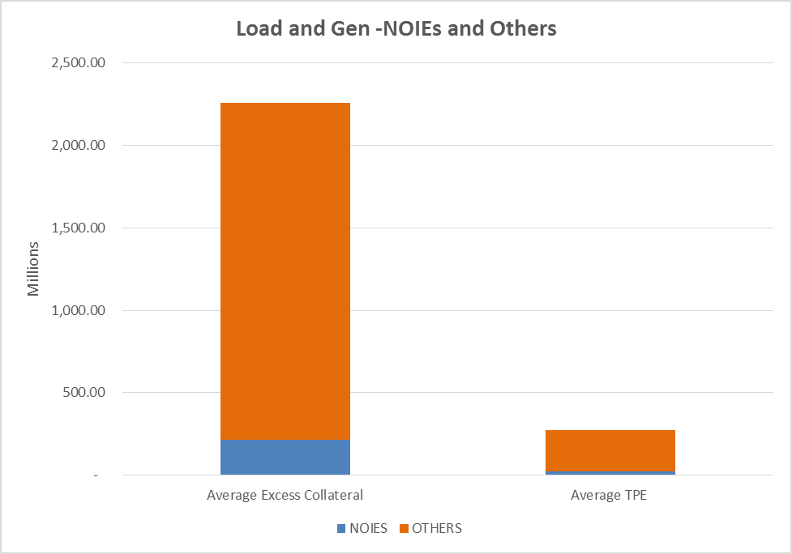
Credit Exposure Update
Average TPE and Excess Collateral Distribution among Load and Gen NOIES/Others

Slide 11
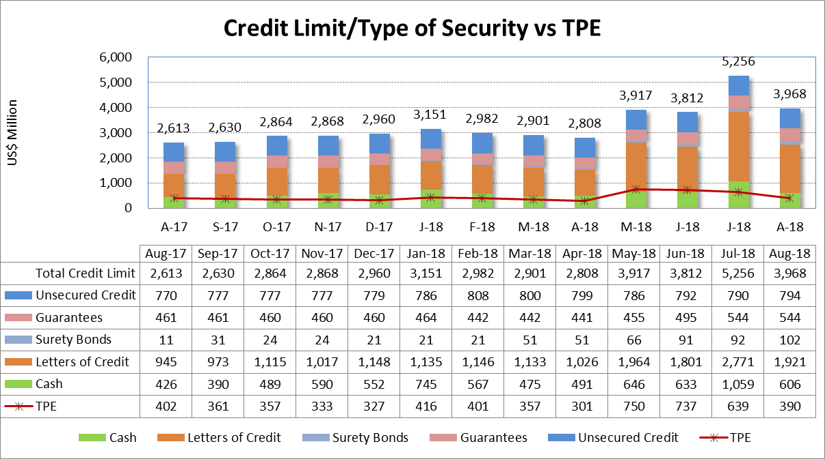
Credit Exposure Update

Slide 12
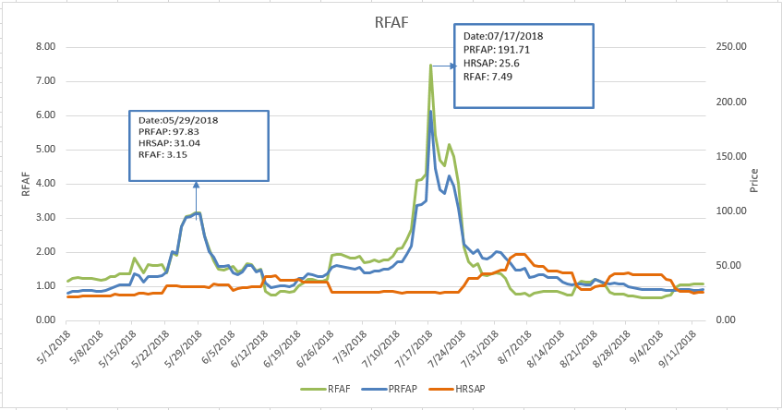
Credit Exposure Update
Real-Time Forward Adjustment Factor (RFAF)
RFAF is calculated using 21 days of ICE future prices and 14 days of ERCOT Real Time Settled Prices for HB_NORTH settlement point

Slide 13
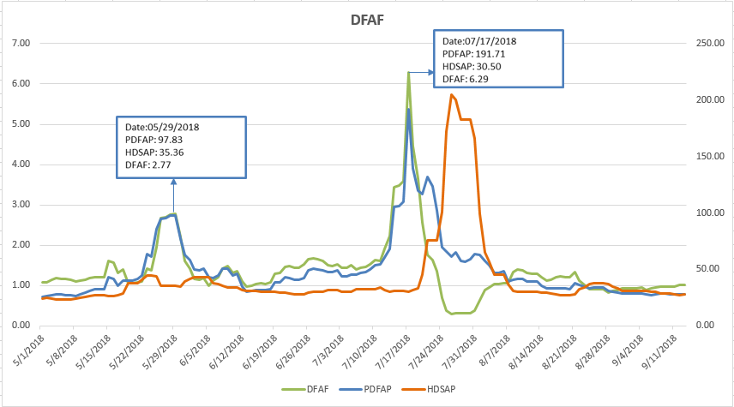
Credit Exposure Update
Day-Ahead Forward Adjustment Factor (DFAF)
DFAF is calculated using 21 days of ICE future prices and 7 days of ERCOT Day Ahead Settled Prices for HB_NORTH settlement point

Slide 14
Credit Exposure Update
Appendix

Slide 15
Credit Exposure Update
Summary statistics by Market Segment

Slide 16
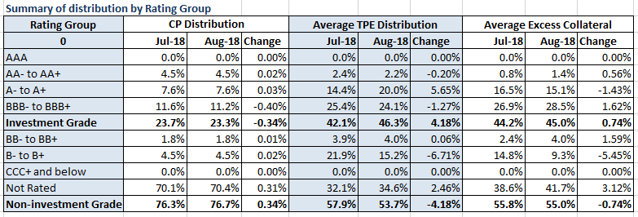
Credit Exposure Update
Summary statistics by Rating Group

Slide 17
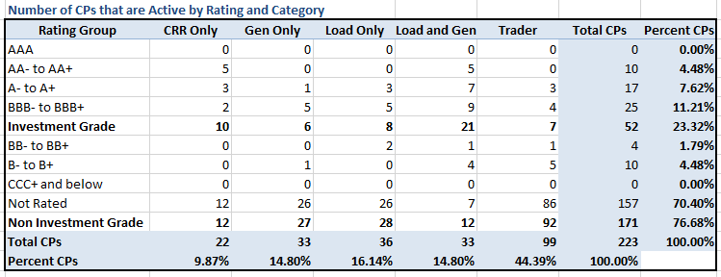
Credit Exposure Update
Active Counter-Parties distribution by rating and category- Aug 2018

Slide 18
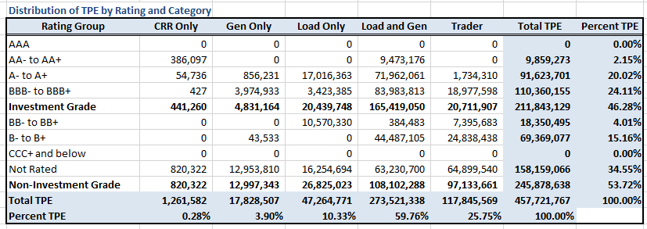
Credit Exposure Update
Average Total Potential Exposure distribution-Aug 2018

Slide 19
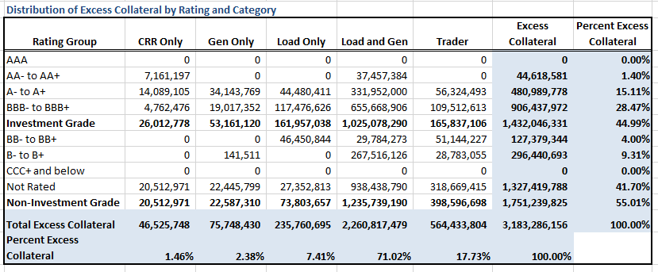
Credit Exposure Update
Average Excess Collateral distribution^{*-}Aug 2018
*Excess Collateral is a voluntary disposition by Counterparty

Slide 20
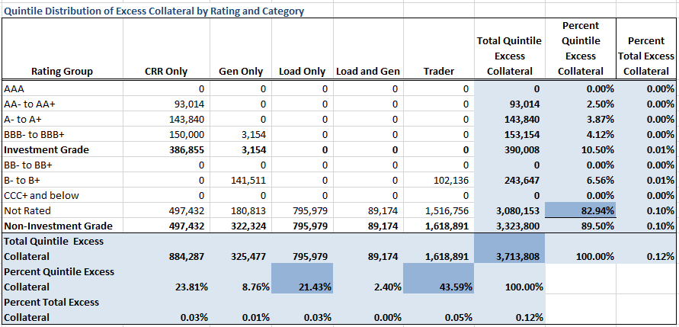
Credit Exposure Update
Distribution in the Bottom Quintile of Excess Collateral^{*-}Aug 2018
*Excess Collateral is a voluntary disposition by Counterparty

Slide 21
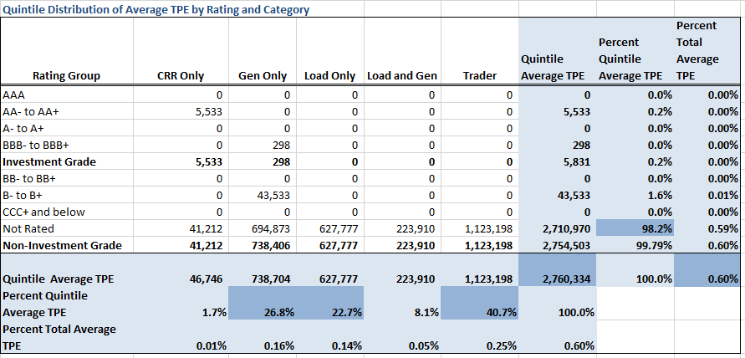
Credit Exposure Update
Distribution of TPE in the Bottom Quintile of Excess Collateral^{*-}Aug 2018
*Excess Collateral is a voluntary disposition by Counterparty

Slide 22
Credit Exposure Update
Questions

