Slide 1
Supply Analysis Working Group Meeting
Pete Warnken
Manager, Resource Adequacy
September 14, 2018

Slide 2
NPRR 891, Removal of NOIE Capacity Reporting Threshold of the Unregistered Distribution Generation Report

Slide 3
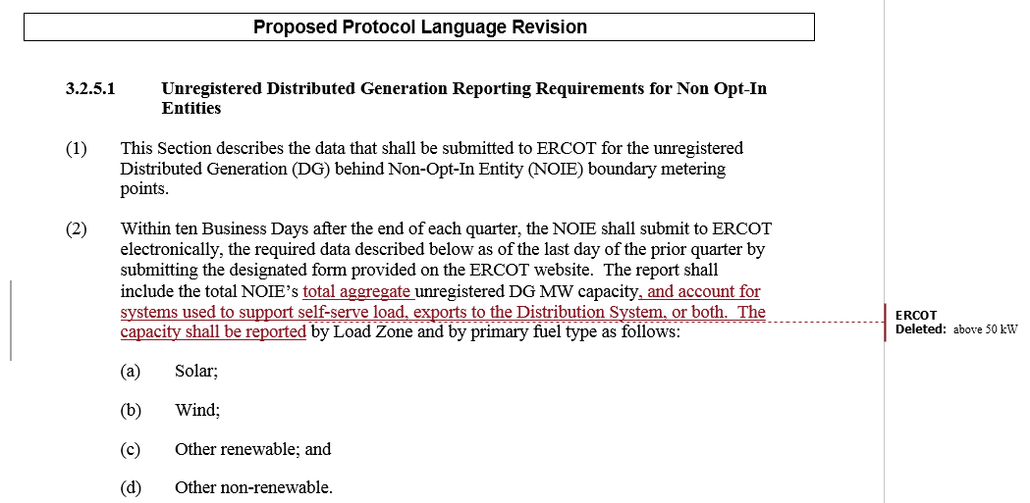
ERCOT’s Original NPRR891 Language

Slide 4
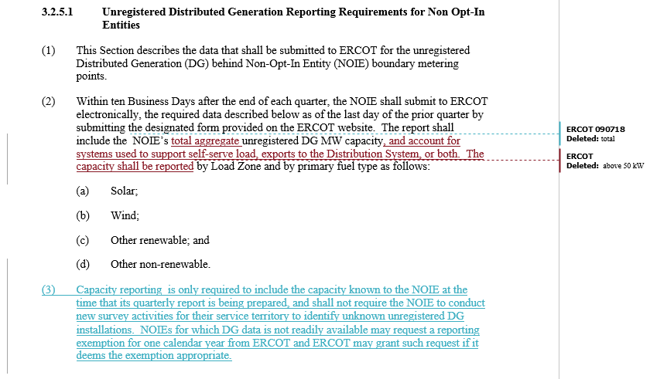
ERCOT’s Modified NPRR891 Language

Slide 5
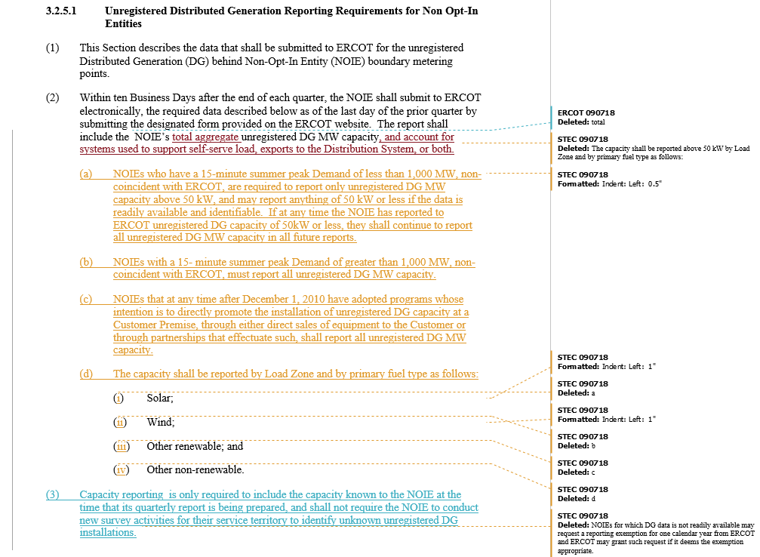
STEC’s Proposed NPRR891 Language

Slide 6
NERC 2018 Long-Term Reliability Assessment (LTRA) Update

Slide 7
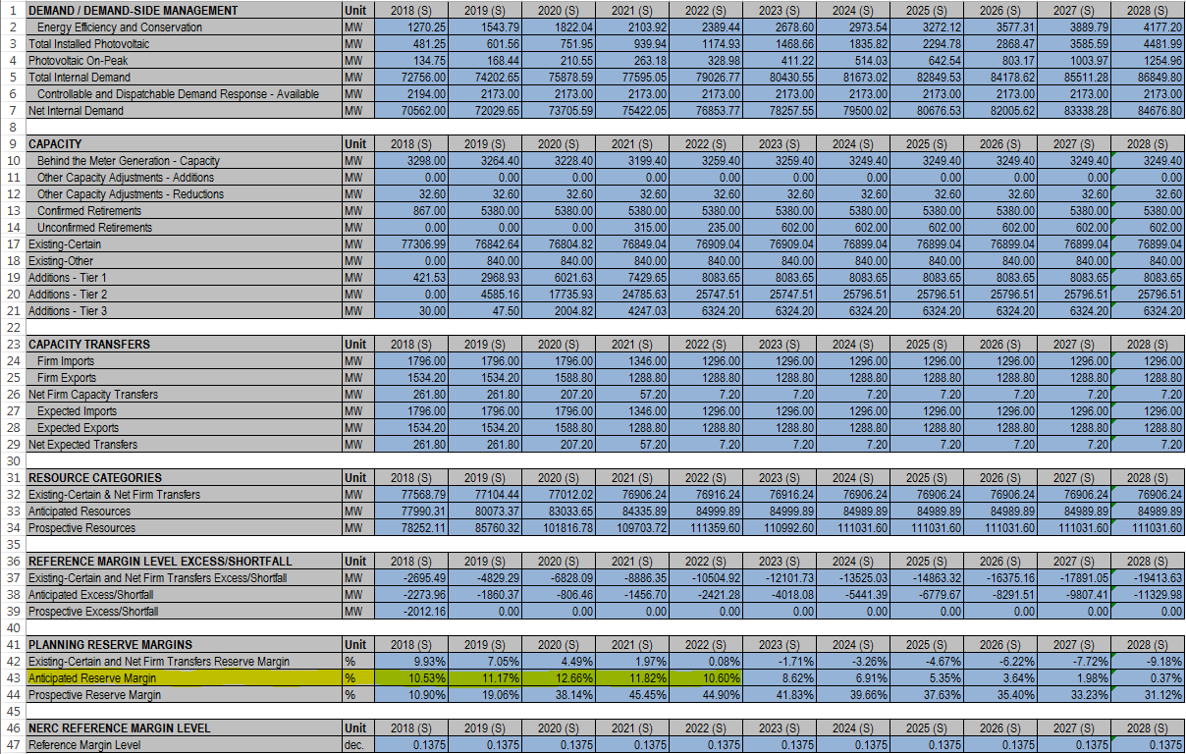
2018 LTRA Data Form Summary Sheet
Notes:
Difference between LTRA and CDR for 2018 summer: Actual ERS procurement amount used (186 MW decrease), thermal unit deratings (mainly Hays Energy Facility, 186 MW decrease)

Slide 8
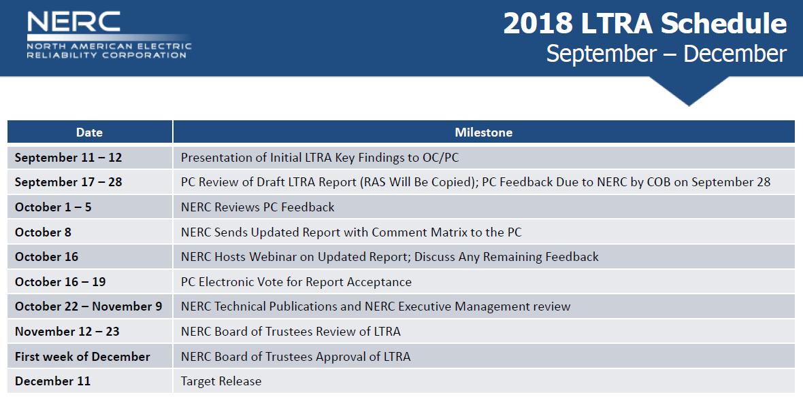
Remaining 2018 LTRA Schedule
Mid-April Version

Slide 9
EORM-MERM Study Update

Slide 10
Remaining 2018 Study Milestones
Base Case runs completed; ERCOT review on-going
Scenario/Sensitivity Results: Week of Sept. 17
Report, First Draft: October 1
Report, Draft for External Review: October 10
SAWG Presentation: October 12
  Astrape/Brattle to participate over the phone
Other presentations: TBD
Report posting: mid-December

Slide 11
Methodology/Assumption Changes
Updated resources to be consistent with early July LTRA data submission:
  Used actual ERS procurement amount, 772 MW rather than CDR amount of 1,132 MW
  Updates to planned resources based on May-June GINR changes (increased renewables)
Weather-year weighting approach for Base Case
  Assumed equal annual weights for the 38 weather years (1980-2017): 1/38th or 2.6%
  Sensitivity analysis based on “consecutive days > 100°F” analysis

Slide 12
Scenarios (Requires Model Runs)
Potential Scenario Name | Base Case Assumption | Suggested Scenario Assumption | Expected EORM Impact
High Renewables Penetration | Only include wind and solar from CDR (1.2 GW new solar / 5.4 GW new wind) | Include some of the wind and solar undergoing interconnection studies that has not met all requirements for CDR (5-12 GW of new solar, 7-17 GW of new wind) | Downward pressure on prices and therefore lower EORM, potentially creating reliability issues
Low Renewables Penetration | Only include wind and solar from CDR (1.2 GW new solar / 5.4 GW new wind) | Set the wind and solar quantities equal to the values used in the 2014 EORM study | Reduced low price hours and net load ramps from base case. Potentially higher EORM
High Gas Price | 2018 EIA AEO High Oil and Gas Resource and Technology Case | 2018 EIA AEO Low Oil and Gas Resource and Technology | ~$3/MMBtu difference in gas prices, resulting in ~1.5% change in EORM

Slide 13
Sensitivities (Do Not Require Model Runs)
Sensitivity | Base Case Assumption | Sensitivity Range
Gross Cone/ATWACC | General Merchant Values | -10%/+25%
Forward Period for Capacity Decisions | 3 years | 0 years to 4 years
VOLL | $9,000/MWh | $5,000-$30,000/MWh
Weather-year weights for Load Forecasts | Equal weight to all 38 weather years | Set weather weights using distribution-fitting based on consecutive days > 100°F analysis
Economic Forecast Uncertainty | 4% under-forecast to 4% over-forecast | Change weightings of forecast scenarios

Slide 14

Alternative Weather-Year Weighing
Index based on EORM-MERM Study Manual
Fit the annual index values to a Generalized Pareto Distribution

Slide 15
Alternative Weather-Year Weighing
Probability of a zero index value is 16%
Extreme weather-year probabilities: 2011 = 1.2%, 1980 = 1.7%

Slide 16
SARA and CDR Comparisons using the Actual 2018 Peak Load Hour

Slide 17
CDR vs. Actual for Current 2018 Peak Load Hour*
* July 19, Hour Ending 5:00 pm

Slide 18
SARA Actual for Current 2018 Peak Load Hour*
* July 19, Hour Ending 5:00 pm
Outages > 500 MW
None

