Slide 1
Project Update and Summary of
Project Priority List (PPL) Activity
September 13, 2018

Slide 2
Project Update Agenda
Project Portfolio Update p. 3-8
Recent / Upcoming Project Implementations
2018 Release Targets
Planned Project Starts
2018 Project Spending Forecast
Revision Request Funding Placeholder Status
Priority/Rank Options for Revision Requests with Impacts
Appendix
Project Portfolio Gantt Chart p. 9-16
Location of Project Priority List (PPL): http://www.ercot.com/services/projects/index

Slide 3
Recent / Upcoming Project Implementations
2018 August Release – 8/7/2018 – 8/9/2018 Complete
NPRR819 – Modification of Non-Price Error Resettlement Thresholds and Resettlement Clean-Ups
NPRR844 – Clarification to Outage Report
NPRR854 – NOIE TDSP Submittal of Meters with Bidirectional Flow Caused by Generation Interconnected at Distribution Voltage
SCR791 – Correction of 60-day SCED GRD Disclosure Report
2018 October Release – 10/23/2018 – 10/25/2018 In Flight
NPRR833(a) – Modify PTP Obligation Bid Clearing Change
DAM changes
NPRR843(a) – Short-Term System Adequacy & AS Offer Disclosure Reports Additions
One CDR report, one 48-hour report, and two 7-day reports
NPRR864 – RUC Modifications to Consider Market-Based Solutions
RRGRR015 – Additional Guidance for Transformer and Station Data
RRGRR016 – Additional Guidance for Solar Data
SCR795 – Addition of Intra-Hour Wind Forecast to GTBD Calculation
Note: Projected Go-Live dates are subject to change. Please watch for market notices as the effective dates approach.

Slide 4
2018 Release Targets – Board Approved NPRRs / SCRs / xGRRs
February 2/6 – 2/8 | April 4/5 – 4/9 | May 5/29 – 5/31 | August 8/7 – 8/9 | October 10/23 – 10/25 | December 12/11 – 12/13
NPRR659 NPRR683 NPRR743 NPRR760 NPRR800 NPRR810 PGRR042 NPRR846 | NPRR562(b) SCR792 | NPRR768 NPRR815 OBDRR002 NPRR776 NOGRR167 | NPRR819 NPRR844 NPRR854 SCR791 NPRR702 (partial implementation) | NPRR833(a) NPRR843(a) NPRR864 NPRR875 RRGRR015 RRGRR016 SCR795 NPRR825(a) | PGRR057 NPRR809(b) NPRR833(b) NPRR842 NPRR843(b) NPRR858 SCR794
8 | 2 | 5 | 5 | 8 | 7
ü
ü
ü
ü
ü
ü
ü
ü
ü
ü
ü
ü
ü
ü
ü
ü
ü
E
E
E
E
E
E
E
E
E
E
E
P
E
NS
E
CMM Release 1a
1/1 & 2/1
6/1
9/1
10/1
1/1
ü
ü
ü
2/1
TBD Items (and point at which they became “TBD”)
2014 | 2015 | 2016 | 2017 | 2018
NPRR664 | None | SCR781 P | NPRR702 P, SCR777, NPRR831(b), NPRR749 E | NPRR825(a), NPRR519, NPR620, NPRR741, NPRR755
Go-live dates can differ from Protocol effective dates – Please refer to market notices for more details
APPENDIX
Red Text: New additions and target release changes
Strike-Through Text: Previous target release
(a), (b), etc.: Multiple phase release
Project Status Codes
NS = Not Started
I = Initiation
P = Planning
E = Execution
H = On Hold
NPRR825(a) – NoticeBuilder changes
NPRR562(b) – Reporting/posting system changes
NPRR809(b) – Reporting/posting system changes
NPRR833(a) – DAM system changes
NPRR833(b) – SCED system changes
NPRR843(a) – CDR, 48 hour, & 7 day reports
NPRR843(b) – 60 day reports
Release targets are subject to change

Slide 5
Approved Revision Requests “Not Started” – Planned to Start in Future Months
Revision Request | Target Start Date | Release Target | Cost Estimate | Author
NPRR858 – Provide Complete Current Operating Plan (COP) Data | Sept 2018 | 2018-R6 | $25k-$45k | Citigroup Energy
NPRR847 – Exceptional Fuel Cost Included in the Mitigated Offer Cap NPRR817 – Create a Panhandle Hub VCMRR022 – Determination of Fuel Adder Price for Coal and Lignite Resources | Oct 2018 | 2019-R2 | $40k-$60k $150k-$200k $20k-$30k | ERCOT DC Energy ERCOT
NOGRR174 – AVR and PSS Testing Requirements | Oct 2018 | 2019-R1 | $30k-$50k | Luminant
NPRR856 – Treatment of OFFQS Status in Day-Ahead Make Whole & RUC Settlement NPRR841 – RT Adjustments to Day-Ahead Make Whole Payments due to A/S Infeasibility Charges NPRR821 – Eliminate CRR Deration Process for Resource Node to Hub or Load Zone CRRs | Oct 2018 | 2019-R1 | $50k-$75k $60k-$80k $30k-$50k | ERCOT ERCOT DC Energy
NPRR865 – Publish RTM Shift Factors for Hubs, Load Zones, and DC Ties | Oct 2018 | 2019-R1 | $30k-$40k | DC Energy
NPRR866 – Mapping Registered DG and Load Resources to Transmission Loads in the Network Operations Model PGRR061 – Related to NPRR866 RRGRR017 – Related to NPRR866 | Oct 2018 | 2018-R6 or 2019-R1 | $10k-$20k <$10k $20k-$40k | ERCOT ERCOT ERCOT
NPRR877 – Use of Actual Interval Data for IDR ESI IDs for Initial Settlement (Phase 1) | Oct 2018 | 2018-R6 or 2019-R1 | $10k-$25k | Oncor
SCR793 – SSR Related Telemetry for Transmission Service Provider (TSP) Operators | Oct 2018 | 2019-R1 | $40k-$50k | Cross Texas Transmission
SCR796 – Change Validation Rules to Preclude Certain Transactions at Resource Nodes within PUNs | Nov 2018 | 2019-R1 | $35k-$55k | ERCOT
NPRR873 – Posting ERCOT-Wide Intra-Hour Wind Power and Load Forecast on MIS Public | Dec 2018 | 2019-R2 | $60k-$80k | ERCOT
Project Initiations – Next 3 Months

Slide 6
Aging Items Report
Aging Items Report | Last Action | Status
NPRR664 – Fuel Index Price for Resource Definition and Real-Time Make-Whole Payments for Exceptional Fuel Cost Events | Board approved on 12/9/2014 | Board approved NPRR847 in August 2018 -- ERCOT presented options to WMS in Sept 2018 to resolve remaining gray-boxes

Slide 7
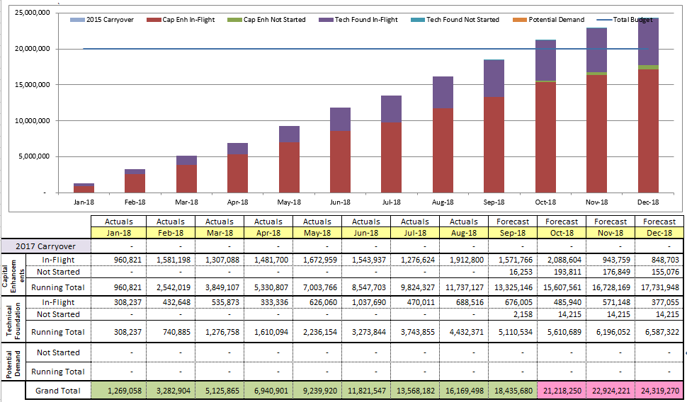
2018 Project Spending
2018 PPL Budget = $20.0M
“Potential Demand” represents internal ERCOT projects that have not been fully approved

Slide 8
Revision Request Funding Placeholder Status
In 2018 and 2019, ERCOT forecasted $4.0M for Revision Request work
Yearly Revision Request Spending Forecast Summary
Project Status | 2018 | 2019
YTD Actuals | $1.19M
Approved – In-Flight / Complete | $2.29M | $0.64M
Approved – On Hold | $0.00M | $0.00M
Approved – Not Started | $0.18M | $0.35M
Remaining Funding | $1.53M | $3.01M
Total Allocation | $4.00M | $4.00M
As of 7/31/2018
SCR789
August data not available at time of mailing

Slide 9
Priority / Rank Options for Revision Requests with Impacts
Options for…
Revision Request | Description | Priority | Rank | Comments
NPRR880 | Publish Real-Time Market Shift Factors for Private Use Network Settlement Points | 2018 | 2300 | If approved by PRS, TAC and Board, ERCOT will combine this NPRR with NPRR865 (which has a target project start date of October 2018 – see slide 5)
PPL Rank Information
Next available 2018 Rank in Business Strategy = 2300
Next available 2019 Rank in Business Strategy = 2550
Next available Rank in Regulatory = 220

Slide 10
Appendix
9/1/2018 Project Gantt
In-flight items sorted by Project End Date
“Not Started” items sorted by Project Start Date

Slide 11
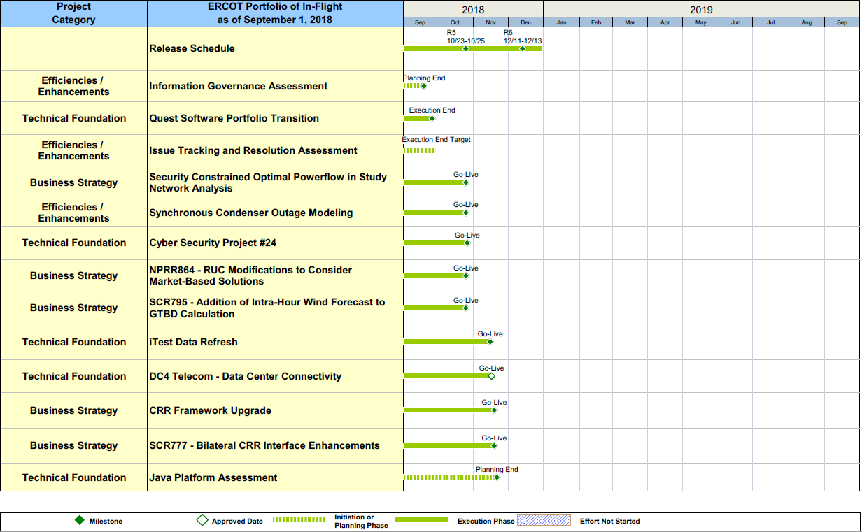
Project Portfolio Status – as of 9/1/2018

Slide 12
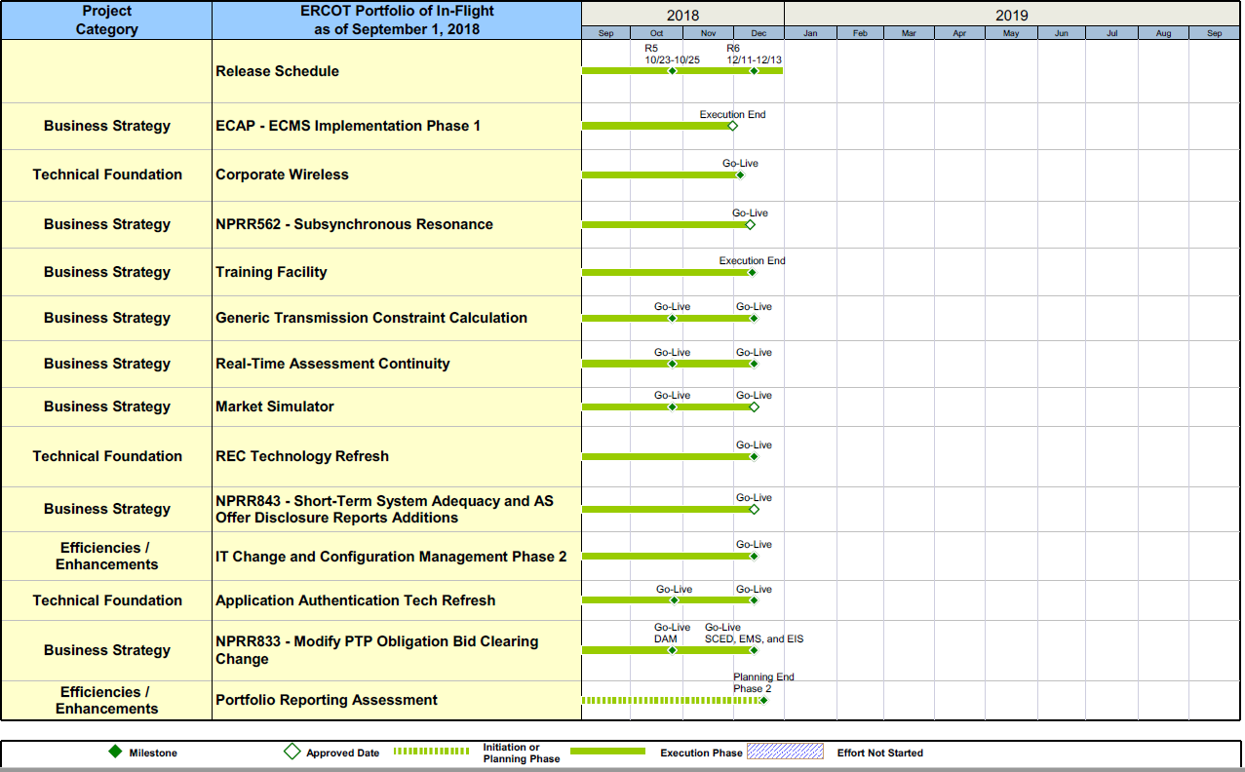
Project Portfolio Status – as of 9/1/2018

Slide 13
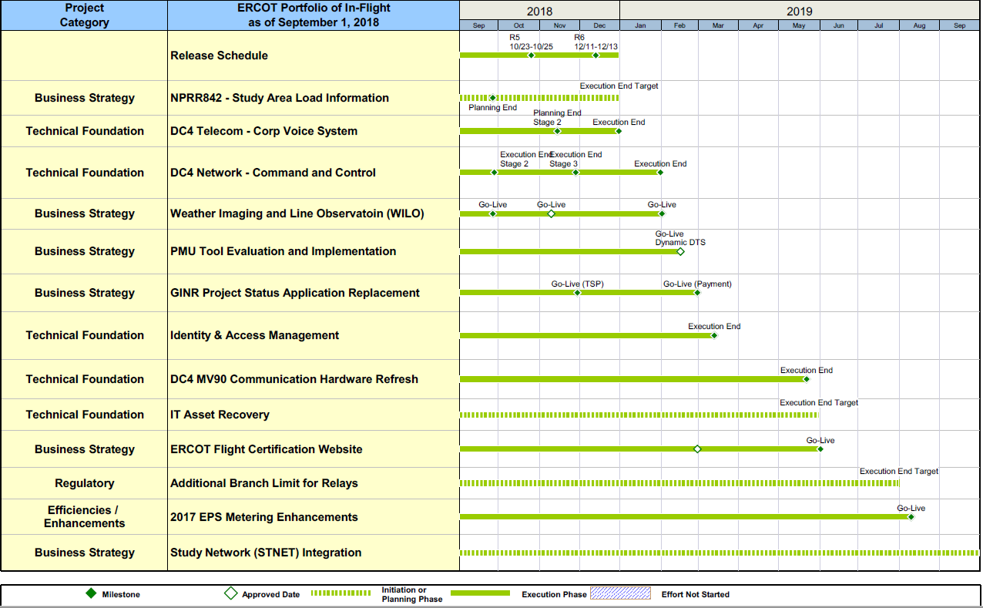
Project Portfolio Status – as of 9/1/2018

Slide 14
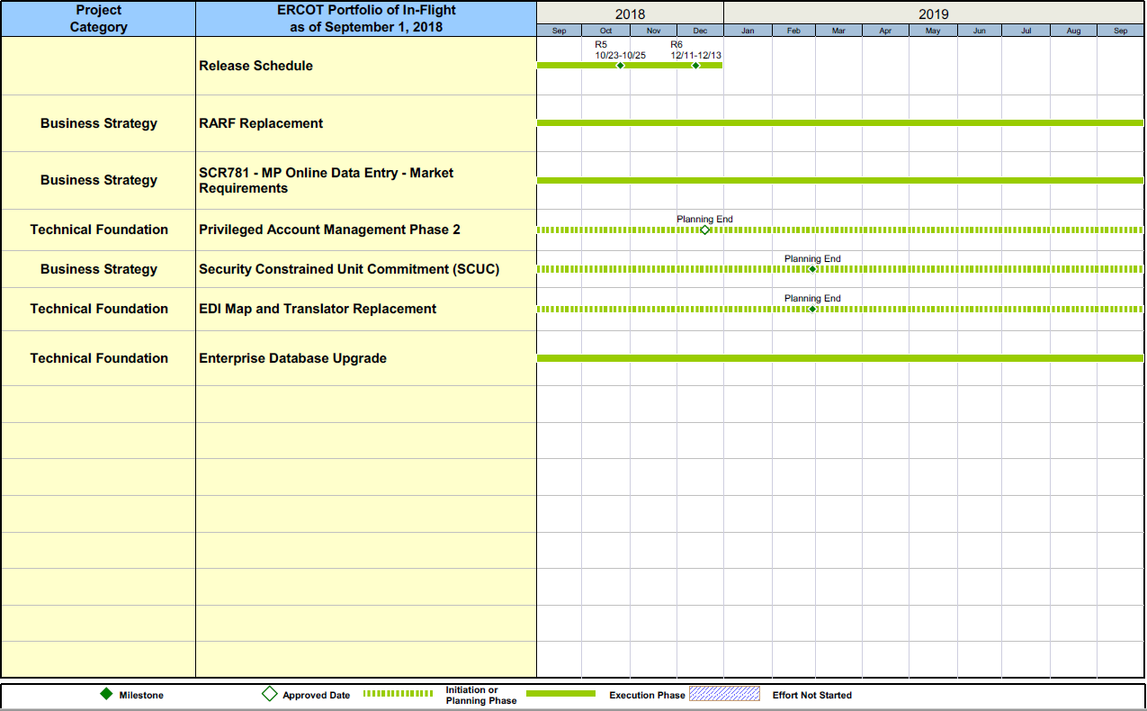
Project Portfolio Status – as of 9/1/2018

Slide 15
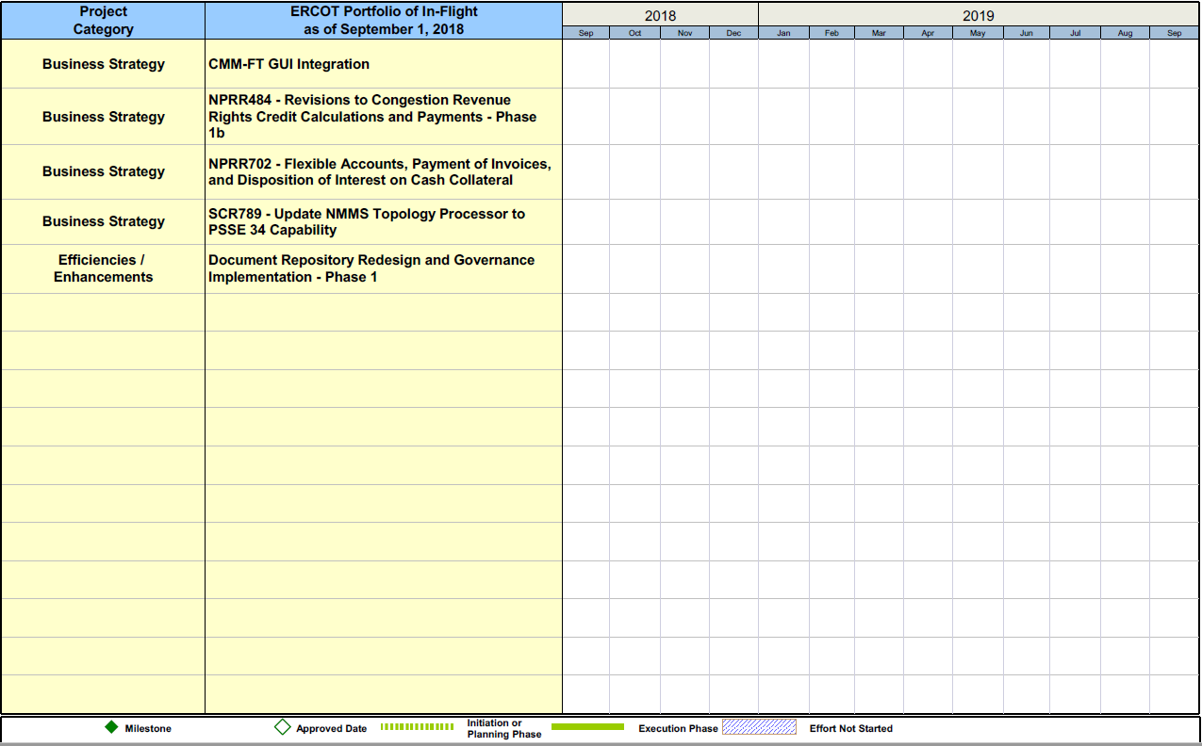
Project Portfolio Status – as of 9/1/2018

Slide 16
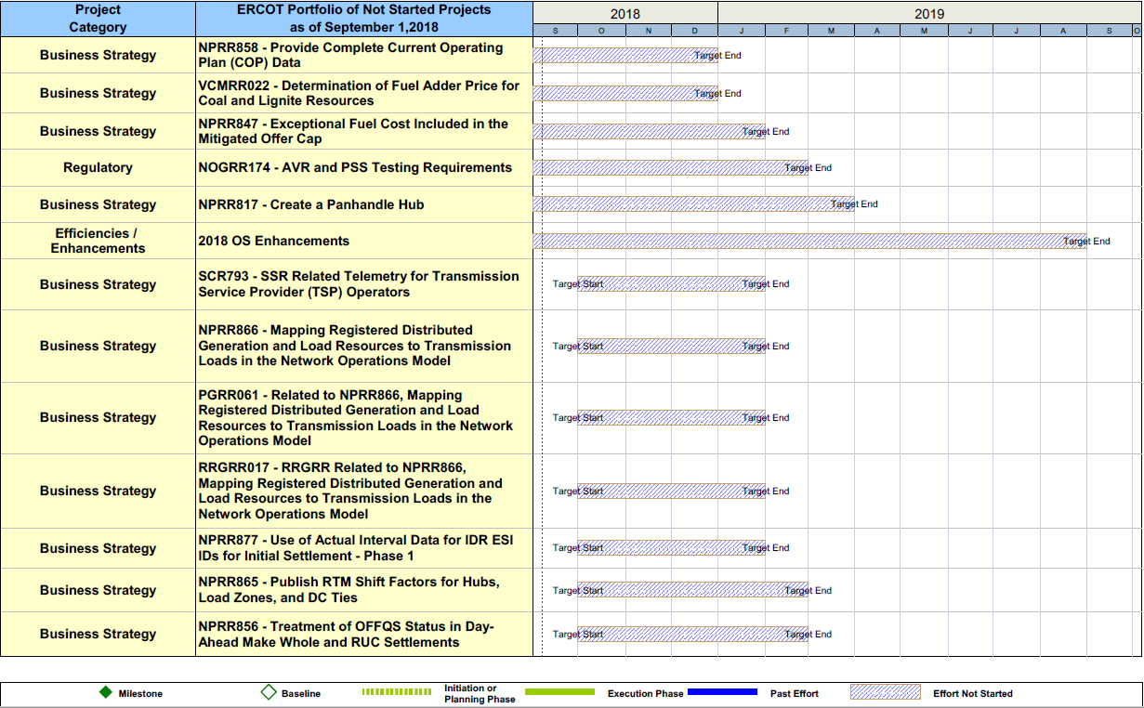
Project Portfolio Status – as of 9/1/2018 – On Hold

Slide 17
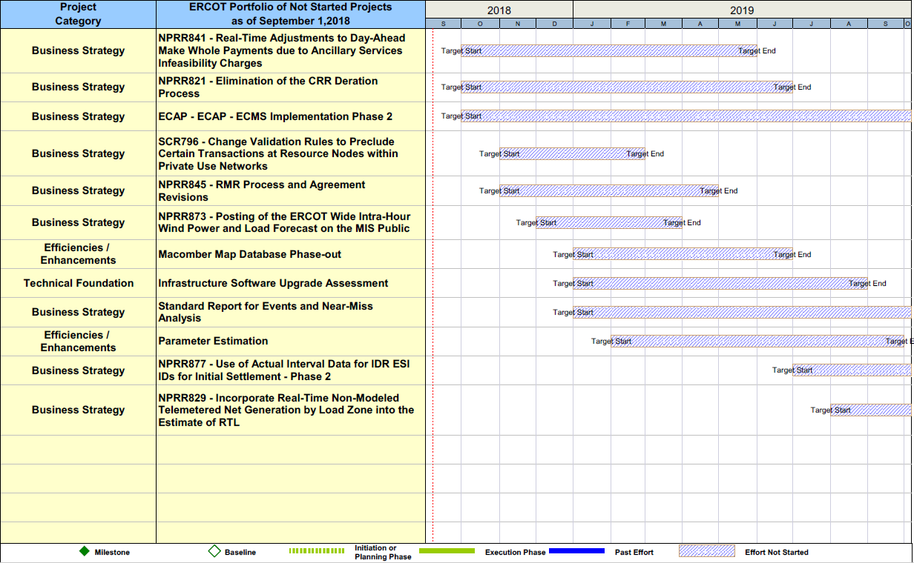
Project Portfolio Status – as of 9/1/2018 – Not Started

