Slide 1
Resource Definition Task Force
Sept 13, 2018

Slide 2
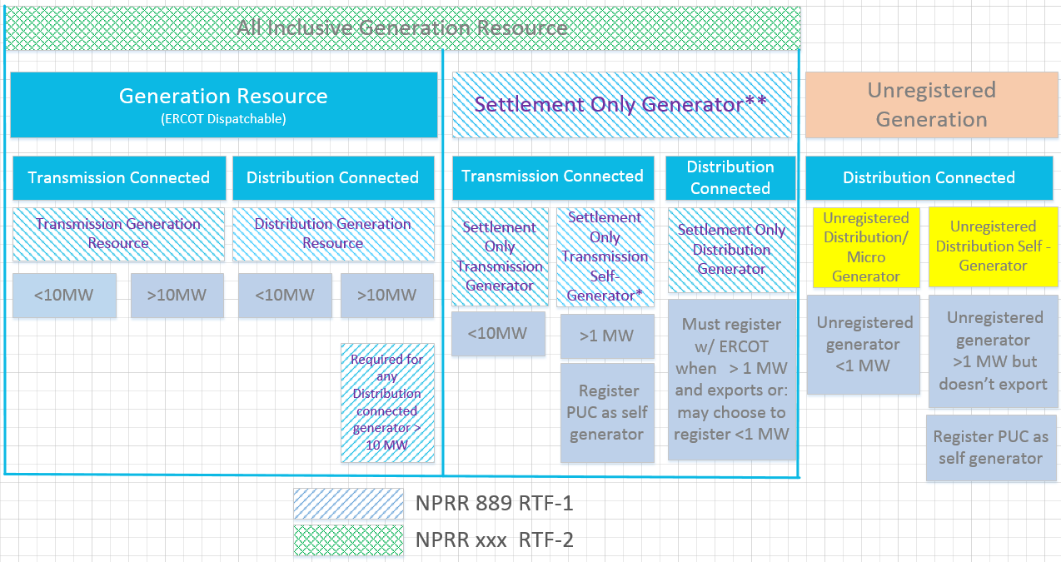
Resource Definition Framework

Slide 3
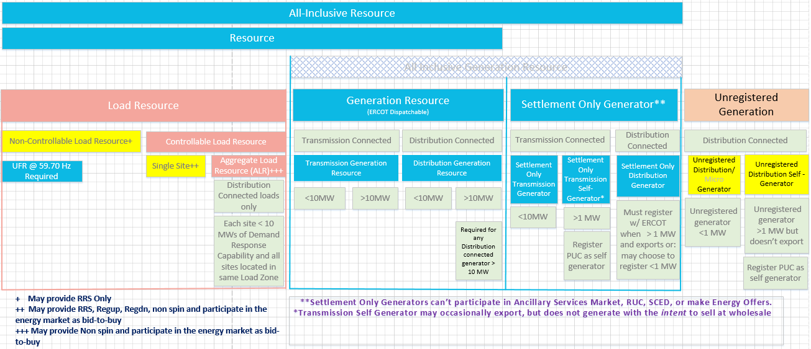
Proposed Resource Definition Framework

Slide 4
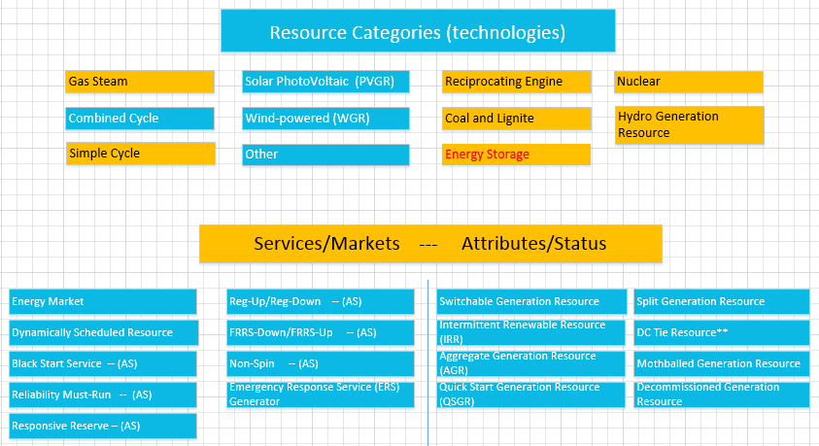
Resource Technology, Attributes and Services
Example of services

Slide 5
Topics for Additional Discussion – Phase 2 (Transmission)
All transmission connected resources would be required to be registered and modeled, regardless of size.
Finish introduction of Resource Framework
Include definitions of all technologies
Energy Storage.
Develop definition
registration/modeling/market issues will not be a significant area of focus as part of this task force and will instead be included in the whitepaper for further discussion.

Slide 6
Conceptual NPRRs
RTF-1 Establish Framework, Replace Non-Modeled with Settlement Only (889)
RTF-2 Eliminate Term “All-Inclusive Generation Resource” (Finalize today)
RTF-3 Introduce Load Resource Framework including term Non-Controllable Load Resource (not started)
RTF-4 Clarify Black-start Resource as Black Start Unit (next up- on the discussion for Sept 11 BSWG)
RTF-5 Clarify Dynamically Scheduled Resource, Quick-start Resource, Switchable Generation Resource using (unit, system, etc..) terminology?
RTF-6 Clarify Mothballed Generation Resource, Decommissioned Generation Resource, and resolve IRRG vs IRR vs PVGR vs WGR, and resolve what to do with Resource Category (not all technologies listed?)
RTF-7 Clarify the terms Registered DG, Unregistered DG, and Revise term All-Inclusive Resource to include unregistered DG.
Energy Storage (on hold pending PUC 48023)

