Slide 1
2018-19 Preliminary Winter Weather Outlook
Chris Coleman
ERCOT Sr. Meteorologist
Generator Weatherization Workshop
September 6, 2018

Slide 2
Agenda
Review of last winter (and other recent winters)
Current conditions
Expectations for the upcoming winter

Slide 3
Temperature Ranking of Recent Winters (Texas)
2017-18 | 77th coldest
2016-17 | 123rd coldest (warmest winter on record)
2015-16 | 116th coldest (8th warmest of 123)
2014-15 | 69th
2013-14 | 30th
2012-13 | 109th
2011-12 | 99th
2010-11 | 69th
2009-10 | 8th
2008-09 | 110th
2007-08 | 100th
Since 2001, only two winters have ranked
in the coldest third (1-41) of historical winters
While last winter seemed cold – and most certainly included periods of cold extremes – there have been 76 historical winters colder than last winter

Slide 4
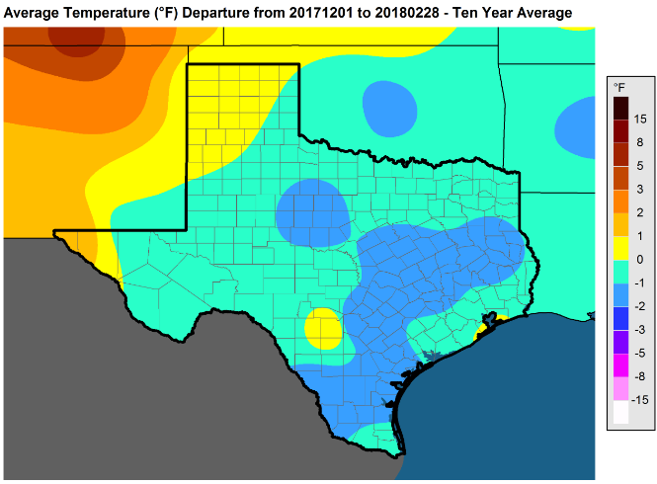
Explaining Ranks and Normal
Last winter was the 77th coldest (or 47th warmest), dating back to 1895.
That means 76 past winters were colder and 46 were warmer.
But why does the map appear “cold?”
This map shows last winter’s temperatures compared to the past 10 winters. Of the past 10,
4 were colder, 5 were warmer – thus, it ranks slightly cooler when compared to recent years.
But compared to all historical years (back to 1895), last winter was warmer than most.
Last Winter

Slide 5
Explaining Ranks and Normal
Of the past 20 winters (1999-2018),
9 ranked 24th warmest winter or warmer
20 winters prior (1979-98), 1 ranked top 24
20 winters prior (1959-78), 2 ranked top 24
20 winters prior (1939-58), 3 ranked top 24
20 winters prior (1919-38), 5 ranked top 24
23 winters prior (1895-1918), 4 ranked top 24
Texas has had a lot of warm winters this century
So much so, that it makes a “normal” or “average” winter appear colder than it is
Last winter was the 77th coldest, dating back 123 years. Not really all that cold
when compared to all historical winters. But the winter prior (2016-17) was the
warmest winter on record. And the winter before that (2015-16) was the 8th
warmest winter on record.

Slide 6
Seasonal versus Extremes
***Mild winters can have very cold periods***
February 2, 2011:
Dallas: 13° (20MPH wind)
Houston: 21° (16MPH wind)
San Antonio: 19° (25MPH wind)
Austin: 18° (26MPH wind)
Brownsville: 32° (26MPH wind)
Abilene: 7° (16MPH wind)
Midland: 6° (16MPH wind)
January 17, 2018:
Dallas:13° (5MPH wind)
Houston: 19° (13MPH wind)
San Antonio: 23° (10MPH wind)
Austin: 18° (10MPH wind)
Brownsville: 30° (14MPH wind)
Abilene: 8° (5MPH wind)
Midland:28° (7MPH wind)
Winter of 2010-11: 69th coldest in TX weather history
Winter of 2017-18: 77th coldest in TX weather history
***Coldest day since February 2011***
All-time winter peak load on this date: 65,750 MW
Winter 2013-14 was the coldest this decade (polar vortex winter) – but no single day that winter approached the cold extremes of 1/17/18
Notes:
Coldest ever recorded at IAH (Jan 1930 was 5). Coldest since 1949 in Dallas. Coldest December days ever for AUS/SAT.

Slide 7
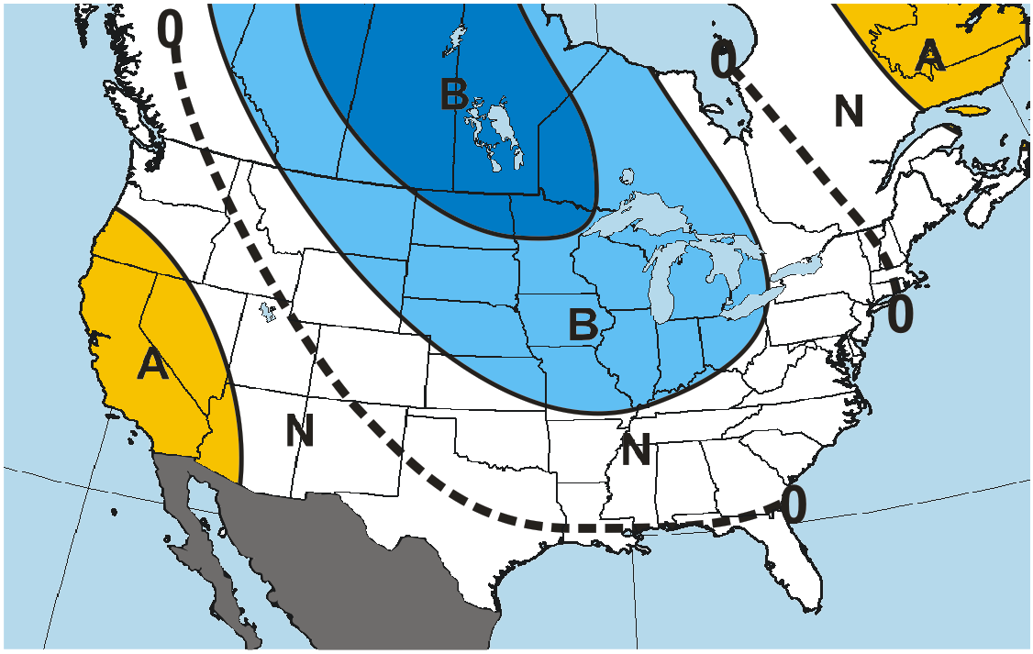
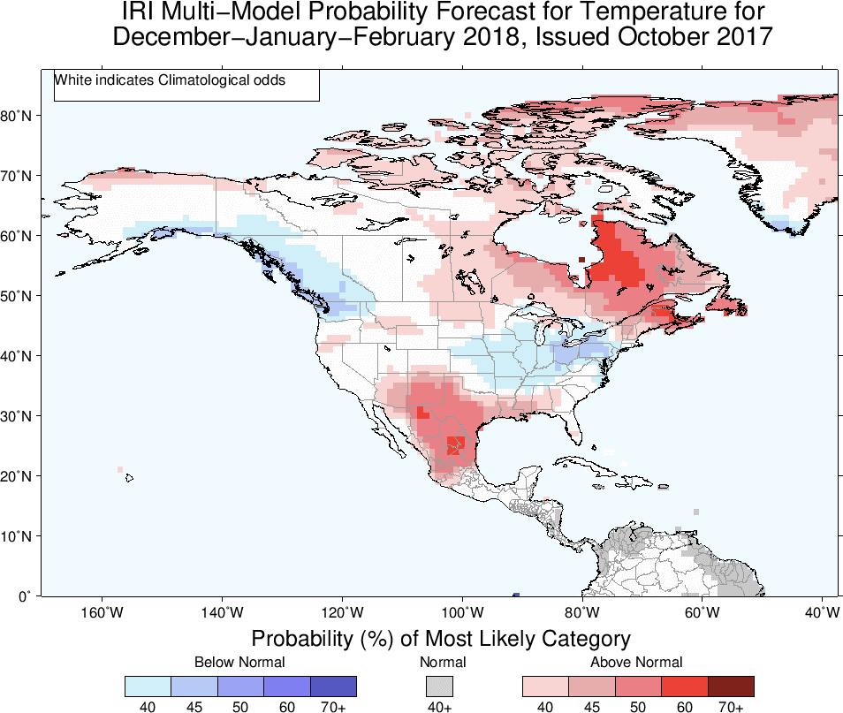
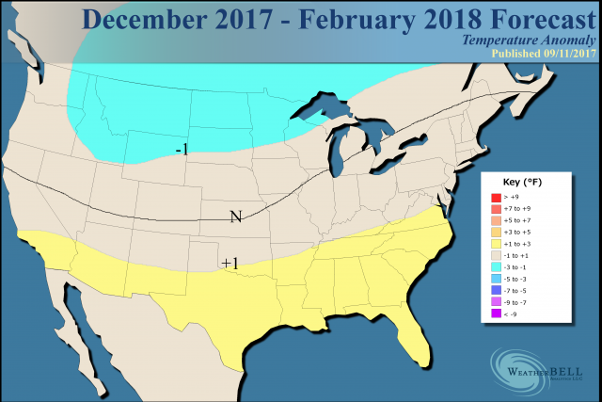
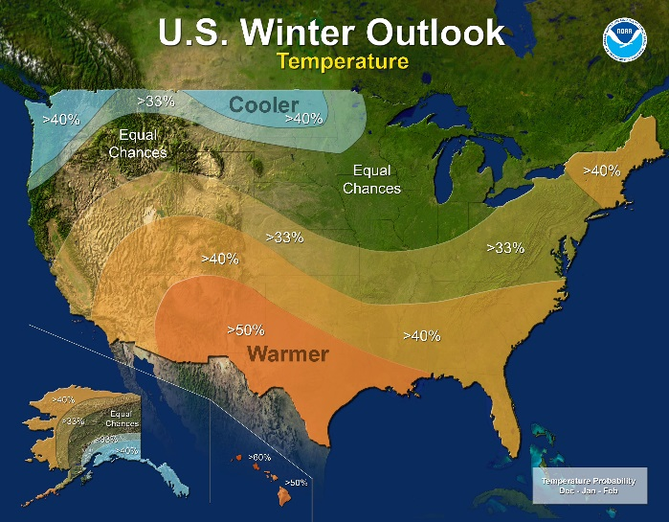
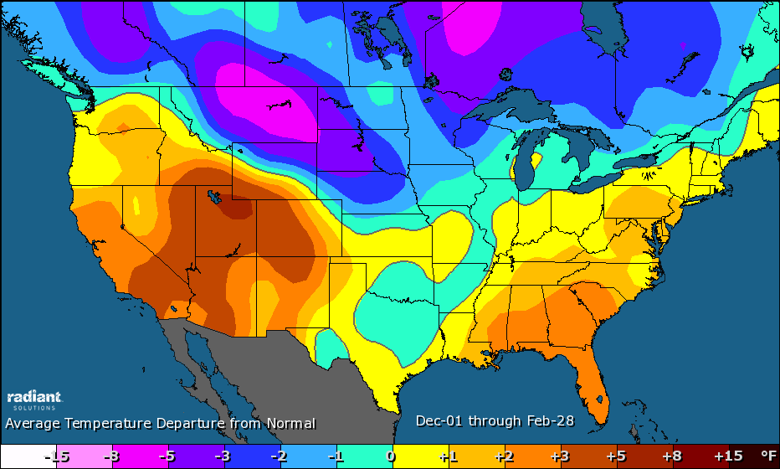
What Other Weather Sources Were Saying (last winter)
ACTUAL TEMPS
(All based on 30-year normal)

Slide 8
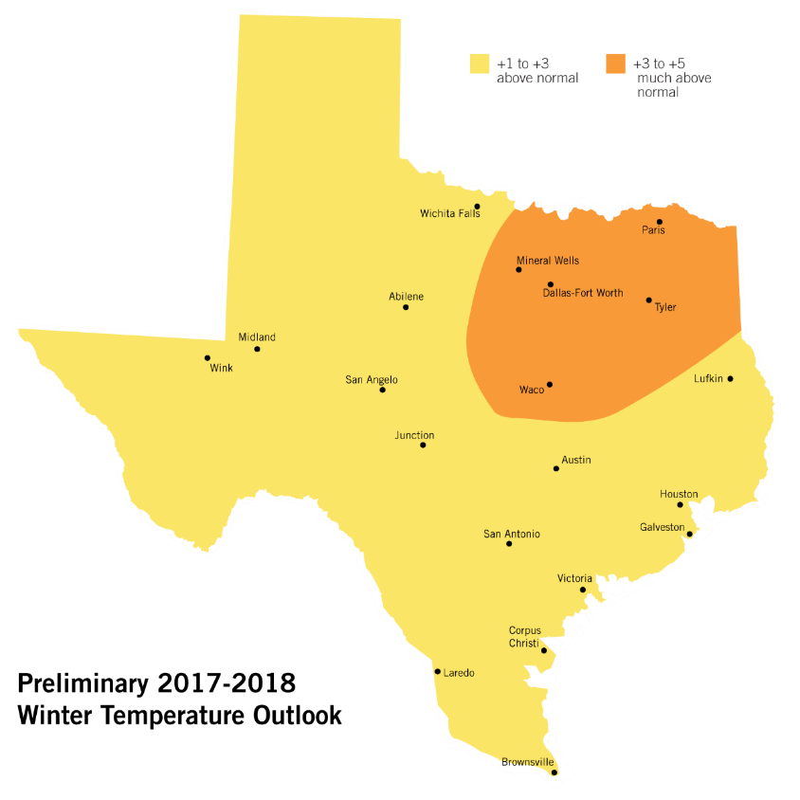
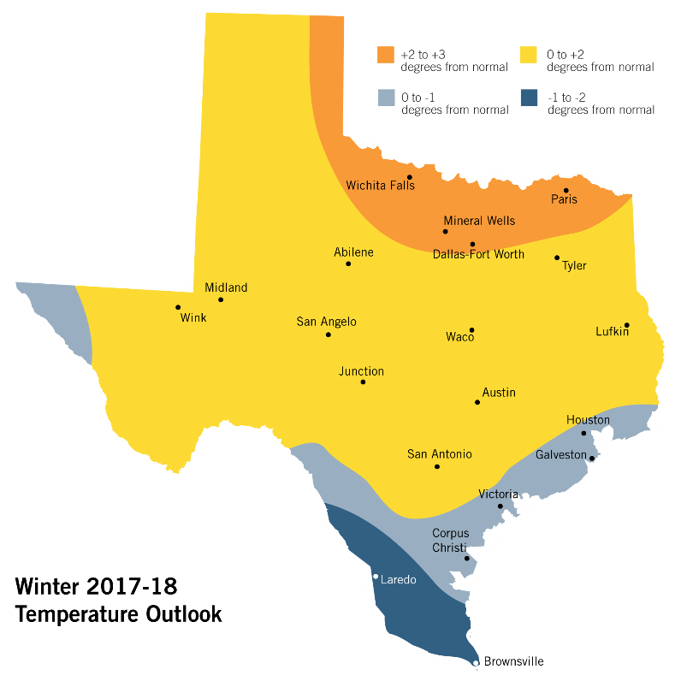
Reviewing Last Winter’s Forecast
General pattern may change with finalized forecast (Nov 1)
If trends toward 1994-95, would be warmer (especially West Texas)
(West TX was warmer, but not the rest of
ERCOT)
Can’t yet rule out a finalized, colder forecast (2006-07?)
(it was colder, but not as cold as 06-07,
which was 43rd coldest)
Nothing currently to suggest, however, it will be among the coldest winters (upper-third)
(it wasn’t)
Mild winters can – and oftentimes do – have very cold periods!
(yes, as this past winter did)

Slide 9
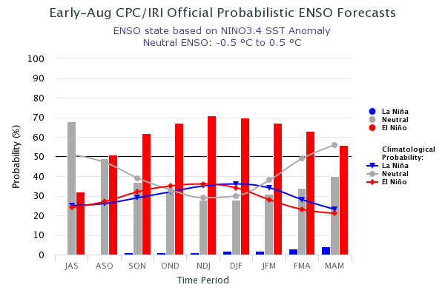
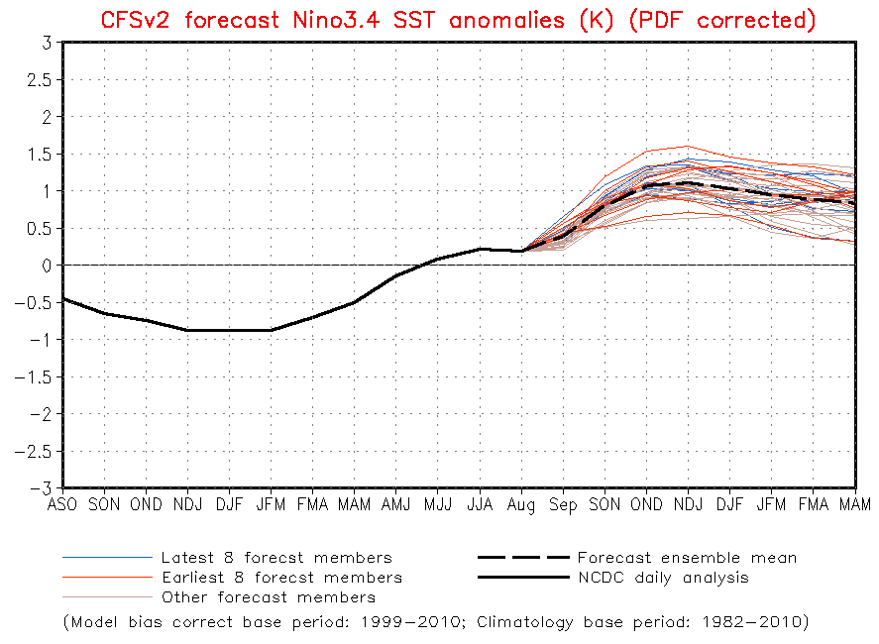
This Winter: El Niño, La Niña, or Neutral?
Likely El Niño this winter
Not likely to be a strong El Niño – thus other factors will come into play

Slide 10
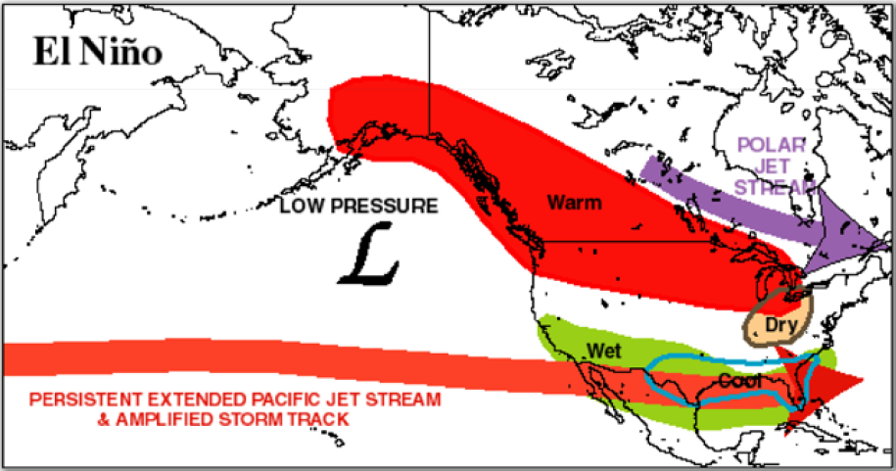
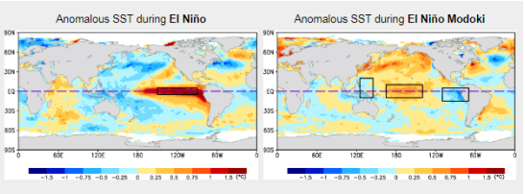
Typical El Niño Weather Pattern
This pattern is most likely with a strong El Niño. This is not likely to be strong.
Modoki is colder, wetter
for Texas

Slide 11
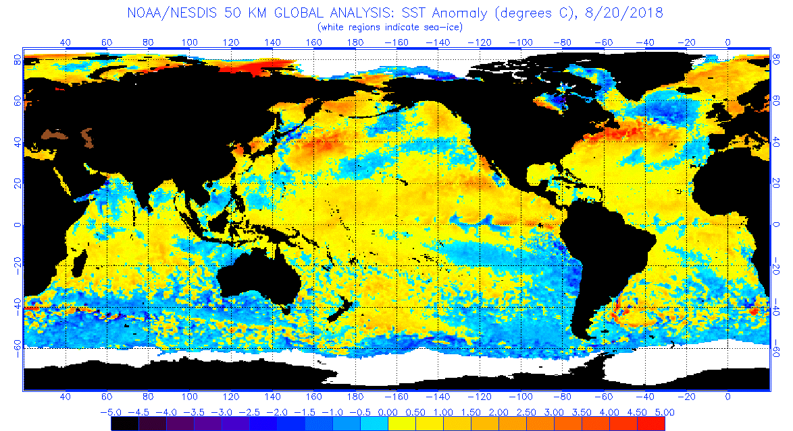
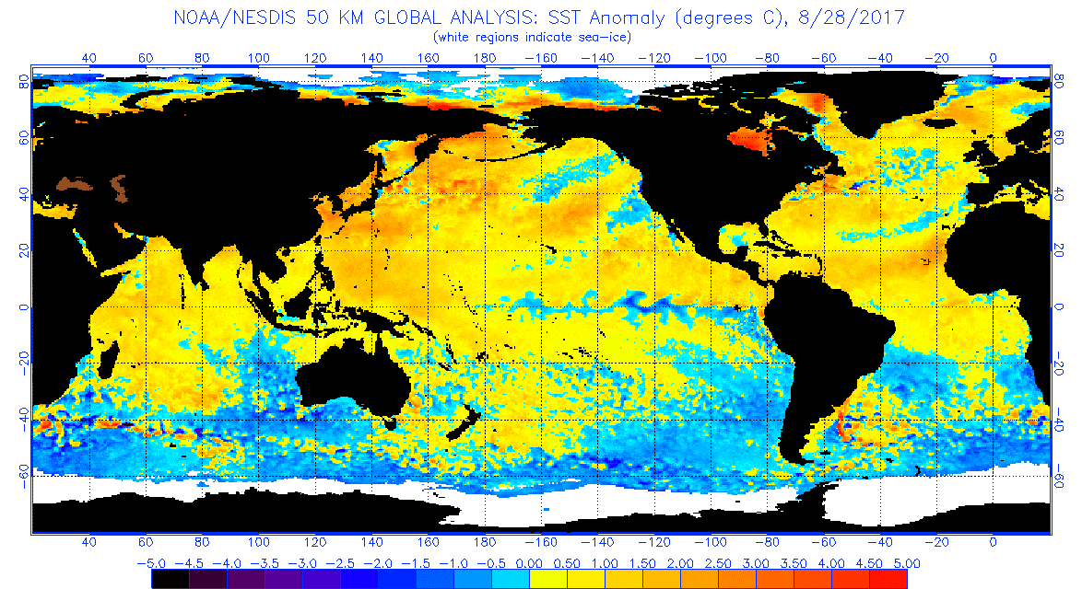
Ocean Temperatures

Slide 12
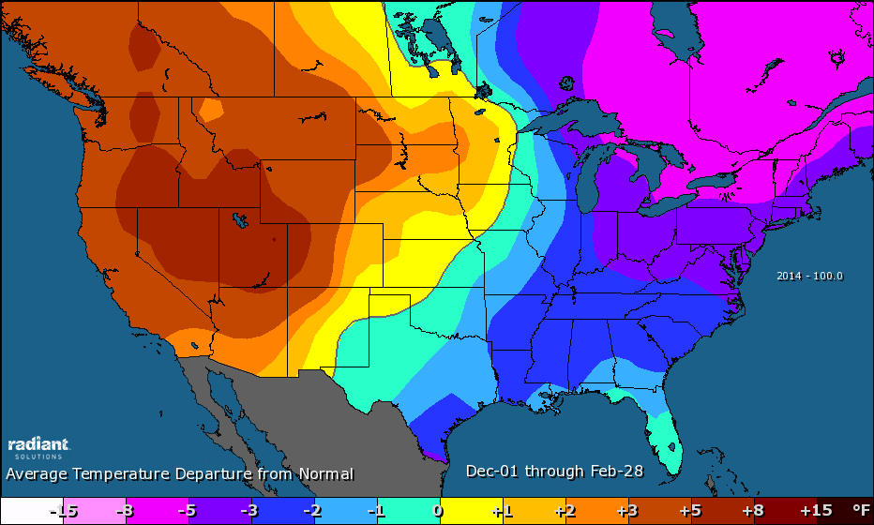
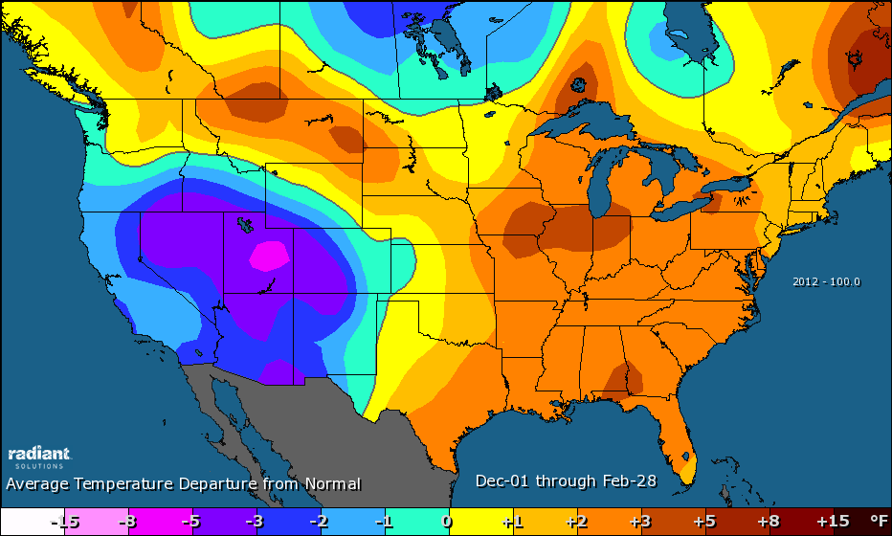
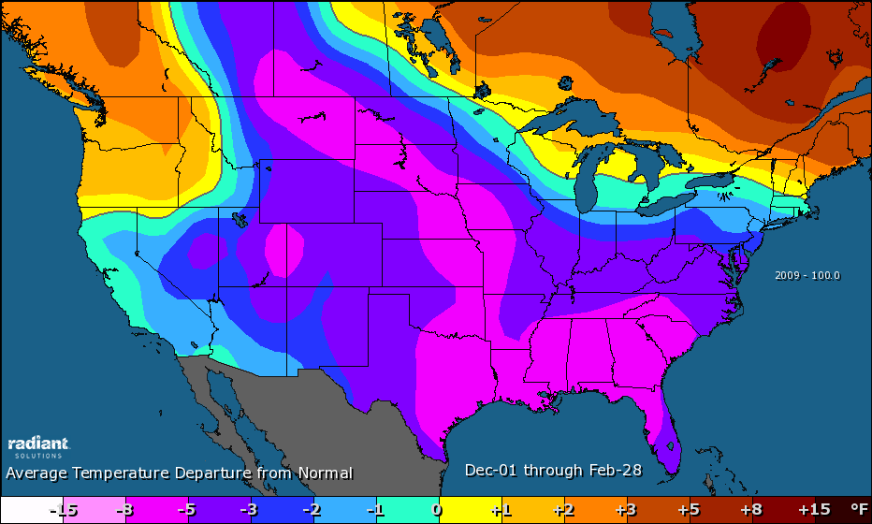
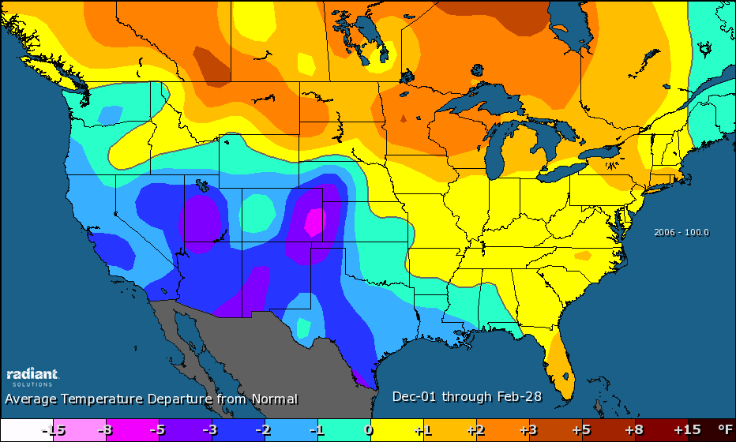
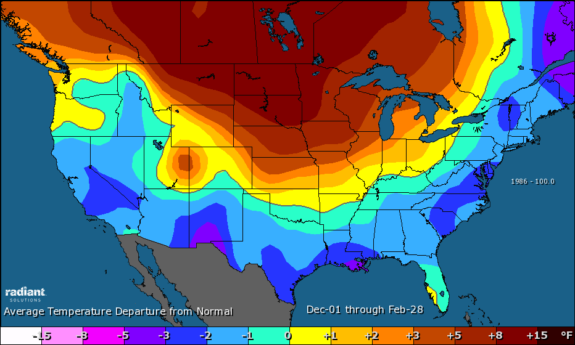
Historical El Niño Winters (mean temperatures)
2014-15
2012-13
2009-10
2006-07
1986-87

Slide 13
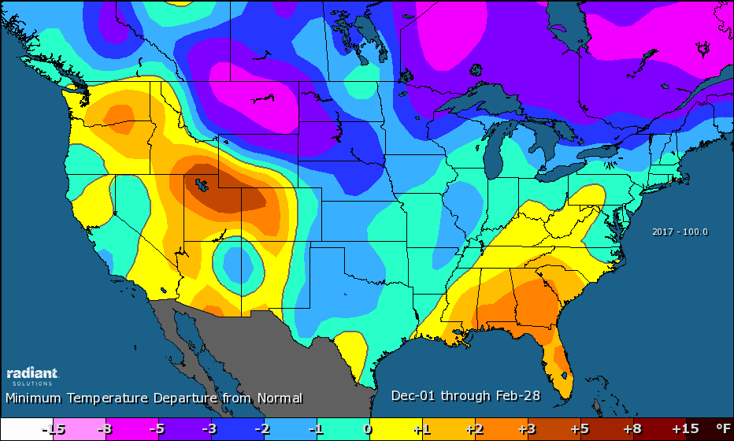
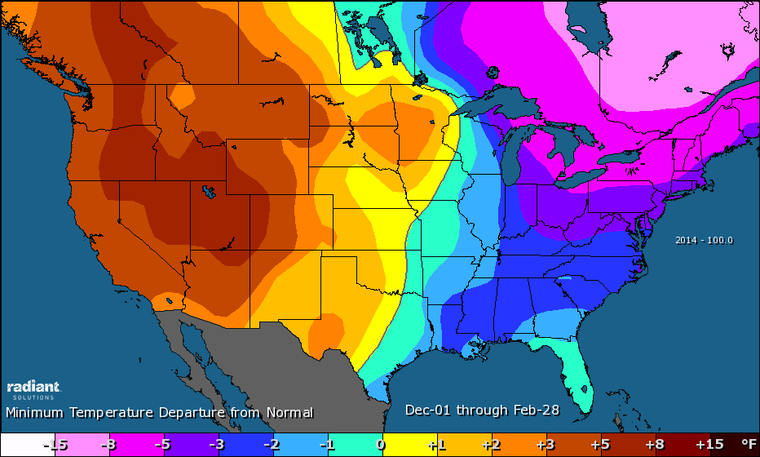
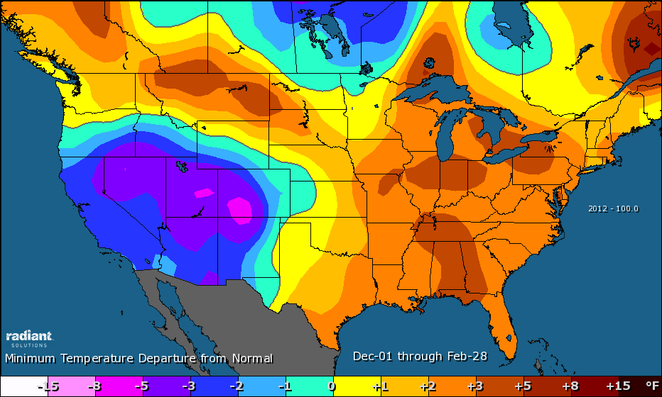
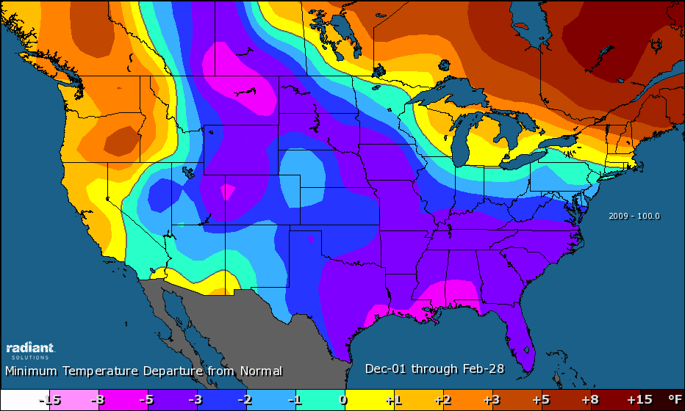
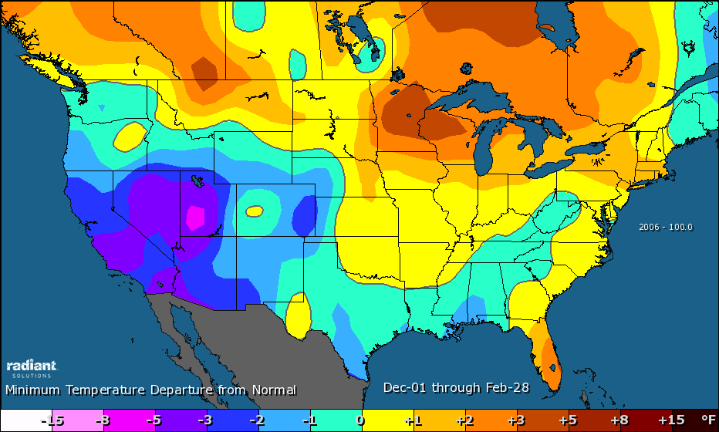
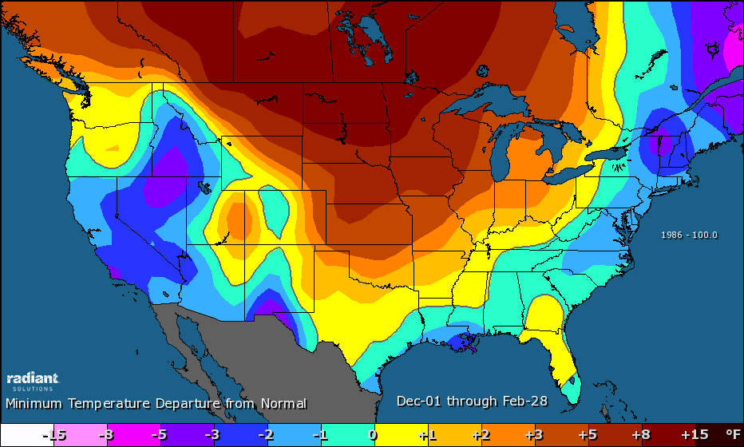
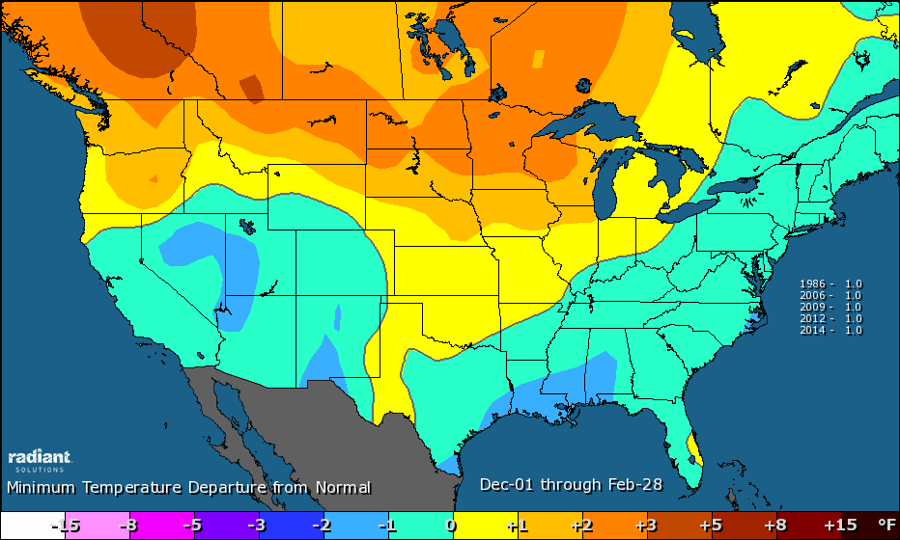
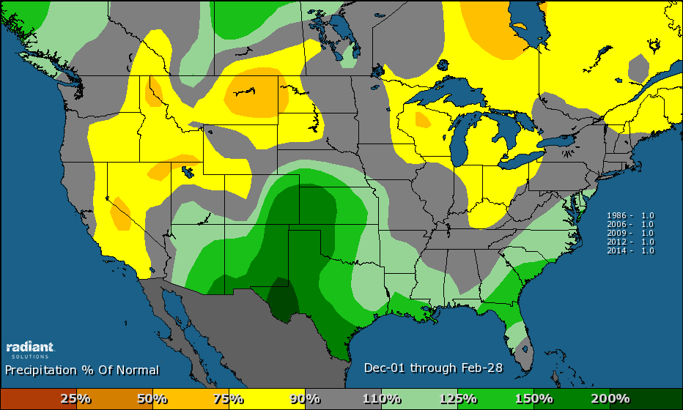
Historical El Niño Winters (minimum temperatures)
2014-15
2012-13
2009-10
2006-07
1986-87

Slide 14
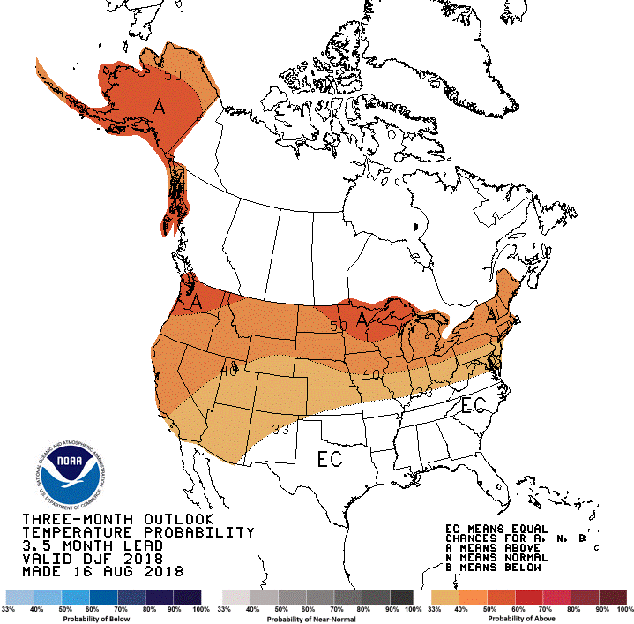
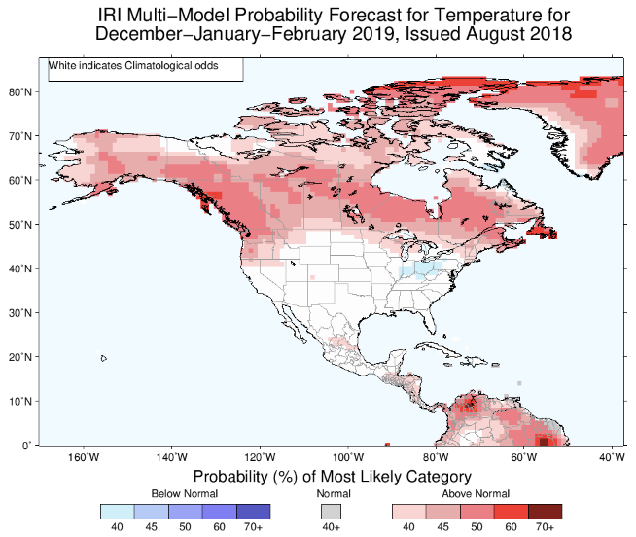
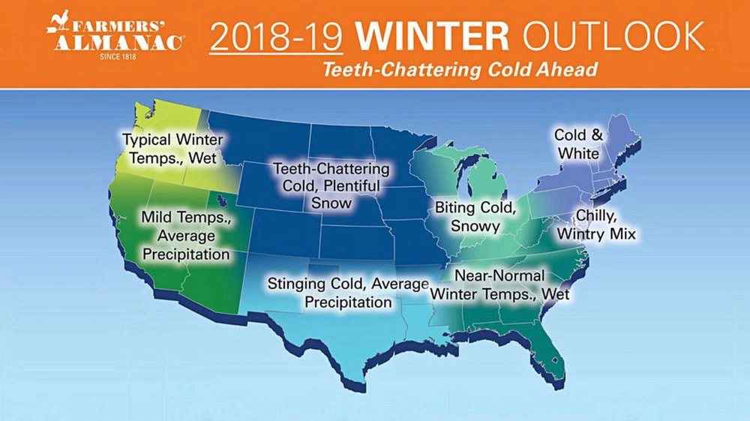
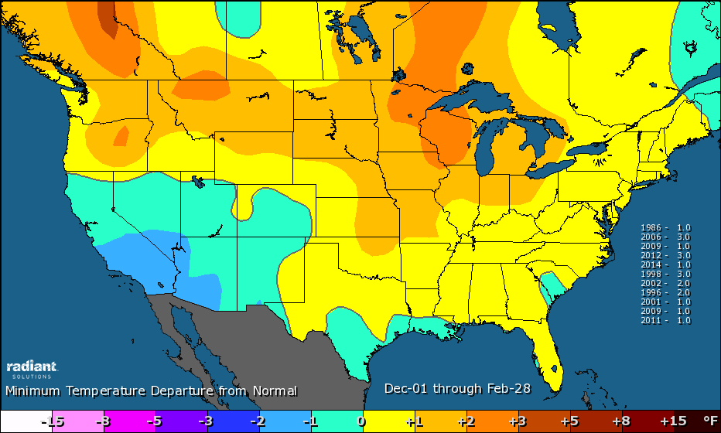
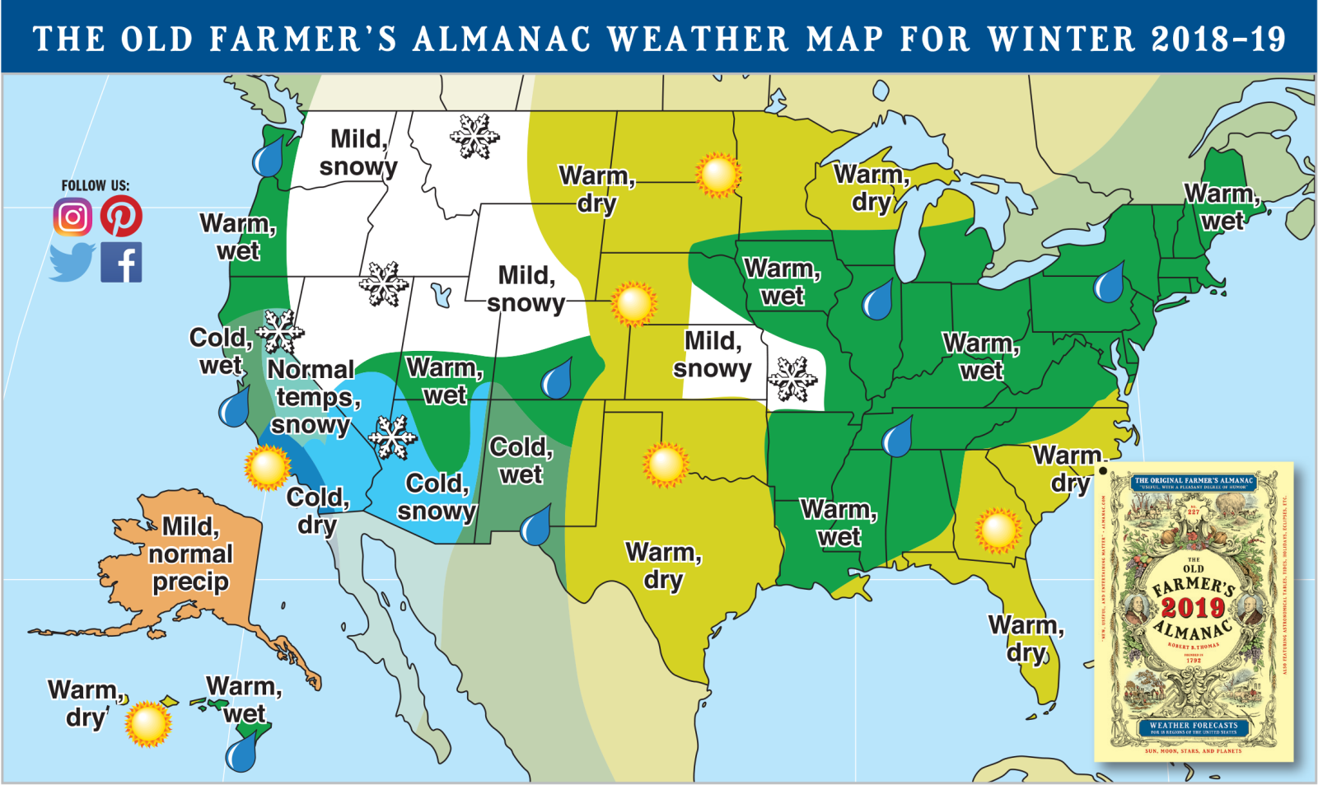
What Other Weather Sources are Forecasting (this winter)

Slide 15
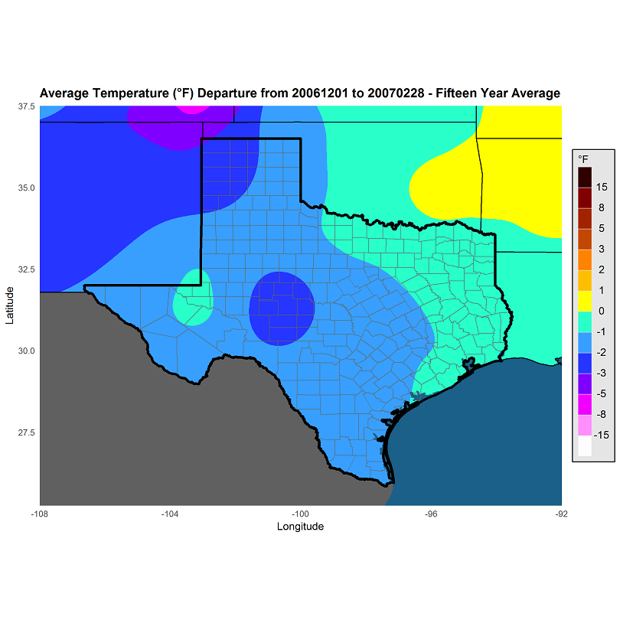
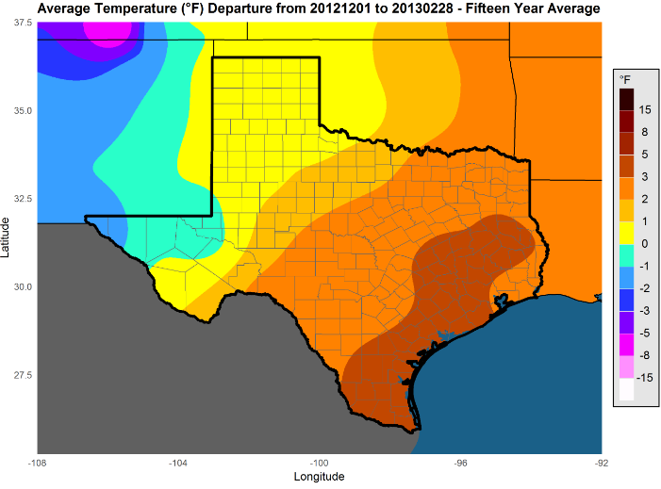
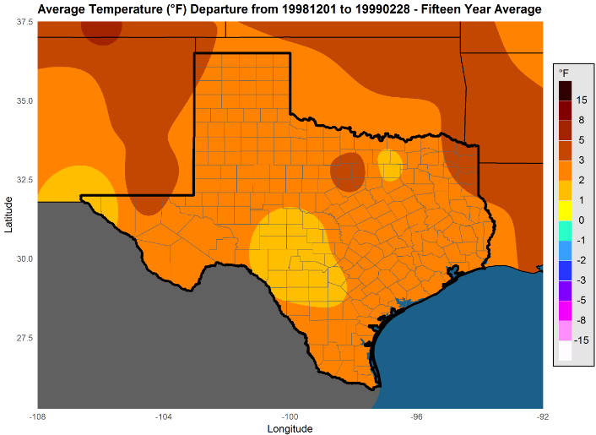
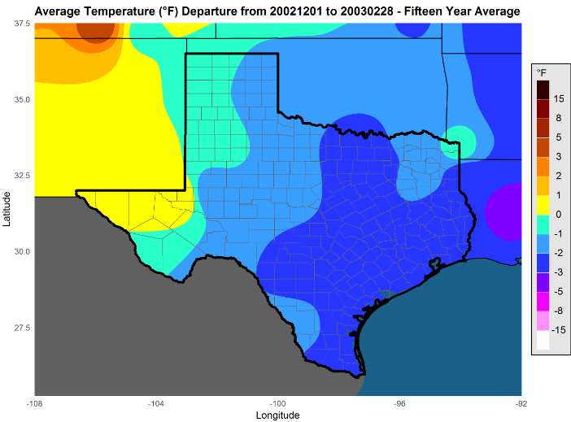
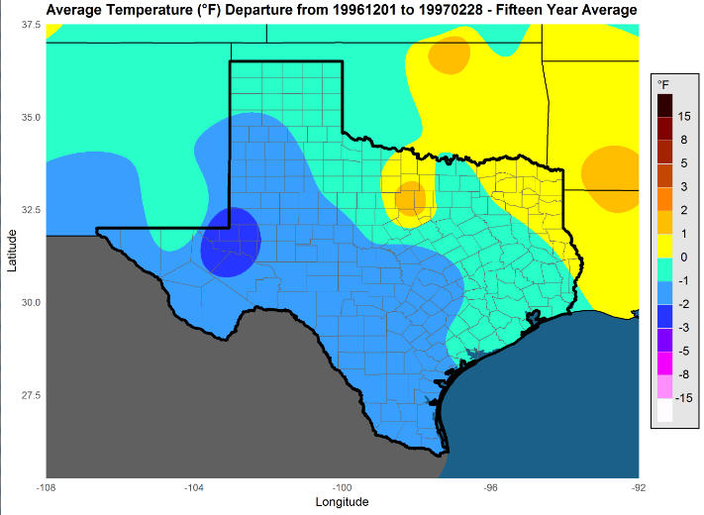
Historical Matches (Analogs)
2006-07 (43rd/71st coldest)
2012-13 (109th/105th)
1998-99 (120th/113th)
Last winter ranked 77th/71st (mean/min) coldest; this winter could be similar. Better chance warmer than colder.
None rank in the bottom third of coldest winters for Texas
2002-03 (64th/84th)
1996-97 (74th/95th)

Slide 16
Preliminary Winter 2018-19 Temperature Outlook
Analog weighted consensus:

Slide 17
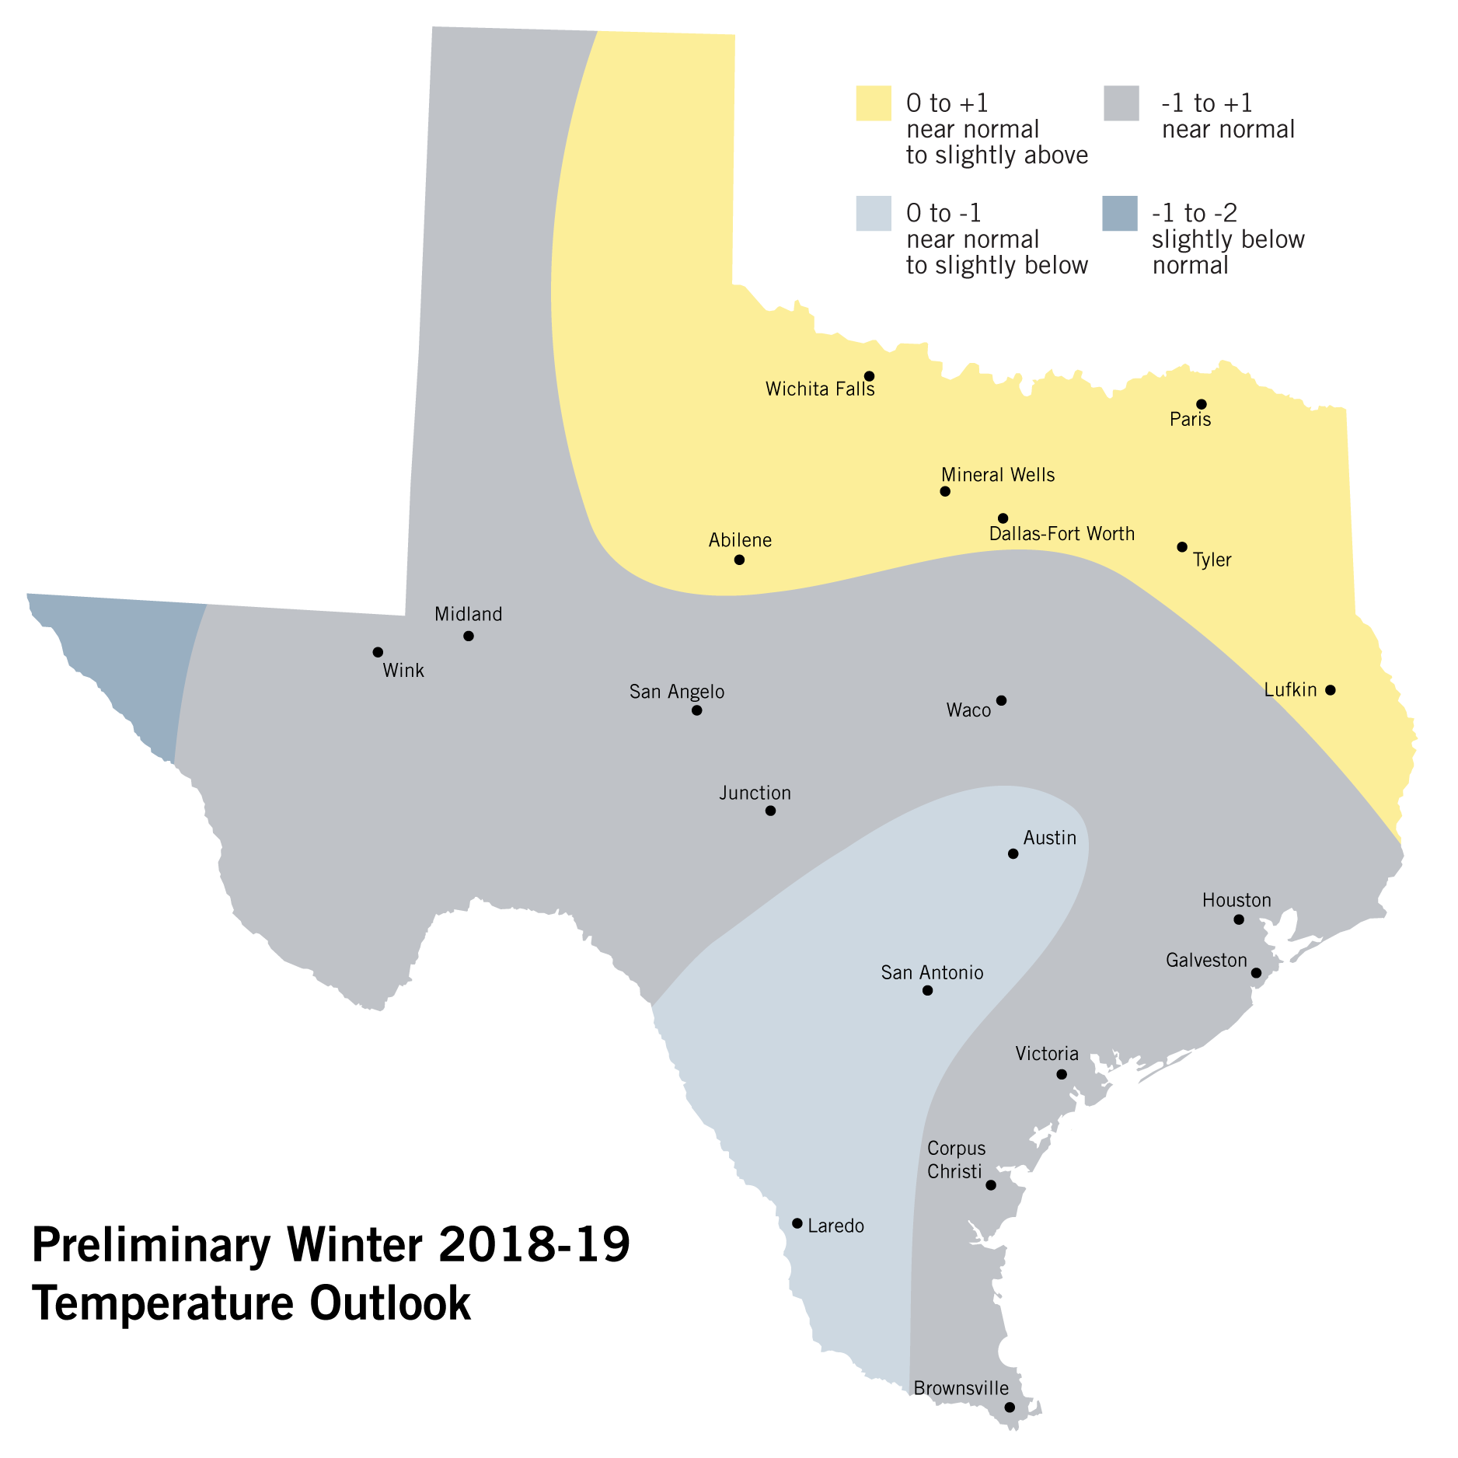
Winter 2018-19 Temperature Outlook
Unlikely to see a winter that ranks among the top third coldest of all-time (2013-14 is the most recent winter that ranked that cold)
Can’t yet rule out a finalized, colder forecast (2006-07?), which would be on the cusp of the coldest third and colder than last winter
But the preliminary forecast suggests similar to or less cold than last winter
Mild winters can – and oftentimes do – have very cold periods!

Slide 18
Precipitation Ranking of Recent Winters (Texas)
2017-18 | 71st driest (out of 123)
2016-17 | 94th
2015-16 | 56th^{th}
2014-15 | 70th
2013-14 | 11th
2012-13 | 60th
2011-12 | 114th
2010-11 | 17th
2009-10 | 113th
2008-09 | 1st driest
2007-08 | 24th

Slide 19
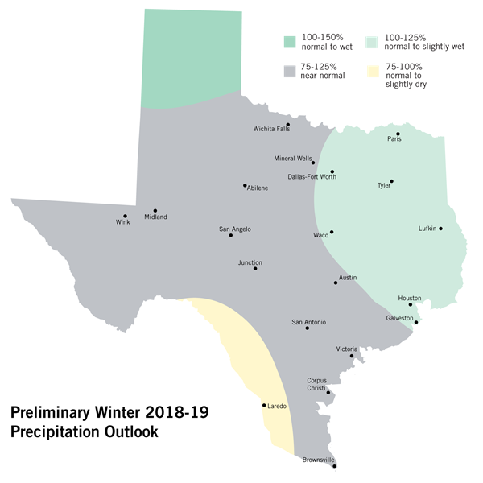
Winter 2018-19 Precipitation Outlook
Most solutions are wetter rather than drier. El Niño most times (not always) support relatively wetter winters.
North Texas has higher potential than South Texas for precipitation
Austin recorded snow on 4 of the 9 historical analog (matching) winters

Slide 20

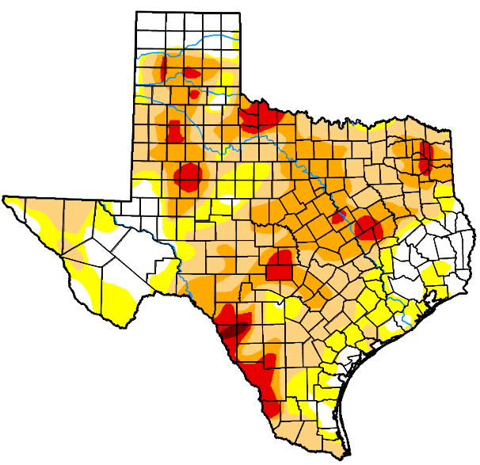
Winter 2017-18 Precipitation Outlook vs Drought
Current Drought:
62% of the state’s area
with drought concerns
(compared to 1% a year ago)
Improvements to the Panhandle and parts of North Texas
are possible; South Texas may worsen. In all, more opportunities
for improvement than deterioration

Slide 21
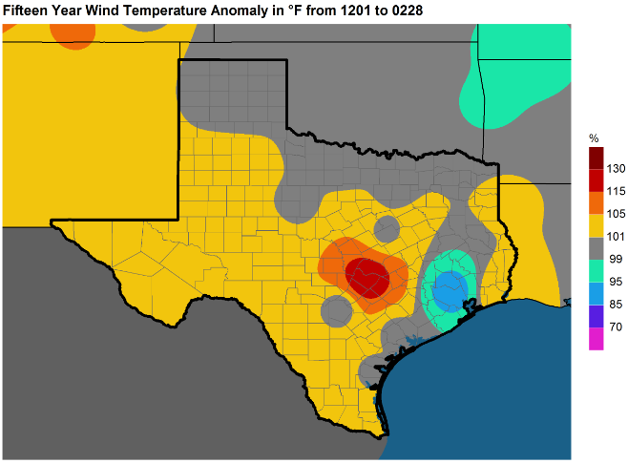
Historical Analog Winds
2006-07, 2012-13, 1998-99, 2002-03, 1996-97
Would project normal to above-normal wind this winter (most of ERCOT)
Obviously, however, wind matters most on the handful of days when you really need it (high load, tight on generation) – and this is a very broad brush forecast

Slide 22
Summary
This is a preliminary forecast. It will be finalized by November 1 and posted to ERCOT.com
Early indications suggest a normal winter in terms of temperatures and slightly wet in regards to precipitation
A normal winter may seem cold compared to most winters over the past 10-20 years – but it’s not strongly cold on a 100+ year comparison
There’s slightly more potential for this winter to be warmer than forecast rather than cooler
There’s slightly more potential for this winter to be warmer than last winter rather than colder. Even if colder, that doesn’t necessarily equate to a higher winter peak.
Unlikely to be as cold as the winter of
2013-14 (30th coldest)
Even during a mild winter, you should always be prepared for a very cold period/worst case scenario!
The winter should provide opportunities to improve on a drought that has developed in 2018

