Slide 1
Generator Winter Weatherization Workshop
September 6, 2018
Alan H. Allgower
Operations Analyst, Senior
alan.allgower@ercot.com
512-248-4613 (o)

Slide 2
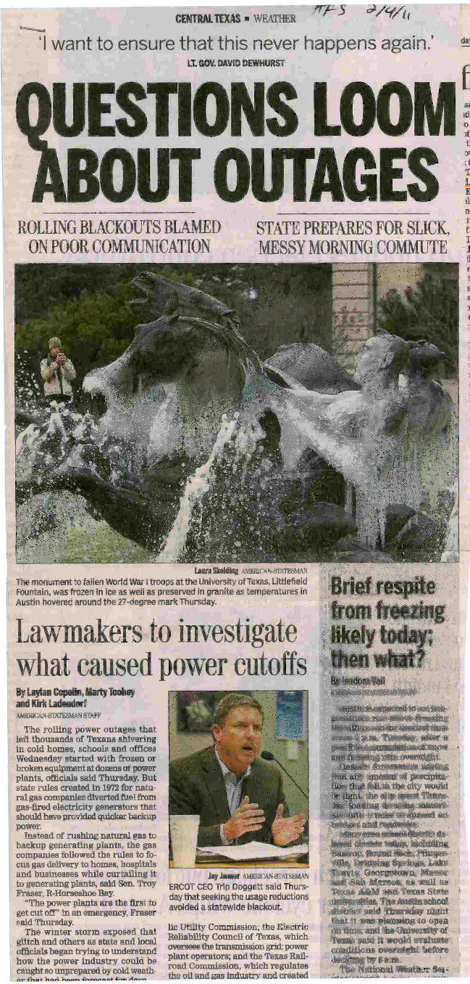
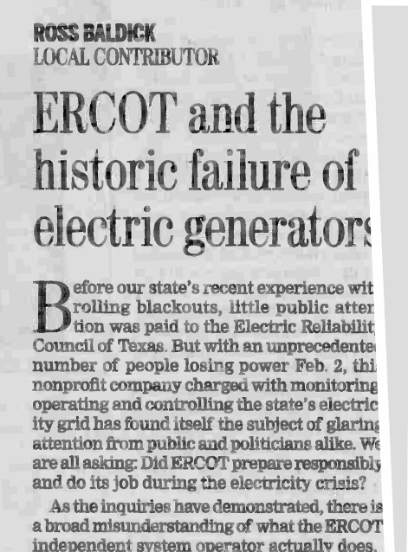
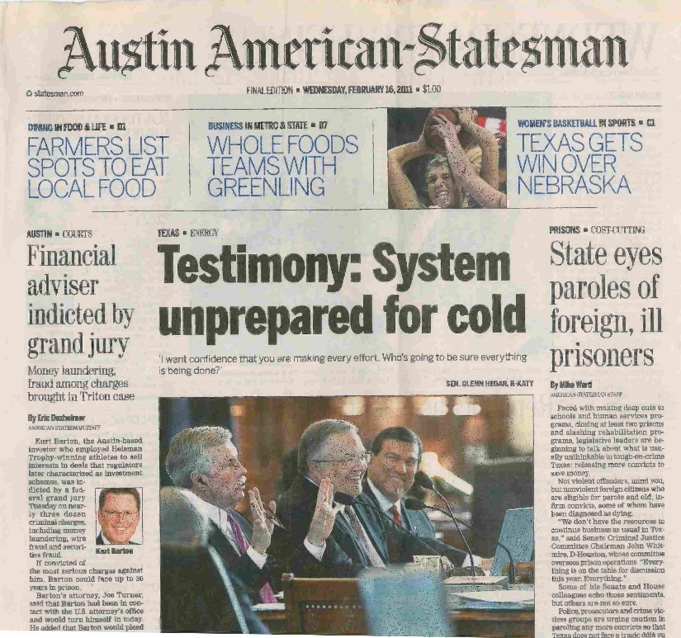
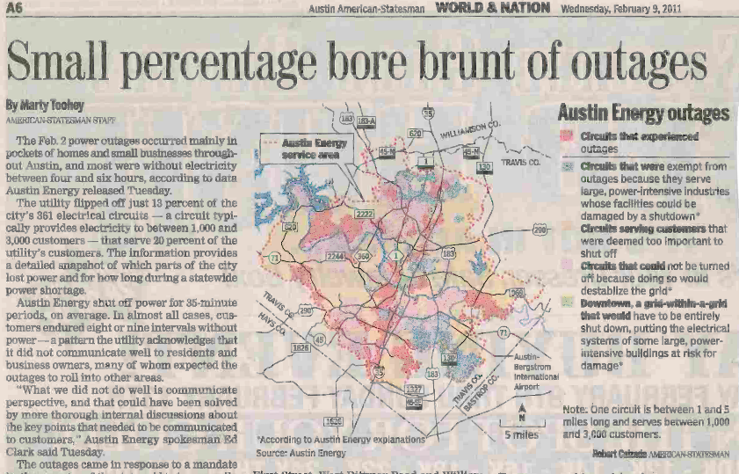
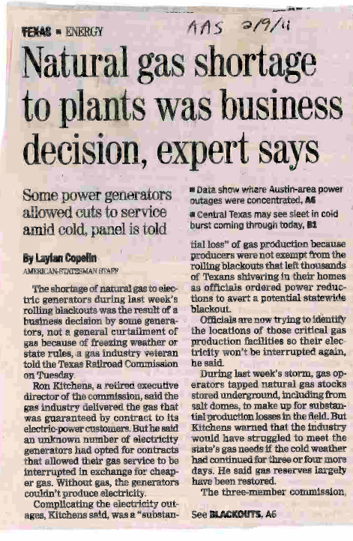
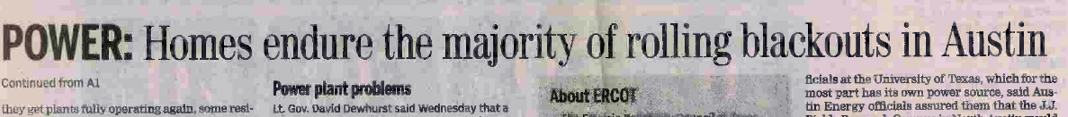
February 2011 Headlines….

Slide 3
Four coldest days in the past eight years
EEA3 – 4000MW
firm load shed
Normal day
For ERCOT
Normal day
In ERCOT
EEA2
Source: Chris Coleman, ERCOT

Slide 4
Hours at and below freezing (32 DegF or less) during four coldest days in ERCOT in the past eight years.
EEA3 – 4000MW
firm load shed
Normal
operations
Normal
operations
EEA2
Source: Chris Coleman, ERCOT

Slide 5
EEA3
EEA2
Normal
Operations
Normal
Operations
Normal
Operations
Normal
Operations
Normal
Operations
Salmon colored reflects four coldest days in ERCOT in last eight years

Slide 6
Plant spot checks winter season 2017_2018
  74 units spot checked
    Fuel types of plants
      7 lignite units
      2 coal unit
      65 gas fired units (conventional and combined cycle)
    16 units were scheduled early due to frozen instrumentation during previous winter.
      15 units demonstrated mitigation to prevent re-occurrence.
      1 unit will complete improvements to critical components list and mitigation measures by December 1, 2018.
    49 units had no deficiencies.
    9 units had deficiencies and with a goal to correct.

Slide 7
Causes of frozen elements during January 1 to 3, 2018 extreme cold weather event.
  Plant A CC1 tripped – loss of instrument air to main gas supply valve regulator due to moisture freezing in instrument air line.
    Root cause not identified.
  Plant B CC1 tripped – HP “A” drum level transmitter froze.
    Root cause; transmitter cabinet heater not working.
    Contributing factor - operator running in manual “A” transmitter for level control rather than median average, two of three “A, B or C” transmitters.
  Plant C Unit 1A tripped – drum level transmitter sensing line froze.
    Root cause; section of heat trace not working.
    Contributing factor; heat trace testing needs improvement.

Slide 8
Causes of frozen elements during January 1 to 3, 2018 extreme cold weather event (continued).
  Plant D CC1 tripped – heat trace boiling of low leg for condensate level.
    Root cause; incorrect heat trace for application.
  Plant E CC1 tripped – three HP drum level transmitters froze.
    Root cause; tripped circuit breaker in heat trace panel.
    Contributing factor; operators failed to verify HP transmitter enclosures temperatures on rounds.

Slide 9
Causes of frozen elements during January 15 to 17, 2018 extreme cold weather event.
  Plant A_CC1 tripped – loss of instrument air to main gas supply valve due to moisture freezing in instrument air line.
    Root cause; steam side and air side check valves failed.
  Plant B_GT1 tripped – one of two rotor cooling air heat exchanger transmitter froze, which caused a low level condition.
    Root cause; lack of transmitter cabinet heater.
    Corrective action; plant to install cabinet heater.
  Plant C_G1 tripped – sensing line level transmitter froze.
    Root cause; insulation missing.
    Corrective action; plant to install flexible wrap insulation. Heat trace is not an option for this section of line.

Slide 10
January 1 and 17, 2018 extreme cold weather event.
  Plant A_CC1 tripped – loss of instrument air to main gas supply valve due to moisture freezing in instrument air line.
  Corrective actions.
    Replace the steam side check valves during the spring outage 2018.
    Rebuild the welded in check valves on the air side for the fall winter readiness outage.
    Additional automatic blow down valves.
    Convert the instrument air to natural gas feeding off of the gas line for the regulator.

Slide 11
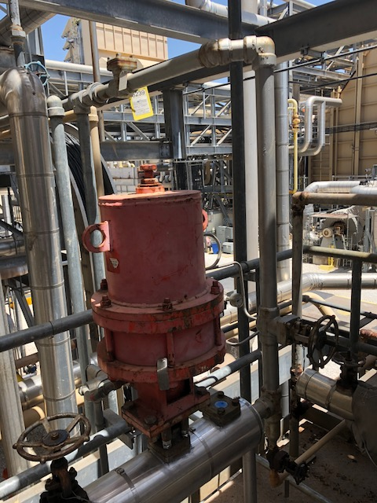
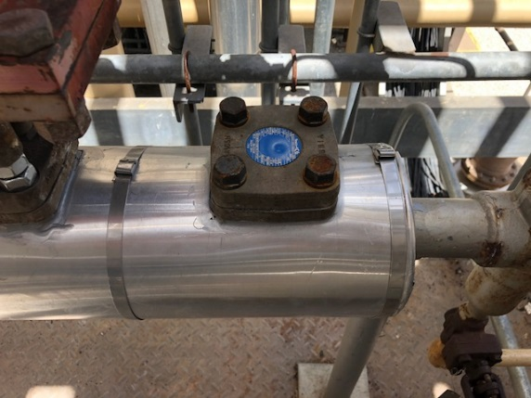
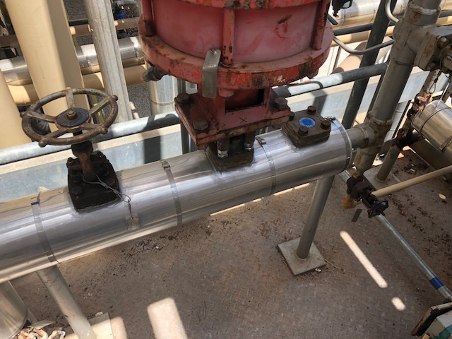
Steam side check valves for CT’s
Replaced steam side check valves
on both units during Spring 2018 outage

Slide 12
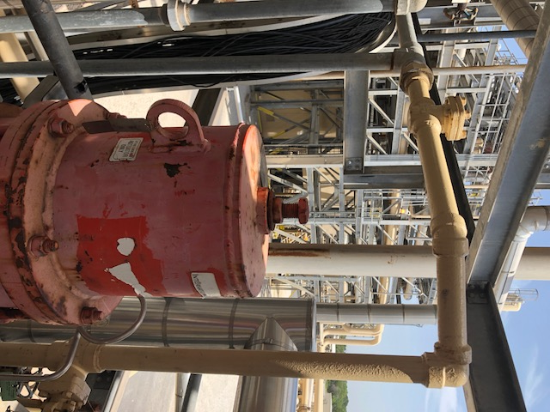
Air side check valve
Air side check valve to be rebuilt
during Fall 2018 outage.

Slide 13
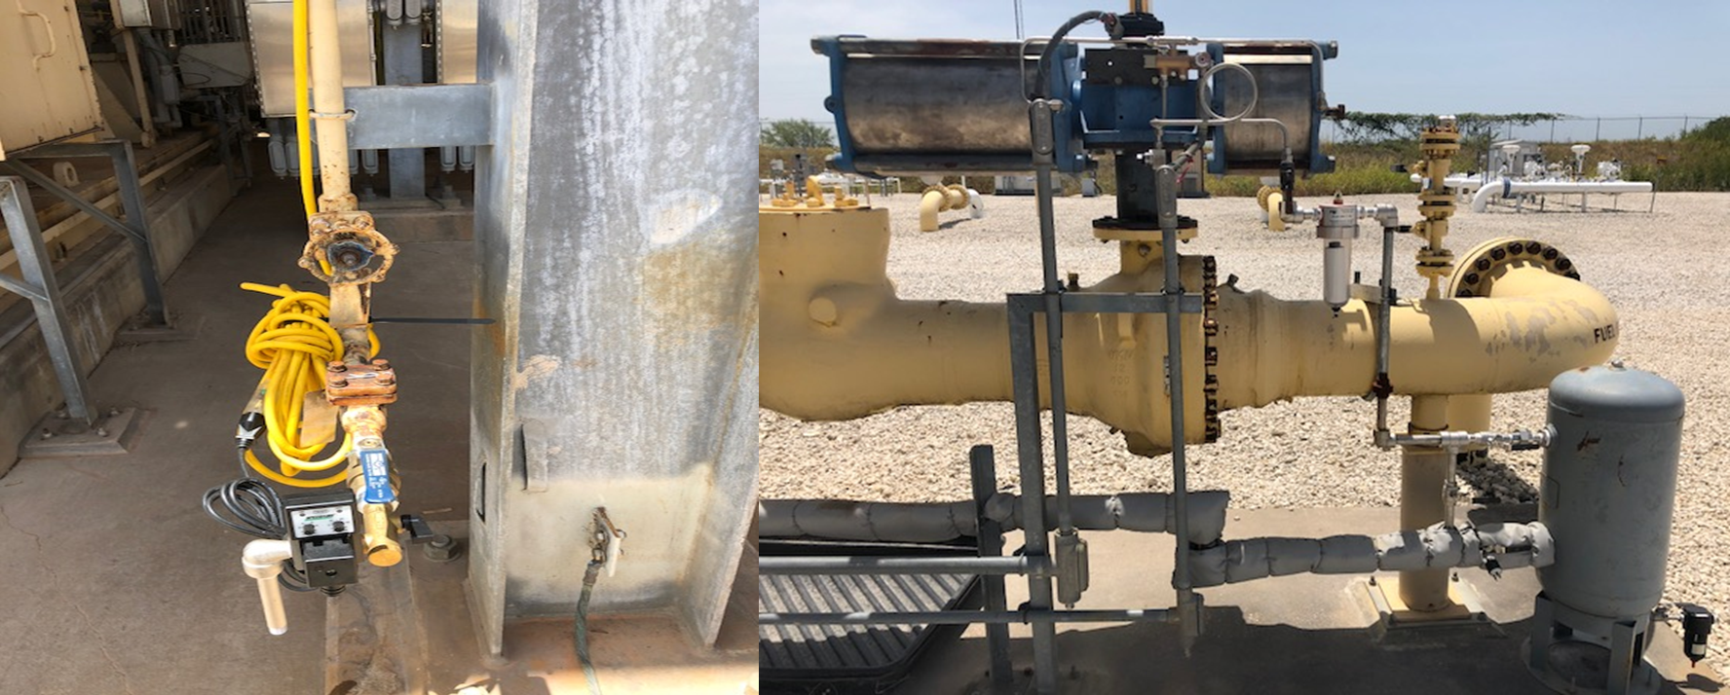
Added instrument air blow down and gas regulator to main supply valve.
Gas supply regulator valve to
be converted to natural gas
during fall outage.
Additional automatic
blow downs.

Slide 14
Instrument Air Supply Header
IP cooling steam line
to gas turbine used to purge
110-120psi
Air side check failed and scheduled to be replaced during fall 2018 outage
110-120psi
650psi
Old N2 purge line that plant installed with automatic blow down valve
110-120psi
650psi
Steam side check failed and has been replaced
Capped drain and drain valve

Slide 15
Identifying critical components or equipment is required
§25.53. Electric Service Emergency Operations Plans.
    (c)(2)(B) A plan that addresses any known critical failure points, including any effects of weather design limits.
Nodal Protocol 3.20 (3)
  No earlier than November 1 and no later than December 1 of each year, each Resource Entity shall submit the declaration Section 22, Attachment K, Declaration of Completion of Generation Resource Weatherization Preparations, to ERCOT stating that, at the time of submission, each Generation Resource under the Resource Entity’s control has completed or will complete all weather preparations required by the weatherization plan for equipment critical to the reliable operation of the Generation Resource during the winter time period (December through February).
  If the work on the equipment that is critical to the reliable operation of the Generation Resource is not complete at the time of filing the declaration, the Resource Entity shall provide a list and schedule of remaining work to be completed.
Section 22, Attachment K, Declaration of Completion of Generation Resource Weatherization Preparations
“I hereby attest that all weatherization preparations for equipment critical to the reliable operation of each of the above-listed Generation Resources during the time period stated above are complete or will be completed, as required by the weatherization plan applicable to each Generation Resource.”

Slide 16
Mitigation measures to prevent freezing of critical components
  Test and repair all critical heat trace circuits.
  Inspect critical components insulation prior to winter.
  Test critical components transmitter cabinet heater.
  Inspect transmitter enclosures.
  Install wind breaks and/or space heaters, as necessary.
  Verify instrument air dryers, dew point monitoring, blow downs are operating correctly. Ensure blow down drains are insulated and heat traced, as necessary.
  Conduct a training drill with staff on extreme cold weather procedures.
  Prior to every extreme cold weather event verify critical heat trace circuits are functioning.

Slide 17
Comments
ERCOT assists generators in preparing for winter operations with spot checks, sharing lessons learned, best practices, recommendations and the annual fall workshop.
Recent history has shown us that for every extreme cold weather event, a small amount of generation will experience freeze related derates or trips.
Overall, ERCOT was pleased with the performance of generators during this past winter.

Slide 18


Slide 19
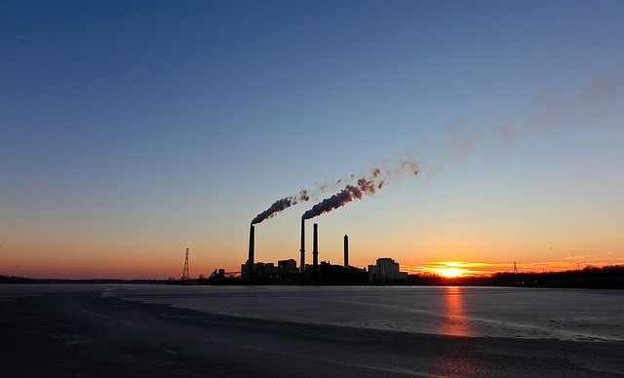
Thank you generator owners, operators and plant staff for your efforts on winter weatherization!

